Slide 1

TERRESTRIAL PLATFORM | TERRAHVAC | ENTERPRISE SPECIFICATION
TerraHVAC: Thermodynamic AI Chiller Governance & Industrial Climate Management
Autonomous Industrial Intelligence Suite · Tier-1 Plant Architecture
““Eliminating low delta-T syndrome and chiller plant waste through thermodynamic AI approach optimization and intelligent multi-mode scheduling.””
— — THE OUTCOME-BASED REVOLUTION
EXECUTIVE OPERATIONAL SYNOPSIS
TerraHVAC optimizes central chiller plants and industrial HVAC networks where cooling accounts for up to 60% of facility electricity. Running proprietary thermodynamic AI models, it eliminates low delta-T syndrome, dynamically tunes primary/secondary chilled water circuits, and optimizes cooling tower approach temperatures.
CHILLED WATER LOOP
7.0°C / 12.0°C
DELTA-T SYNC
5.0°C Optimized
VFD PUMP MOD
35-50 Hz Dynamic
COP OPTIMIZATION
+14.2% Seasonal
TERRESTRIAL PLATFORM CORE
Edge-to-Cloud Cognitive Nervous System
Physics-informed mathematical twin running sub-25ms closed-loop supervisory control with full ISA-95/101 conformity.
Notes:
TerraHVAC - Enterprise Product Specification
Tagline: Thermodynamic AI Chiller Governance & Industrial Climate Management
Outcome Quote:
“Eliminating low delta-T syndrome and chiller plant waste through thermodynamic AI approach optimization and intelligent multi-mode scheduling.” (— THE OUTCOME-BASED REVOLUTION)
Executive Overview:
TerraHVAC optimizes central chiller plants and industrial HVAC networks where cooling accounts for up to 60% of facility electricity. Running proprietary thermodynamic AI models, it eliminates low delta-T syndrome, dynamically tunes primary/secondary chilled water circuits, and optimizes cooling tower approach temperatures.
Key Telemetry Metrics:
- CHILLED WATER LOOP:: 7.0°C / 12.0°C
- DELTA-T SYNC:: 5.0°C Optimized
- VFD PUMP MOD:: 35-50 Hz Dynamic
- COP OPTIMIZATION:: +14.2% Seasonal

Slide 2
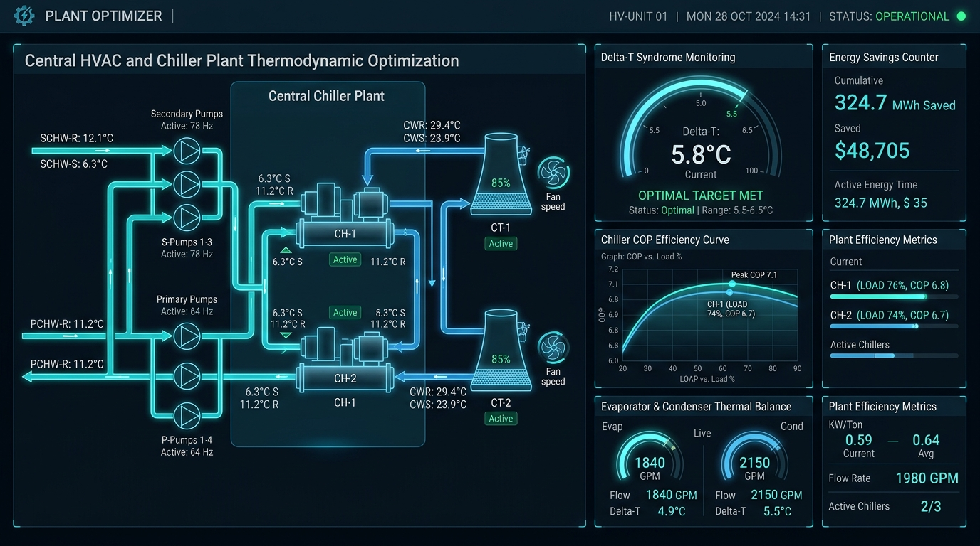
TERRESTRIAL PLATFORM | TERRAHVAC | OPERATIONAL INTERFACE
TerraHVAC ANSI/ISA-101 Operational Interface & Real-Time System Representation
ANSI/ISA-101 Ergonomic High-Performance HMI · Real-Time System Representation
Notes:
TerraHVAC - ANSI/ISA-101 Verified Operational Interface
Representation: TerraHVAC ANSI/ISA-101 Operational Interface & Real-Time System Representation
Compliance: ANSI/ISA-101 Verified HMI
Asset File: terra_hvac_showcase.jpg

Slide 3
TERRESTRIAL PLATFORM | TERRAHVAC | CORE CAPABILITIES
What TerraHVAC Will Do
Specific operational functions and engineering capabilities directly sourced from technical documentation.
PILLAR 01 | ENGINEERING CAPABILITY
Primary & Secondary Circuit Optimizer
Enhances the efficiency of primary cooling circuits and optimizes secondary distribution for maximum energy savings.
PILLAR 02 | ENGINEERING CAPABILITY
Approach Optimizer
Monitors and optimizes temperature approach in condensers and cooling towers, preventing scale-induced energy penalties.
PILLAR 03 | ENGINEERING CAPABILITY
Intelligent Multi-Mode Scheduler
Dynamically stages Free Cooling, Economizer, and Boost Cooling operations based on weather and thermal demand.
PILLAR 04 | ENGINEERING CAPABILITY
Chiller System Manager (CSM) Integration
Coordinates multiple chillers, primary/secondary pumps, and cooling tower fans as a single unified thermodynamic plant.
Notes:
What TerraHVAC Will Do:
[1] Primary & Secondary Circuit Optimizer:
Enhances the efficiency of primary cooling circuits and optimizes secondary distribution for maximum energy savings.
[2] Approach Optimizer:
Monitors and optimizes temperature approach in condensers and cooling towers, preventing scale-induced energy penalties.
[3] Intelligent Multi-Mode Scheduler:
Dynamically stages Free Cooling, Economizer, and Boost Cooling operations based on weather and thermal demand.
[4] Chiller System Manager (CSM) Integration:
Coordinates multiple chillers, primary/secondary pumps, and cooling tower fans as a single unified thermodynamic plant.

Slide 4
TERRESTRIAL PLATFORM | TERRAHVAC | FIELD USE CASES
Operational Use Cases & Field Impact
Actual documented use cases across Quality Assurance, Reduced Manpower, Efficiency, and Asset Productivity.
CASE 01 | EFFICIENCY
Efficiency (Ambient-Temperature Driven AC Optimization)
Ambient-temperature-driven AC optimization yielded ₹1,80,000 in 2022 and ₹2,10,000 in 2023 in direct power savings at Airport of India.
CASE 02 | PRODUCTIVITY & ASSET PROTECTION
Productivity & Asset Protection (CNS & Clean Room Envelopes)
Maintains ultra-strict temperature and humidity tolerances for sensitive navigation electronics and clean room production batches.
CASE 03 | EFFICIENCY
Efficiency (Approach Optimizer & Heat Exchanger Health)
Implements strategies to optimize the temperature approach in chillers and cooling towers, catching fouling early.
CASE 04 | REDUCED MANPOWER
Reduced Manpower (Automated Free Cooling Transitions)
Automatically switches between Free Cooling, Economizer, and Boost Cooling based on outdoor wet-bulb temperatures without technician manual switching.
Notes:
TerraHVAC - Operational Use Cases & Field Impact:
[Efficiency] Efficiency (Ambient-Temperature Driven AC Optimization):
Ambient-temperature-driven AC optimization yielded ₹1,80,000 in 2022 and ₹2,10,000 in 2023 in direct power savings at Airport of India.
[Productivity & Asset Protection] Productivity & Asset Protection (CNS & Clean Room Envelopes):
Maintains ultra-strict temperature and humidity tolerances for sensitive navigation electronics and clean room production batches.
[Efficiency] Efficiency (Approach Optimizer & Heat Exchanger Health):
Implements strategies to optimize the temperature approach in chillers and cooling towers, catching fouling early.
[Reduced Manpower] Reduced Manpower (Automated Free Cooling Transitions):
Automatically switches between Free Cooling, Economizer, and Boost Cooling based on outdoor wet-bulb temperatures without technician manual switching.

Slide 5
TERRESTRIAL PLATFORM | TERRAHVAC | ARCHITECTURAL CONTRAST
Comparison with Traditional SCADA / Legacy Systems
Point-by-point contrast demonstrating the technological shift from legacy industrial automation to the Terrestrial Platform.
TRADITIONAL LEGACY SYSTEMS / SILOED SCADA
TERRAHVAC TERRESTRIAL PLATFORM ADVANTAGE
Chillers run at static design setpoints (e.g. 7°C chilled water) regardless of ambient outdoor wet-bulb variations.
Dynamic thermodynamic setpoint optimization adjusting chilled and condenser water setpoints continuously based on real-time loads.
Low delta-T syndrome forcing facilities to start redundant chillers and pumps to circulate water through bypassed coils.
AI valve throttling ensuring every cooling coil extracts maximum thermal duty, restoring proper return delta-T.
Cooling tower scaling and tube fouling discovered only after chillers trip on high-pressure discharge alarms.
Approach Optimizer continuously calculates temperature approach in heat exchangers, predicting tube cleaning needs.
Notes:
TerraHVAC - Architectural Contrast (Legacy SCADA vs Terrestrial Platform):
LEGACY:
Chillers run at static design setpoints (e.g. 7°C chilled water) regardless of ambient outdoor wet-bulb variations.
TERRESTRIAL ADVANTAGE:
Dynamic thermodynamic setpoint optimization adjusting chilled and condenser water setpoints continuously based on real-time loads.
LEGACY:
Low delta-T syndrome forcing facilities to start redundant chillers and pumps to circulate water through bypassed coils.
TERRESTRIAL ADVANTAGE:
AI valve throttling ensuring every cooling coil extracts maximum thermal duty, restoring proper return delta-T.
LEGACY:
Cooling tower scaling and tube fouling discovered only after chillers trip on high-pressure discharge alarms.
TERRESTRIAL ADVANTAGE:
Approach Optimizer continuously calculates temperature approach in heat exchangers, predicting tube cleaning needs.

Slide 6
TERRESTRIAL PLATFORM | TERRAHVAC | SYSTEM ARCHITECTURE
End-to-End System Diagram & Data Pipeline
Visual architecture diagram representing field telemetry ingestion, deterministic edge fabric, AI reasoning, and closed-loop actuation.
LAYER 01
Chiller & Hydronic Ingestion
High-precision acquisition from chilled water flowmeters, primary/secondary pump VFDs, cooling tower fan tachometers, and RTD temperature sensors.
PROTOCOLS & STANDARDS:
• BACnet/IP
• Modbus RTU/TCP
• Class 1 BTU Meters
LAYER 02
Hydronic Loop Stream
Sub-second thermal loop balance streaming, condenser water temperature gradient tracking, and flow pressure differential buffering.
PROTOCOLS & STANDARDS:
• Hydronic Loop Stream
• Differential Pressure Bus
• Thermal Energy Buffer
LAYER 03
Chiller COP Optimizer
Non-linear chiller staging algorithms, dynamic cooling tower wet-bulb approach minimization, Delta-T syndrome mitigation, and pump VFD affinity curves.
PROTOCOLS & STANDARDS:
• Chiller Staging AI
• Approach Temp Optimizer
• Delta-T Syndrome AI
LAYER 04
VFD & Valve Cockpit
Closed-loop primary/secondary pump VFD frequency modulation, cooling tower fan sequencing, and ANSI/ISA-101 central plant optimizer dashboards.
PROTOCOLS & STANDARDS:
• Pump VFD Modulation
• Fan Staging Control
• ISA-101 Plant HMI
UNIFIED DATA PIPELINE FLOW
Chiller & Hydronic Sensor Telemetry ➔ Thermodynamic Loop Stream ➔ Dynamic Chiller COP & Delta-T Optimization ➔ Closed-Loop VFD & Valve Actuation
Notes:
TerraHVAC - End-to-End System Diagram & Data Pipeline:
Layer 01: Chiller & Hydronic Ingestion
High-precision acquisition from chilled water flowmeters, primary/secondary pump VFDs, cooling tower fan tachometers, and RTD temperature sensors.
Protocols: BACnet/IP, Modbus RTU/TCP, Class 1 BTU Meters
Layer 02: Hydronic Loop Stream
Sub-second thermal loop balance streaming, condenser water temperature gradient tracking, and flow pressure differential buffering.
Protocols: Hydronic Loop Stream, Differential Pressure Bus, Thermal Energy Buffer
Layer 03: Chiller COP Optimizer
Non-linear chiller staging algorithms, dynamic cooling tower wet-bulb approach minimization, Delta-T syndrome mitigation, and pump VFD affinity curves.
Protocols: Chiller Staging AI, Approach Temp Optimizer, Delta-T Syndrome AI
Layer 04: VFD & Valve Cockpit
Closed-loop primary/secondary pump VFD frequency modulation, cooling tower fan sequencing, and ANSI/ISA-101 central plant optimizer dashboards.
Protocols: Pump VFD Modulation, Fan Staging Control, ISA-101 Plant HMI
Pipeline Flow:
DATA PIPELINE FLOW: Chiller & Hydronic Sensor Telemetry ➔ Thermodynamic Loop Stream ➔ Dynamic Chiller COP & Delta-T Optimization ➔ Closed-Loop VFD & Valve Actuation

Slide 7
TERRESTRIAL PLATFORM | TERRAHVAC | DEPLOYMENT & SI VALUE
System Integrator Deployment Framework & Commercial Model
Zero rip-and-replace turnkey onboarding with recurring enterprise margins and co-selling enablement.
PHASE 01 | CONNECTIVITY & AUDIT
Zero Rip-and-Replace Onboarding
Non-intrusive protocol discovery across field PLCs, RTUs, and historians. Plug-and-play mapping of tags into the unified TPIM semantic namespace without stopping ongoing plant production.
PHASE 02 | TWIN CALIBRATION
Physics-Model Synchronization
Deploy high-frequency Edge Gateway on premise. Calibrate first-principles thermodynamic and kinematic models against historical telemetry to achieve 99.4%+ deterministic accuracy.
PHASE 03 | AUTONOMOUS GO-LIVE
Closed-Loop Setpoint Actuation
Supervisory closed-loop setpoint dispatch with bumpless transfer. Comprehensive ISA-101 verified cockpit handoff with continuous SI recurring monitoring and support tiers.
COMMERCIAL VALUE PROPOSITION FOR SYSTEM INTEGRATORS (TERRAHVAC)
• High-Margin Software Recurring Revenue: Earn 25%–35% continuous recurring margin on every TerraHVAC software deployment, maintenance tier, and AI compute instance.
• Turnkey Engineering Velocity: Deploy within 7 to 14 days leveraging pre-trained neural networks and automated semantic tag mapping, avoiding expensive months-long custom PLC code rewrites.
• Enterprise Co-Selling & Ecosystem: Access joint executive pipeline opportunities, certified engineering documentation, and board-level C-Suite presentation toolkits.
Notes:
TerraHVAC - System Integrator Deployment Framework & Commercial Model:
Phase 1: Connectivity & Audit
Phase 2: Twin Calibration
Phase 3: Autonomous Go-Live
Commercial Enablement:
- 25%-35% recurring SaaS margins
- 7-14 day rapid commissioning
- Co-selling and enterprise enablement support

