Slide 1

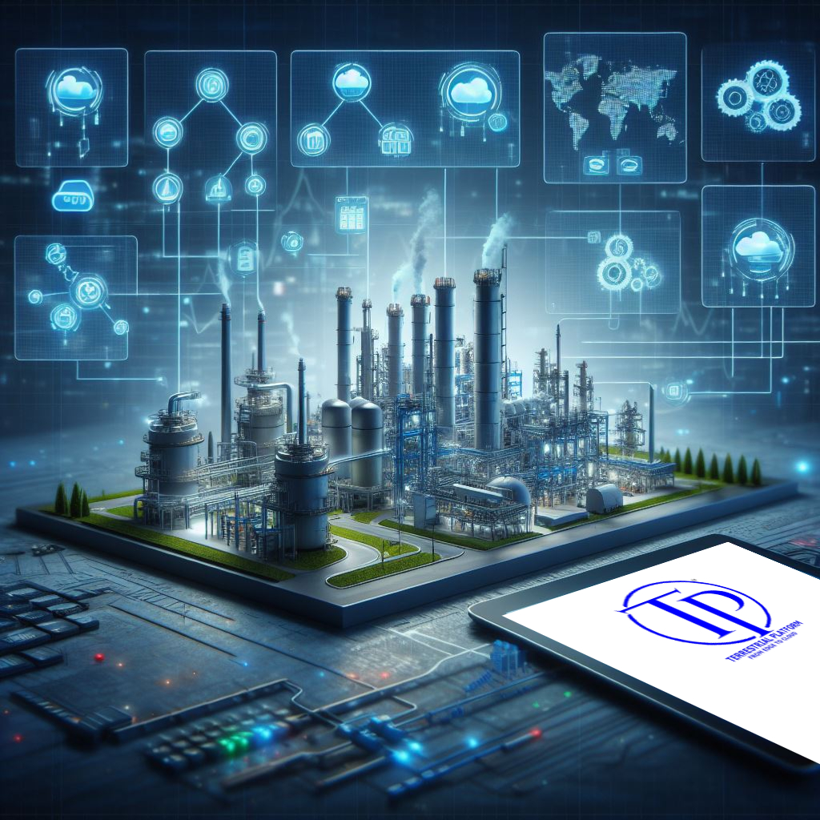
Our solution : Centralized AI Operating System for enterprise’s manufacturing operations

Slide 2

India
I², Plot No. 238 & 239, Survey No. 811, Airport Ring Road, Bhuj, Kachchh, Gujrat, India, 370001
Contact No : +91-9978975552, E-mail : info@innovationintellect.com
S 30 B , Silcore House, Sumel Business Park-5, Nr Chamunda Bridge, Asarawa
Ahmedabad-380016, Gujrat, India. Phone : 9687661615
Europe
Innovative Inc OU
Harju country, Tallinn, Kesklinna district, Tornimae tn 5, 10145, Estonia, Europe. www.innovationintellect.com

Slide 3
I² is one-stop solution for achieving a fully digitized and AI-powered industrial environment.
Notes:
I2 will be the one stop solution by making fully digitized and AI-powered industrial environment.
Let us see how it possible and how it becomes your solution

Slide 4
evolution
2001
2004
2007
2013
Inception of the company in December 2001 with core area of working in Engineering , Electrical and HVAC
Diversified into field of Civil & Mechanical Engineering
Diversified into
in-house Research & Development of industrial technologies through the formation of a subsidiary
Diversified into the field deployment of State of the Art Industry 4.0 Technologies

Slide 5





I2 Company overview
Extensive knowledge in plant engineering and execution in some of the largest and most complex industrial projects
110K +
Man-days dedicated to engineering and
R & D
2
DECADES OF OPERATION
14
STATE HAVE EXECUTION
1700 +
REGISTERED
VENDORS
100 + CLIENT
First of its kind in India, indigenously we have developed edge to cloud to AI comprehensive digital stake in the form of ‘Terrestrial Platform’ for digitization of entire manufacturing process and implement Industry 4.0

Slide 6






Our installations in India
IFC-Kathua
JPDCL,
Jammu
KPDCL, Srinagar
DRDO, Chandigarh
IR, Punjab
AIIMS , DELHI
NCB, HARYANA
IR-Gorakhpur
MES,
Sri Ganganagar, Rajasthan
CSIR, Lucknow
ADANI, TOYO, GETCO, IOCL, Archean, MANE, Ultratech , Dagger Forst GUJARAT
AAI, Kolkata
Flood Monitoring System,
Maharashtra
IR,Bengal
Indian Railway, Orissa
IR-Bilaspur-16 Channel Data Logger
IREPS, Hubli
MES, Bangalore
BEML, Kolar Gold Field
IOCL , Chennai
AAI, Chennai
Notes:
JPDCL - Smart S.S
DRDO - Weather monitoring
Surat & Kolkata airport - Smart S.S
TOYO (Japanese) - Industry 4.0
Mane (French) – Industry 4.0
Adani group – Smart utility
IOCL – Pipeline monitoring, wireless alarm system
Railway sector – Smart S.S, EMS.
Delhi aims – blood bank.
IFC-Kathua-Water Level Sensor with Data Logger
IR-Gorakhpur-Provision of IOT devices
IR-Bilaspur-16 Channel Data Logger
Railway-Bhuvneshwar-Supply Of 16 Channel Data Logger System
Railway-Ludhiana- 8 CHANNEL DATA LOGGER SYSTEM WITH 08 NOS TEMPERATURE SENSORS

Slide 7
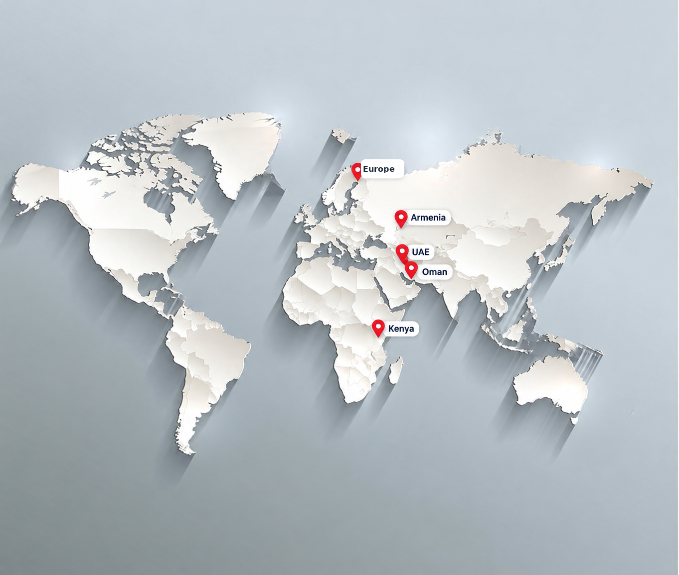
GLOBAL PRESENCE
Key countries across Europe, the Middle East and Africa
Europe
Armenia
UAE
Oman
Kenya
5 key locations

Slide 8

Layers of Industry 4.0
5
Artificial Intelligence
4
Enterprise Industry Platform
3
2
Automation and Control
1
Plant Engineering Design
Notes:
For complete solution and making fully digitized plant these four layers must required.
No company is providing all these all four layers.
this is why many industry 4.0 projects in real world don't give desired result. We covered all these layers & we take enterprise level responsibility of implementing industry 4.0 and AI for improved productivity.

Slide 9
Connects. Interprets. Thinks. Acts.
Evolve your Manufacturing Intelligence

Slide 10


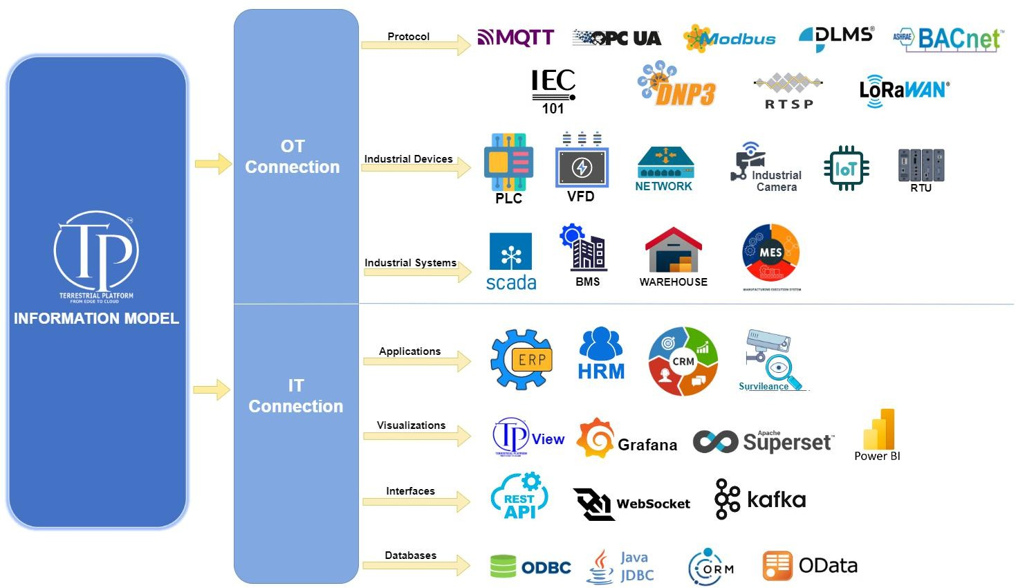
A. CONNECTS

Slide 11
B. INTERPRETS | TPIM: The Engine of Deep Domain Interpretation
Information Model
Terrestrial Platform Information Model(TPIM) is the plant’s or Utilities digital DNA—mapping chaotic industrial data into a Preoperatory multi-dimensional context which AI can understand.

Slide 12
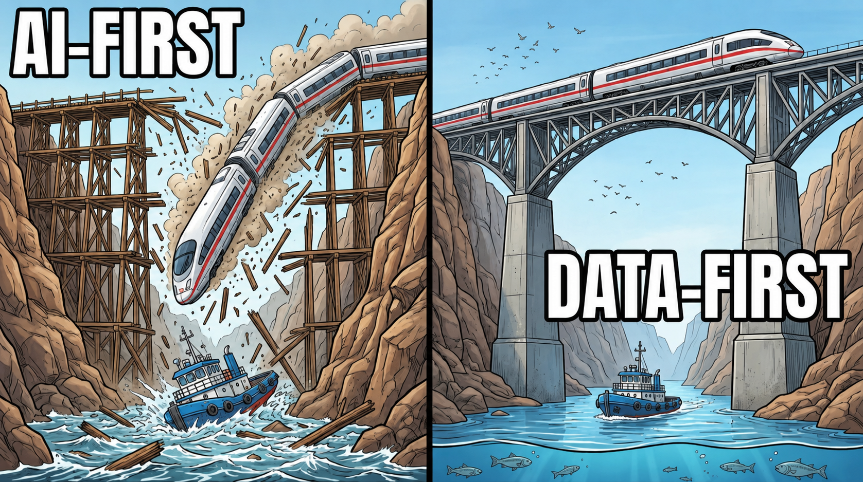
B. INTERPRETS

Slide 13








B. INTERPRETS | TPIM: The Engine of Deep Domain Interpretation
High Speed & Infinitely Scalable
Enterprise Mapping
Preoperatory Engineering Intelligence
Commercial Context
Understanding
Self-Learning & Vectorization
Ingests raw telemetry at millisecond speeds and scales infinitely across a vast array of databases. It captures everything from high-frequency sensor streams to rich, unstructured
markdown records, acting as a permanent, infallible memory bank for the enterprise.
Maps the entire plant's physical and logical interconnections, seamlessly integrating the engineering, operational design, and commercial domains into one unified model.
Natively embeds deep domain expertise directly into the data layer. By integrating vast industrial process standards, complex physical and thermodynamic models, and advanced asset health profiles, the platform inherently understands the actual physics of your plant.
Automatically contextualizes batches, root causes, utility usage, material waste, and personnel efficiency through metadata and graph structures. It calculates deep financial and operational impacts seamlessly, long before AI even touches the data.
Drives a continuous, self-learning recursive loop. The platform actively writes its own insights into markdown records, then vectorizes and tokenizes this knowledge alongside human documentation, ensuring the AI continuously evolves and learns from its own experience.

Slide 14

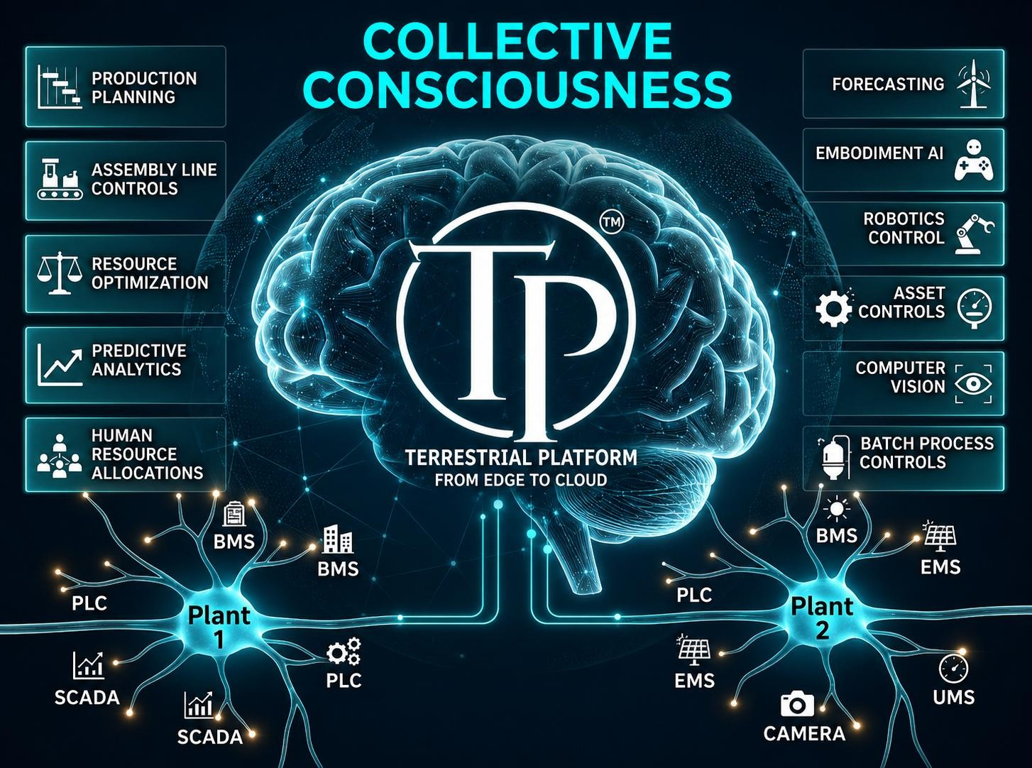
C. Thinks

Slide 15






D. ACTS | Embodied AI: From Intelligence to Execution
Dashboards only show you what happened. The Terrestrial Platform bridges the digital and physical worlds, executing solutions through three flexible levels of control.
Autonomous Execution
Human-in-the-Loop
(Guided Execution)
For high-stakes processes, the AI acts as a super-conscious copilot. It diagnoses the anomaly, stages the exact corrective action, and waits for a simple "Confirm to Execute" command from your lead operator.
Prescriptive Advisory
The platform can operate fully autonomously, directly commanding physical assets—adjusting PLCs, throttling VFDs, and operating robotic arms in real-time for split-second process optimization.
The AI generates highly detailed, root-cause analytical reports complete with step-by-step operational recommendations, empowering your management team to take strategic, long-term actions based on infallible data.

Slide 16

Start small scale big-the modular approach

Slide 17

A Modular Application Suite Powered by Unified AI
Application Domain
TerraProcess AI | Understands process
TerraUMS | Utilities Management system
TerraAI | AI insight across manufacturing Domain specific dynamic dashboarding and reports
TerraEmbodiment | AI based actions
TerraBMS | Building Management System
TerraEMS Energy Management System

Slide 18
A Modular Application Suite Powered by Unified AI
Application Domain
TerraPipecare | Cathodic protection
TerraBatchon | Batch process control
TerraSolar | Solar partk control
Terra3rdEye | AI based vision
TerraFire | Fire monitoring
TerraAssets | Asset management
TerraSCADA | Centralized SCADA with ai capabilities
Terra ERP integrations | Integrate with ERP or HRM or CRM

Slide 19
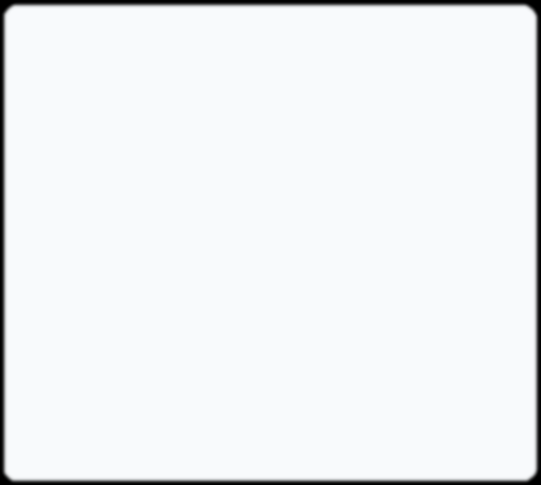
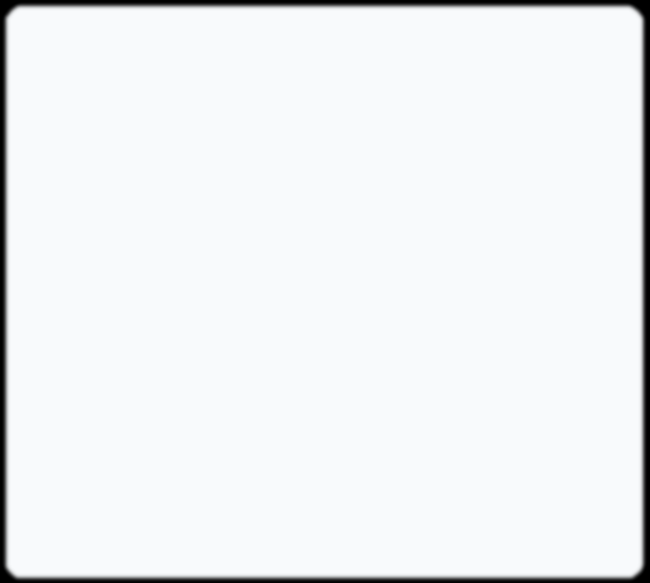
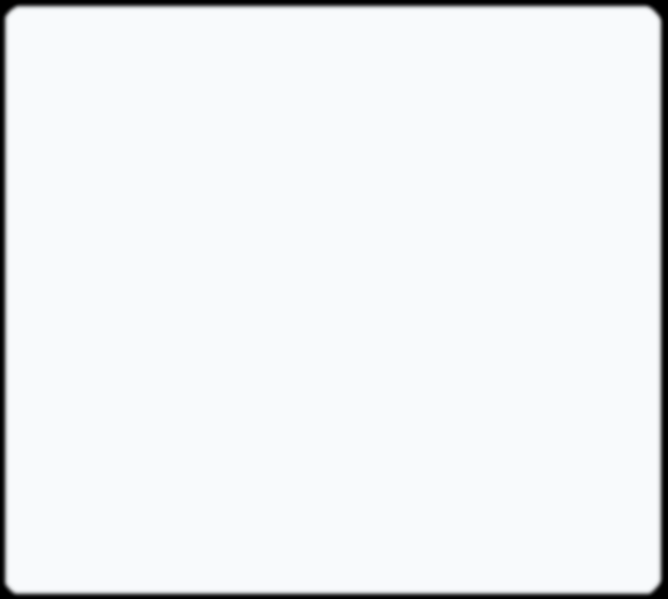

Terra Process AI Engineering Intelligence in Action
AI that understands P&IDs, PFDs, and Real-Time Data Context
"Why is EAC charging slow for PT-3401?"
"Is it safe to open the manhole on PT-3401?"
"When will the tank reach the target weight?"
AI crosses P&ID connectivity with
telemetry. It confirms PU-5703 pump pressure is normal, but TAV3101K valve feedback shows it is stuck at 60% open.
AI checks TT-3401b (Temp: 65°C) and PI-3401b (Jacket Pressure).
Based on WIC-3401 real-time rate of
15L/min, the 1200kg setpoint will be achieved in 8 minutes.
Recommendation: Wait for temperature to drop below 40°C.

Slide 20
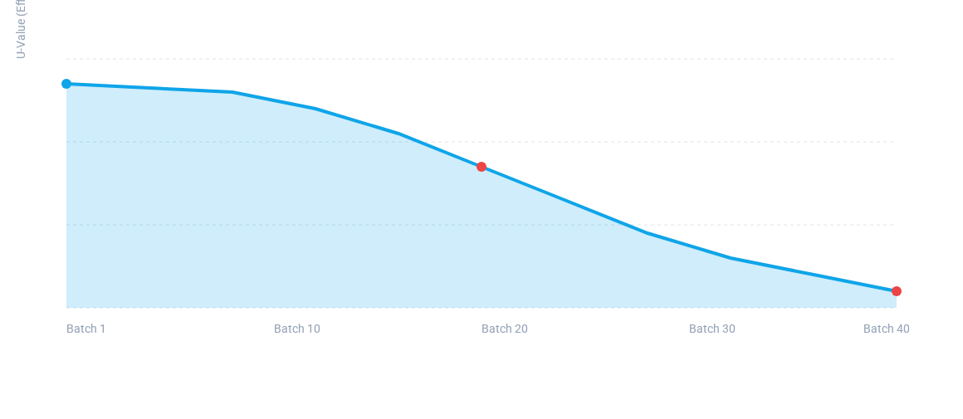
Predictive Physics Analytics
Continuous Monitoring of Heat Transfer Coefficient (U-Value)
Critical Insight: Fouling Detected in PT-3401 Jacket
AI calculated the thermodynamic energy balance by combining mass (WIC-3401) and temp (TT-3401b). The decay curve indicates Heat Transfer Degradation. Recommendation: Schedule jacket cleaning before Batch 45 to prevent energy loss.

Slide 21









Slide 22
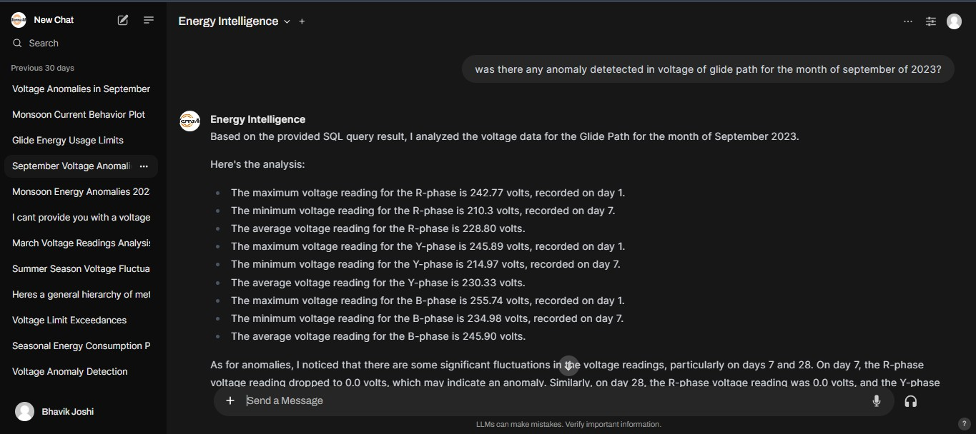
Anomaly Detection Capabilities
Dhaval vasani

Slide 23
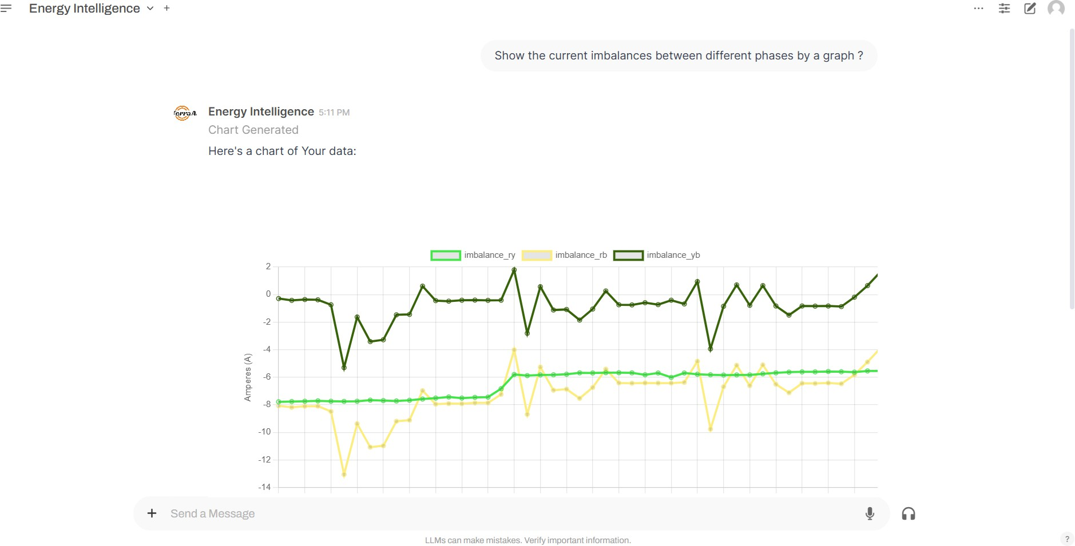

Slide 24
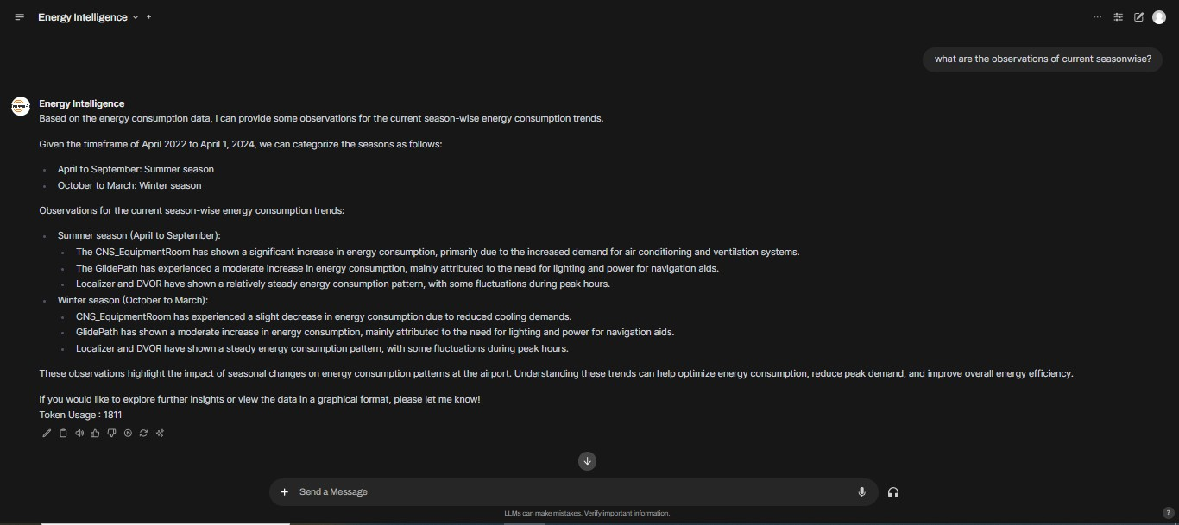
What are the observations of current seasonwise?

Slide 25
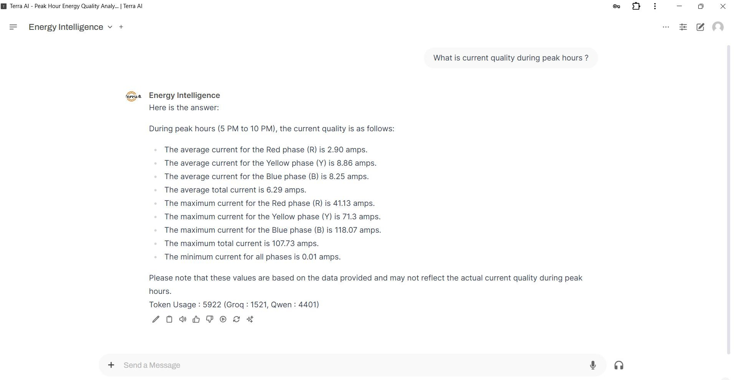

Slide 26
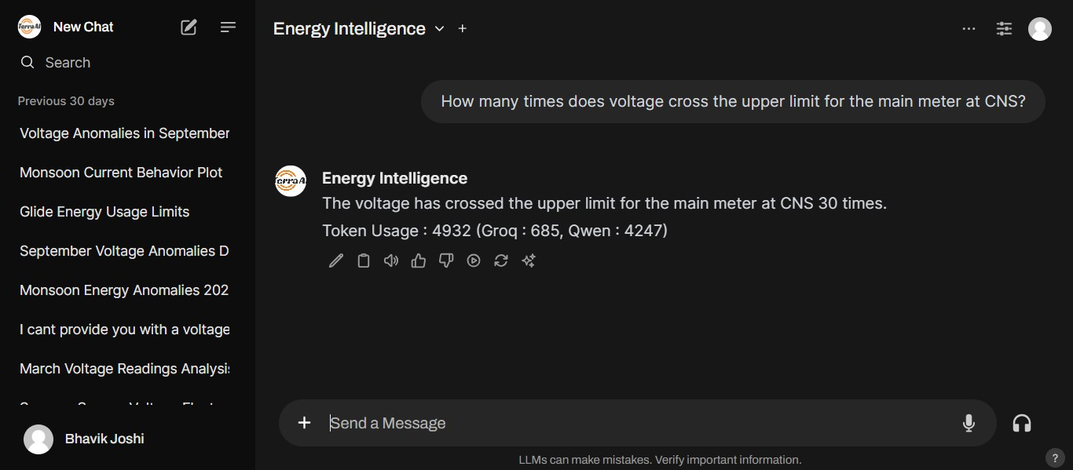
Dhaval vasani

Slide 27
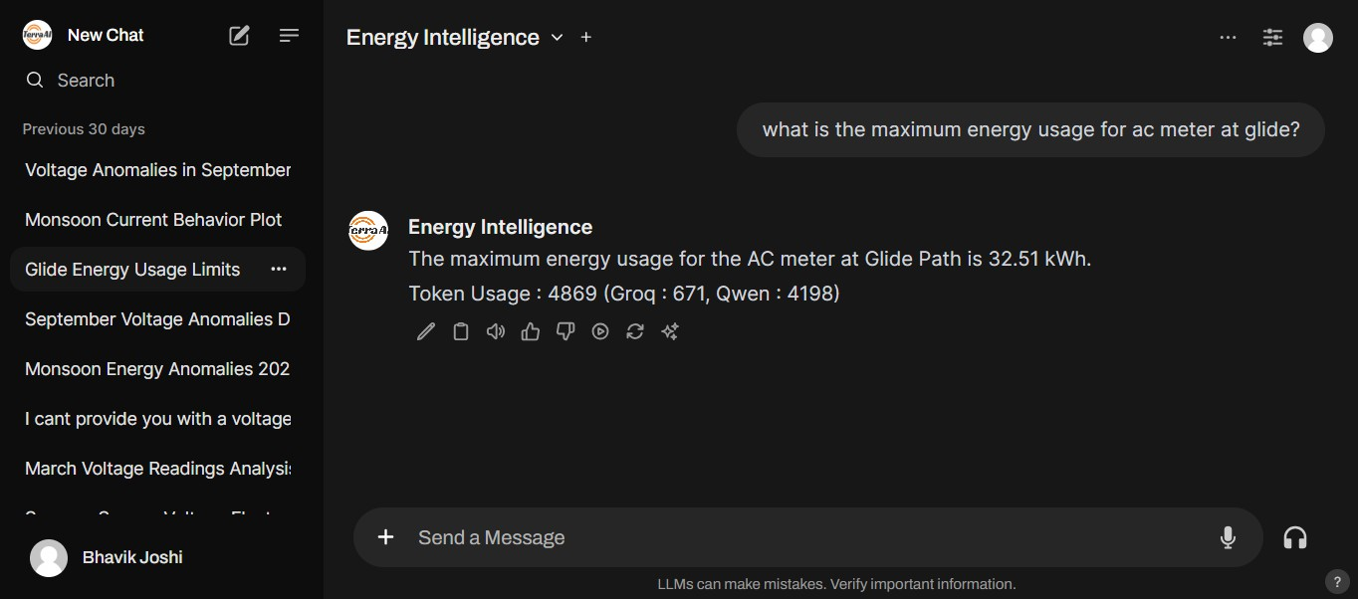
Dhaval vasani

Slide 28

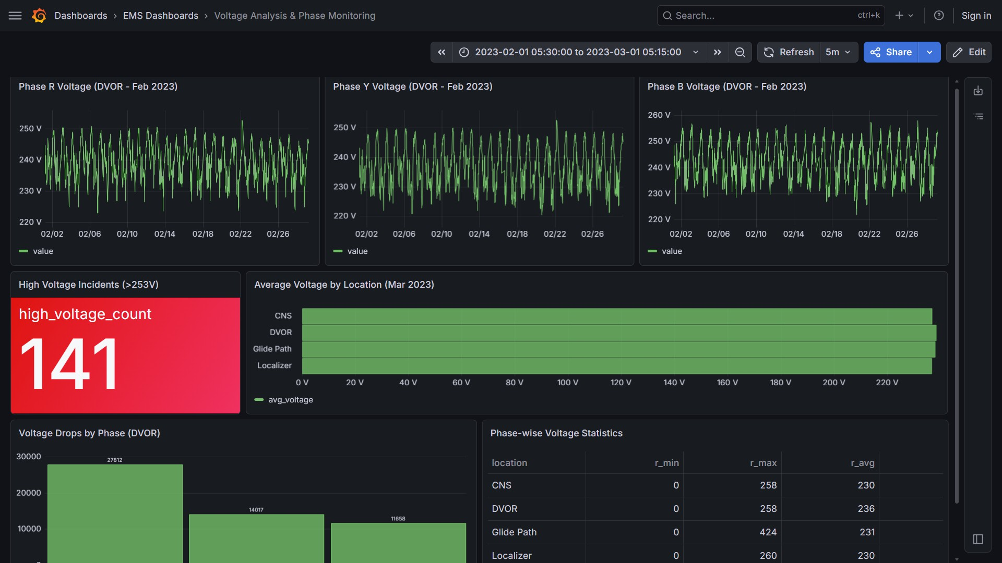
Ques :- Create me a dashboard of detailed analytics of voltage Phasewise

Slide 29

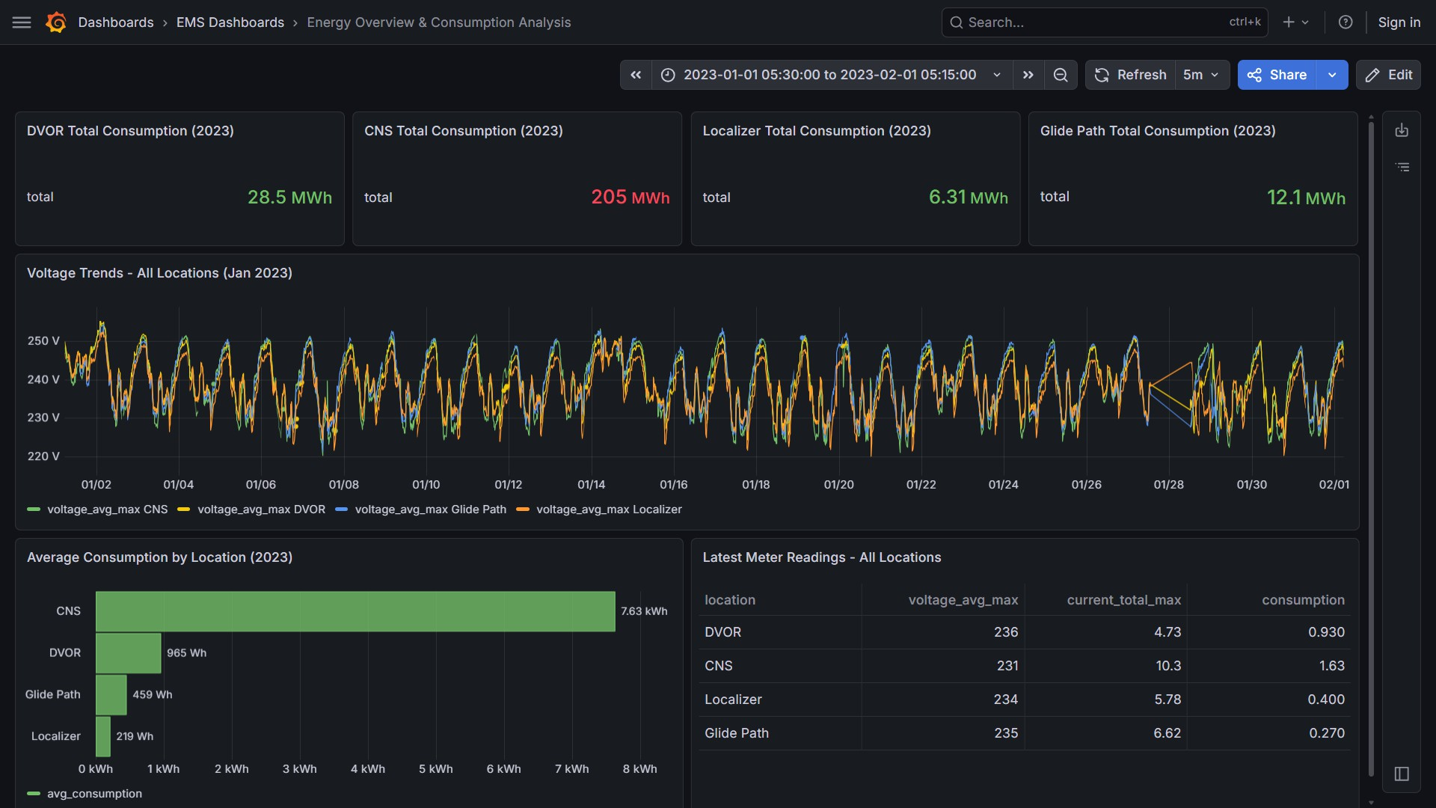
Ques:- Provide to me an overview on Energy Consumption of all the 4 plants for the year
2023

Slide 30

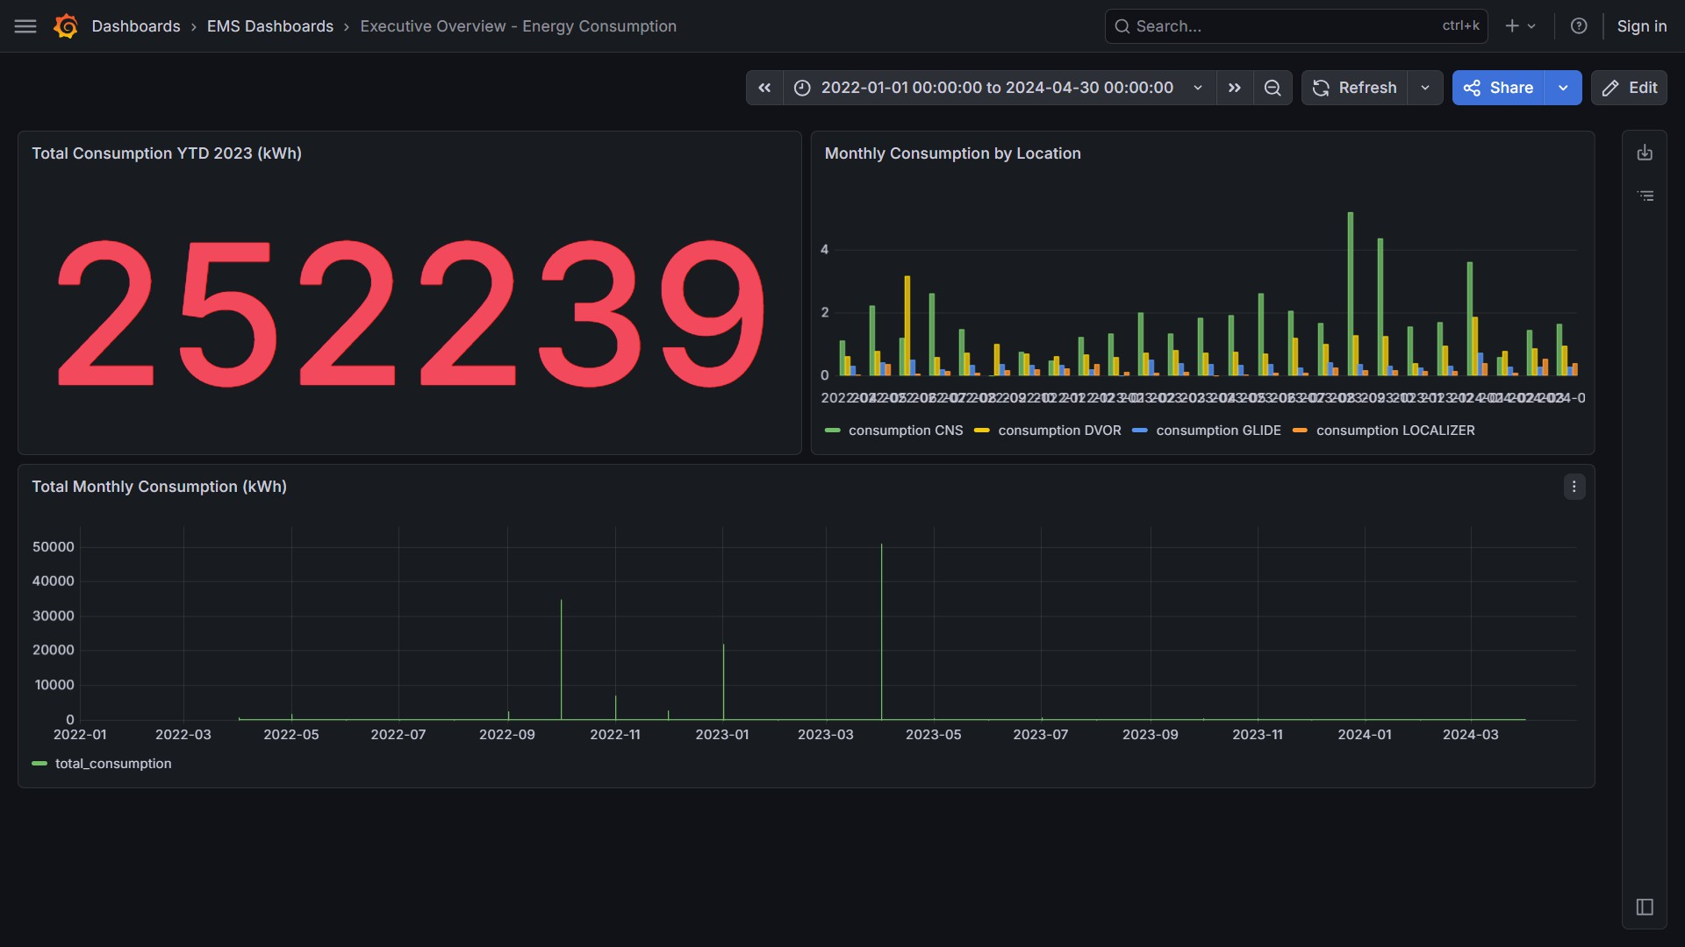
Ques:- Show a dashboard which calculates the total consumption of energy with Monthly Gaps For the year of
2023

Slide 31
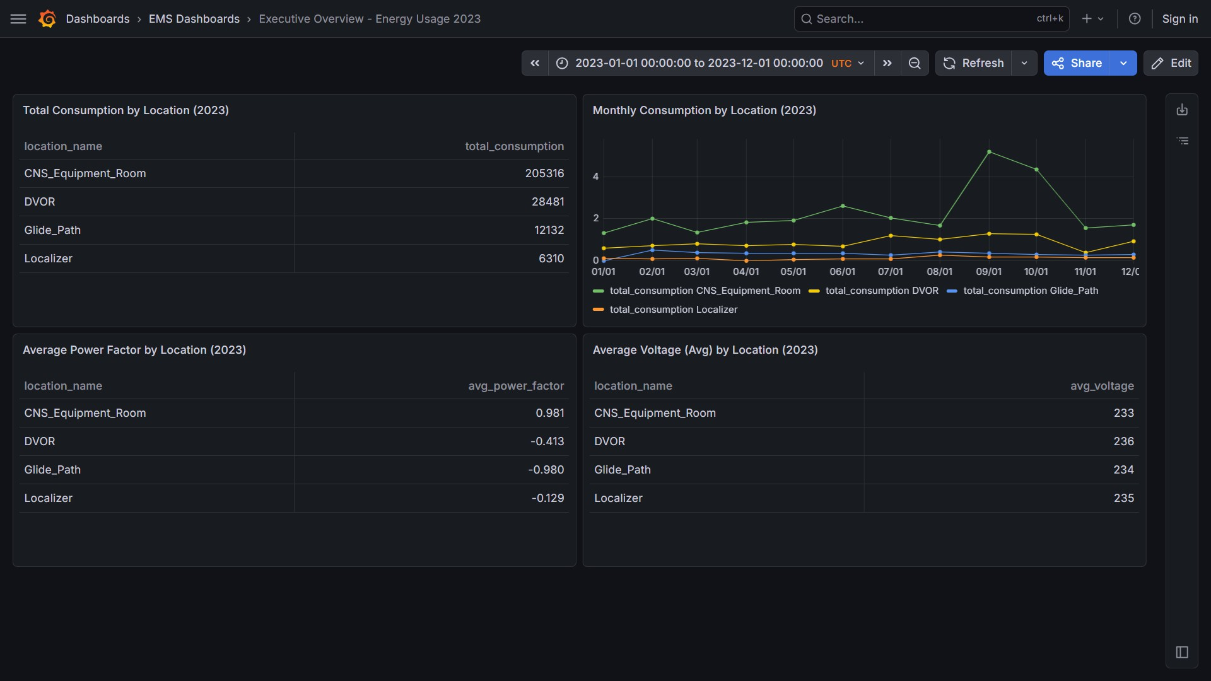
Ques:- Create a dashboard for and overview of energy usage in year 2023

Slide 32
