Slide 1


Slide 2

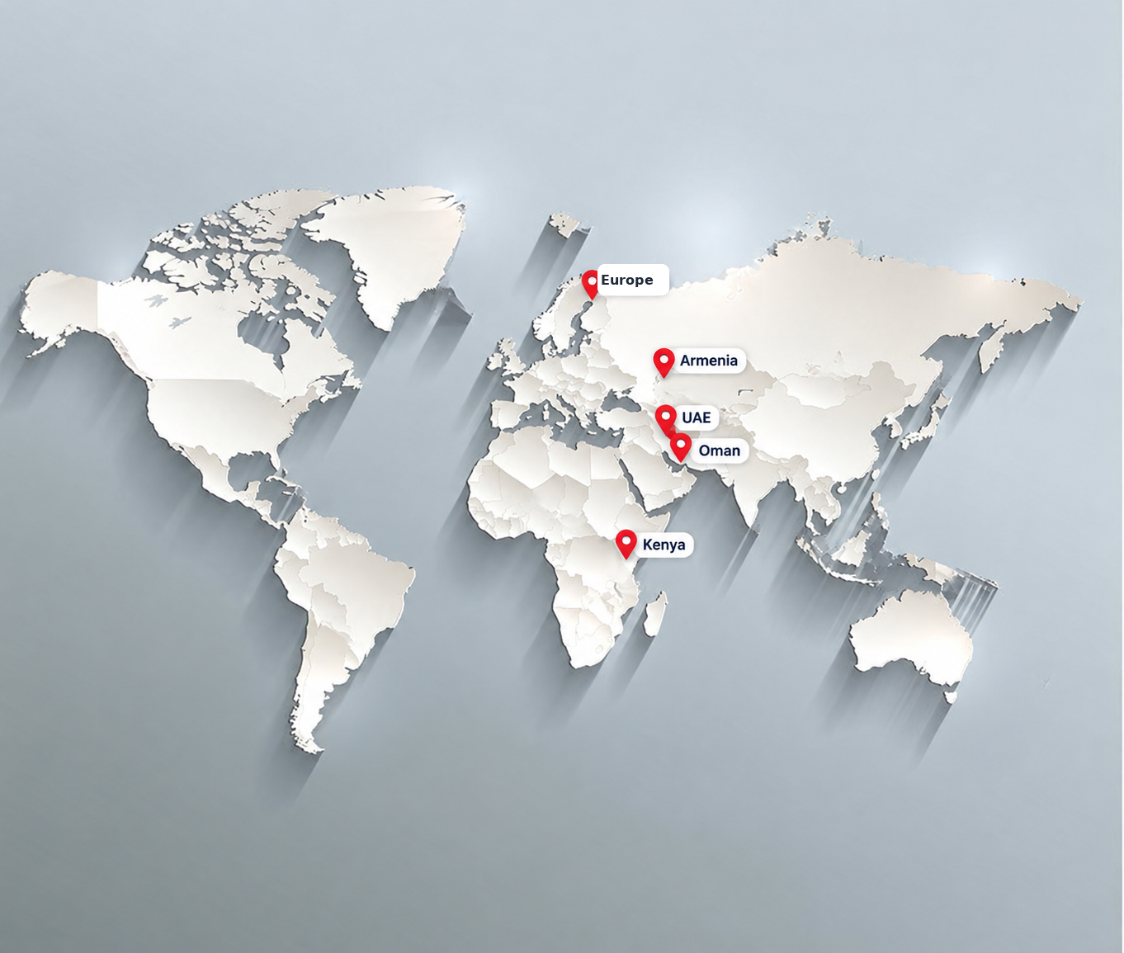
GLOBAL PRESENCE
Key countries across Europe, the Middle East and Africa
Europe
Armenia
UAE
Oman
Kenya
5 key locations

