Slide 1

Group 18 Project outline

Slide 2
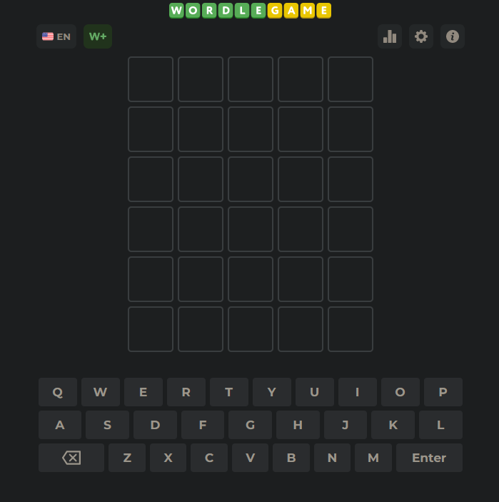
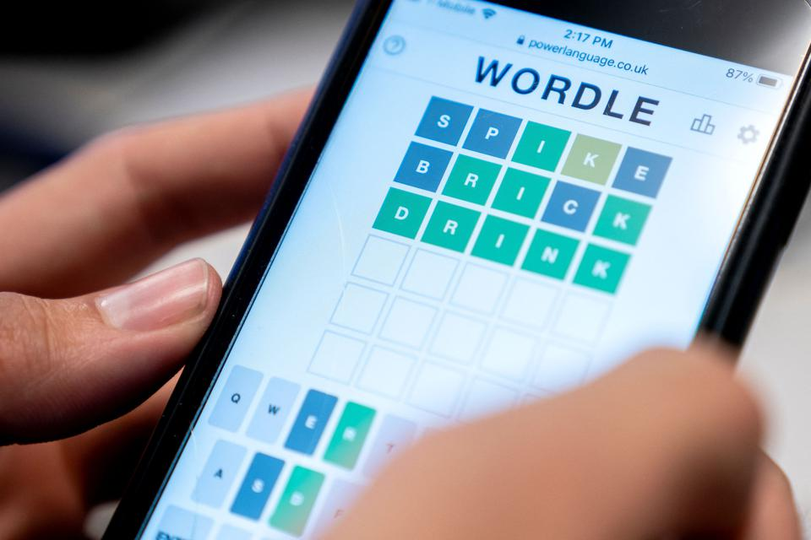
Inspiration

Slide 3

Targeting users
University Students studying Computer Science

Slide 4


API

Slide 5
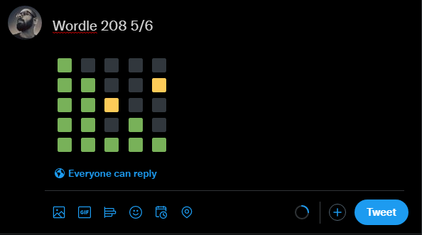
Twitter sharing
(Wordle example)

Slide 6
Main functions
Daily Quiz
Users account
Leaderboard
Twitter sharing

