Slide 1
Regressor
사용 모델 알고리즘
LinearRegression()
Ridge()
Lasso()
DecisionTreeRegressor()
RandomForestRegressor()
GradientBoostingRegressor()
XGBRegressor()

Slide 2
학습 데이터 기간 : 2020/01/02 ~ 2021/12/03
테스트 데이터 기간 : 2021/12/03 ~ 2021/12/10 (일주일 = 5일)
random_state=17 고정
cv=5
아무 설정 없이 모델 학습
1에 교차검증(grid)
다항화, 교차검증

Slide 3
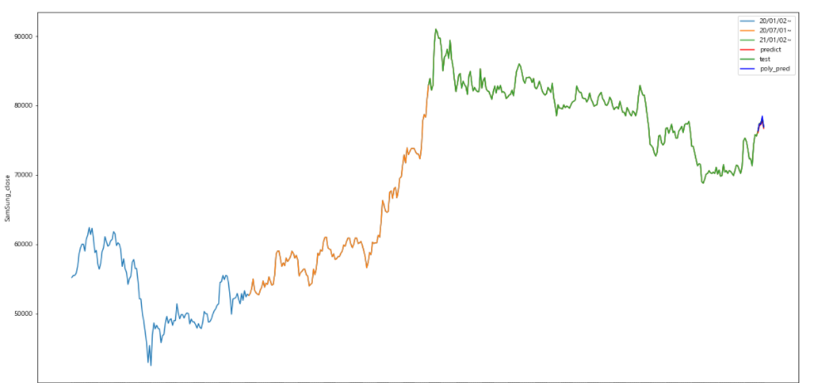
test : 삼성 종가
predict : 기본 모델 예측
best_pred : 기본 모델 + 하이퍼 파라미터 예측
poly_(best)_pred : 다항화 + 하이퍼 파라미터 예측

Slide 4
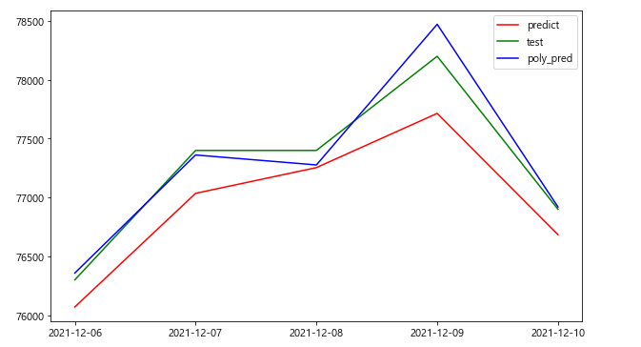
LinearRegressor
1. train_score : 0.9996768419102545
test_score : 0.7518470833096909
3. degree = 3
train_score : 0.9999149983930522
test_score : 0.9520671280645093

Slide 5
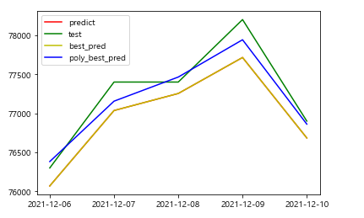
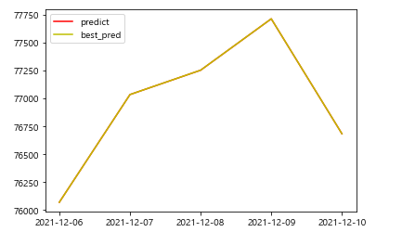
Ridge
1. train_score : 0.9996768416251155
test_score : 0.7516350103214077
3. degree = 2
Ridge(alpha=10, max_iter=500)
train_score : 0.9998817340329035
test_score : 0.9294719947105937
best_train_score : 0.9998817340329035
best_test_score : 0.9294719947105937
2. Ridge(alpha=0.001, 'max_iter‘=500)
train : 0.9996768419102543
test : 0.751846870323656

Slide 6
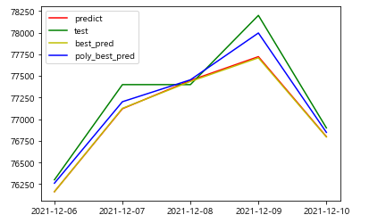
Lasso
1. train_score : 0.9996127723983546
test_score : 0.8295310434864609
3. degree = 4
Lasso(alpha=10, max_iter=1000)
train_score : 0.9998422314495918
test_score : 0.9554982019959594
best_train_score : 0.9998422314495918
best_test_score : 0.9554982019959594
2. Lasso(alpha=5, 'max_iter‘=1000)
train : 0.9996139430085761
test : 0.8241531222353934

Slide 7
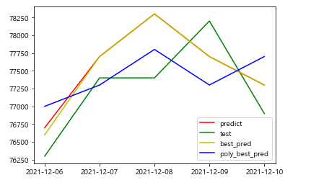
DecisionTreeRegressor
1. train_score : 1.0
test_score : -0.1713995943204869
3. degree = 3
DecisionTreeRegressor(max_depth=11)
train_score : 1.0
test_score : -0.06997971602434072
best_train_score : 1.0
best_test_score : -0.06997971602434072
2. DecisionTreeRegressor(max_depth=15)
train : 1.0
test : 0.2900608519269777

Slide 8
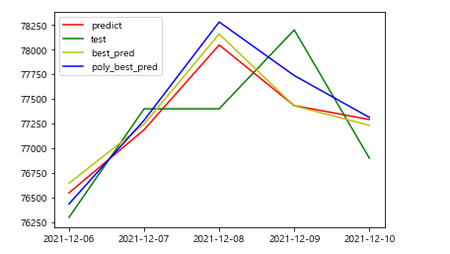
RandomForestRegressor
1. train_score : 0.9998723758301289
test_score : 0.35672160243407713
3. degree = 4
RandomForestRegressor(max_depth=11,
n_estimators=100)
train_score : 0.9998184962344205
test_score : 0.3958975659229209
best_train_score : 0.9998184962344205
best_test_score : 0.3958975659229209
2. RandomForestRegressor(max_depth=13,
n_estimators=100)
train : 0.9998742200246591
test : 0.2792074036511156

Slide 9
GradientBoostingRegressor
3. degree = 2
GradientBoostingRegressor(max_depth=3,
learning_rate=1,
n_estimators=100)
train_score : 1.0
test_score : 0.24070397988144487
best_train_score : 1.0
best_test_score : 0.24070397988144487
1. train_score : 0.9999324850024487
test_score : -0.18029732873661963
2. GradientBoostingRegressor(
max_depth=3,
learning_rate=0.1,
n_estimators=5000)
train : 0.9999999999999999
test : -0.14988984201308608

Slide 10
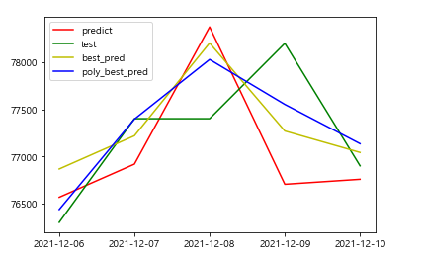
ExtraGradientBoostingRegressor
1. train_score : 0.9999945451034528
test_score : -0.7880377581453987
3. degree = 4
ExtraGradientBoostingRegressor(
learning_rate=0.01, max_depth=11,
n_estimators=1000)
train_score : 0.9999988725145763
test_score : 0.5489384170748883
best_train_score : 0.9999988725145763
best_test_score : 0.5489384170748883
2. ExtraGradientBoostingRegressor(
learning_rate=0.1, max_depth=11,
n_estimators=5000)
train : 0.9999999999909958
test : 0.044284234006312984

Slide 11
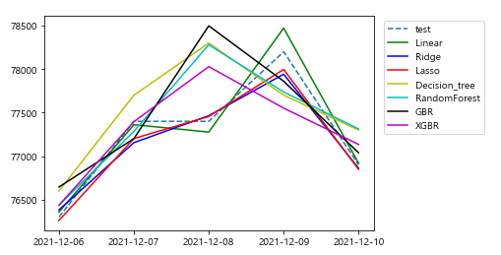
각 모델 예측 값 비교

Slide 12
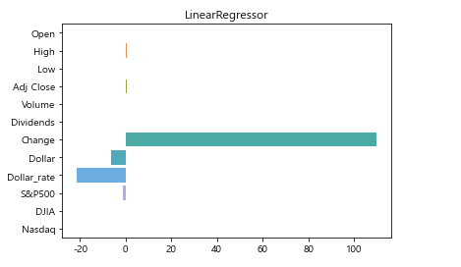
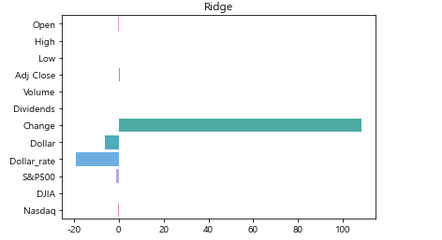
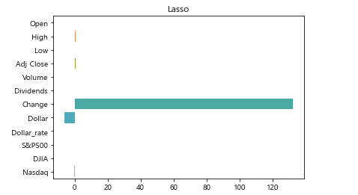
coef_비교

Slide 13
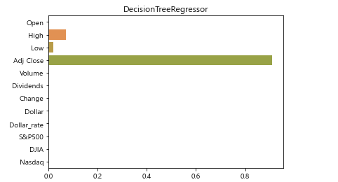
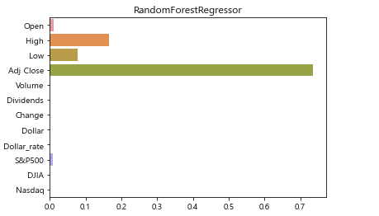
Feature_importances_비교

Slide 14
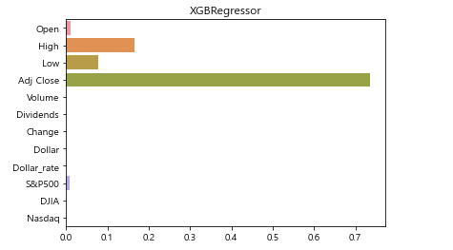
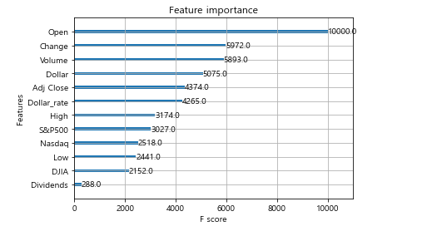
xgboost feature가 노드 분할 시 사용된 횟수

Slide 15
추후
1. train, test 기간 나눠서
2. 선형,릿지,라쏘 -> coef_ 비교 후, 필요없는 데이터 제거 후 다시 돌리기
3. 결정트리 회귀 종류 importance 비교 후 -> 필요없는 데이터 제거 후 다시 돌리기
4. 보팅 회귀

