Slide 1
Convolutional Neural Networks (CNN)
Artificial Intelligence in Everyday Life

Slide 2

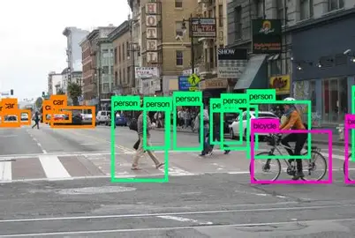
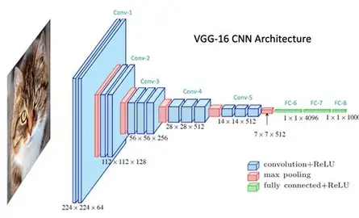
AI in daily life
Natural Language Processing
( NLP )
AI
Convolutional Neural Network
( CNN )
Computer Vision

Slide 3
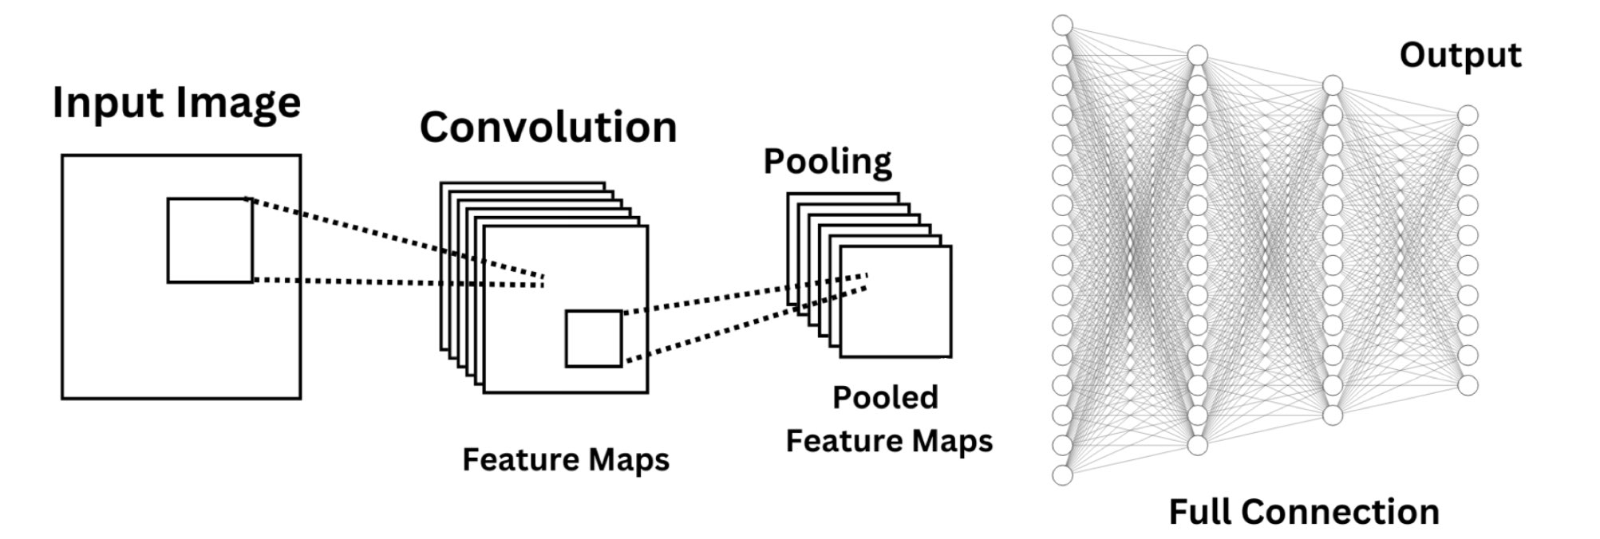
How CNN Works
Convolutional Layer → detects edges, lines
Pooling Layer → compresses, keeps key informations
Fully Connected Layer → combines features → classification

Slide 4
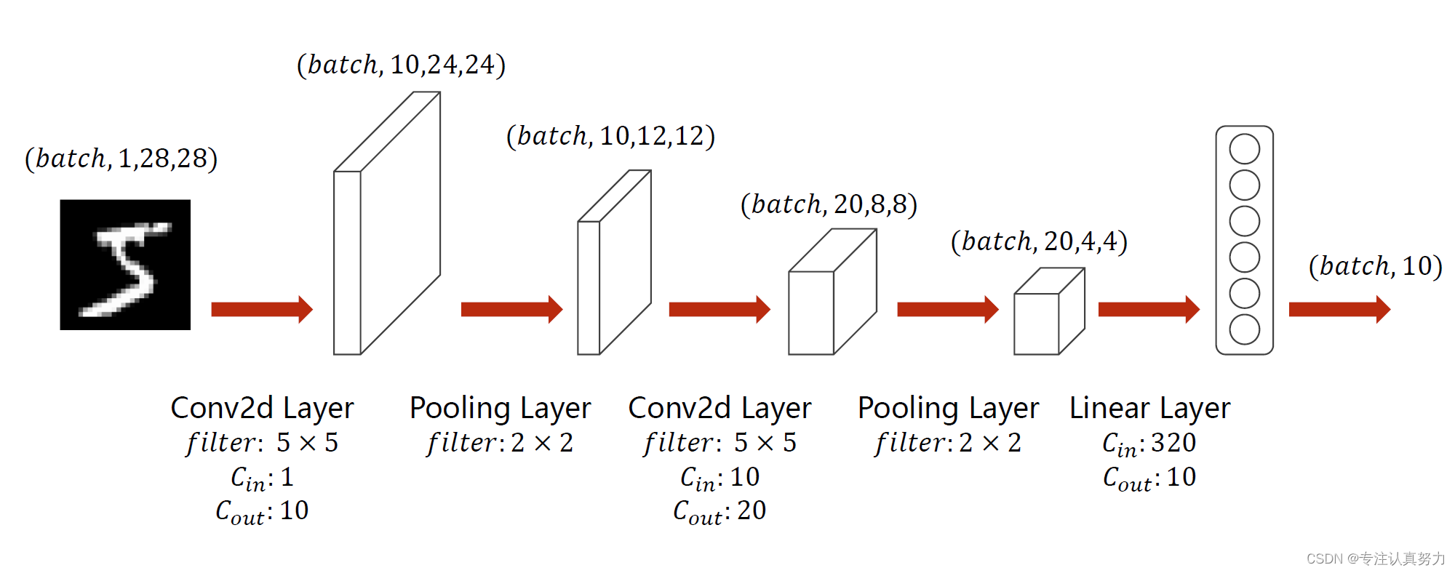
Mathematical processing
matrix multiplications and nonlinear transformations

Slide 5
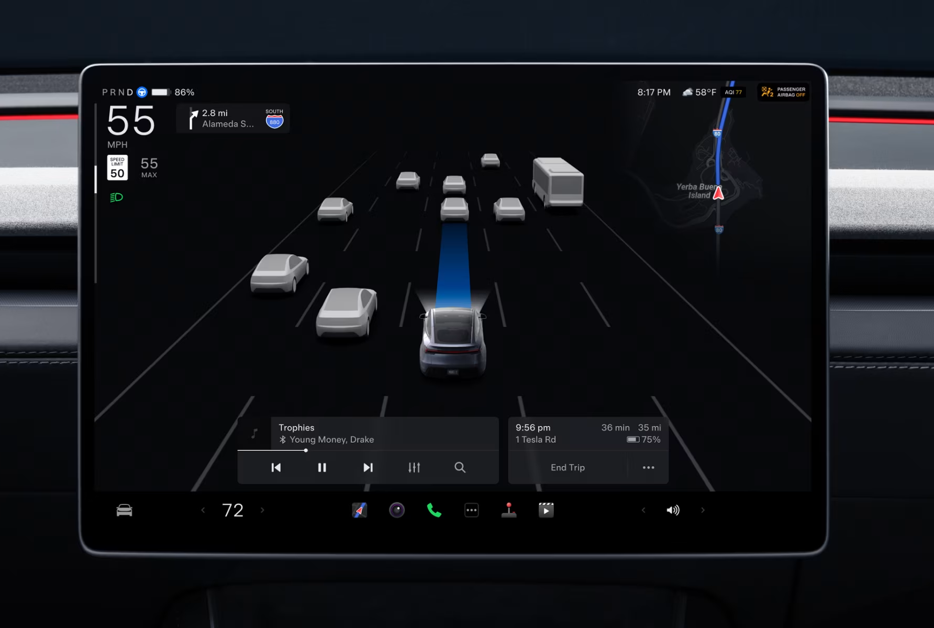
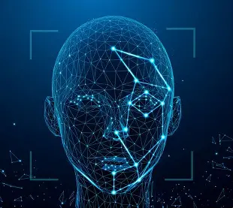
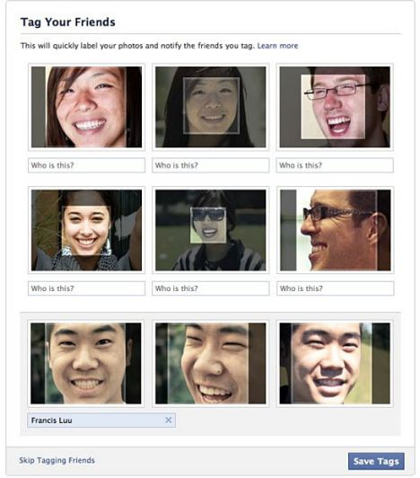
Applications of CNN
• Autonomous driving
• Face Recognition
• Social media tag friends

Slide 6
End of this presentation

