Slide 1
Category review: Chips
June 2020
Retail Analytics
Brand note: If client logo is not required, use alternate title page layout right click slide thumbnail > Layout > Title

Slide 2
Notes:
To view Privacy video explaining how important data privacy is to Quantium, please click here: https://www.youtube.com/watch?v=Zq1QDAkoRzU
or here Q:\Company Reference\Brand & Design\Brand videos\Q Privacy.mp4
At Quantium, we believe that data is the behavioural footprint of humanity and that it has to be treated with the utmost care and responsibility.
Histories, attitudes, indeed lives are stored within it in ways that aren’t always apparent – and that’s what makes its potential so powerful.
To work with it responsibly, sensitively, we set ourselves the highest data privacy protection and governance standards.
We have spent 17 years perfecting privacy-by-design and secure-by-design principles. Central to this is not holding any personally identifiable information about people –
we neither receive it, and put the necessary protections in place to be unable to decipher it.
Every aspect of handling data is safeguarded: from its de-identification, to its encryption – data security is paramount and of the highest grade.
We pride ourselves on gaining the trust of iconic organisations around the world through years of securely working with their data,
and in turn the trust that builds with their stakeholders.

Slide 3
Executive summary
01
Task 1
• Older families (budget/mainstream) are the largest value-driving segments, supported by higher shopping frequency and larger baskets.
• Mainstream young singles/couples pay the highest average price per unit, creating a second premium/value opportunity.
• Recommendation: focus volume-led activation on families and targeted premium messaging on mainstream singles/couples.
02
Task 2
• Control stores selected: 233 for 77, 155 for 86, and 237 for 88.
• Store 77 delivered the clearest uplift; Store 86 was customer-led; Store 88 was positive but lower confidence.
• Recommendation: use Store 77 as the main evidence base for rollout and continue testing before full deployment.

Slide 4
01
Category

Slide 5
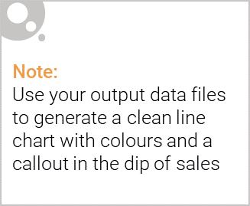
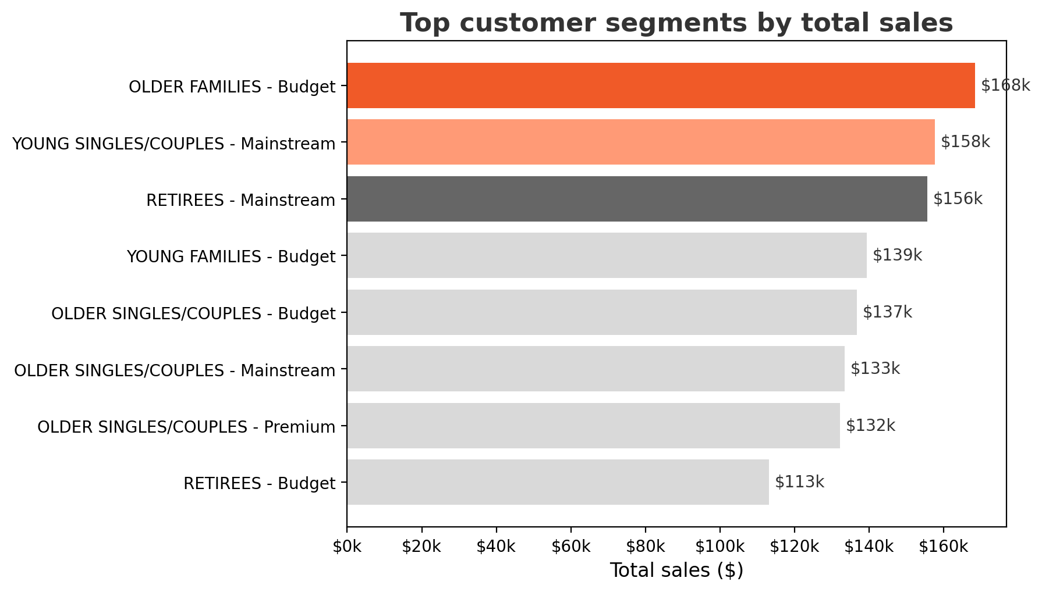
Older families and mainstream young singles/couples are the highest-value chips shoppers
Budget older families generated the highest total sales at approximately $168k.
Mainstream young singles/couples and mainstream retirees were the next strongest segments at roughly $158k and $156k.
The category therefore depends on both family-driven volume and mainstream single/couple value.

Slide 6

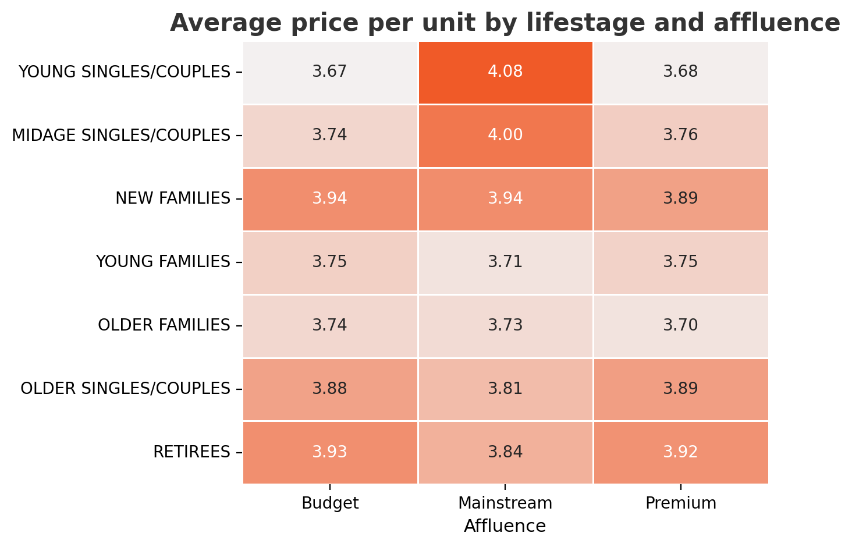
Family shoppers drive volume, while mainstream young singles/couples show stronger price tolerance
Older family segments shop more frequently and buy slightly more units per trip, making them the clearest volume opportunity.
Mainstream young singles/couples pay the highest average price per unit ($4.08), indicating lower price sensitivity.
Commercial implication: use value-led mechanics for families and premium-positioned activation for mainstream singles/couples.

Slide 7
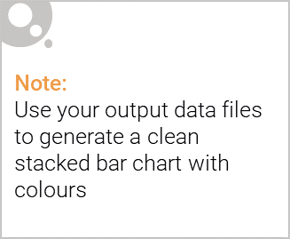
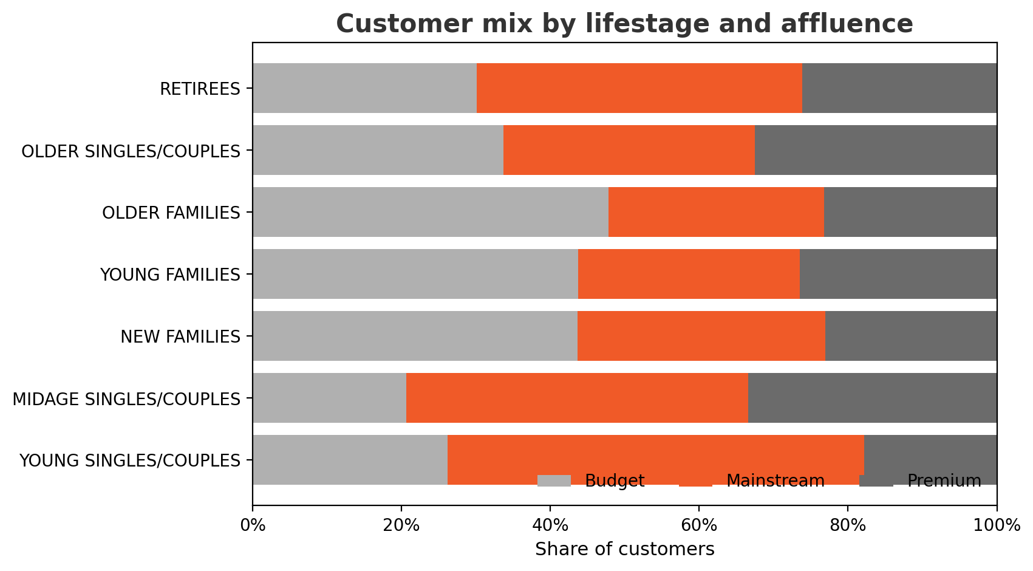
Editable (delete this)
Mainstream dominates younger singles, while budget matters more for families
Mainstream is the largest customer mix within younger singles/couples and midage singles/couples.
Budget customers are more prominent in family segments, especially older families.
Different segment mixes imply that one-size-fits-all targeting is likely to underperform.

Slide 8
02
Trial store performance

Slide 9
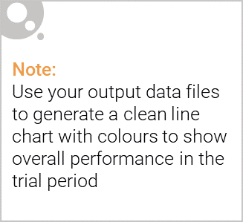
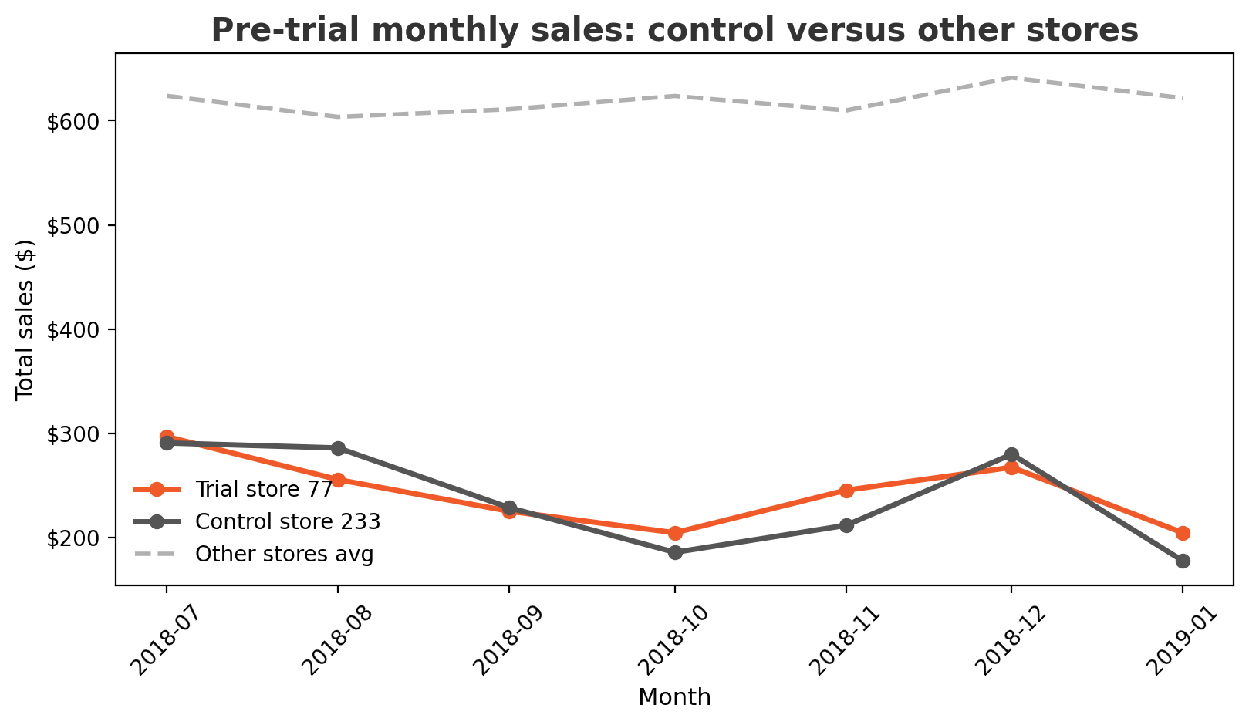
Control stores were selected because they tracked trial stores more closely than the broader store base
Final trial-control pairs
77 → 233
86 → 155
88 → 237
Stores were matched using pre-trial sales and customer similarity.
Store 233 tracks Store 77 more closely than the broader store base, illustrating the selection logic used across all trial stores.

Slide 10
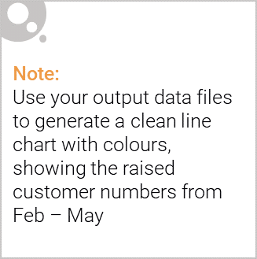
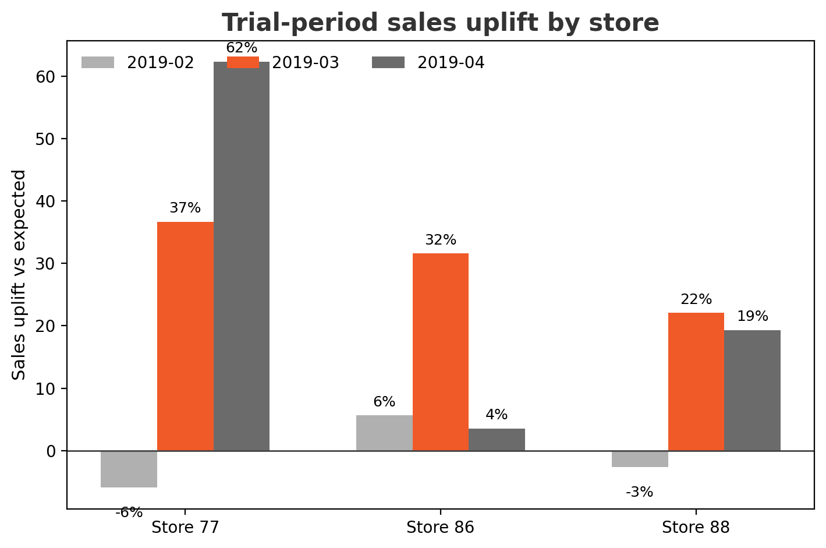
Store 77 showed the clearest trial uplift, while Stores 86 and 88 provided weaker supporting evidence
Store | Sales uplift | Customer uplift | Confidence
77 | Strong in Mar/Apr | Strong in Mar/Apr | Strong
86 | Mainly in Mar | Positive across trial | Moderate
88 | Positive in Mar/Apr | Positive in Mar/Apr | Moderate / cautious
Store 77 is the strongest evidence base for broader rollout consideration.
Store 86 improved traffic, but the sales uplift was less consistent.
Store 88 was positive, but should be interpreted with more caution because the control match was weaker.

