Slide 1
Cocaine Usage by Demographics
By: Stephen Lawrence, Charlie Day, Terry Yi, and Rachael Gu

Slide 2
Introduction
In 2012, the age-adjusted rate of drug overdose deaths involving cocaine was 1.2 per 100,000. In 2019 it was 4.9. 2020, 6.0.
Target: state-level health department policymaker
Well separated clustering, fuzzy clustering both useful

Slide 3
Dataset Discussion
867 observations, 50 states + D.o.C * 17 years of observations
Rows represent an individual state per for a given year, data on alcohol, tobacco, marijuana, and cocaine use given
Data from NSDUH study
Dataset excluded other drugs collected in the study
We will only use cocaine and population variables with categorical identifiers (year, state)

Slide 4
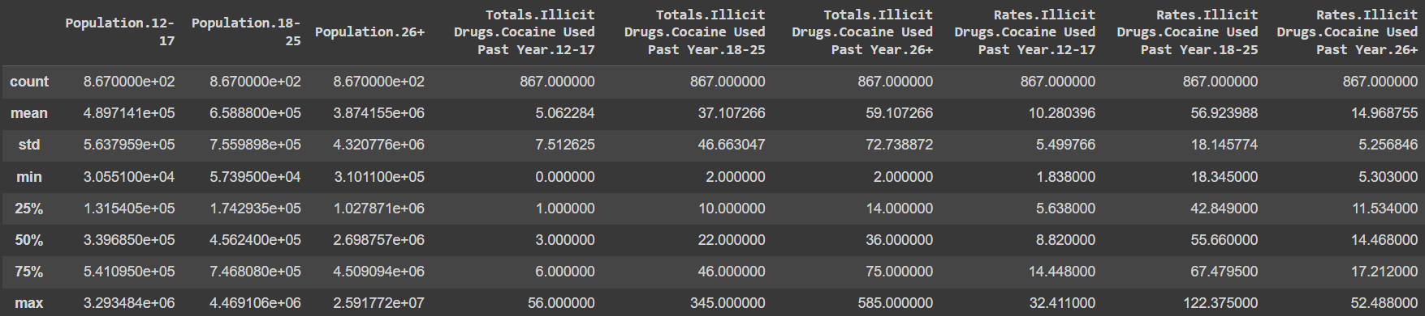
Cleaning and Scaling
No missing values, no need to reduce
Variables have drastically different magnitudes, so we should scale

Slide 5
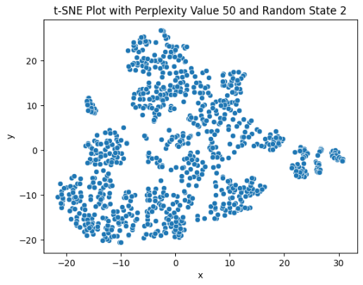
Clusterability
High variability across states and demographics
Significant correlations between age group populations and cocaine usage rates
State specific data over multiple years boosts clustering potential.
Diverse variables, like demographics and drug usage rates, aid in nuanced cluster identification
Standardized scaling ensures equal variable contribution, enhancing the effectiveness of distance-based clustering

Slide 6
Algorithm Selection
K-Medoids
Robust to Outliers
Non-Spherical Clusters
Stability
Fuzzy clustering
Good fit for analyzing drug usage patterns
Capture complex and overlapping influences

Slide 7
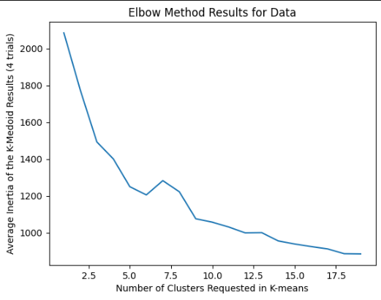
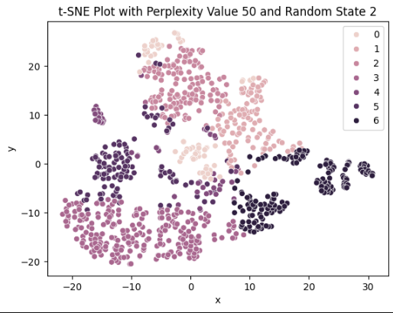
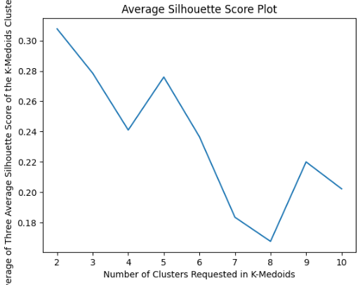
K-Medoids

Slide 8
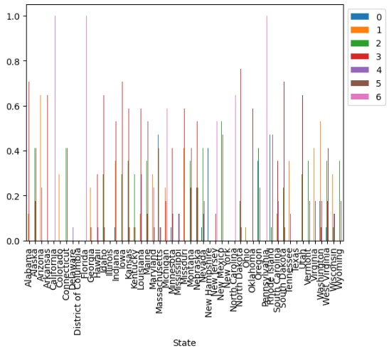
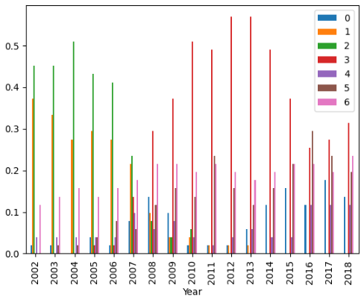
Analysis Result
Key observation
Dominant Cluster 6(t-SNE, similarity matrix)
Rates of Cocaine Usage
Age 12-17
Age 18-25
Cluster Attributes
Cluster 0: Year (2010-2018), diverse array of states(California, Texas), regions with persistent cocaine usage.
Cluster 1: Year (2003-2018), populous states (New York, Florida), consistent cocaine usage across extended period.
Cluster 2: Year (2008-2018), lower population densities, emerging reports of cocaine usage.
Cluster 3: Year (2002-2007), successful interventions in drug trends post-2007(Ohio ,Pennsylvania) .
Cluster 4: Year (2002-2007), earlier peaks in cocaine usage trends(Oregon, Nevada).
Cluster 5: Year (2003-2018), consistent cocaine usage issues without significant fluctuations(Michigan, Illinois).
Cluster 6: Year (2000-2018), consistent cocaine usage of lower population states(Montana, Wyoming).

Slide 9
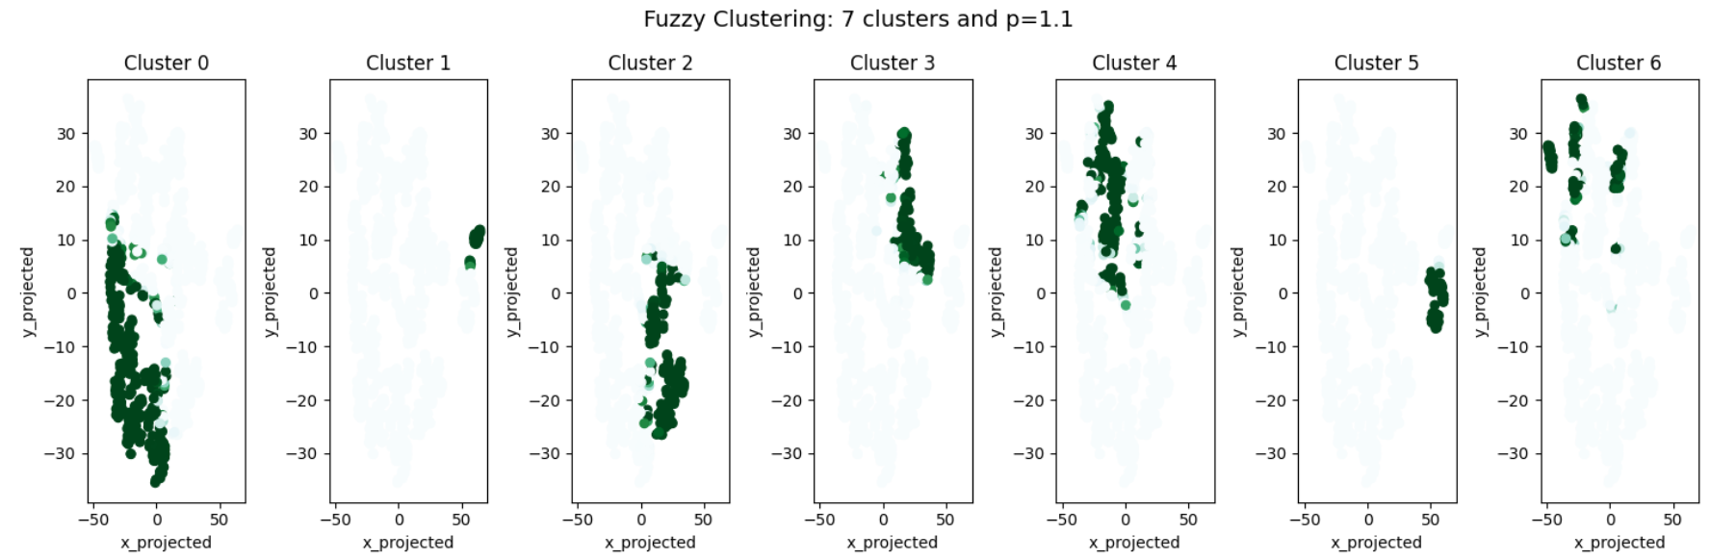
Fuzzy c-means

Slide 10
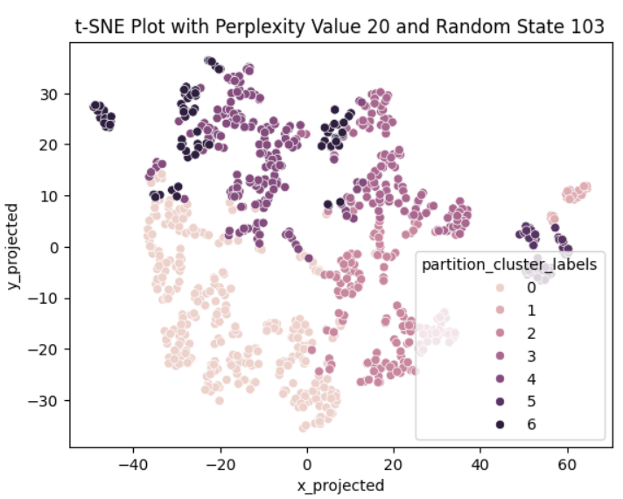
Partitional Clustering
Key Observations:
don’t follow ideal conditions: size, shape, separation, etc.
some clusters have been split up (e.g. 6)
Cluster Attributes:
Cluster 0: Year (2008 - 2018) and total illicit cocaine usage
Cluster 1: high population among all age categories
Cluster 2: Year (2008 - 2018), relative low population and rate of usage
Cluster 3: Year (2002 - 2007), relative low population and rate of usage
Cluster 4: Year (2002 - 2007), low population and rate of usage
Cluster 5: moderate population and total cocaine usage
Cluster 6: low population, low total usage, and moderate rate of cocaine usage

Slide 11
Discussion
Rand-score indicates different results, further analysis suggests otherwise
Due to similarity between clustering and high dimensionality, both are not fit
K-Medoids well separated, more trust
K-Medoids revealed insights on geographic locations
Fuzzy c-means revealed points being clustered in multiple groups

Slide 12
Conclusion
Observations:
No inherent clusters identified
Shortcomings:
‘Population’ had a large magnitude -> biased initial clustering results
same state and close years are similar
Future Work:
Restructure data
Analyze cocaine data with synthetic opioid data

Slide 13
Thank You!

