Slide 1
Lab 06 Rasterization -Line

Slide 2
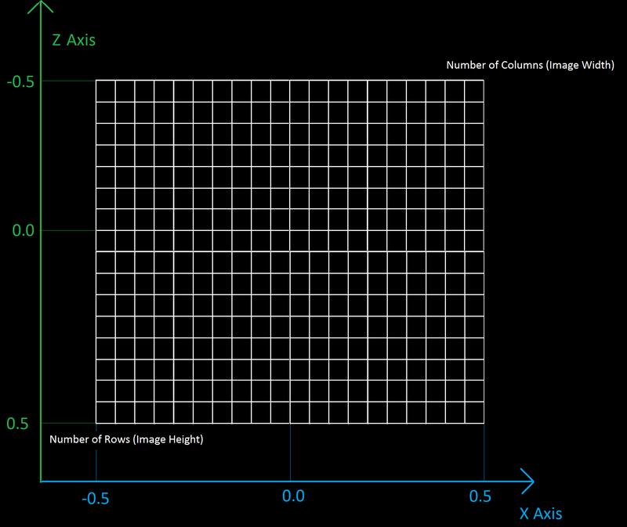
Use the 2D grid you created from previous Lab
Clickable 2D Grid
Provide a popup menu to select the grid dimensions: (10 or 15 or 20 etc…)
Draw a 2D grid based on the selected dimension.
The default is 10 → x: (-10 ~ 10), y: (-10 ~ 10)
The origin (0,0) is at center
When the user select 15, the grid will be re-drawn to: x: (-15 ~ 15), y: (-15 ~ 15)
When the user click on one of the cell
draw/fill the cell
You will need to implement a function to convert coordinates
Print out the coordinate (x, y) of this cell on the console window

Slide 3
midpoint algorithm
Select two endpoints
Use midpoint algorithm to draw the pixels along the line
Draw and print out all the pixels represent the line
Print out the coordinate (x, y) OF EACH PIXELS
Considering all regions
(First 2 region for 30%, the rest regions total 20%)
anti-aliasing algorithm
A popup menu to switch between midpoint/anti-aliasing algorithm
3
2
4
1
5
8
7
6

Slide 4
Visualize your result!

Slide 5
Requirement
Do not use other libraries. Only OpenGL API (gl, glu, glut) is allowed
Write comments in your code
Turn in your code and demo video

