Slide 1
opencv配置

Slide 2
Source
https://jason-chen-1992.weebly.com/home/install-visual-studio-2017-with-opencv-on-win10

Slide 3
OpenCV – 2.4.13.6
https://opencv.org/releases/page/3/

Slide 4
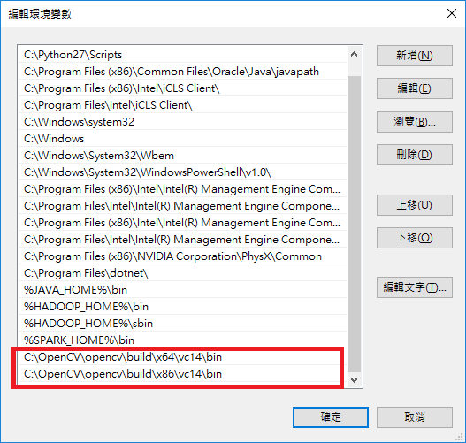
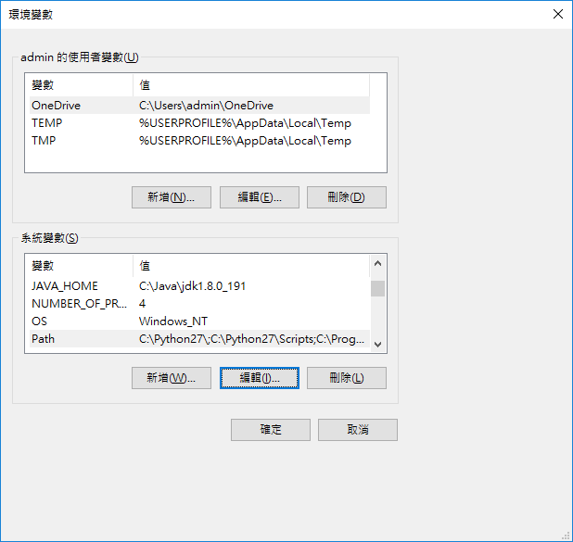
設定系統環境變數

Slide 5
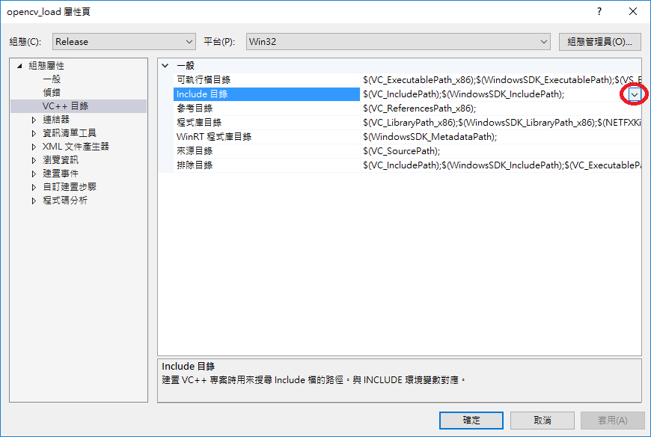
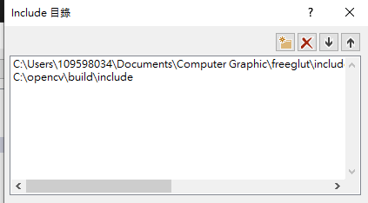
Visual Studio

Slide 6
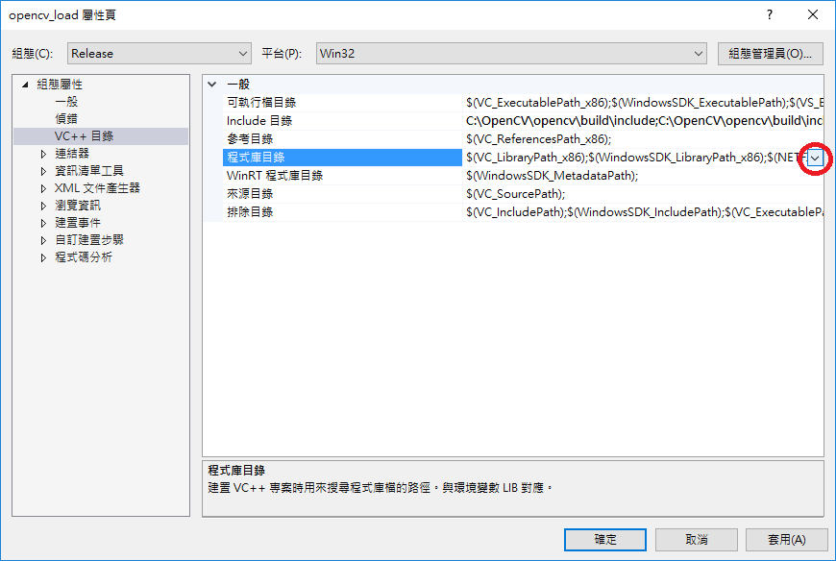
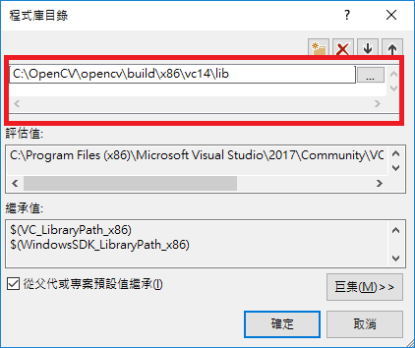

Slide 7
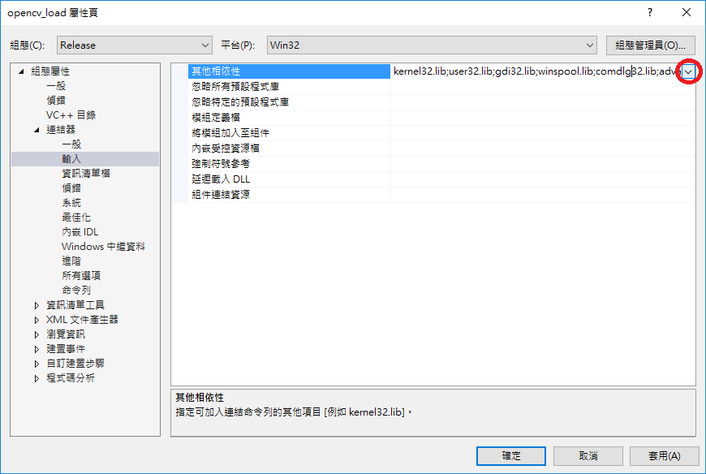
opencv_calib3d2413d.lib
opencv_contrib2413d.lib
opencv_core2413d.lib
opencv_features2d2413d.lib
opencv_flann2413d.lib
opencv_gpu2413d.lib
opencv_highgui2413d.lib
opencv_imgproc2413d.lib
opencv_legacy2413d.lib
opencv_ml2413d.lib
opencv_nonfree2413d.lib
opencv_objdetect2413d.lib
opencv_ocl2413d.lib
opencv_photo2413d.lib
opencv_stitching2413d.lib
opencv_superres2413d.lib
opencv_ts2413d.lib
opencv_video2413d.lib
opencv_videostab2413d.lib

Slide 8
重開機

Slide 9
測試
#include <iostream>
#include <opencv2/core/core.hpp>
#include <opencv2/highgui/highgui.hpp>
using namespace std;
using namespace cv;
int main(int argc, char** argv){
String ImgPath = "D:\\Lena.png";
Mat image = imread(ImgPath, CV_LOAD_IMAGE_COLOR);
if (!image.data){
cout << "Can not load the image!" << std::endl;
return -1;
}
namedWindow("Display Window", CV_WINDOW_NORMAL);
imshow("Display Window", image);
waitKey(0);
return 0;
}

