Slide 1

Starts at 15:15
Attendance report will be generated by Teams
Notes:
Thank you for listening. Now, I would like to end today’s talk by the Q & A time.

Slide 2

Embedded System Lecture 00: Course Information
Department of Computer Science and Information Engineering
Shuo-Han Chen (陳碩漢), shchen@ntut.edu.tw
Hong-Yue Technology Research Building 334
W 15:10 - 18:00

Slide 3
Course Information
Embedded System
Full English
Designed for students in graduate school
Course Time and Place
Lecture (3 - 2.5 Hours)
Wednesday 15:10 - 18:00
Hong-Yue Technology Research Building 334e
Course Website :
Check i-study -> 1101_嵌入式系統_293663
3

Slide 4





Course Instructor & Teaching Assistant
Course Instructor
Dr. Shuo-Han Chen (陳碩漢)
Office: 宏裕科技大樓 1532
Office Hours: Monday 11:00 - 15:00
Email: shchen@ntut.edu.tw
Teaching Assistant
陳廷豪
Office: 宏裕科技大樓 438
Office Hours: Wednesday 13:00 – 15:00
Email: t110598040@ntut.edu.tw
4

Slide 5
Prerequisites
Addend & Interact
Comfortable with C
Already taken the Operating System Course
Not afraid of English
And, of course, willing to learn more about Embedded System
5

Slide 6
Course Assessment
Assignment: 40 %
Weekly or Biweekly / Including presentation & outcome of flipped classroom
Midterm Exam: 40 %
Open book/notes, but no google
Survey Paper Presentation: 20 %
Two people a group & each group will be requested to read a 12-page papers
Form a 30 minutes English presentation
30 minutes for two-members team (15 minutes for each member) & 20 minutes for one-member team
Slides and transcript are required
Each member needs to have 50% of contribution (listed at the last page of your slides)
Your points is determined on how much efforts you put into this presentation
Time control is critical ! Close to 30 minutes but no longer
6

Slide 7
Course Schedule
No class on school exam week.
W | Date | Lecture | Notes | Homework
1 | Sept. 22 | Lec01: Introduction |  | HW00
2 | Sept. 29 | Lec02: The Big Picture
3 | Oct. 6 | Lec03: Linux and Real time
4 | Oct. 13 | Lec04: The Linux Kernel | Flipped
5 | Oct. 20 | Lec05: Kernel Arch for Device Drivers & Kernel Initialization
6 | Oct. 27 | Lec06: Driver Allocation, Input Subsystem & Memory
7 | Oct. 24 | Lec07: Direct Memory Access & misc | Flipped
8 | Nov. 3 | Lec08: File System
9 | Nov. 10 | School Midterm Exam | No Class
10 | Nov. 17 | Lec09: Flash Memory | Flipped
11 | Nov. 24 | Midterm on Nov. 24 | Physical : Paper/Pen or Online : Google
12 | Dec. 1 | Lec10: Flash Memory | Flipped
13 | Dec. 8 | Lec11: USB Device
14 | Dec. 15 | Lec12: I2C
15 | Dec. 22 | Lec13: Kernel Framework & PCI
16 | Dec. 29 | Final Presentation | Online
17 | Jan. 12 | Final Presentation | Online
18 | Jan. 19 | School Final Exam | No Class
7

Slide 8
Flipped Classroom (翻轉教室) Tentative
This class has applied the project of conducting flipped classroom
It’s still under approval, I will let you know the result
If it’s approved
Online videos regarding the topic will be given before class
Including the slides I am originally used
Each student needs to come up with an architecture for the topic
For example, on 10/13, figures for Linux architecture / flow chart of Linux Booting Process
During the class, divide students into 4-people groups
Discuses with teammates to come up with an integrated figure
Discussion leads by the person going to present
Present your outcome
Each team member need to present once
8

Slide 9
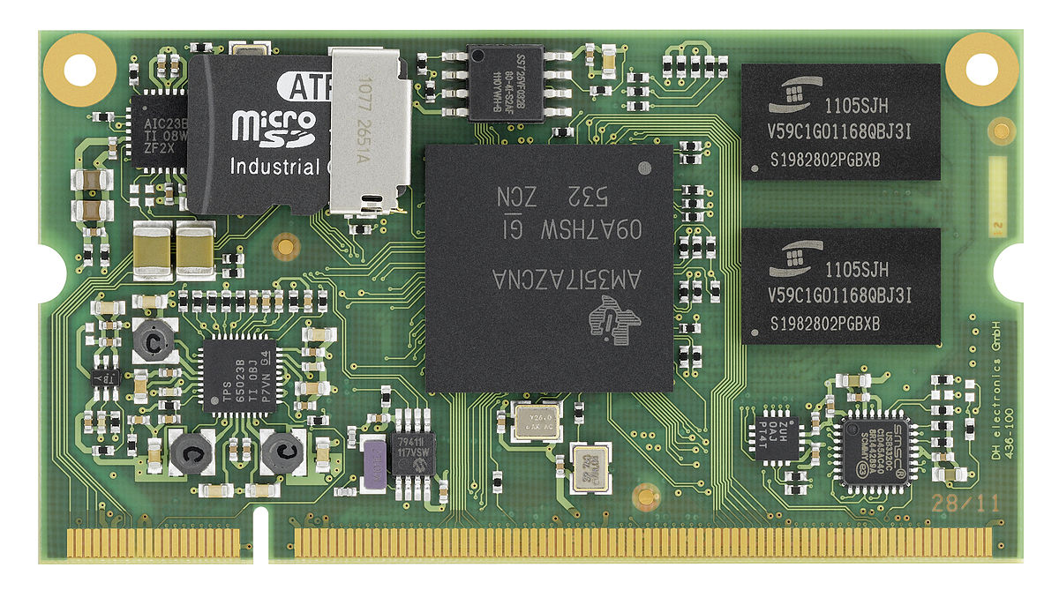
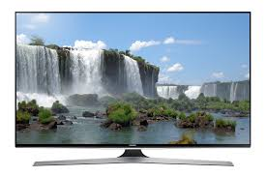
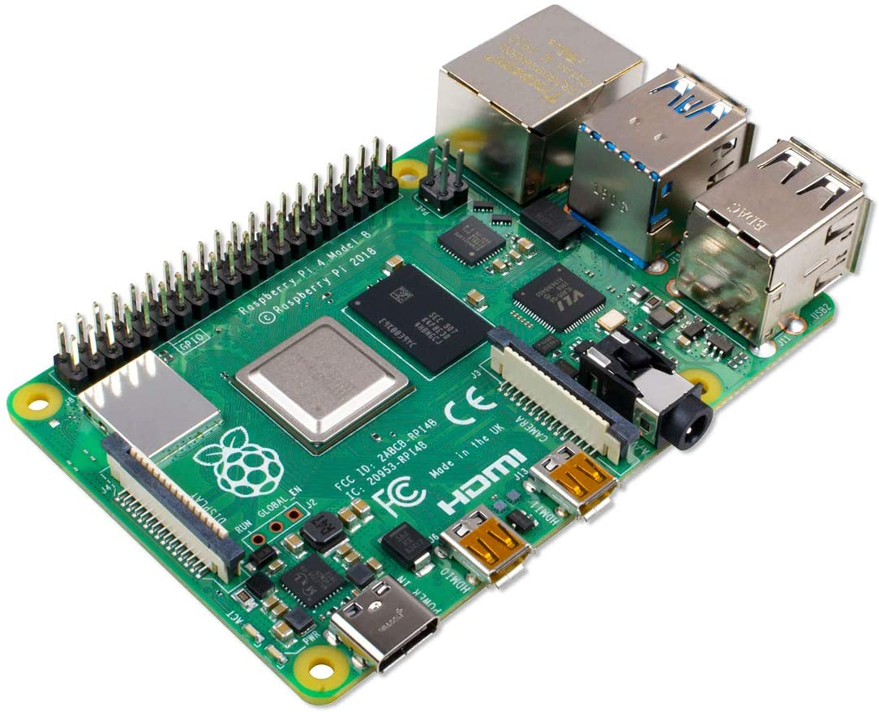
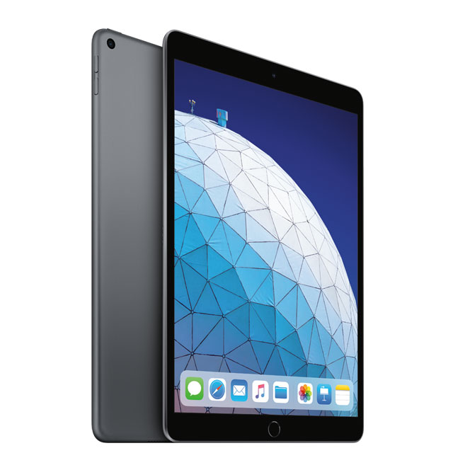
Big Question : What is Embedded System ?
Should be mobile ?
Should be small ?
Should have battery ?
Should be less powerful than desktop ?
Should be inexpensive ?
Actually, these are not deciding factors of embedded system
9

Slide 10
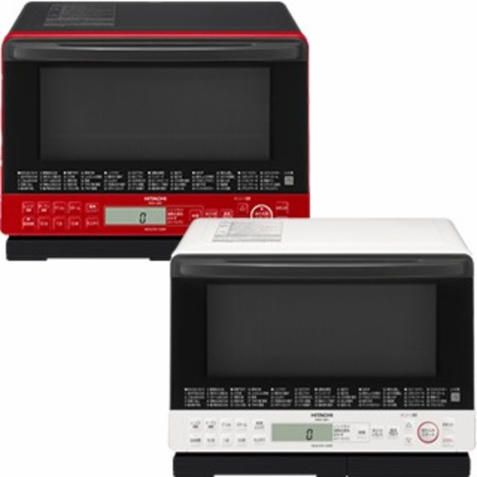

Big Question : What is embedded system ?
A Combination of computer hardware, software, and input/output peripheral devices
Hardware = Motherboard, Processor, RAM, Storage
Designed to perform a specific function.
Very few people realize that a processor and software are involved in the preparation of their lunch or dinner !!!
General-purpose computer is not designed to perform a specific function.
Induction Heater
Healsio
10

Slide 11
Big Question : What is embedded system ?
Usually Installed in a larger system
The existence of processor & software should be completely unnoticed by a device user
For example, cars and trucks contain many embedded systems
Anti-lock brake controller
Vehicle emission monitor and controller
Dashboard information display
Tesla has embedded system with AI chips for auto drive
11

Slide 12
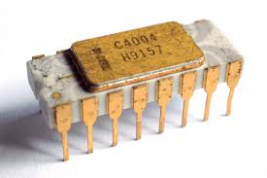
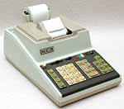
Interesting Facts
When did embedded systems first appear?
Not before 1974, because that’s when world’s first microprocessor
Intel 4004, for use in Busicom 141-PF calculator of a Japan Company
The microprocessor was an overnight success !
Increased use in the server future decade
12

Slide 13
Generic Embedded System
Embedded systems will continue to increase
Memory
Input
Processor
Output
13

Slide 14





We are going to focus on Embedded Linux System
First of all, what is Linux ?
Just like Windows, iOS, and Mac OS, Linux is an operating system
It’s a software that manages all of the hardware resources
Contains of
Bootloader
Kernel
Init system
Daemons
Graphical server
Desktop environment
Applications
Very Popular and has many different Linux distribution
14

Slide 15
What’s Embedded Linux ?
Umbrella term:
Ad-hoc recipes for building Linux-based embedded systems
Very wide range of systems:
Very tiny (mmuless)
Smartphones (i.e. Android)
Cellular base stations
etc.
An Embedded Linux system doesn't have any specific:
Kernel
User-space filesystem content
API
etc.
15

Slide 16
Why Linux ?
Linux has been adopted for embedded products
Linux supports a vast variety of hardware devices, probably more than any other OS.
Linux supports a huge variety of applications and networking protocols.
Linux is scalable, from small consumer-oriented devices to large, heavy-iron, carrier-class switches and routers.
Linux can be deployed without the royalties required by traditional proprietary embedded operating systems.
Linux has attracted a huge number of active developers, enabling rapid support of new hardware architectures, platforms, and devices.
An increasing number of hardware and software vendors support Linux.
16

Slide 17
Why Linux and What are We Going to Learn ?
It’s open source and under GNU GPL (General Public License)
GPL states that “When we speak of free software, we are referring to freedom, not price.”
Goals of this course
Linux and Real time
Architecture of Linux Kernel
Kernel & User Space Initialization
File System and Flash storage
MTD / Driver / USB
17

Slide 18
Q & A
Thank you for your attention.
Find your team member for final presentation !
Notes:
Thank you for listening. Now, I would like to end today’s talk by the Q & A time.

