Slide 1

Embedded System HW 01: Kernel Module
Department of Computer Science and Information Engineering
Shuo-Han Chen (陳碩漢), shchen@ntut.edu.tw
Hong-Yue Technology Research Building 334
W 15:10 - 18:00
Notes:
Good Afternoon everyone
I am Shuo-Han Chen, a postdoctoral research fellow at Academia Sinica
It is a great honor to be invited by the department for being here today

Slide 2
Purpose for this Homework
Part 1 : Learn how to write a kernel module
Install build-essential package
New a folder
Create hello_world.c & Makefile in that folder
Compile your code with make
Screenshot the result in your report
Screenshot 1 : Your hello_world.c & Makefile
Screenshot 2 : Check your module after insmod with lsmod
Screenshot 3 : demsg
Rename your code as hello_109000000.c for submitting homework
2
Notes:
Here is more detail about me. I started working as a postdoctoral research fellow at the Institute of Information Science, Academia Sinica since March 2018
During my fellowship, I have been to the Purdue University USA and the Chinese University of Hong Kong for visiting
Before my fellowship, I spent two and half years for my phd degree at the CS Department of National Tsing Hua University
My research interests mainly lies in
the next generation memory/storage architecture designs
Emerging non-volatile memory and storage technologies
Low power system designs for artificial neural networks
In the past few years, I have revived few awards and a best paper nomination at DAC conference, which is a top rated conference in the EDA field

Slide 3
Purpose for this Homework (Cont’d)
Part 2 : Learn how to read files in a kernel module
New a folder
Create fileIO.c & Makefile in that folder
Change Makefile for new module name
The file is input.txt and you have to save the content to output.txt in a reversed order
Screenshot your output.txt in your report
Rename your code as fileIO_109000000.c for submitting homework
3
Notes:
Here is more detail about me. I started working as a postdoctoral research fellow at the Institute of Information Science, Academia Sinica since March 2018
During my fellowship, I have been to the Purdue University USA and the Chinese University of Hong Kong for visiting
Before my fellowship, I spent two and half years for my phd degree at the CS Department of National Tsing Hua University
My research interests mainly lies in
the next generation memory/storage architecture designs
Emerging non-volatile memory and storage technologies
Low power system designs for artificial neural networks
In the past few years, I have revived few awards and a best paper nomination at DAC conference, which is a top rated conference in the EDA field

Slide 4
Purpose for this Homework (Cont’d)
The submission
Complete above steps and form a PDF report
Submit your (1) report, (2) hello_109000000.c, (3) fileIO_109000000.c, (4) output.txt as four separate files to 北科 i 學園 PLUS
DO NOT ZIP YOUR FILES
Deadline is schedule on 24:00 of Wednesday 10/27 (10/27 晚上12點)
4
Notes:
Here is more detail about me. I started working as a postdoctoral research fellow at the Institute of Information Science, Academia Sinica since March 2018
During my fellowship, I have been to the Purdue University USA and the Chinese University of Hong Kong for visiting
Before my fellowship, I spent two and half years for my phd degree at the CS Department of National Tsing Hua University
My research interests mainly lies in
the next generation memory/storage architecture designs
Emerging non-volatile memory and storage technologies
Low power system designs for artificial neural networks
In the past few years, I have revived few awards and a best paper nomination at DAC conference, which is a top rated conference in the EDA field

Slide 5
Writing the Hello World Kernel Module
(In terminal / through UI)
sudo apt-get install build-essential
sudo apt-get install vim
mkdir hello_world
Go to the folder and create two files
Hello_world.c
Makefile
Writing the Hello World kernel Module
Writing the makefile
vim Makefile, then press tab
Check if the format of your make file is correct
Incorrect will be marked with be marked in red
5
Notes:
Here is more detail about me. I started working as a postdoctoral research fellow at the Institute of Information Science, Academia Sinica since March 2018
During my fellowship, I have been to the Purdue University USA and the Chinese University of Hong Kong for visiting
Before my fellowship, I spent two and half years for my phd degree at the CS Department of National Tsing Hua University
My research interests mainly lies in
the next generation memory/storage architecture designs
Emerging non-volatile memory and storage technologies
Low power system designs for artificial neural networks
In the past few years, I have revived few awards and a best paper nomination at DAC conference, which is a top rated conference in the EDA field

Slide 6
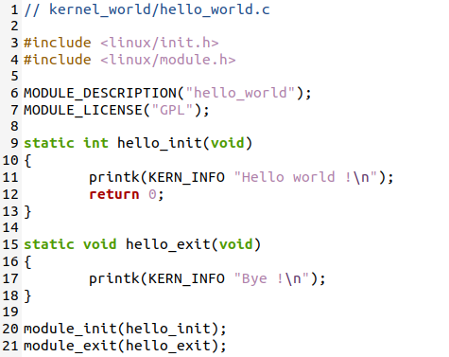
Your Hello World will look like this
6
Notes:
Here is more detail about me. I started working as a postdoctoral research fellow at the Institute of Information Science, Academia Sinica since March 2018
During my fellowship, I have been to the Purdue University USA and the Chinese University of Hong Kong for visiting
Before my fellowship, I spent two and half years for my phd degree at the CS Department of National Tsing Hua University
My research interests mainly lies in
the next generation memory/storage architecture designs
Emerging non-volatile memory and storage technologies
Low power system designs for artificial neural networks
In the past few years, I have revived few awards and a best paper nomination at DAC conference, which is a top rated conference in the EDA field

Slide 7
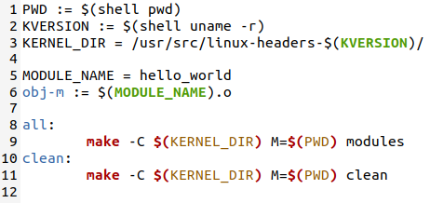
Your Makefile will look like this
7
Notes:
Here is more detail about me. I started working as a postdoctoral research fellow at the Institute of Information Science, Academia Sinica since March 2018
During my fellowship, I have been to the Purdue University USA and the Chinese University of Hong Kong for visiting
Before my fellowship, I spent two and half years for my phd degree at the CS Department of National Tsing Hua University
My research interests mainly lies in
the next generation memory/storage architecture designs
Emerging non-volatile memory and storage technologies
Low power system designs for artificial neural networks
In the past few years, I have revived few awards and a best paper nomination at DAC conference, which is a top rated conference in the EDA field

Slide 8

After make, try the build module
Mount the module -> sudo insmod hello_world.ko
Check if it’s mounted -> sudo lsmod | grep "hello_world“
Unmount the module -> sudo rmmod hello_world
Go to dmesg to find the print message -> dmesg
8
Notes:
Here is more detail about me. I started working as a postdoctoral research fellow at the Institute of Information Science, Academia Sinica since March 2018
During my fellowship, I have been to the Purdue University USA and the Chinese University of Hong Kong for visiting
Before my fellowship, I spent two and half years for my phd degree at the CS Department of National Tsing Hua University
My research interests mainly lies in
the next generation memory/storage architecture designs
Emerging non-volatile memory and storage technologies
Low power system designs for artificial neural networks
In the past few years, I have revived few awards and a best paper nomination at DAC conference, which is a top rated conference in the EDA field

Slide 9
Please write Part 2 on your own
You can do google, but please write your code by yourself
9
Notes:
Here is more detail about me. I started working as a postdoctoral research fellow at the Institute of Information Science, Academia Sinica since March 2018
During my fellowship, I have been to the Purdue University USA and the Chinese University of Hong Kong for visiting
Before my fellowship, I spent two and half years for my phd degree at the CS Department of National Tsing Hua University
My research interests mainly lies in
the next generation memory/storage architecture designs
Emerging non-volatile memory and storage technologies
Low power system designs for artificial neural networks
In the past few years, I have revived few awards and a best paper nomination at DAC conference, which is a top rated conference in the EDA field

Slide 10

Q & A
Remember to submit your report.
Deadline is set to 10/27 24:00 !
Late submission will be not accepted !
Notes:
Thank you for listening. Now, I would like to end today’s talk by the Q & A time.

