Slide 1

Embedded System HW 02: Generic Driver
Department of Computer Science and Information Engineering
Shuo-Han Chen (陳碩漢), shchen@ntut.edu.tw
Hong-Yue Technology Research Building 334
W 15:10 - 18:00
Notes:
Good Afternoon everyone
I am Shuo-Han Chen, a postdoctoral research fellow at Academia Sinica
It is a great honor to be invited by the department for being here today

Slide 2
Purpose for this Homework
In previous homework, you have learned
How to write kernel module
How to read files from kernel module
In this homework, we are going to practice
Extend kernel module into a character driver
Need to support open/close/read/write
Implement above functions to access a backend file
Write a C based program to access the driver
Note that C program are in user space, Just like any other regular program you wrote
In Linux, you can write a makefile to compile you c program
2
Notes:
Here is more detail about me. I started working as a postdoctoral research fellow at the Institute of Information Science, Academia Sinica since March 2018
During my fellowship, I have been to the Purdue University USA and the Chinese University of Hong Kong for visiting
Before my fellowship, I spent two and half years for my phd degree at the CS Department of National Tsing Hua University
My research interests mainly lies in
the next generation memory/storage architecture designs
Emerging non-volatile memory and storage technologies
Low power system designs for artificial neural networks
In the past few years, I have revived few awards and a best paper nomination at DAC conference, which is a top rated conference in the EDA field

Slide 3
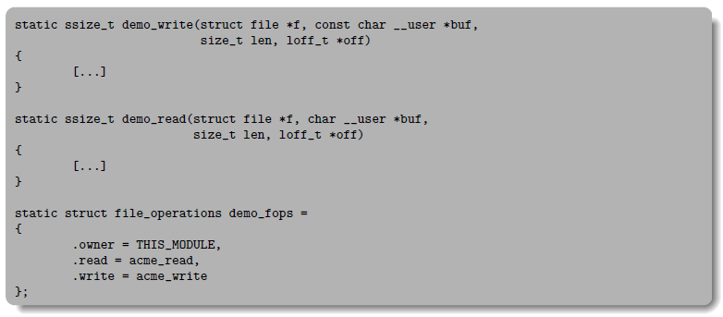
Extend kernel module into a character driver
Refer to the slide of Week 5, you should have
Two addition functions are required here for open & close
Add .open = … & .close = … here
3
Notes:
Here is more detail about me. I started working as a postdoctoral research fellow at the Institute of Information Science, Academia Sinica since March 2018
During my fellowship, I have been to the Purdue University USA and the Chinese University of Hong Kong for visiting
Before my fellowship, I spent two and half years for my phd degree at the CS Department of National Tsing Hua University
My research interests mainly lies in
the next generation memory/storage architecture designs
Emerging non-volatile memory and storage technologies
Low power system designs for artificial neural networks
In the past few years, I have revived few awards and a best paper nomination at DAC conference, which is a top rated conference in the EDA field

Slide 4
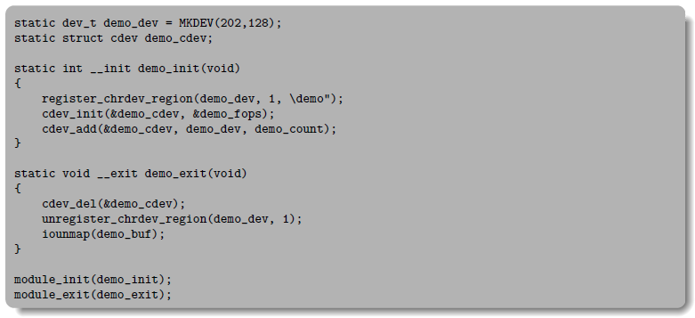
Extend kernel module into a character driver
Then, extend the init & exit functions of kernel module as follows
Here is the name of your driver
After insmod the compile kernel module, you should see demo under /dev
4
Notes:
Here is more detail about me. I started working as a postdoctoral research fellow at the Institute of Information Science, Academia Sinica since March 2018
During my fellowship, I have been to the Purdue University USA and the Chinese University of Hong Kong for visiting
Before my fellowship, I spent two and half years for my phd degree at the CS Department of National Tsing Hua University
My research interests mainly lies in
the next generation memory/storage architecture designs
Emerging non-volatile memory and storage technologies
Low power system designs for artificial neural networks
In the past few years, I have revived few awards and a best paper nomination at DAC conference, which is a top rated conference in the EDA field

Slide 5
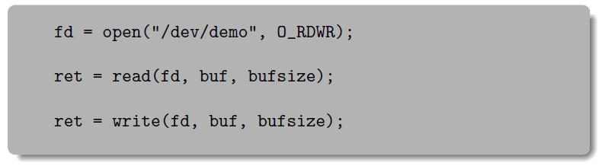
Write a C based program to access the driver
In your C based program, it would look like this
Then, you need to
Write a string to the driver through write
Read back the written string from the driver
Out the read result to bash terminal
5
Notes:
Here is more detail about me. I started working as a postdoctoral research fellow at the Institute of Information Science, Academia Sinica since March 2018
During my fellowship, I have been to the Purdue University USA and the Chinese University of Hong Kong for visiting
Before my fellowship, I spent two and half years for my phd degree at the CS Department of National Tsing Hua University
My research interests mainly lies in
the next generation memory/storage architecture designs
Emerging non-volatile memory and storage technologies
Low power system designs for artificial neural networks
In the past few years, I have revived few awards and a best paper nomination at DAC conference, which is a top rated conference in the EDA field

Slide 6
Files to submit
The submission
Complete above steps and form a PDF report
Submit your (1) report, (2) kernel_Module_109000000.c, (3) C_file_109000000.c as four separate files to 北科 i 學園 PLUS
In the report, you should detailly explain each line of codes
DO NOT ZIP YOUR FILES
Deadline is schedule on 24:00 of Sunday 12/19 24:00
6
Notes:
Here is more detail about me. I started working as a postdoctoral research fellow at the Institute of Information Science, Academia Sinica since March 2018
During my fellowship, I have been to the Purdue University USA and the Chinese University of Hong Kong for visiting
Before my fellowship, I spent two and half years for my phd degree at the CS Department of National Tsing Hua University
My research interests mainly lies in
the next generation memory/storage architecture designs
Emerging non-volatile memory and storage technologies
Low power system designs for artificial neural networks
In the past few years, I have revived few awards and a best paper nomination at DAC conference, which is a top rated conference in the EDA field

Slide 7

Q & A
Remember to submit your report.
Deadline is set to 12/19 24:00 !
Late submission will be not accepted !
Notes:
Thank you for listening. Now, I would like to end today’s talk by the Q & A time.

