Slide 1

File and Storage System Lecture 00: Course Information
Department of Computer Science and Information Engineering
Shuo-Han Chen (陳碩漢), shchen@ntut.edu.tw
Hong-Yue Technology Research Building 334
M 16:10 - 18:00 & W 11:10-12:00

Slide 2
Course Information
File and Storage System
Full English
Designed for students in graduate school
Course Time and Place - Lecture (2.5 Hours)
M 16:10 - 18:30 & W 11:10-12:00
Hong-Yue Technology Research Building 334e
Course Website
Please check the i-study system
2

Slide 3





Course Instructor & Teaching Assistant
Course Instructor
Prof. Shuo-Han Chen (陳碩漢)
Office: 宏裕科技大樓 1532
Office Hours: Monday 11:00 - 15:00
Email: shchen@csie.ntut.edu.tw
Teaching Assistant
陳廷豪
Office: 宏裕科技大樓 438
Office Hours: Wednesday 13:00 – 15:00
Email: t110598040@ntut.edu.tw
3

Slide 4
Prerequisites
Addend & Interact
Comfortable with C/C++
Already taken the Operating System Course
Not afraid of English
And, of course, willing to learn more about File and Storage System
C/C++
4

Slide 5
Course Assessment
Assignment: 50 %
5 homework in total
Upload your HW to course gitlab
https://css-gitlab.csie.ntut.edu.tw/
Register with your student ID and school email for submitting HW !
Midterm Exam: 25 %
Survey Paper Presentation: 25 %
Two people a group & Will be requested to read a 6 to 12 page paper
Form a 20 minutes English presentation (may be adjusted)
You are required to meet with me in advance to practice
Your points is determined by how much effort you put into this presentation
Not how fluently you can speak in English
5

Slide 6
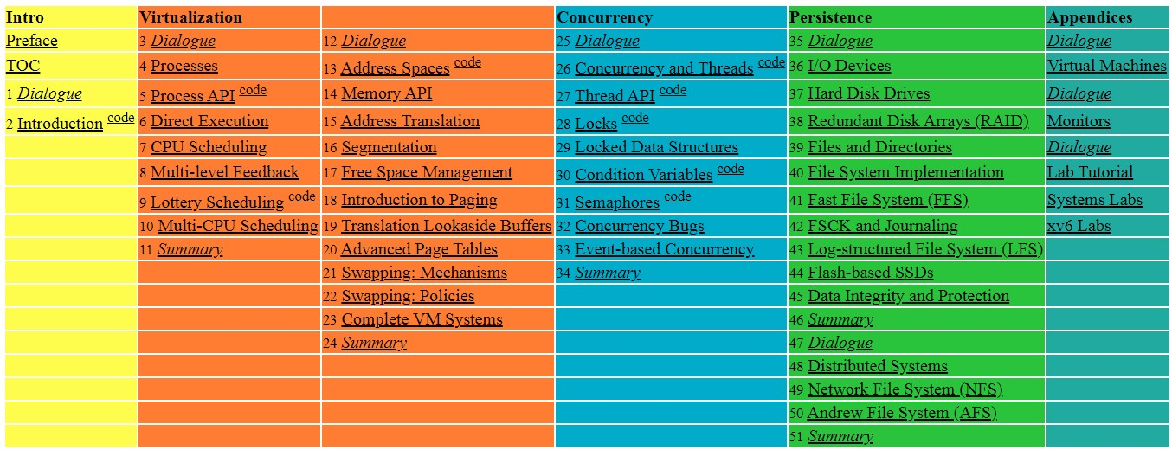
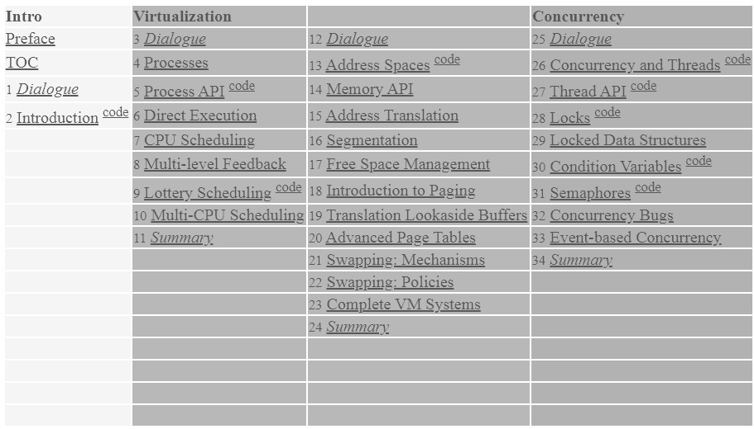
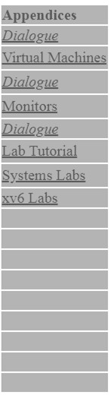
Course Materials
Suggested Readings
Remzi H. Arpaci-Dusseau and Andrea C. Arpaci-Dusseau,
“Operating Systems: Three Easy Pieces”
Free online form: http://pages.cs.wisc.edu/~remzi/OSTEP/
Papers from top system conferences or highly referenced:
E.g., FAST, OSDI/SOSP, USENIX ATC, EuroSys, NSDI, etc.
6

Slide 7
What We are Going to Learn (1/2)
Understand the design and implementation of file and storage systems, from a system perspective:
Data
Analytics
Databases
Graph
Streaming
File and Storage Systems
HDD | SSD Disk Array Memory
7

Slide 8
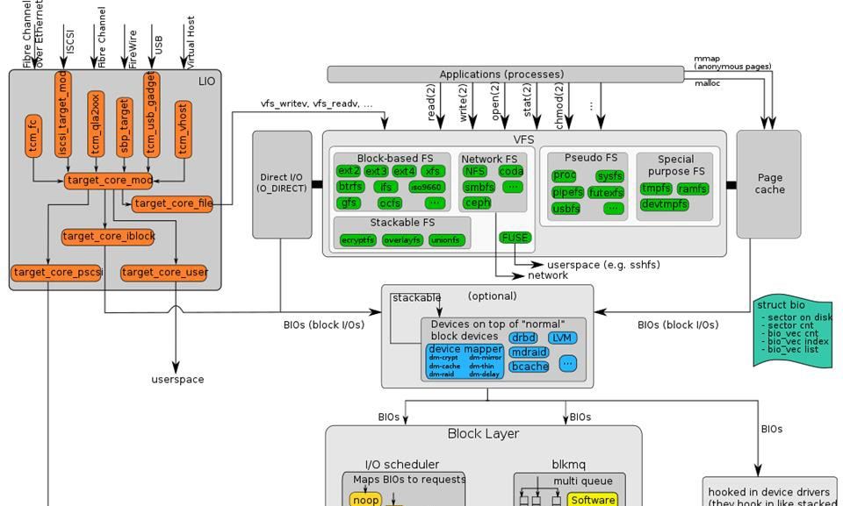
What We are Going to Learn (2/2)
Understand the I/O stack of Linux kernel:
https://upload.wikimedia.org/wikipedia/commons/3/30/IO_stack_of_the_Linux_kernel.svg
8

Slide 9
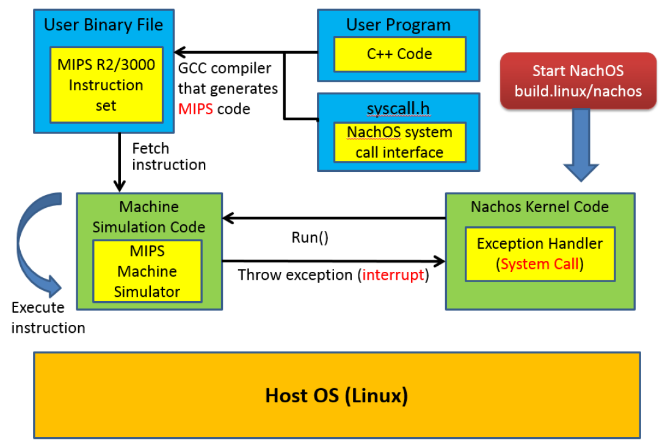
Project 1 : Playing with NachOS
A kernel (OS) and MIPS code machine simulator
Two homework for this project
To implement system calls for file system operation
Write an simplified file system for NachOS
9

Slide 10
Project 2 : NAND flash Management
Provided by PHISON
10

Slide 11
Project 2 : Make Your Own File System
File System in Kernel-space
Very difficult to build
Need careful use of synchronization primitives
Only C language supported
Standard C libraries not available
Need root privilege
File System in User-space (using FUSE!)
Framework to implement user-space file system
User-space file systems trade performance for flexibility
Easy to write: Avoid awful coding in kernel
Easy to test: Run like a normal user program
Easy to integrate libraries: Can easily deploy libraries
11

Slide 12
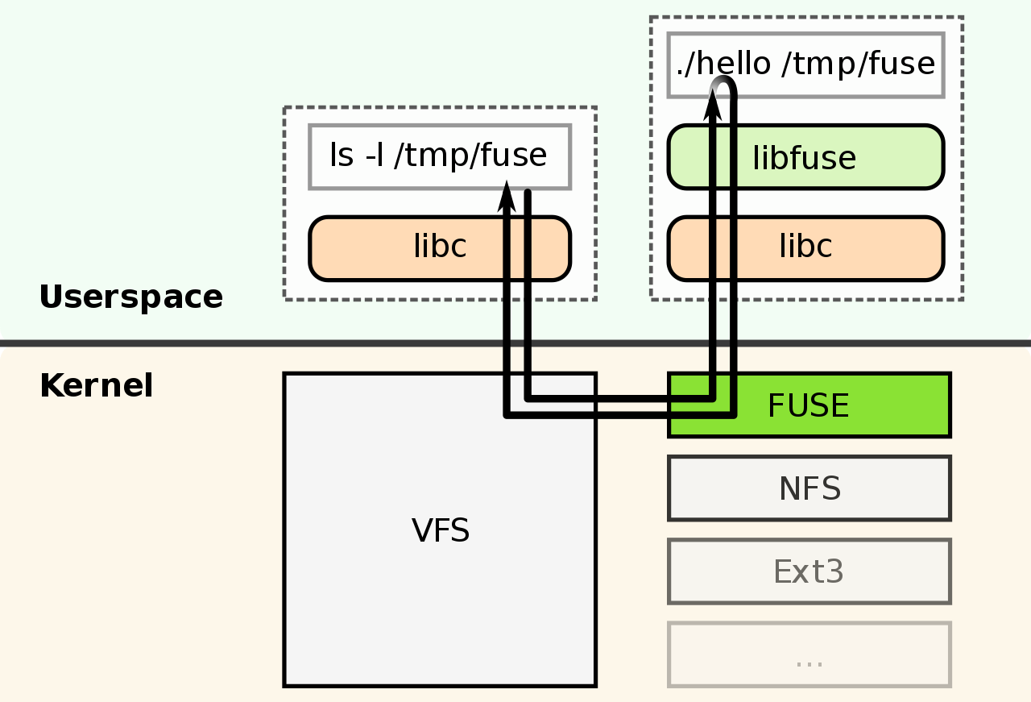
Project 2 : FUSE, Filesystem in USErspace
FUSE lets non-privileged users create their own file systems in user-space without editing kernel code.
https://en.wikipedia.org/wiki/Filesystem_in_Userspace
12

Slide 13
Project 2 : My File System using FUSE
Two homework for this project
First Phase: All-In-Memory File System
Implement an all-in-memory file system based on FUSE.
Both metadata (e.g., indexing structures of the file system) and file data are maintained in the memory.
Second Phase: In-Storage File System
Based on the first phase, convert the all-in-memory file system into an in-storage file system.
Both metadata and file data are persisted into a storage device (e.g., a USB flash drive).
The file data can still be accessed after re-mounting the user-space file system.
13

Slide 14
Course Schedule
W | Date | Lecture | Notes | Homework
1 | Feb. 21 | Lecture 00: Course Information |  | HW00
2 | Feb. 28 | Peace Memorial Day | No Class
3 | Mar. 7 | Lecture 01: System Calls & I/O Devices
4 | Mar. 14 | Lecture 02: RAID and Data Integrity
5 | Mar. 21 | Lecture 03: File System Basics
6 | Mar. 28 | Lecture 04: File System Designs | Flipped
7 | Apr. 4 | Tomb Sweeping Day | No Class
8 | Apr. 11 | Lecture 05: Distributed File Systems | Flipped
9 | Apr. 18 | Midterm
10 | Apr. 25 | Lecture 06: Flash Memory | PHISON
11 | May 2 | Lecture 06: Flash Memory | PHISON
12 | May 9 | Lecture 06: Flash Memory | PHISON
13 | May 16 | Lecture 06: Flash Memory | PHISON
14 | May 23 | Lecture 07: Next-generation Hard Disk Drive | Flipped
15 | May 30 | Lecture 08: Persistent Memory | Flipped
16 | Jun. 6 | Final Presentation
17 | Jun. 13 | Final Presentation
18 | Jun. 20 | Final Presentation
14

Slide 15
Important Notes
Visit our course website regularly
Plagiarism will NOT be tolerated
Don’t copy!
Don’t let other(s) copy!
Can discuss but write up the solutions by yourself!
The best way to learn is through practice!
Visit i-study for HW00 tomorrow 21:00 !
Trace system-call-related source code in NachOS
15

Slide 16

Q & A
Thank you for your attention.
Notes:
Thank you for listening. Now, I would like to end today’s talk by the Q & A time.

