Slide 1

File and Storage System Lecture 01: System Calls & I/O Devices
Department of Computer Science and Information Engineering
Shuo-Han Chen (陳碩漢), shchen@ntut.edu.tw
Hong-Yue Technology Research Building 334
M 16:10 - 18:00 & W 11:10-12:00

Slide 2
Course Schedule
W | Date | Lecture | Notes | Homework
1 | Feb. 21 | Lecture 00: Course Information |  | HW00
2 | Feb. 28 | Peace Memorial Day | No Class
3 | Mar. 7 | Lecture 01: System Calls & I/O Devices
4 | Mar. 14 | Lecture 02: RAID and Data Integrity
5 | Mar. 21 | Lecture 03: File System Basics
6 | Mar. 28 | Lecture 04: File System Designs | Flipped
7 | Apr. 4 | Tomb Sweeping Day | No Class
8 | Apr. 11 | Lecture 05: Distributed File Systems | Flipped
9 | Apr. 18 | Midterm
10 | Apr. 25 | Lecture 06: Flash Memory | PHISON
11 | May 2 | Lecture 07: Next-generation Hard Disk Drive | Flipped
12 | May 9 | Lecture 06: Flash Memory | PHISON
13 | May 16 | Lecture 06: Flash Memory | PHISON
14 | May 23 | Lecture 06: Flash Memory | PHISON
15 | May 30 | Lecture 08: Persistent Memory | Flipped
16 | Jun. 6 | Final Presentation
17 | Jun. 13 | Final Presentation
18 | Jun. 20 | Final Presentation
2

Slide 3


Outline
I/O Stack
System Calls
Basics of I/O Devices
System Architecture
Canonical Device and Canonical Protocol
Polling vs. Interrupt
Device Interaction Methods
Programmed I/O vs. Direct Memory Access
Device Driver
Char Device vs. Block Device
Case Study of Block I/O Device: HDD
Disk Organization
Disk I/O Performance
Disk Scheduling
Application
User
Kernel
File System
Block Layer
Device Driver
I/O Device
3

Slide 4
x86 Protection Rings
Privileged instructions can be executed only when current privileged level (CPL) is 0
Operating system
kernel
Level 0
Operating system services
Level 1
Level 2
Level 3
Applications
4

Slide 5
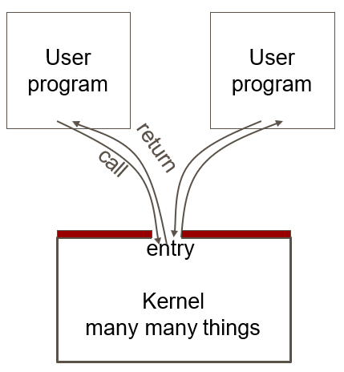
Monolithic Kernel
An operating system architecture where the entire operating system is working in kernel space
All kernel routines are together.
A system call interface.
Examples:
Linux.
Most Unix OS.
NT.
5

Slide 6
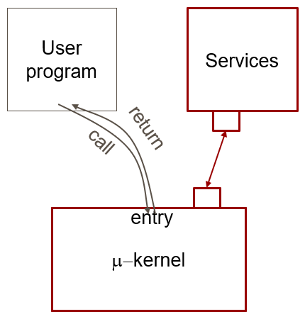
Micro Kernel
Micro-kernel is “micro”
Services are implemented as regular process.
Micro-kernel get services on behalf of users by messaging with the service processes.
Examples: Taos, Mach, L4.
6

Slide 7
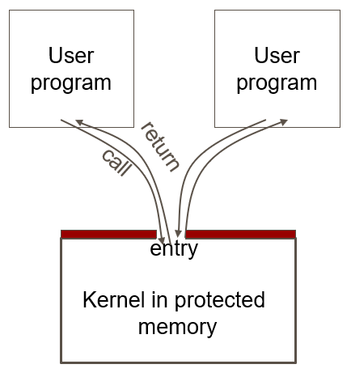
System Call Mechanism
User code can be arbitrary.
User code cannot modify kernel memory.
Makes a system call with parameters.
The call mechanism switches code to kernel mode.
Execute system call.
Return with results.
7

Slide 8
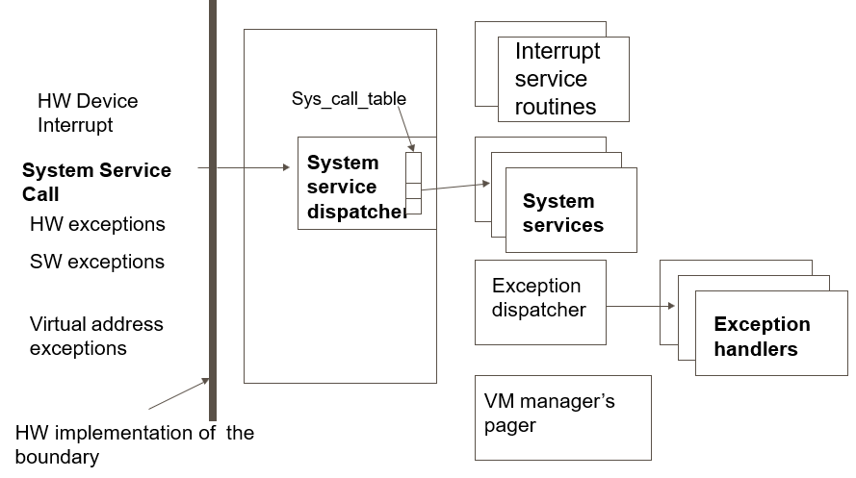
OS Kernel : Trap Handler
8

Slide 9
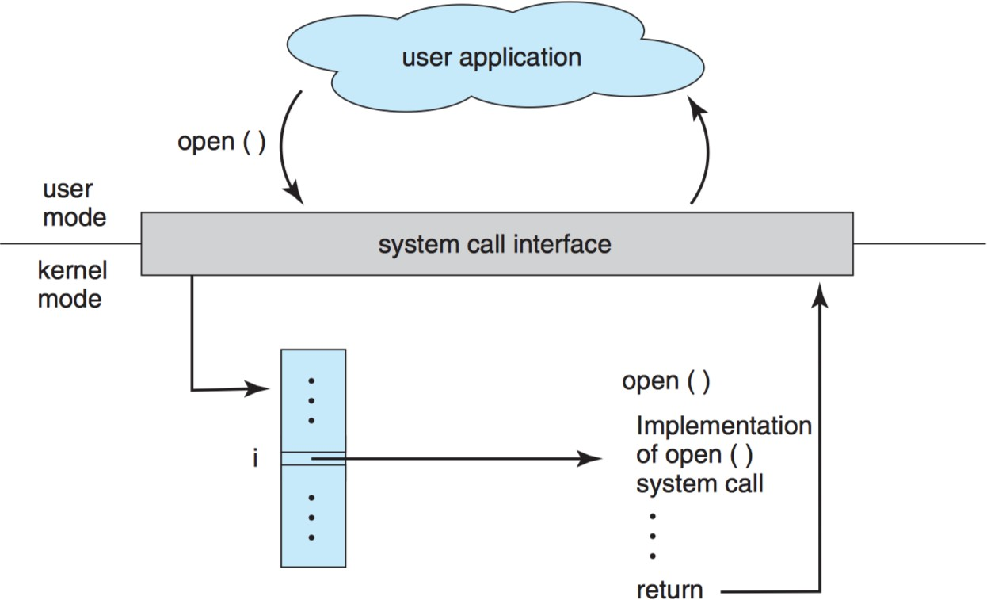
Library function vs. System Call
= Library
System Call Handler
function pointer(s)
9

Slide 10

strace and ltrace
Debugging tool
10

Slide 11
Outline
I/O Stack
System Calls
Basics of I/O Devices
System Architecture
Canonical Device and Canonical Protocol
Polling vs. Interrupt
Device Interaction Methods
Programmed I/O vs. Direct Memory Access
Device Driver
Char Device vs. Block Device
Case Study of Block I/O Device: HDD
Disk Organization
Disk I/O Performance
Disk Scheduling
Application
User
Kernel
File System
Block Layer
Device Driver
I/O Device
11

Slide 12
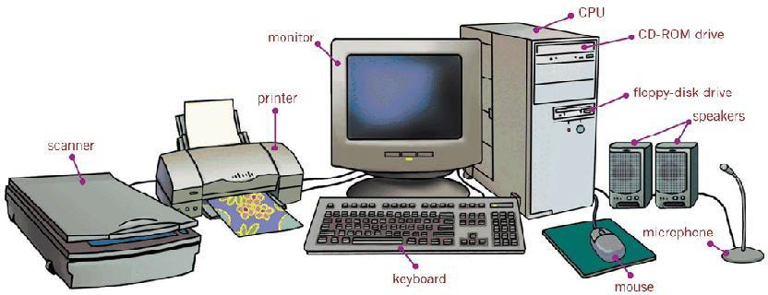
Input and Output (I/O)
Computers should have the ability to exchange information with a wide range of I/O devices.
– E.g., keyboard, mouse, printer, disk drives, etc.
12

Slide 13

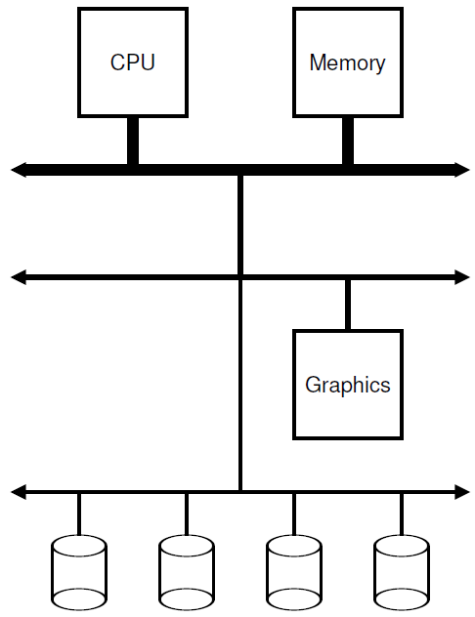
Prototypical System Architecture
High Speed
Physics vs. Cost: Hierarchical Bus Structure
– The faster a bus is, the shorter it should be!
Low
Cost
Memory Bus interconnects the fastest CPU and main memory of the system.
General I/O Bus (e.g., PCI) connects the graphics card and higher-performance I/O devices to the system.
Peripheral I/O Bus (e.g., SCSI, SATA, or USB) connects the slow I/O devices, including disks, mice, and keyboards, to the system.
13

Slide 14
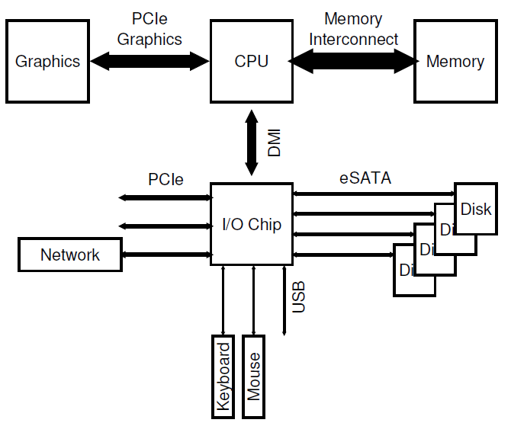
Modern System Architecture
Modern systems use specialized chipsets and faster point-to-point interconnects to improve performance.
DMI (Direct Media Interface) connects
the CPU to a specialized I/O chip.
I/O Chip
Maximal Interface Transfer Speed
1 GB/s
600 MB/s
PCIe 3.0 (x1)
SATA III USB 3.0
USB 2.0
500 MB/s
60 MB/s
14

Slide 15
Outline
I/O Stack
System Calls
Basics of I/O Devices
System Architecture
Canonical Device and Canonical Protocol
Polling vs. Interrupt
Device Interaction Methods
Programmed I/O vs. Direct Memory Access
Device Driver
Char Device vs. Block Device
Case Study of Block I/O Device: HDD
Disk Organization
Disk I/O Performance
Disk Scheduling
Application
User
Kernel
File System
Block Layer
Device Driver
I/O Device
15

Slide 16
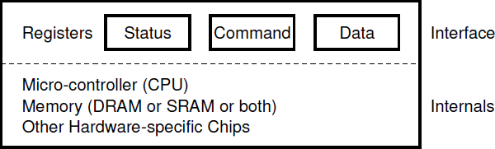
Canonical Device
A canonical (not real) device can be abstracted into two components:
Interface: allows system software to control its operation by reading and writing the interface registers.
Status: holds current device status.
Command: tells device to perform certain tasks.
Data: pass data via device.
Internal Structure: contains firmware (software within a hardware device) to implement specific functionalities.
16

Slide 17
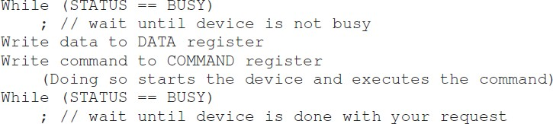
Canonical Protocol
The canonical protocol is of the following four steps:
① The OS waits until the device is ready by polling the device (i.e.,
repeatedly reading the status register);
② The OS sends data down to the data register;
③ The OS writes a command to the command register;
④ The OS waits for the device to finish by again polling it
17

Slide 18
Class Discussion
Question: What are the potential inefficiencies in the canonical protocol?
Answer: The polling mechanism wastes a great deal of CPU time on waiting for the (usually slow) I/O device.
18

Slide 19


Polling vs. Interrupt (1/2)
Considering a system with two processes (indicated by 1 and 2) and Process 1 issues an I/O request.
Polling
The OS simply waits on repeatedly checking the status register until the I/O is complete.
Interrupt
The OS can issue a request, put the calling process to sleep, and context switch to another task.
The I/O device raises a hardware interrupt when I/O is complete.
– The CPU jumps to a predetermined interrupt handler.
CPU
I/O Device
CPU needs to wait while Process 1 is polling the I/O device until it’s completed.
CPU
Process 2 runs on the CPU
while the I/O device is
servicing Process 1.
I/O Device
19

Slide 20
Polling vs. Interrupt (2/2)
Interrupt is not always the best.
Reason: Context switch is expensive (e.g., 1~10us).
Imagine a device that performs its tasks very quickly: the first poll usually finds the device to be done with task.
Using an interrupt in this case will actually slow down the system:
① switching to another process, ② handling the interrupt, and
③ switching back to the issuing process is expensive.
Simple Rule: If the device is fast, it may be best to poll; if the device is slow, interrupts are the best.
What if the speed of the device is unknown or sometimes fast and sometimes slow?
A hybrid approach may achieve the best of both worlds!
It may be best to use a hybrid that polls for a little while and then, if the device is not yet finished, uses interrupts.
20

Slide 21
Outline
I/O Stack
System Calls
Basics of I/O Devices
System Architecture
Canonical Device and Canonical Protocol
Polling vs. Interrupt
Device Interaction Methods
Programmed I/O vs. Direct Memory Access
Device Driver
Char Device vs. Block Device
Case Study of Block I/O Device: HDD
Disk Organization
Disk I/O Performance
Disk Scheduling
Application
User
Kernel
File System
Block Layer
Device Driver
I/O Device
21

Slide 22
Device Interaction Methods (1/3)
The canonical protocol is of the following four steps:
① The OS waits until the device is ready by polling the device (i.e.,
repeatedly reading the status register);
② The OS sends data down to the data register;
③ The OS writes a command to the command register;
④ The OS waits for the device to finish by again polling it.
22

Slide 23
Device Interaction Methods (2/3)
Method 1) Programmed I/O (PIO): The CPU is involved with the data transfer.
Port-mapped I/O: Data are explicitly transferred, through specific port (which names the device), to device register.
Specialized I/O instructions (such as in and out on x86) are used.
Memory-mapped I/O: The data transfer is through the shared memory (i.e., device registers as memory locations).
General memory instructions (such as load and store) are used.
Port-mapped I/O
Memory-mapped I/O
CPU
CPU
load / store
load / store
0xFF
in / out
I/O port(s)
load / store
Memory Address
0x00 0xFF
0x00
I/O Addr.
Memory Addr.
I/O Device
Memory
Interface
Interface
I/O Device
23

Slide 24


Class Discussion
Question: What is the potential inefficiency of Programmed I/O even though the interrupt is used?
CPU
I/O Device
Answer: The CPU could be still overburdened when transferring a large chunk of data to a device.
CPU
I/O Device
24

Slide 25
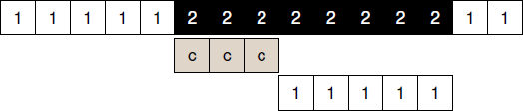
Device Interaction Methods (3/3)
Method 2) Direct Memory Access (DMA): The data transfer is conducted without much CPU intervention.
The OS offloads the data transfer (from the device to the memory) to the DMA hardware for freeing the CPU.
When complete, the DMA raises an interrupt to notify OS.
CPU
DMA
I/O Device
Both methods are still in use today.
Method 1) Programmed I/O (with CPU involved)
Port-mapped I/O (e.g., ARM) & Memory-mapped I/O (e.g., Intel)
Method 2) Direct Memory Access (without CPU involved)
25

Slide 26
Outline
I/O Stack
System Calls
Basics of I/O Devices
System Architecture
Canonical Device and Canonical Protocol
Polling vs. Interrupt
Device Interaction Methods
Programmed I/O vs. Direct Memory Access
Device Driver
Char Device vs. Block Device
Case Study of Block I/O Device: HDD
Disk Organization
Disk I/O Performance
Disk Scheduling
Application
User
Kernel
File System
Block Layer
Device Driver
I/O Device
26

Slide 27
Device Driver (1/2)
In reality, each device may have its specific interface and internal structures.
Device Driver: encapsulates device-specific details.
Applications issue I/O requests to devices via POSIX API.
The specific device driver handles the I/O request.
Manufacturers implement the device driver for each device.
Over 70% of OS code (millions of lines) is device drivers.
Application
User
Space
POSIX API [open, read, write, close, etc.]
? ?
Kernel
Space
Char. Device Driver
Block Device Driver [SCSI, ATA, USB, etc.]
Char I/O Device
[keyboard, mouse, etc.]
Block I/O Device
[hard disk drive, solid-state drive, etc.]
I/O Device
27

Slide 28
Device Driver (2/2)
Character I/O Device: transfers I/O in bytes serially.
Block-oriented I/O Device: transfers I/O in blocks.
Some block devices (e.g., HDD or SSD), which can persist the stored data, are also referred to as data storage.
A block device can be directly read/written via the raw interface.
A file system can further provide file abstraction to manage the data.
A block interface (and bio structure) unifies the block accesses.
Application
User
Space
POSIX API [open, read, write, close, etc.]
Raw
File System
Kernel
Space
Generic Block Interface [block read/write]
Char. Device Driver
Char I/O Device
[keyboard, mouse, etc.]
Block Device Driver [SCSI, ATA, USB, etc.]
Block I/O Device
[hard disk drive, solid-state drive, etc.]
I/O Device
28
28

Slide 29
Outline
I/O Stack
System Calls
Basics of I/O Devices
System Architecture
Canonical Device and Canonical Protocol
Polling vs. Interrupt
Device Interaction Methods
Programmed I/O vs. Direct Memory Access
Device Driver
Char Device vs. Block Device
Case Study of Block I/O Device: HDD
Disk Organization
Disk I/O Performance
Disk Scheduling
Application
User
Kernel
File System
Block Layer
Device Driver
I/O Device
29

Slide 30

Why Hard Disk Drive (HDD)?
Let’s focus on one specific I/O device: hard disk drive (HDD).
HDDs have been the main form of persistent data storage in computer systems for decades.
In 1953, IBM recognized the urgent need.
The first commercial usage of HDD began in 1957.
Time
Many file and storage systems are designed and optimized based on HDD characteristics.
1953 1957
2019
30

Slide 31
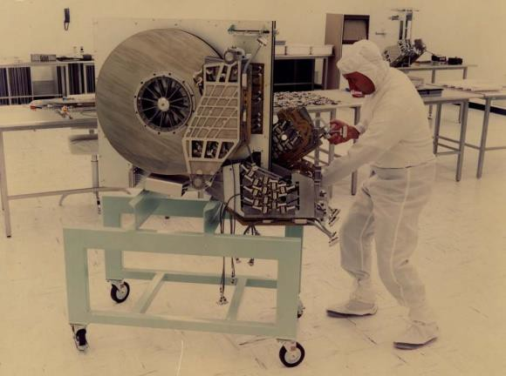
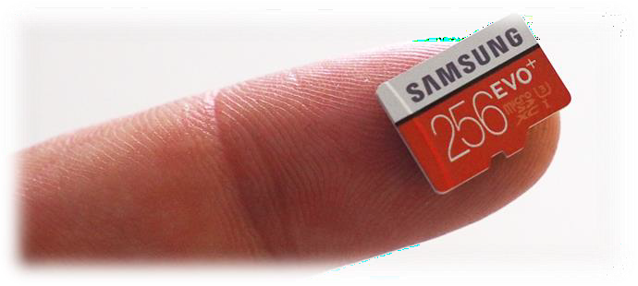
Amazing Photos about HDD
Below is a 250 MB hard disk drive in 1979 …
31

Slide 32
Disk Organization: Logical View
HDD: Accessed in blocks but organized in sectors
Sector
The most common sector size is 512 bytes.
The sector size is fixed on an HDD.
All sectors are numbered from 0 to 𝑛 − 1 (i.e., the
address space).
The disk can be logically viewed as an array of 𝒏 sectors.
Block
Disk I/Os are in units of blocks.
A block may refer to one or multiple sectors.
In an HDD, only a single 512-byte write is atomic.
It will either complete in entirety or fail at all.
Torn Write: Only a portion of a larger write may complete.
32

Slide 33
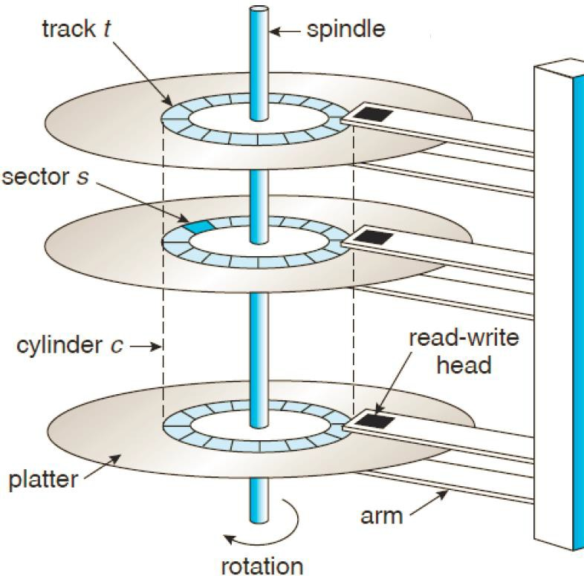
Disk Organization: Physical View
A hard disk has one or multiple platters.
Each platter has 2 sides (surfaces).
Platters are bound together by a spindle.
Each surface has multiple concentric circles called tracks.
A track is further divided into sectors.
A disk head reads or
^{writes data of sectors.}
33

Slide 34
Outline
I/O Stack
System Calls
Basics of I/O Devices
System Architecture
Canonical Device and Canonical Protocol
Polling vs. Interrupt
Device Interaction Methods
Programmed I/O vs. Direct Memory Access
Device Driver
Char Device vs. Block Device
Case Study of Block I/O Device: HDD
Disk Organization
Disk I/O Performance
Disk Scheduling
Application
User
Kernel
File System
Block Layer
Device Driver
I/O Device
34

Slide 35
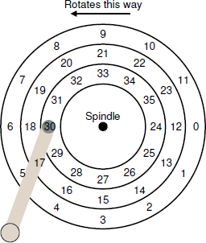
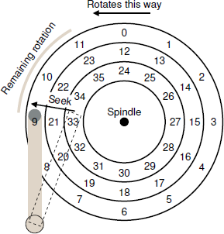
Disk I/O Performance (1/2)
Rotational Delay: Single-track latency
The time to rotate a disk to move the desired sector
under the disk head.
Full rotational delay: R
– E.g., 10,000 RPM disk → R = 4ms.
– Rotations per Minute: The rate of rotation.
Average rotational delay: R/2
Seek Time: Multiple-track latency
The time to move the disk arm to the correct track.
Average seek time: The order of ms.
Transfer Time
The time to read/write data to the surface.
35

Slide 36


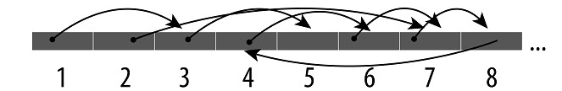
Disk I/O Performance (2/2)
I/O Time: The sum of three major components.
I/O Rate: Divide the size of data transfer by the time.
I/O performance heavily depends on workloads.
Sequential Workload: Large reads/writes (e.g., 100MB) to a number of contiguous sectors.
Random Workload: Small reads/writes (e.g., 4KB) to random sector locations on the disk.
Sequential Workload Random Workload
36

Slide 37
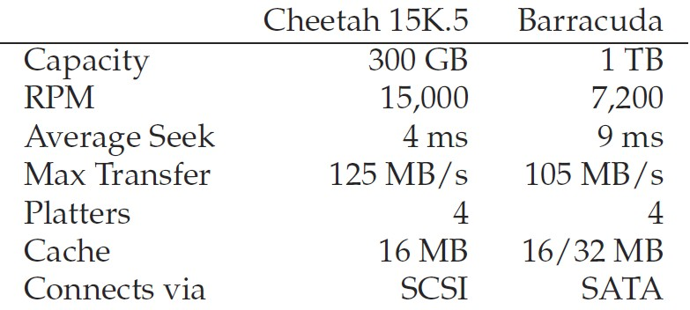

Disk I/O Performance: An Example
Let’s consider two modern disks from Seagate.
Left: “high performance” disk vs. Right: “large capacity” disk
Performance under random/sequential workloads:
Sequential I/O: Determined by transfer performance.
Random I/O: Determined by rotation and seek time.
37

Slide 38
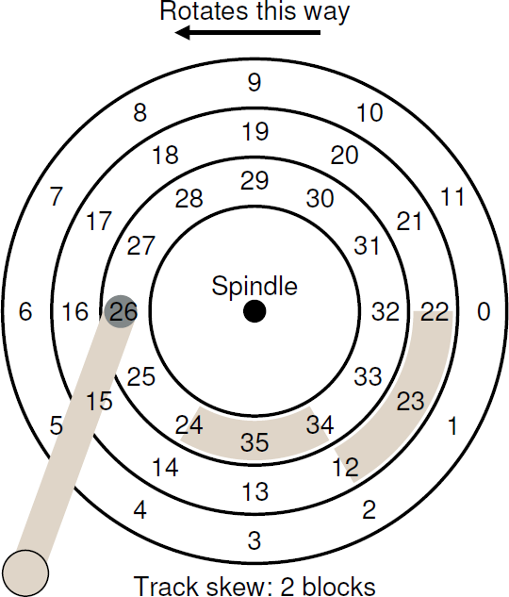
More Details: Track Skew
Track Skew: ensures that sequential reads can be properly serviced when crossing track boundaries.
– The disk needs time to re-position the head.
38

Slide 39
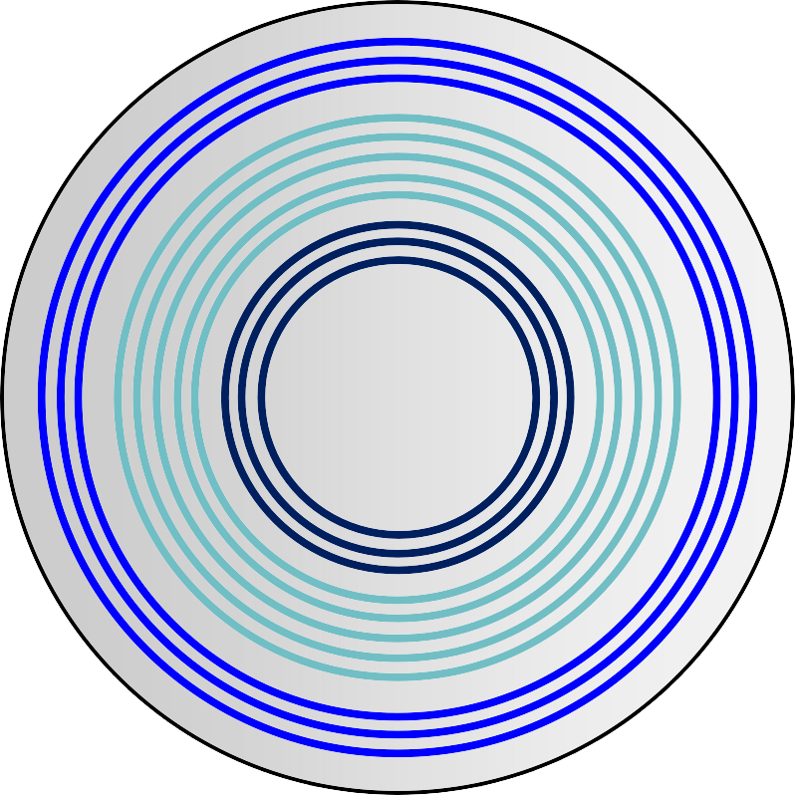



More Details: Zones
Another reality is that outer tracks tend to have more sectors than inner tracks.
It is nothing special but a result of geometry: there is simply more room out there.
Multi-zoned HDDs are organized into multiple zones.
A zone is consecutive set of tracks on a surface.
In a zone, every track has the same number of sectors.
Outer zones have more sectors than inner zones.
Also known as zone bit recoding.
39

Slide 40
More Details: Disk Caching
Disk Cache (or Track Buffer): A small amount of in-disk memory (usually around 8 or 16 MB) to hold data read from or written to disk.
On reads, the drive may cache all sectors of a track to quickly respond to subsequent reads to same track.
On writes, the drive has a choice:
Write-Through: Write is completed when data is on disk.
Write-Back: Write is completed when data is in cache.
Write-Through
Disk Cache
Cache
Write-Back
(later)
40

Slide 41
Outline
I/O Stack
System Calls
Basics of I/O Devices
System Architecture
Canonical Device and Canonical Protocol
Polling vs. Interrupt
Device Interaction Methods
Programmed I/O vs. Direct Memory Access
Device Driver
Char Device vs. Block Device
Case Study of Block I/O Device: HDD
Disk Organization
Disk I/O Performance
Disk Scheduling
Application
User
Kernel
File System
Block Layer
Device Driver
I/O Device
41

Slide 42
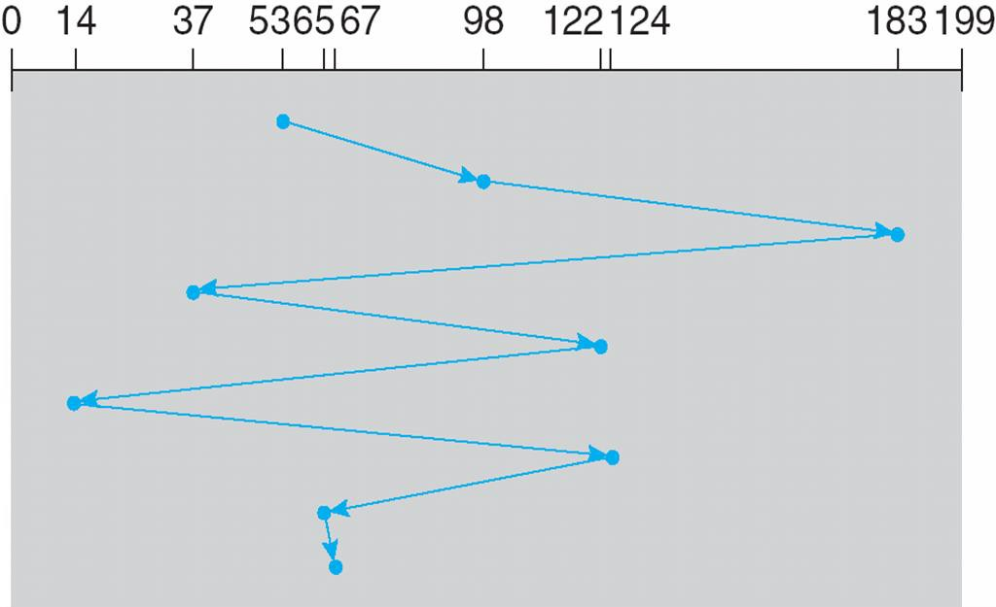
Disk Scheduling: Decides the order of I/Os
Without disk scheduling, the requests are served in a
First Come First Serve (FCFS) basis.
Given accesses: 53, 98, 183, 37, 122, 14, 124, 65, 67
Total head movement: 640 cylinders
42

Slide 43
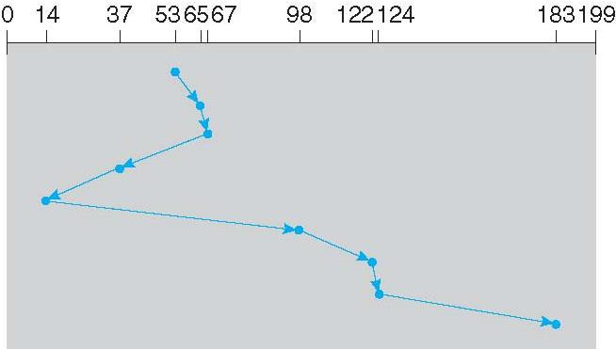
Shortest Seek Time First (SSTF)
SSTF selects the request with the minimum seek time from the current head position.
Given accesses: 98, 183, 37, 122, 14, 124, 65, 67
Head starts at 53
Total head movement: 236 cylinders
STARVATION!
43

Slide 44
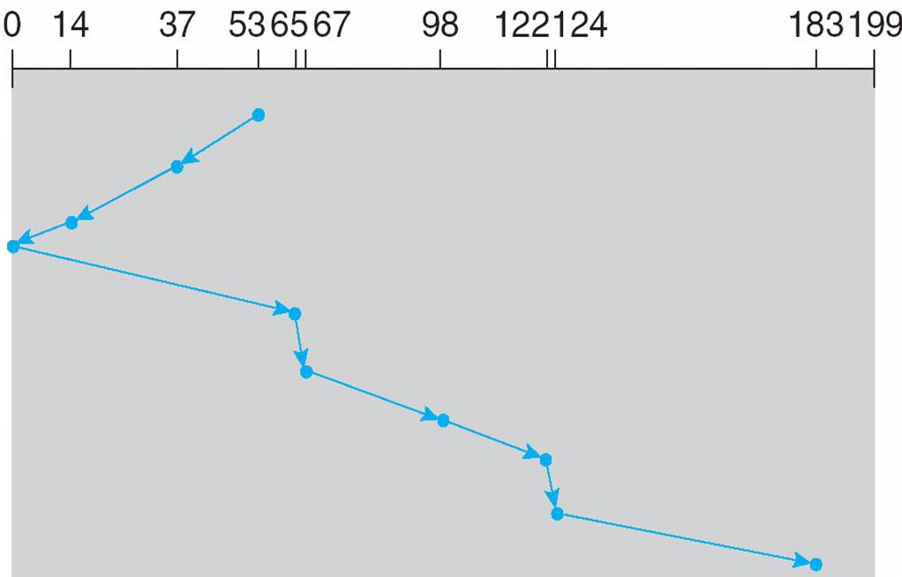
SCAN (a.k.a. Elevator)
SCAN starts at one end of the disk, moves toward the other end, reverses until reaching any end.
Given accesses: 98, 183, 37, 122, 14, 124, 65, 67
Head starts at 53
Total head movement: 236 cylinders
STARVATION!
44

Slide 45
Variants of SCAN
SCAN (a.k.a. Elevator)
Moves the head across tracks of the disk from one end to the other end, and services requests in order.
Reverses the direction of the head at the other end.
F-SCAN
It uses two sub-queues.
Freezes the second queue of requests during a sweep of first queue.
Avoids starvation of far-away requests, by delaying the servicing of late-arriving (but nearer by) request.
C-SCAN
When the head reaches the end, immediately returns to the beginning and services the requests from beginning to end (i.e., always serves in one direction).
Avoids favoring the middle locations.
45

Slide 46
Class Discussion
Question: Why SSTF, SCAN and its variants cannot deliver the best scheduling results?
Answer: They don’t consider the rotation delay.
I/O Time: The sum of three major components.
46

Slide 47
Shortest Positioning Time First (SPTF)
Shortest Position Time First (SPTF)
Estimates the sum of the seek time and rotation delay from the disk head to the read location.
Limitation: Usually performed within a drive, but not in OS.
Why? The OS generally does not have a good idea where track boundaries are or where the disk head currently is.
47

Slide 48
Application
Other Disk Scheduling Issues
File System
Q1. Where is disk scheduling performed?
At both OS (in block layer) and disk.
The OS scheduler picks a few best requests;
The disk scheduler selects the best possible order (e.g., SPTF).
Q2. Can we merge I/O to further improve
performance?
Consider a series of requests: 33, 8, 34.
The scheduler should merge requests for blocks 33 and 34 into a single request.
Q3. How long should the OS wait before issuing an I/O?
By waiting, a new and “better” request may arrive at the disk, and thus overall efficiency is increased.
It is tricky to decide “when” and “how long” to wait.
Block Layer
Scheduler
Device Driver
Hard Disk
Scheduler
48

Slide 49
Summary
I/O Stack
System Calls
Basics of I/O Devices
System Architecture
Canonical Device and Canonical Protocol
Polling vs. Interrupt
Device Interaction Methods
Programmed I/O vs. Direct Memory Access
Device Driver
Char Device vs. Block Device
Case Study of Block I/O Device: HDD
Disk Organization
Disk I/O Performance
Disk Scheduling
Application
User
Kernel
File System
Block Layer
Device Driver
I/O Device
49

Slide 50
Flipped Classroom (翻轉教室)
This class has applied the project of conducting flipped classroom
It’s still under approval, I will let you know the result
If it’s approved
Online videos regarding the topic will be given before class
Including the slides I am originally used
Each student needs to come up with an architecture for the topic
For example, on 3/28, figures for file system designs/ flow chart of for file system designs
During the class, divide students into 4-people groups
Discuses with teammates to come up with an integrated figure
Discussion leads by the person going to present
Present your outcome
Each team member need to present once
50

Slide 51

Q & A
Thank you for your attention.
Notes:
Thank you for listening. Now, I would like to end today’s talk by the Q & A time.

