Slide 1

File and Storage System Lecture 02: RAID and Data Integrity
Department of Computer Science and Information Engineering
Shuo-Han Chen (陳碩漢), shchen@ntut.edu.tw
Hong-Yue Technology Research Building 334
M 15:10 - 18:00

Slide 2
Regarding Online Courses
We are part of the online course project
The timeframe for online class has been determined (see next slide)
For each week, an online material will be released
Either videos or articles
Title：Files & File Systems: Crash Course Computer Science #20
Link：https://www.youtube.com/watch?v=KN8YgJnShPM
Discussion Topic in Chat Room
What is the Basic Structure of File System?
Cooperating with Zuvio App for instant Q&A
For final presentation, it’s also online
Everyone should be online before classes starts
Lose 1 point in final grade if late or no show
2

Slide 3
Course Schedule
Online class will be announced according to school time table & It’s required by school (due to Covid-19)
W | Date | Lecture | Notes | Homework
1 | Feb. 22 | Lecture 00: Course Information |  | HW00
2 | Mar. 1 | Peace Memorial Day | No Class
3 | Mar. 8 | Lecture 01: System Calls & I/O Devices
4 | Mar. 15 | Lecture 02: RAID and Data Integrity |  | HW00 Due
5 | Mar. 22 | Lecture 03: File System Basics | Online Class
6 | Mar. 29 | Lecture 03: File System Basics |  | HW01
7 | Apr. 5 | Tomb Sweeping Day | No Class
8 | Apr. 12 | Lecture 04: File System Designs | Online Class | HW01 Due
9 | Apr. 19 | School Midterm Week | No Class | HW02
10 | Apr. 26 | Lecture 05: Distributed File Systems
11 | May 3 | Midterm on May 3 |  | HW02 Due
12 | May 10 | Lecture 06: Flash Memory | Online Class | HW03
13 | May 17 | Lecture 07: Next-generation Hard Disk Drive
14 | May 24 | Lecture 08: Persistent Memory |  | HW03 Due
15 | May 31 | Final Presentation – 6 People | Online Class | HW04
16 | Jun. 7 | Final Presentation – 6 People | Online Class
17 | Jun. 14 | Dragon Boat Festival | No Class | HW04 Due
18 | Jun. 21 | Final Presentation – 5 People | Online Class
3

Slide 4
Additional Course Materials
We are part of the Open Text Book Project
Selected & Suggested Readings
Remzi H. Arpaci-Dusseau and Andrea C. Arpaci-Dusseau, “Operating Systems: Three Easy Pieces”
Free online form: http://pages.cs.wisc.edu/~remzi/OSTEP/
Ch 36 - 51
Shawn T. O'Neil, “A Primer for Computational Biology”
Free online form: https://open.oregonstate.education/computationalbiology/
Part I, Ch 1 - 12
Max Hailperin, “Operating Systems and Middleware: Supporting Controlled Interaction”
Free online form: https://gustavus.edu/mcs/max/os-book/
Ch 7 - 8
4

Slide 5


Outline
I/O Stack
Generic Block Layer
Redundant Arrays of Inexpensive Disk
RAID Interface and Internals
Fault Model: Fail-Stop
RAID Levels and Analysis
Capacity, Reliability, and Performance
RAID Reconstruction
Data Integrity
Other Disk Failure Modes and Handling
Latent Sector Error
Corruption
Lost Writes
Scrubbing
Application
User
Kernel
File System
Block Layer
Device Driver
HDD HDD … HDD
5

Slide 6
Generic Block Layer
Generic Block Layer: A kernel component that handles the requests for all block devices in blocks.
Thanks to this abstraction, the kernel may easily:
Schedule I/O requests for I/O devices (e.g., HDD);
Implement data buffer to keep data blocks to optimize I/O;
Manage logical volumes (e.g., one disk ➔ many volumes);
Implement a RAID (e.g., many ➔ one), and so on.
Application
User Space
POSIX API [open, read, write, close, etc.]
Raw
File System
Kernel
Space
Generic Block Interface [block read/write]
Char. Device Driver
Block Device Driver [SCSI, ATA, USB, etc.]
Char I/O Device
[keyboard, mouse, etc.]
Block I/O Device
[hard disk drive, solid-state drive, etc.]
I/O Device
6

Slide 7
Outline
I/O Stack
Generic Block Layer
Redundant Arrays of Inexpensive Disk
RAID Interface and Internals
Fault Model: Fail-Stop
RAID Levels and Analysis
Capacity, Reliability, and Performance
RAID Reconstruction
Data Integrity
Other Disk Failure Modes and Handling
Latent Sector Error
Corruption
Lost Writes
Scrubbing
Application
User
Kernel
File System
Block Layer
Device Driver
HDD HDD … HDD
7

Slide 8
Redundant Arrays of Inexpensive Disks
RAID: Redundant Arrays of Inexpensive Disks
Aggregates multiple physical disks as one logical (and bigger) one.
Developed by researchers at Berkeley in late 80s.
RAID offers the following advantages transparently with the same interface as a single disk.
Capacity: more disks
Reliability: fault tolerance by maintaining redundancy
Performance: parallelism
RAID
HDD HDD HDD HDD
8

Slide 9


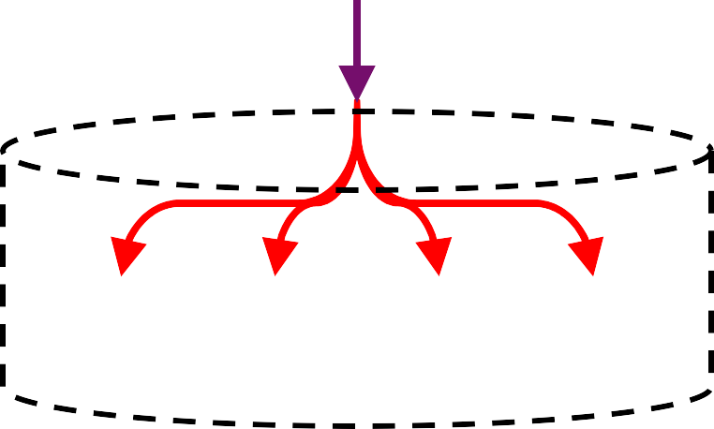
RAID Interface and Internals
RAID converts a logical I/O from the file system into one or multiple physical I/Os to disks(s).
RAID is often built as a separate hardware
box, with a standard bus to a host.
A microcontroller to run firmware for RAID operations.
Some memory to buffer data blocks as they are read/written.
Specialized logic to perform parity (redundancy) calculation.
RAID can be also built by software (e.g., mdadm).
Application
File System
RAID
HDD HDD HDD HDD
9

Slide 10
Outline
I/O Stack
Generic Block Layer
Redundant Arrays of Inexpensive Disk
RAID Interface and Internals
Fault Model: Fail-Stop
RAID Levels and Analysis
Capacity, Reliability, and Performance
RAID Reconstruction
Data Integrity
Other Disk Failure Modes and Handling
Latent Sector Error
Corruption
Lost Writes
Scrubbing
Application
User
Kernel
File System
Block Layer
Device Driver
HDD HDD … HDD
10

Slide 11


Fault Model
RAID is designed to detect and recover from certain kinds of disk faults.
Let’s begin with the simplest fail-stop fault model:
If a disk is working, all its data can be read/written.
If a disk fails, all its data are permanently lost.
RAID controller can immediately detect if a disk fails.
In practice, disk failures can be more complex (e.g., bad sectors in a working disk or “silent” failures).
RAID
HDD
HDD
HDD
HDD
11

Slide 12
Outline
I/O Stack
Generic Block Layer
Redundant Arrays of Inexpensive Disk
RAID Interface and Internals
Fault Model: Fail-Stop
RAID Levels and Analysis
Capacity, Reliability, and Performance
RAID Reconstruction
Data Integrity
Other Disk Failure Modes and Handling
Latent Sector Error
Corruption
Lost Writes
Scrubbing
Application
User
Kernel
File System
Block Layer
Device Driver
HDD HDD … HDD
12

Slide 13
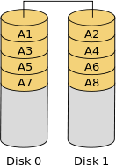
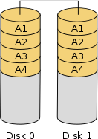
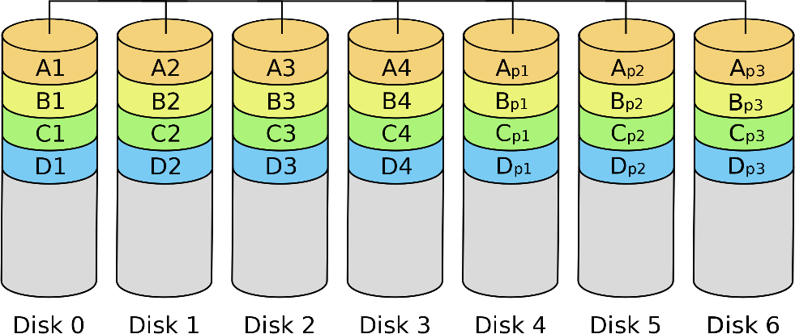
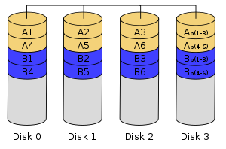
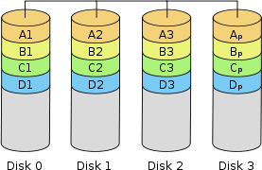
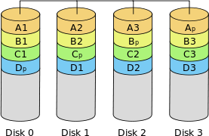
Basic RAID Levels: A Glance
RAID-0
Striping
RAID-1
Mirroring
RAID-2
Striping at bit-level (rarely used)
RAID-3
Striping at byte-level (rarely used)
RAID-4
Striping at block-level
RAID-5
Striping at block-level with distributed parity
13

Slide 14
RAID Analysis: Three Aspects
Capacity
The effective storage size in number of blocks
Let N be the total number of disks in RAID.
Let B be the total number of blocks in a single disk .
Reliability
The number of tolerable disk failures.
Performance
– Single-Request Latency: 𝑇_{𝐼/𝑂} = 𝑇_{𝑠𝑒𝑒𝑘} + 𝑇_{𝑟𝑜𝑡𝑎𝑡𝑖𝑜𝑛} + 𝑇_{𝑡𝑟𝑎𝑛𝑠𝑓𝑒𝑟}
Let T be the latency that a request to a single disk would take.
– Steady-State Throughput: 𝑅𝑎𝑡𝑒_{𝐼/𝑂} = 𝑆𝑖𝑧𝑒_{𝑇𝑟𝑎𝑛𝑠𝑓𝑒𝑟} ÷ 𝑇_{𝐼/𝑂}
Let S and R be the single-disk transfer bandwidths (or rates) under sequential and random workloads, respectively (S >> R).
14

Slide 15
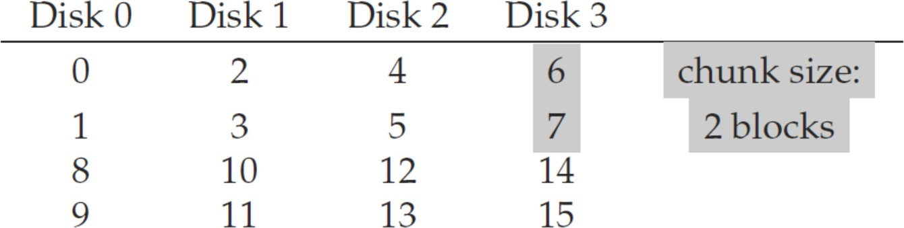
Terminologies
Disks organize data in blocks (e.g., 4KB).
RAID usually distributes data across disks in units of
chunks, which is composed of one or more blocks.
Chunk size mostly affects performance of RAID.
Small chunk size increases parallelism of reads/writes.
Large chunk size reduces positioning time of disks.
Let the chunk size be the block size in our analysis.
A stripe refers to the same row of chunks.
Block
Stripe
Chunk
15

Slide 16
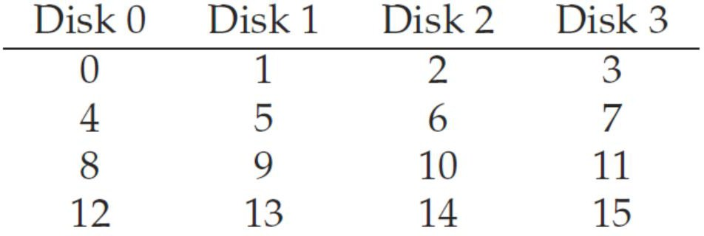
RAID-0 (Striping)
RAID-0 distributes data blocks across disks in a round-robin fashion (without any redundancy!).
Capacity: 𝑁 ∗ 𝐵 (the upper bound)
Reliability: 0 (no fault tolerance)
Performance:
Read/Write Latency: 𝑇 (the same as in a single disk)
– The I/O request is simply redirected to one of the disks.
Sequential Read/Write Throughput: 𝑁 ∗ 𝑆 (full bandwidth)
Random Read/Write Throughput: 𝑁 ∗ 𝑅 (full bandwidth)
Full Stripe
16

Slide 17
Discussion
Question: How to do address mapping from a logical block address to a physical block address in RAID?
Answer:
Let the chunk size be the block size.
Let LBA be the logical block address.
Bonus: What about a general chunk size (i.e., a chunk is of multiple blocks)?
𝐷𝑖𝑠𝑘 = 𝐿𝐵𝐴 % 𝑛𝑢𝑚𝑏𝑒𝑟_𝑜𝑓_𝑑𝑖𝑠𝑘𝑠
𝑂𝑓𝑓𝑠𝑒𝑡 = 𝐿𝐵𝐴 / 𝑛𝑢𝑚𝑏𝑒𝑟_𝑜𝑓_𝑑𝑖𝑠𝑘𝑠
17

Slide 18
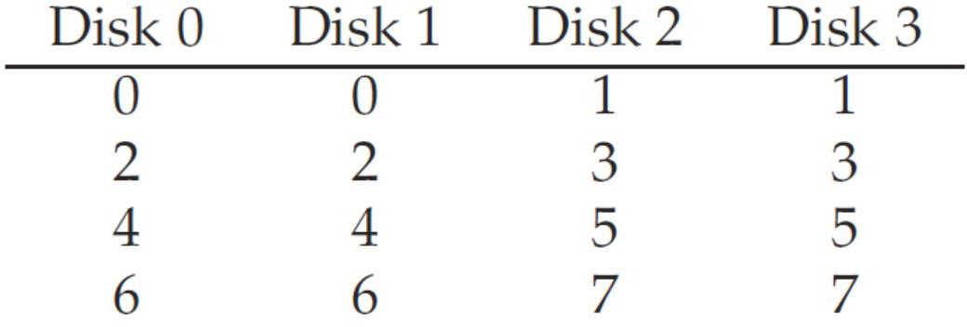
RAID-1 (Mirroring) (1/2)
RAID-1 keeps two physical copies for every block.
Capacity: 𝑁 ∗ 𝐵/2 (very expensive!)
Reliability: 1 (any one for certain); 𝑢𝑝 𝑡𝑜 𝑁/2 (if lucky!)
Performance:
Read/Write Latency: 𝑇 (the same as in a single disk)
Read from one hard copy; Write to two hard copies in parallel.
Random Write Throughput: 𝑁 ∗ 𝑅/2 (all in use, but half effective)
Random Read Throughput: 𝑁 ∗ 𝑅 (possible to reach full bandwidth)
E.g., randomly read blocks 0, 3, 4, and 7
Random Reads
18

Slide 19
RAID-1 (Mirroring) (2/2)
RAID-1 keeps two physical copies for every block.
Capacity: 𝑁 ∗ 𝐵/2 (very expensive!)
Reliability: 1 (any one for certain); 𝑢𝑝 𝑡𝑜 𝑁/2 (if lucky!)
Performance (cont’d):
Sequential Write Throughput: 𝑁 ∗ 𝑆/2 (all in use, but half effective)
Sequential Read Throughput: 𝑁 ∗ 𝑆/2
Why not 𝑁 ∗ 𝑆 (similar to random read throughput)?
Answer: Each disk receive a request for every other block. While it is rotating over the skipped block, it is not delivering effective bandwidth.
Sequential Reads
19

Slide 20

Discussion
In RAID-1, updates (i.e., writes) to both copies of each logical block must be consistent (or atomic, i.e., both copies are updated or neither is updated).
Question: How to guarantee the consistency when a power loss (or system crash) occurs?
Answer: Write-Ahead Log (will be discussed later)
Do the log before updating two disks.
Use a small amount of non-volatile, battery-backed RAM for better logging performance.
Replay the log if a crash occurs.
20

Slide 21
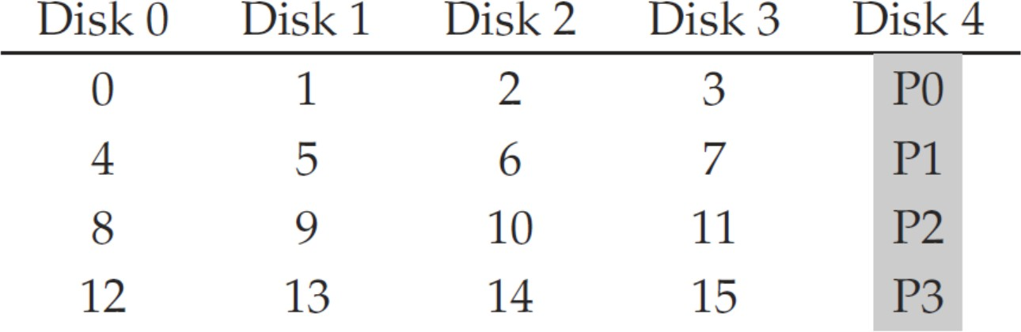
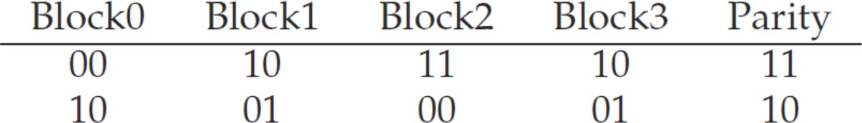
RAID-4 (1/5)
RAID-4 adding redundancy (known as parity) to a disk for each stripe.
One disk is dedicated as the parity disk.
Parity must withstand the loss of any one block in a stripe.
Parity can be computed via bitwise XOR.
Recovery? Block0 = Block1 XOR Block2 XOR Block3 XOR Parity
21

Slide 22
RAID-4 (2/5)
RAID-4 adding redundancy (known as parity) to a disk for each stripe.
Capacity: (𝑁 − 1) ∗ 𝐵(one dedicated parity disk)
Reliability: 1 (any one for certain and no more)
Performance:
Random Read Throughput: (𝑁 − 1) ∗ 𝑅 (parity disk has no effect!)
Sequential Read Throughput: (𝑁 − 1) ∗ 𝑆 (parity disk has no effect!)
22

Slide 23
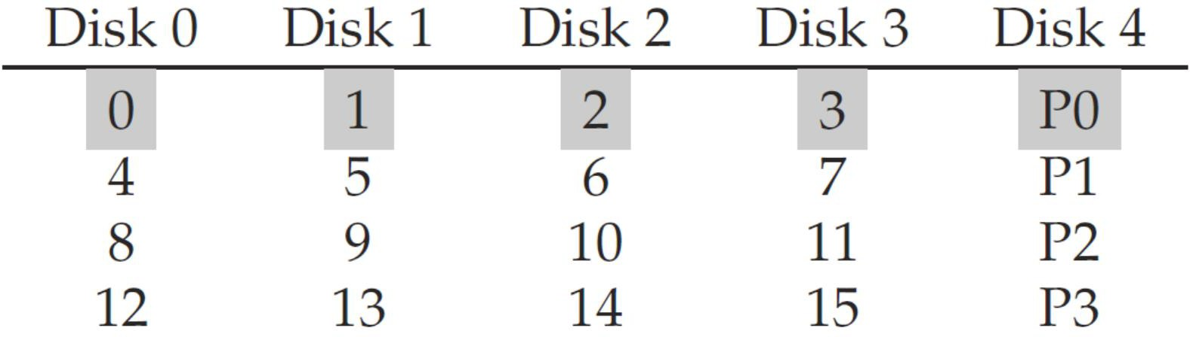
RAID-4 (3/5)
RAID-4 adding redundancy (known as parity) to a disk for each stripe.
Performance:
Sequential Write Throughput: (𝑁 − 1) ∗ 𝑆 (parity disk has no effect!)
How to do full-stripe write under RAID-4?
① Buffer all data blocks of a stripe
② Compute the parity block
③ Write all data and parity blocks in parallel
Full Stripe
23

Slide 24
RAID-4 (4/5)
RAID-4 adding redundancy (known as parity) to a disk for each stripe.
Performance:
Random writes need to update both data and parity blocks.
Approach 1) Additive Parity (as known as reconstruct-writes)
① Read all other data blocks in a stripe in parallel
② XOR those with the new block to form a new parity block
③ Write the new data block and new parity block to disks
Approach 2) Subtractive Parity (as known as read-modify-writes)
① Read only the old data block to be updated and old parity block
② Compute the new parity block: P_{new} = (D_{new} ^ D_{old}) ^ P_{old}
③ Write the new data block and new parity block to disks
Random Write Throughput: 𝑅Τ2 (using subtractive parity)
- Each random write triggers two reads and two writes.
» The reads can happen in parallel, as can the writes.
24

Slide 25
Discussion
Question: What is the tradeoff between additive parity and subtractive parity?
Answer: Additive parity incurs more I/Os if the number of disks is large; vice versa for subtractive parity.
Bonus: What is the cross-over point?
– That is, how many disks would need so that the additive method performs fewer I/Os than subtractive method.
25

Slide 26
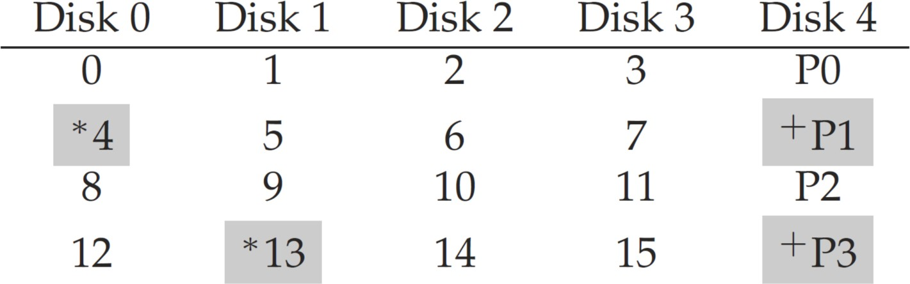
RAID-4 (5/5)
RAID-4 adding redundancy (known as parity) to a disk for each stripe.
Performance:
Read Latency: 𝑇 (the same as in a single disk)
A single read is just redirected to a single disk.
Write Latency: 𝑇 ∗ 2 (twice in a single disk)
A single write needs two reads and two writes (subtractive parity).
» The reads can happen in parallel, as can the writes.
26

Slide 27
RAID-5
RAID-5 rotates parity blocks across stripes.
Other operations remain the same as RAID-4.
Identical to RAID-4 in the following: capacity, reliability, read/write latency, and sequential r/w throughput.
Random Read Throughput: 𝑁 ∗ 𝑅 (possible to reach full bandwidth).
Random Write Throughput: N/4 ∗ 𝑅(improved greatly over RAID-4).
Assume a large number of random writes keeps all disks evenly busy.
The factor of four loss: Each RAID-5 write still need four I/O operations.
27

Slide 28
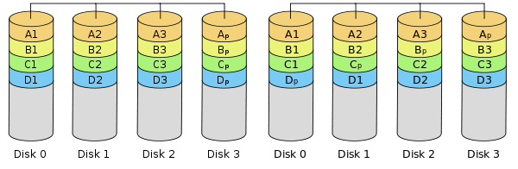
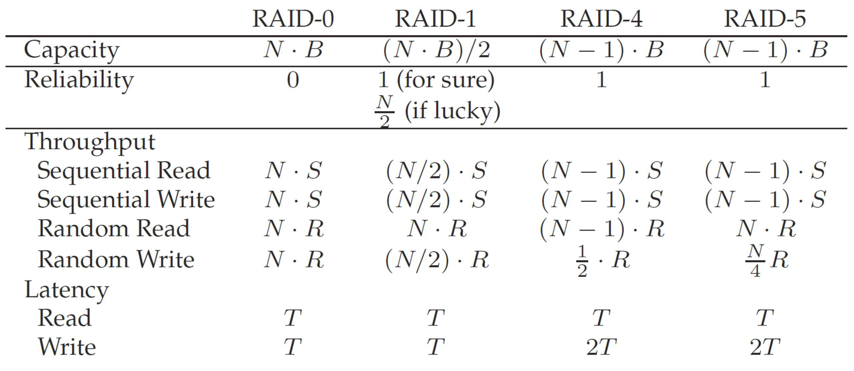
RAID Comparison: A Summary
RAID-0 RAID-1 RAID-4
RAID-5
28

Slide 29
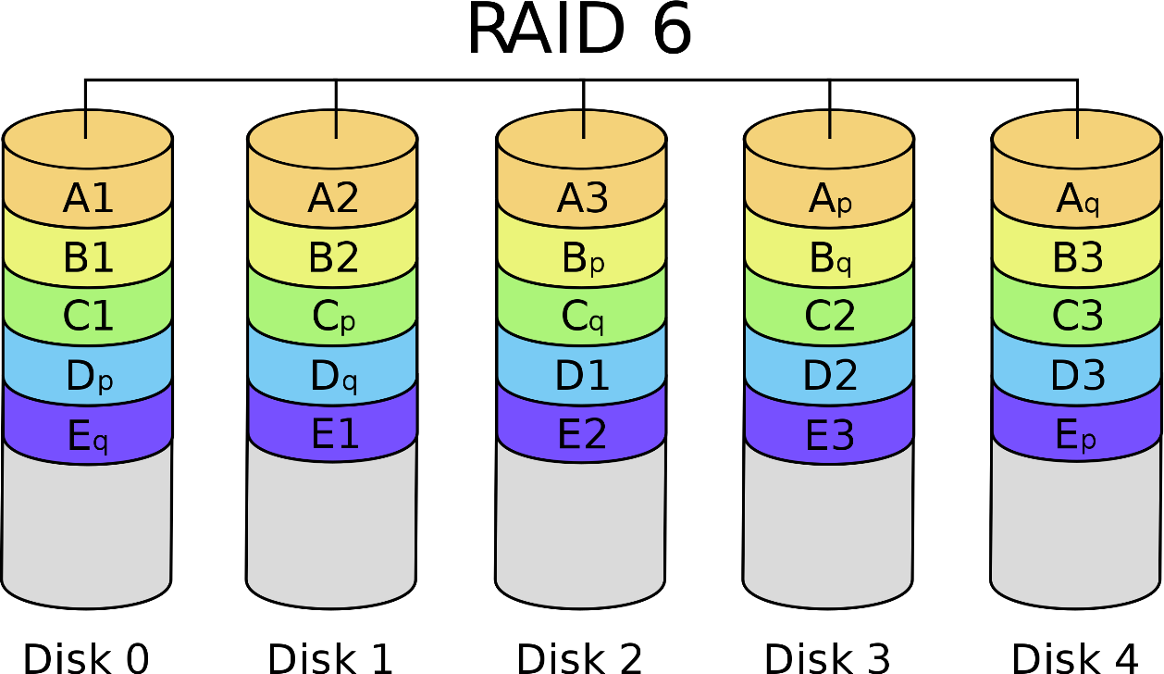
Other Basic RAID Levels
RAID-6 can tolerate multiple disk faults by
Introducing more redundancy (i.e., parity blocks);
Using more powerful error correction code (e.g., Reed- Solomon code).
29

Slide 30
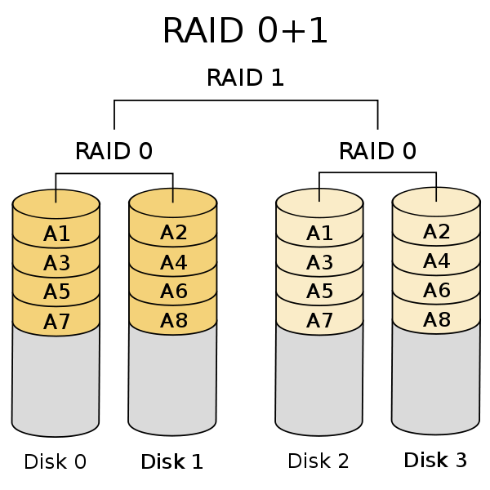
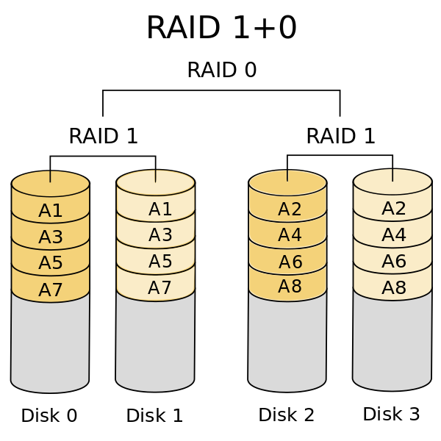
Advanced RAID Levels
Nested RAID (or Hybrid RAID): Combines two or more of basic RAID levels (i.e., RAID-0~RAID-6).
– To gain performance, additional redundancy or both, as a result of combining properties of different RAID layouts.
30

Slide 31
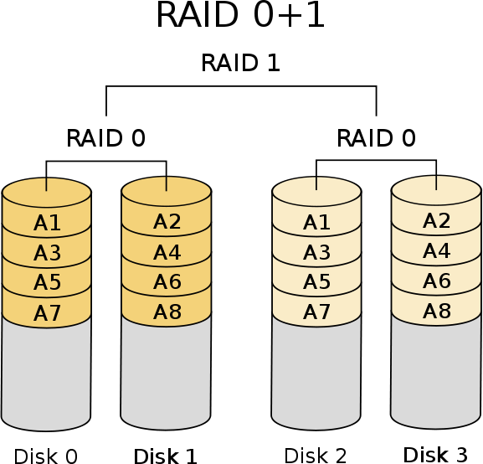
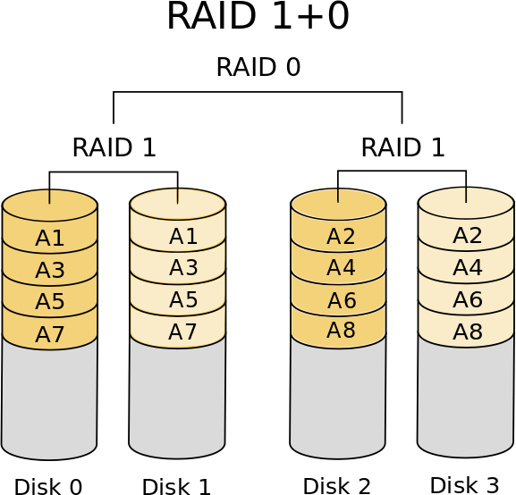
Discussion
Question: Which one is better? RAID-01 or RAID-10?
Answer: The reliability of RAID-10 is better than RAID-01 in more failure scenarios.
31

Slide 32
Outline
I/O Stack
Generic Block Layer
Redundant Arrays of Inexpensive Disk
RAID Interface and Internals
Fault Model: Fail-Stop
RAID Levels and Analysis
Capacity, Reliability, and Performance
RAID Reconstruction
Data Integrity
Other Disk Failure Modes and Handling
Latent Sector Error
Corruption
Lost Writes
Scrubbing
Application
User
Kernel
File System
Block Layer
Device Driver
HDD HDD … HDD
32

Slide 33
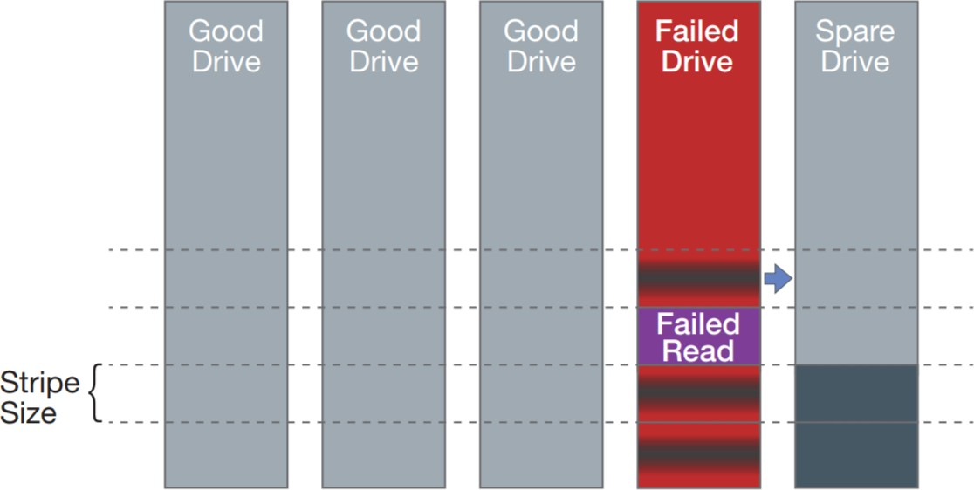
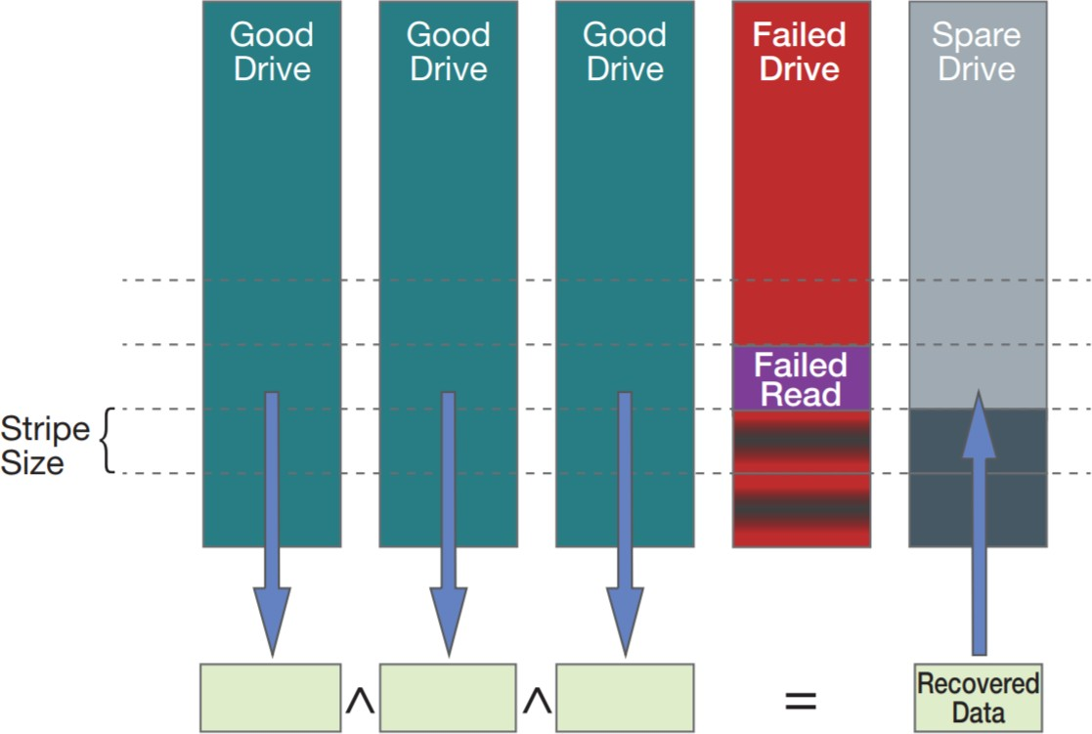
RAID Reconstruction
The RAID system needs to be reconstructed when a disk fails.
The failed disk needs to be replaced by a spare one.
Hot Spare: enables a RAID system to automatically failover.
Cold Spare: resides in the RAID but requires manual intervention.
The entire spare disk needs to be rebuilt by using either failed disk or other healthy disks in the RAID system.
33

Slide 34
Outline
I/O Stack
Generic Block Layer
Redundant Arrays of Inexpensive Disk
RAID Interface and Internals
Fault Model: Fail-Stop
RAID Levels and Analysis
Capacity, Reliability, and Performance
RAID Reconstruction
Data Integrity
Other Disk Failure Modes and Handling
Latent Sector Error
Corruption
Lost Writes
Scrubbing
Application
User
Kernel
File System
Block Layer
Device Driver
HDD HDD … HDD
34

Slide 35
Data Integrity and Other Failure Modes
So far, we only consider the fail-stop fault model.
Either the entire disk is working, or it fails completely.
The data integrity should be further ensured.
The data put into the system must be the same as returned.
The fail-partial fault model is more practical.
Disks seem working, but some blocks can’t be used.
Two common types of single-block failures.
Latent Sector Errors: Blocks are inaccessible or damaged.
(Silent) Corruptions: Blocks hold wrong content.
 | Cheap (e.g., SATA) | Costly (e.g., SCIS)
Latent Sector Errors | 9.40% | 1.40%
Corruptions | 0.50% | 0.05%
Failure percentages of 1.5 million drives over a 3-year span.
35

Slide 36
Latent Sector Errors
LSEs arise when a disk sector (or group of sectors) has been damaged in some way such as:
Head crash damages disk surface, making bits unreadable.
Cosmic rays flip bits, leading to incorrect contents.
LSEs can be easily detected when accessing a block.
If a block cannot be accessed, the disk returns an error.
If a block can be accessed but the in-disk error correcting codes (ECC) cannot fixed LSEs, the disk returns an error.
ECCs associate the data with some redundancy for detecting and
recovering (usually a fixed number of) error bits.
Classical ECCs include Golay, BCH, Hamming codes, etc.
Most RAID levels (except RAID-0) can recover LSEs by leveraging the redundancy.
36

Slide 37
Outline
I/O Stack
Generic Block Layer
Redundant Arrays of Inexpensive Disk
RAID Interface and Internals
Fault Model: Fail-Stop
RAID Levels and Analysis
Capacity, Reliability, and Performance
RAID Reconstruction
Data Integrity
Other Disk Failure Modes and Handling
Latent Sector Error
Corruption
Lost Writes
Scrubbing
Application
User
Kernel
File System
Block Layer
Device Driver
HDD HDD … HDD
37

Slide 38
Corruptions
Corruptions refer to the cases where a block becomes corrupt but not detectable such as:
A heathy block may get corrupted when it is transferred between the host and the disk across a faulty bus.
Buggy disk firmware writes a block to the wrong location.
In such a case, the in-disk ECC indicates the block contents are fine, but the wrong block is returned to users.
These types of faults are particularly insidious because they are silent faults.
The disk itself has no idea when returning the faulty data.
Once it is known that a particular block is corrupt, recovery is the same as before.
We need a way to detect corruptions.
38

Slide 39
Detecting Corruption: The Checksum
Checksum: ensures data integrity despite corruption.
It is simply a small summary of the data contents (e.g., 4-8 bytes), computed from a chunk of data (e.g., 4KB).
The corruption can be detected only if the checksum does NOT match the data contents.
Why? Beyond the checksum capability or checksum corrupted.
Sender Receiver
Data
Data
Checksum Generator
Checksum Checker
Data
Check
sum
39

Slide 40
The Simplest Checksum: XOR
One simple way: exclusive or (XOR).
Considering a 4-byte checksum over a data block of 16 bytes (lined up in groups of 4 bytes per row):
– The checksum is computed by XOR’ing over each column.
Collision: Different blocks have the same checksum.
Limitation: Even number of error bits in a column.
Bonus: Can you do “error correction” with XOR?
00
10
11
01
110110 01011110 11000100 11001101
111010 00010100 10001010 10010010
101100 11101111 00101100 00111010
000000 10111110 11110110 01100110
XOR)
Checksum
00100000 00011011 10010100 00000011
40

Slide 41
Fletcher and CRC Checksum(s)
Fletcher Checksum: iteratively computes two check bytes, namely s1 and s2, as follows:
– Assume a block D consists of bytes d1, d2, …, dn.
Cyclic Redundancy Check (CRC): divides the data block by an agreed upon value (k) and takes the remainder of this division as the checksum.
– It is one of the most commonly-used checksums today.
Both are good at detecting single-bit, double-bit, and even a large portion of burst errors (think about why).
for | (i=1; | i<=n; | ++i) {
 | s1 = | (s1 + | di) mod | 255;
 | s2 = | (s2 + | s1) mod | 255;
}
41

Slide 42
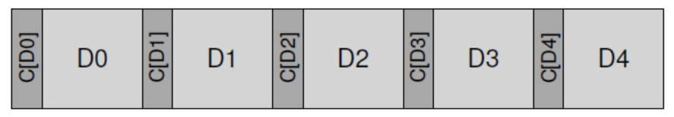
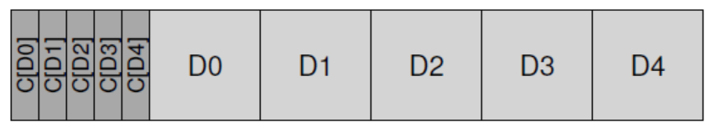
Checksum Layout
How should checksums be stored on disk?
Given five data blocks D0, D1, …, D4, let’s call the checksum of Di as C(Di).
The checksum can be added next to each block:
– Requiring disks be formatted with non-512-byte sector.
The checksums can be also packed into a block:
– Working on all disks but less efficient.
• Two writes for checksum block and the data block.
42

Slide 43
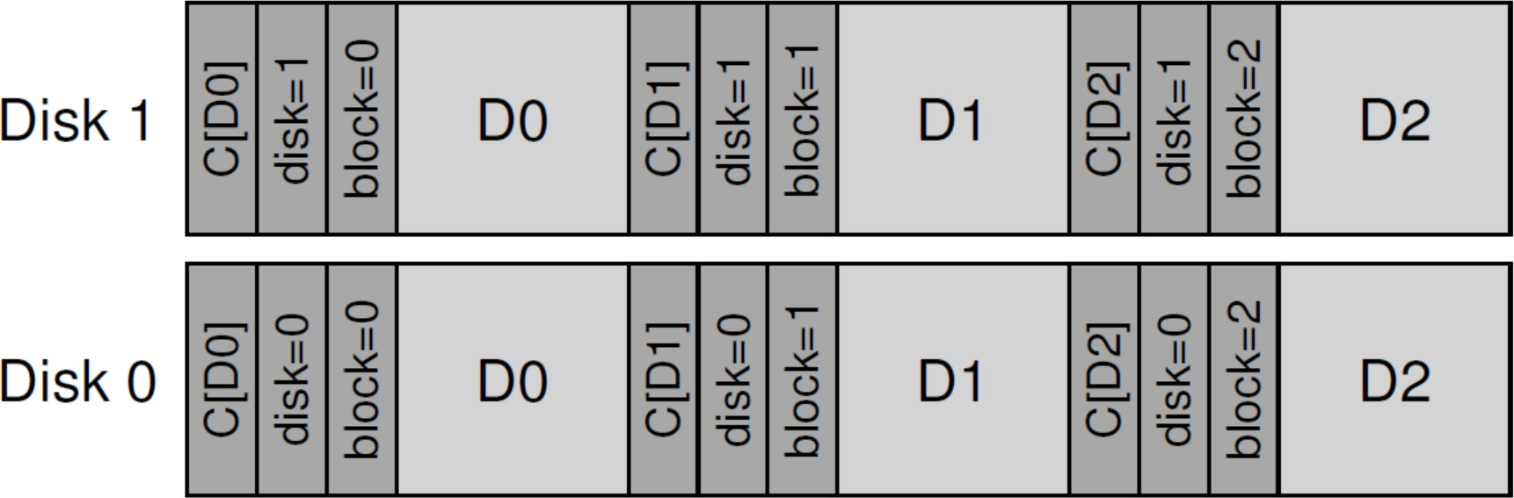
Misdirected Writes
Recall: A corruption will occur when buggy disk firmware writes a block to the wrong location.
This failure mode is called a misdirected write.
Solution: Adding a little more information to checksum.
The physical identifier (ID) can be used to verify whether the data chuck resides within a “correct” location.
Redundancy is always the key for both error detection (in this case) and recovery (in others such as RAID).
43

Slide 44
Outline
I/O Stack
Generic Block Layer
Redundant Arrays of Inexpensive Disk
RAID Interface and Internals
Fault Model: Fail-Stop
RAID Levels and Analysis
Capacity, Reliability, and Performance
RAID Reconstruction
Data Integrity
Other Disk Failure Modes and Handling
Latent Sector Error
Corruption
Lost Writes
Scrubbing
Application
User
Kernel
File System
Block Layer
Device Driver
HDD HDD … HDD
44

Slide 45
Lost Writes
Lost Write: The device informs the upper layer that a write has completed but it’s not persisted.
Basic checksum with physical identity does NOT help.
The old block likely has a matching checksum, and the physical ID used above will also be correct.
Possible Solutions
Read-after-Write
It may double the I/O.
Maintain additional checksum elsewhere in the system
It still can’t solve the problem if both writes are lost.
45

Slide 46
Outline
I/O Stack
Generic Block Layer
Redundant Arrays of Inexpensive Disk
RAID Interface and Internals
Fault Model: Fail-Stop
RAID Levels and Analysis
Capacity, Reliability, and Performance
RAID Reconstruction
Data Integrity
Other Disk Failure Modes and Handling
Latent Sector Error
Corruption
Lost Writes
Scrubbing
Application
User
Kernel
File System
Block Layer
Device Driver
HDD HDD … HDD
46

Slide 47

Scrubbing
Unchecked data are problematic for a reliable system.
Bit rot could accumulate and eventually become unrecoverable anymore.
Disk scrubbing is a periodic process that:
Reads through every block;
Checks whether checksums are still valid;
Repairs the problem if needed;
Scheduled on a nightly or weekly basis.
47

Slide 48
SUMMARY
I/O Stack
Generic Block Layer
Redundant Arrays of Inexpensive Disk
RAID Interface and Internals
Fault Model: Fail-Stop
RAID Levels and Analysis
Capacity, Reliability, and Performance
RAID Reconstruction
Data Integrity
Other Disk Failure Modes and Handling
Latent Sector Error
Corruption
Lost Writes
Scrubbing
Application
User
Kernel
File System
Block Layer
Device Driver
HDD HDD … HDD
48

Slide 49

Q & A
Thank you for your attention.
Notes:
Thank you for listening. Now, I would like to end today’s talk by the Q & A time.

