Slide 1

File and Storage System
Lecture 03: File System Basics
Department of Computer Science and Information Engineering
Shuo-Han Chen (陳碩漢),
shchen@ntut.edu.tw
Hong-Yue Technology Research Building 334
M 16:10 - 18:00 & W 11:10-12:00

Slide 2
Course Schedule
W | Date | Lecture | Notes | Homework
1 | Feb. 21 | Lecture 00: Course Information |  | HW00
2 | Feb. 28 | Peace Memorial Day | No Class
3 | Mar. 7 | Lecture 01: System Calls & I/O Devices
4 | Mar. 14 | Lecture 02: RAID and Data Integrity
5 | Mar. 21 | Lecture 03: File System Basics
6 | Mar. 28 | Lecture 04: File System Designs | Flipped
7 | Apr. 4 | Tomb Sweeping Day | No Class | HW01
8 | Apr. 11 | Lecture 05: Distributed File Systems | Flipped
9 | Apr. 18 | Midterm
10 | Apr. 25 | Lecture 06: Flash Memory | PHISON
11 | May 2 | Lecture 07: Next-generation Hard Disk Drive | Flipped | HW02
12 | May 9 | Lecture 06: Flash Memory | PHISON
13 | May 16 | Lecture 06: Flash Memory | PHISON
14 | May 23 | Lecture 06: Flash Memory | PHISON
15 | May 30 | Lecture 08: Persistent Memory | Flipped | HW04
16 | Jun. 6 | Final Presentation
17 | Jun. 13 | Final Presentation
18 | Jun. 20 | Final Presentation
2

Slide 3


Outline
File System Organization
  Abstraction: Files and Directories
  Metadata Region and Data Region
File System Interface
File System Implementations
  UNIX File System
    Access Paths: Reading and Writing
    Caching and Buffering
  Fast File System (FFS)
    Disk Awareness
    Data Locality
  Crash Consistency
    File System Checker
    Journaling
I/O Stack
Application
User
Kernel
File System
Block Layer
Device Driver
I/O Device
3

Slide 4
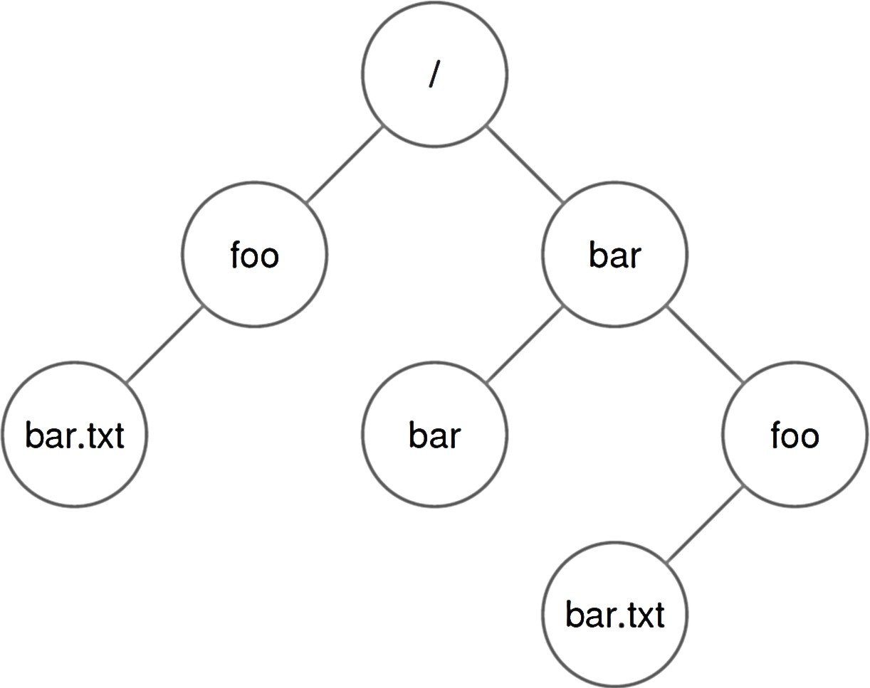
Abstraction: Files and Directories
File: a linear array of bytes that can be read/written
  Each file has a low-level name (or inode number) that uniquely identifies itself in the file system.
    Often, the user is not aware of this name.
Directory: a list of entries
  A directory has an inode number as well.
  A directory is just a special type of file with specific content.
    Each entry is a pair of (user-readable name, inode number).
    Each entry refers to either files or other directories.
A directory tree is formed
  Leaf node: file
  Non-leaf node: directory
4

Slide 5
Directory Tree
/ is the root directory.
– / is also used as a “separator” to name subsequent sub- directories and files.
A file/directory is referred by the absolute pathname.
  Directories and files can have the same name.
    If they are in different locations/directories (e.g., /bar/foo/bar.txt).
  The file extension is to indicate the type of a file (e.g., .txt).
/bar/foo/bar.txt
5

Slide 6
Outline
File System Organization
  Abstraction: Files and Directories
  Metadata Region and Data Region
File System Interface
File System Implementations
  UNIX File System
    Access Paths: Reading and Writing
    Caching and Buffering
  Fast File System (FFS)
    Disk Awareness
    Data Locality
  Crash Consistency
    File System Checker
    Journaling
I/O Stack
Application
User
Kernel
File System
Block Layer
Device Driver
I/O Device
6

Slide 7
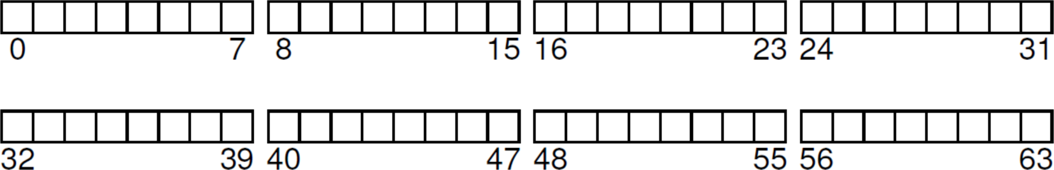
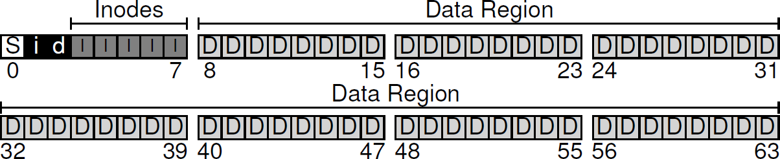
Overall Organization
On-Disk Organization
– A series of blocks (e.g., 4 KB) is addressed from 0 to N −1.
File System Organization
  Metadata Region: tracks data and file system information.
  Data Region: stores user data and occupies most space.
7

Slide 8
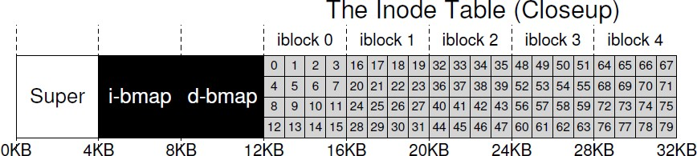
File System Metadata
Inode (I): tracks “everything” about a file / directory.
  Each inode is referenced by an i-number (low-level name).
    Given an i-numbers, the inode can be located.
  An inode keeps which data block(s) are used for a file / dir.
  Inode Table: the collection of all inodes.
i-bmap: tracks which inode is allocated.
d-bitmap: tracks which data block is allocated.
Superblock (S): tracks a file system.
8

Slide 9
Discussion
Question: How to locate an inode by the i-number in the disk?
  Note 1: Each inode is small in size.
  Note 2: A block can hold multiple inodes.
  Note 3: disk is addressed by sectors.
Answer:
  Let inodeStartAddr be start address of the inode table.
  Let sizeof(inode_t) be the size of a single inoode.
blk = (inumber * sizeof(inode_t)) / blockSize;
sector = ((blk * blockSize) + inodeStartAddr) / sectorSize;
9

Slide 10
File Organization: Inode (1/3)
The most important design of the inode:
One simple approach would be to have one or more direct pointers (each refers to one data block).
  Challenge: Hard to support files of big sizes.
Multi-Level Index
  Direct Pointer: points to a data block explicitly.
  Indirect Pointer: points to an indirect block that holds (multiple) pointers to data blocks.
  Double Indirect Pointer: points to pointers to indirect blocks.
  Triple Indirect Pointer: points
How it refers to where data blocks are.
10

Slide 11
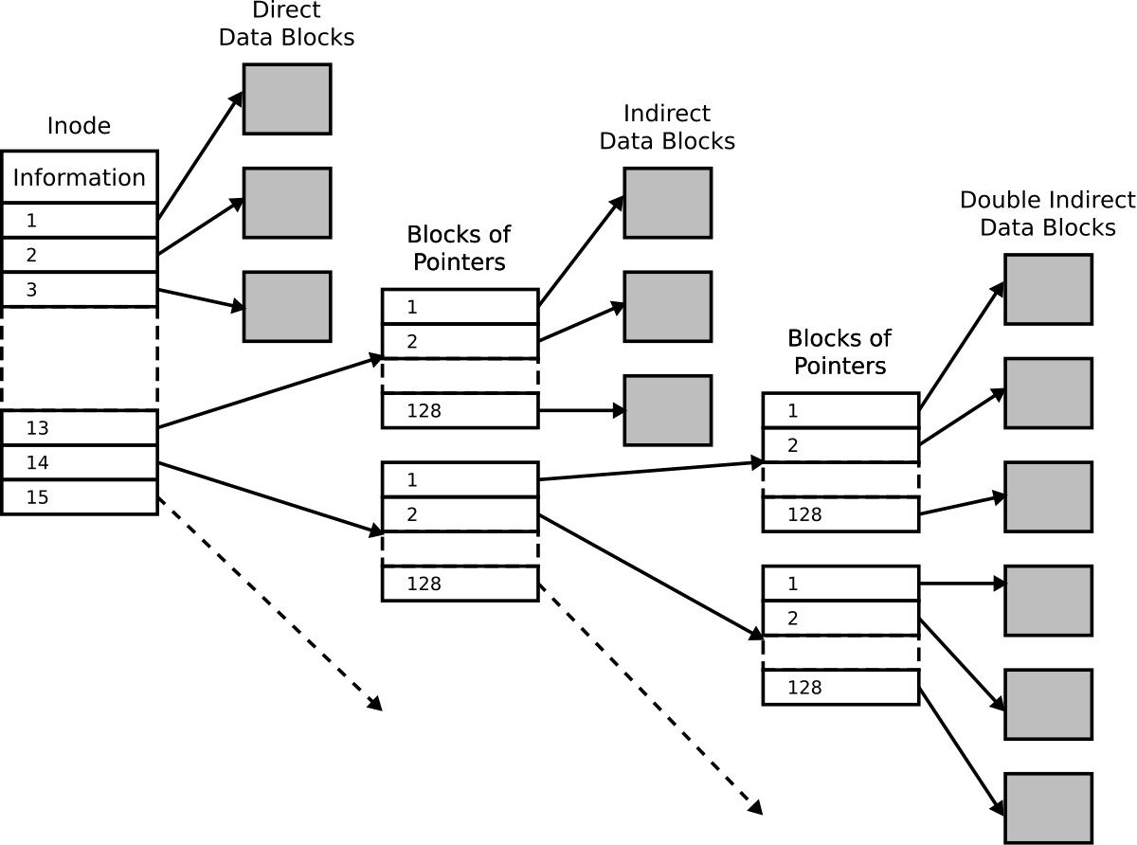
File Organization: Inode (2/3)
Each ext2 inode
15 disk pointers:
12 direct pointers;
1 indirect pointer;
1 double indirect pointer;
1 triple indirect pointer
Indirect Blocks
11

Slide 12
Discussion
Question: Why we maintain an imbalance tree?
Answer:
  Most files are small in practice.
  Access performance is optimized for small files.
Bonus: How big can a file be in Ext2?
  Let the block size be 4KB;
  Let each pointer size be 4 bytes.
  Note: Each inode in Ext2 has 12 direct pointers; 1 indirect pointer; 1 double indirect pointer; 1 triple indirect pointer.
12

Slide 13
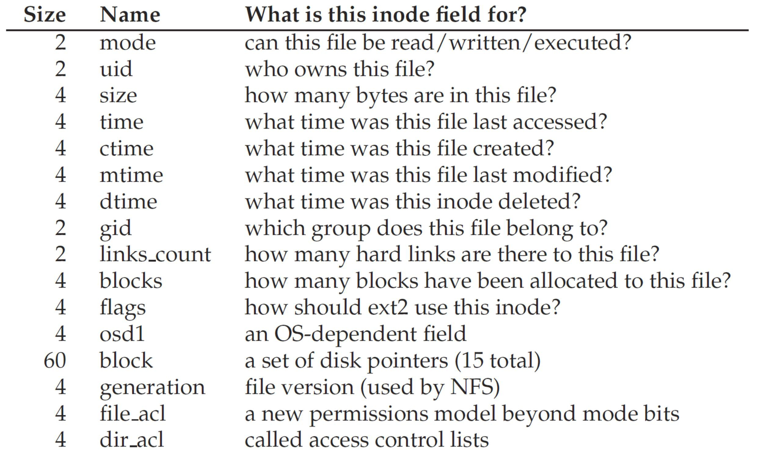
File Organization: Inode (3/3)
An inode tracks everything except “file name” (why?).
13

Slide 14
Directory Organization
A directory is a special type of file.
  Each directory is also associated with an inode number.
  A directory contains a list of (file name, inode number)
pairs in its corresponding data block(s).
        . = current directory
        .. = parent directory
        strlen = length of the file name (including ‘\0’)
        reclen = actual space for an entry (used when deletion)
inum | | | reclen | | strlen | | name
5 |  | 12 | 2 | .
2 |  | 12 | 3 | ..
12 |  | 12 | 4 | foo
13 |  | 12 | 4 | bar
24 |  | 36 | 28 | foobar_is_a_pretty_lon
14

Slide 15
Free Space Management
A file system must track which inodes and data blocks are allocated or not:
  Bitmap is one way for free space management.
    0: free; 1: used
  Other structures, e.g., free list and B-tree, are feasible.
    There is always a trade-off between time and space.
  Pre-allocation may also be used.
    Strategy: Always looking for a sequence of free blocks (say 8).
– A portion of the file will be contiguous on the disk (better performance).
15

Slide 16
Exercise
Question: Can you locate the data block(s) for a file?
The root inode number must be “well known” (e.g., inode #2).
/foo/bar.txt
16

Slide 17
Outline
File System Organization
  Abstraction: Files and Directories
  Metadata Region and Data Region
File System Interface
File System Implementations
  UNIX File System
    Access Paths: Reading and Writing
    Caching and Buffering
  Fast File System (FFS)
    Disk Awareness
    Data Locality
  Crash Consistency
    File System Checker
    Journaling
I/O Stack
Application
User
Kernel
File System
Block Layer
Device Driver
I/O Device
17

Slide 18
File System Interface
File system interface includes:
  Creating files;
  Reading/writing files;
  Renaming files;
  Getting information about files;
  Removing files;
  Managing directories;
  Linking files/directories;
  Mounting/unmounting a file system.
The file system interface uses (or wraps) the OS system calls for file/directory management.
  We focus on UNIX.
18

Slide 19
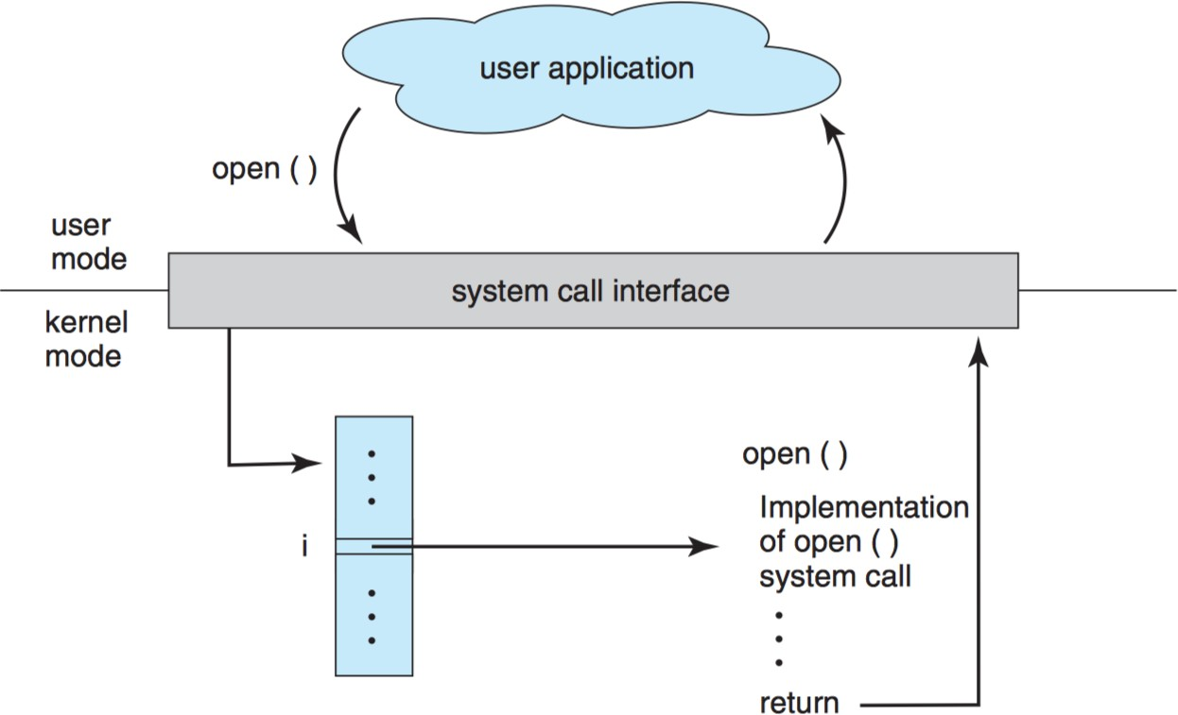
Recall: System Calls
System Call Handler
function pointer(s)
19

Slide 20
Creating Files (1/2)
The system call open() is to create or open a file:
1st argument: file name (absolute or relative pathname)
2nd argument:
  O_CREAT: creates a file;
  O_WRONLY: only write is allowed;
  O_TRUNC: truncate to zero size if a file exists.
3rd argument: specifies permissions (readable or writable).
On success, a file descriptor is returned
  A pointer for subsequent accesses (function calls) to a file.
  In UNIX, it’s just an integer.
int fd = open( "foo", O_CREAT | O_WRONLY | O_TRUNC,
S_IRUSR|S_IWUSR);
20

Slide 21
Creating Files (2/2)
File descriptors are managed on a per-process basis by the operating system .
For example, the UNIX systems (xv6 kernel) must keep some kind of structure in the struct proc:
  A simple array (with a maximum of NOFILE open files) tracks which files are opened on a per-process basis.
  Each entry of the array is just a pointer to a struct file, which tracks the information of the “open file” being used.
struct proc {
...
struct file *ofile[NOFILE]; // Open files
...
};
21

Slide 22
Management of Open Files (1/2)
struct proc {
...
struct file *ofile[N];
// open files
...
};
struct file {
struct inode *ip; char readable; char writable; uint off;
int ref; };
The struct file represents an open file:
  The struct file (an open file) is referenced by a process.
  The readable/writable specifies read/write permissions.
  The off keeps the “current” offset, where the next read/write should take place, for this open file.
  The actual file is referenced by the struct inode.
All open files are kept in an open file table by OS.
22

Slide 23
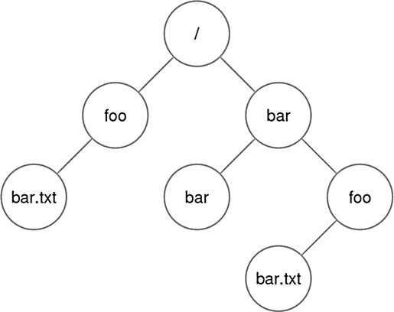
Management of Open Files (2/2)
File System Organization
Process A
Open File Table
struct proc
(struct file) inode *ip off: 100 ref: 1
inode *ip off: 0 ref: 1
inode *ip off: 0 ref: 1
3
Process B
struct proc
3
inode #1000
File A
Process C
struct proc
3
inode #2000
File B
23

Slide 24
Reading and Writing Files (1/4)
How does a process actually read or write a file?
Exercise: Let’s use the strace tool to trace every system call made by reading (cat) the file foo:
prompt> strace cat foo
...
open("foo", O_RDONLY|O_LARGEFILE) | = | 3
read(3, "hello\n", 4096) | = | 6
write(1, "hello\n", 6) | = | 6
hello
read(3, "", 4096) | = | 0
close(3) close(1) | = = | 0 0
...
File
File
stdout
stdout
File
File
stdout
24

Slide 25
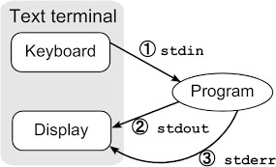
Reading and Writing Files (2/4)
open("foo", O_RDONLY|O_LARGEFILE) = 3
First, the open() system call opens a file for reading:
  O_RDONLY: read only (writing is not allowed)
  O_LARGEFILE: 64-bit offset is used.
open() returns a file descriptor of 3.
  Each running process already has three “open files”:
    Standard Input: 0
    Standard Output: 1
    Standard Error: 2
25

Slide 26
Reading and Writing Files (3/4)
read(3, | "hello\n", | 4096) | = | 6
write(1, | "hello\n", | 6) | = | 6
hello
read(3, | "", 4096) |  | = | 0
close(3) |  |  | = | 0
read() are called for many times to read the file:
  1st argument: file descriptor
  2nd argument: buffer where the results are stored
  3rd argument: size of the buffer
write() is called to display output on screen (fd=1).
close() is called when reaching the EOF.
Writing a file? open() → write() → close()
26

Slide 27
Reading and Writing Files (4/4)
lseek() is to read or write to a specific offset within a file (rather than from the beginning to the end).
  1st argument: file descriptor
  2nd argument: positions the offset to a particular location within a file (for subsequent reads/writes).
    lseek() has nothing to do with a disk seek!
  3rd argument: specifies how lseek() is performed.
    SEEK_SET: set to offset bytes from the beginning
    SEEK_CUR: set to current location plus offset bytes
    SEEK_END: set to offset bytes from the end
off_t lseek(int fd, off_t offset, int whence);
27

Slide 28
Exercise
Let’s track a process that
  opens a file named “file” (of size 300 bytes);
  reads it by calling the read() system call repeatedly (each time reading 100 bytes).
System Calls | Return Code | Current Offset
fd = open("file", O RDONLY);
read(fd, buffer, 100);
read(fd, buffer, 100);
read(fd, buffer, 100);
read(fd, buffer, 100);
close(fd);
28

Slide 29
Exercise
Let’s track a process that
  uses lseek() to reposition the current offset;
  reads 50 bytes from the file;
  closes the file.
System Calls | Return Code | Current Offset
fd = open("file", O RDONLY);
lseek(fd, 200, SEEK_SET);
read(fd, buffer, 50);
close(fd);
29

Slide 30
Exercise
Let’s track a process that
  opens the same file (named “file”) twice;
  issues a read to each of them.
System Calls | Return Code | Current Offset (fd1) | Current Offset (fd2)
fd1 = open("file", O RDONLY);
fd2 = open("file", O RDONLY);
read(fd1, buffer1, 100);
read(fd2, buffer2, 100);
close(fd1);
close(fd2);
30

Slide 31
Shared File Table Entries
In many cases, the mapping of file descriptor to an entry in the open file table is a one-to-one mapping.
An entry in the open file table can be shared when
  A parent process creates a child process with fork();
  A process creates a few file descriptors that refers to the same file with dup() or its cousins dup2() and dup3().
Open File Table Open File Table
Parent Proc
(struct file) inode *ip off: 100 ref: 2
(struct file) inode *ip off: 100 ref: 2
3
3
6
Child
3
31

Slide 32
Forcing Writes
For performance, the file system buffers writes in memory (e.g., for 5 sec or 30 sec).
The fsync() system call forces all dirty (i.e., not yet written) data to the disk.
int fd = open("foo", O_CREAT|O_WRONLY|O_TRUNC,
S_IRUSR|S_IWUSR);
assert(fd > -1);
int rc = write(fd, buffer, size); assert(rc == size);
rc = fsync(fd);
assert(rc == 0);
32

Slide 33
Information of Files
The file system keeps a fair amount of information about each file it is storing.
– stat() or fstat() calls can be used to see the metadata.
struct stat {
dev_t st_dev; /* ID of device containing file */ ino_t st_ino; /* inode number */
mode_t st_mode; /* protection */
nlink_t st_nlink; /* number of hard links */
uid_t st_uid; /* user ID of owner */ gid_t st_gid; /* group ID of owner */
dev_t st_rdev; /* device ID (if special file) */ off_t st_size; /* total size, in bytes */
blksize_t st_blksize; /* blocksize for filesystem I/O */ blkcnt_t st_blocks; /* number of blocks allocated */ time_t st_atime; /* time of last access */
time_t st_mtime; /* time of last modification */
time_t st_ctime; /* time of last status change */ };
33

Slide 34
Summary of File System Operations
File System Operations | System Calls
Creating a file | open()
Reading a file | read()
Writing a file | write(), fsync()
Seeking to an offset | lseek()
Renaming a file | rename() (often an atomic call)
Getting file information | stat() or fstat()
Removing a file | unlink()
Making a directory | mkdir()
Reading a directory | opendir(), readdir(), closedir()
Removing a directing | rmdir() (must be empty)
34

Slide 35
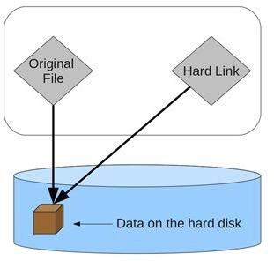
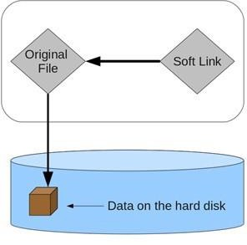
Links
File systems allow links to create multiple names (aliases) for the same file
  Hard Link: holds the inode number of a file.
  Symbolic/Soft Link: holds the pathname to a file.
35

Slide 36
Recall: Directory Organization
A directory is a special type of file.
  Each directory is also associated with an inode number.
  A directory contains a list of (file name, inode number)
pairs in its corresponding data block(s).
        . = current directory
        .. = parent directory
        strlen = length of the file name (including ‘\0’)
        reclen = actual space for an entry (used when deletion)
inum | | | reclen | | strlen | | name
5 |  | 12 | 2 | .
2 |  | 12 | 3 | ..
12 |  | 12 | 4 | foo
13 |  | 12 | 4 | bar
24 |  | 36 | 28 | foobar_is_a_pretty_lon
36

Slide 37
Hard Link
Hard link (ln) creates a new entry in the directory to refer to the same inode number of the original file.
Create a Hard Link Show inode Numbers Remove a File
The inode has a reference count that keeps track of how many hard links refer to it.
  Only when the reference count is zero, the file system frees the inode and related data blocks.
  This explains why unlink() is called when removing a file.
prompt> echo hello > file prompt> cat file
hello
prompt> ln file hard_link prompt> cat hard_link hello
prompt>
ls -i file hard_link 67158084 file
67158084 hard_link
prompt> rm file removed ‘file’ prompt> cat hard_link hello
37

Slide 38
Recall: File Organization: Inode
An inode tracks everything except “file name” (why?).
38

Slide 39
Symbolic/Soft Link
Hard links are limited:
  Cannot link to a directory (to avoid creating a cycle).
  Cannot link to a different partition (only within a file system).
Symbolic Link (ln -s)
  It is a special file with its own inode number.
  It holds a pointer to link but may cause dangling reference.
prompt> echo hello > file prompt> cat file
hello
prompt> ln file soft_link
prompt> cat soft_link hello
prompt> rm file prompt> cat soft_link
cat: soft_link: No such file or directory
prompt> echo hello > file prompt> cat file
hello
prompt> ln file soft_link
prompt> cat soft_link hello
prompt> rm file prompt> cat soft_link
cat: soft_link: No such file or directory
39

Slide 40
Hard Link vs. Soft Link
File systems allow links to create multiple names (aliases) for the same file
  Hard Link: holds the inode number of a file
    By only creating a new directory entry.
  Symbolic/Soft Link: holds the pathname to a file
    By creating a new file of special type.
    Three types of file: 1) Data File; 2) Directory File; 3) Soft Link File.
inum | name
inum | name
Directory
12
12
file hard_link
Directory
12
13
file soft_link
ino #12
ino #12
ino #13
path “file”
file
Disk
ref count: 2
file
Disk
ref count: 1
40

Slide 41
Mounting a File System
Final Step: Set up a file system to make it run.
Mounting (mount) a file system:
– Create a mount point
– Paste a file system onto the directory tree at that point
You can have multiple file systems on the same machine, and mounts all file systems into one tree!
your I/O device (SCSI)
prompt> mount -t ext3 /dev/sda1 /home/users
/home/users/dev/sda1 on / type ext3 (rw) proc on /proc type proc (rw)
sysfs on /sys type sysfs (rw)
/dev/sda5 | on | /tmp | type | ext3 | (rw)
/dev/sda7 | on /var/vice/cache |  |  |  | type | ext3 | (rw)
tmpfs on | /dev/shm type tmpfs |  |  |  | (rw)
AFS on /afs type afs (rw)
41

Slide 42
Outline
File System Organization
  Abstraction: Files and Directories
  Metadata Region and Data Region
File System Interface
File System Implementations
  UNIX File System
    Access Paths: Reading and Writing
    Caching and Buffering
  Fast File System (FFS)
    Disk Awareness
    Data Locality
  Crash Consistency
    File System Checker
    Journaling
I/O Stack
Application
User
Kernel
File System
Block Layer
Device Driver
I/O Device
42

Slide 43
UNIX File System
The organization we have learnt is a simplified version of a typical UNIX file system:
Metadata Region: tracks data and file system information.
Data Region: stores user data and occupies most space.
43

Slide 44
Outline
File System Organization
  Abstraction: Files and Directories
  Metadata Region and Data Region
File System Interface
File System Implementations
  UNIX File System
    Access Paths: Reading and Writing
    Caching and Buffering
  Fast File System (FFS)
    Disk Awareness
    Data Locality
  Crash Consistency
    File System Checker
    Journaling
I/O Stack
Application
User
Kernel
File System
Block Layer
Device Driver
I/O Device
44

Slide 45
Recall: Exercise
Question: Can you locate the data block(s) for a file?
The root inode number must be “well known” (e.g., inode #2).
/foo/bar.txt
45

Slide 46
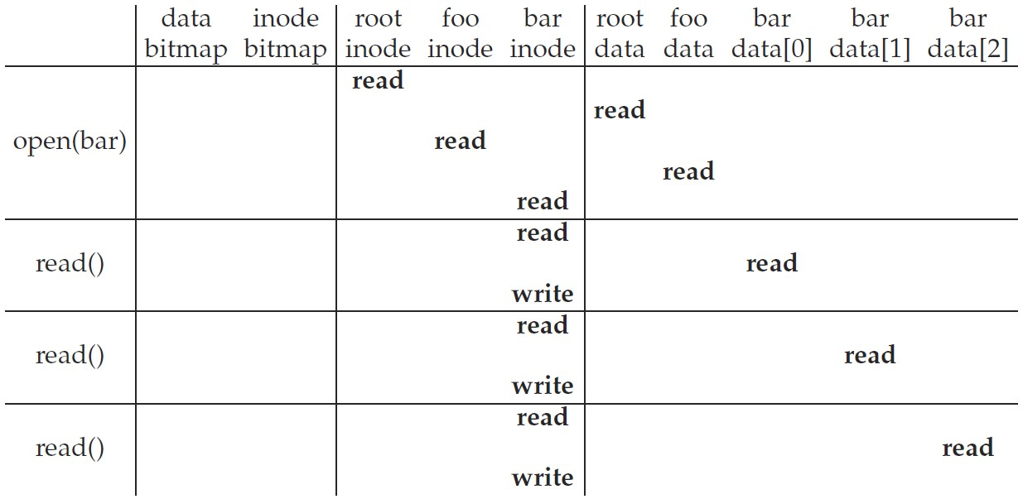
Access Path: Read (1/2)
Example: Read a file /foo/bar
  Traverse the pathname to locate the requested inode:
    root → foo → bar
1. Read root inode (must be known) to locate root data
2. Read root data to find foo inode
3. Read foo inode to locate foo data
4. Read foo data to find bar inode
5. Read bar inode into memory*
Read bar inode to locate data
Read data block of bar
Update timestamp of bar inode
46

Slide 47
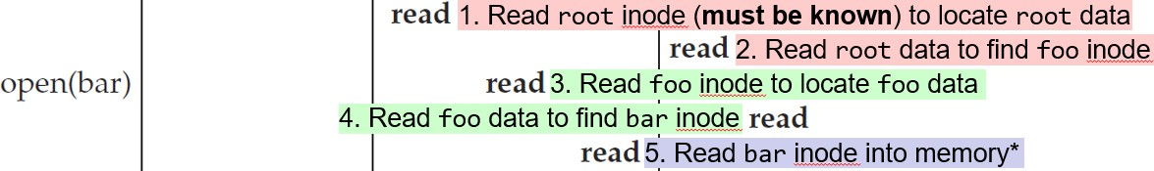
Access Path: Read (2/2)
Note 1: The amount of I/O generated by the open() is proportional to the length of the pathname.
  Large directories would make this worse. (Why? Step 4)
Note 2: The following work is also needed but not listed:
  Step 5 also needs to check permissions; allocate a file descriptor for this process; create an entry in the open-file table; return the file descriptor to the user.
Read bar inode to locate data
  Note 3: The read will further update the in-memory open file table to maintain the file offset for this file descriptor.
    Such that the next read will read the subsequent file block.
47

Slide 48
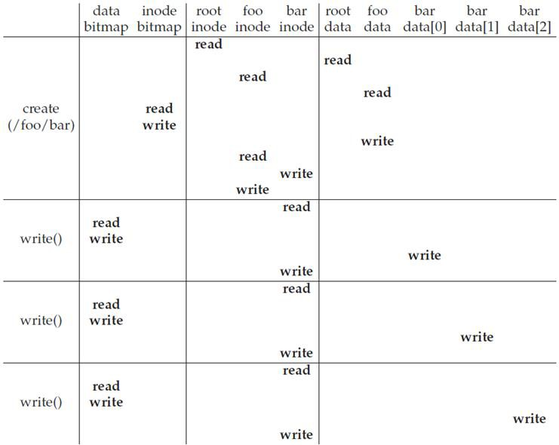

Access Path: Write (1/2)
Example: Create (write) a new file /foo/bar
1. The file must be opened as well
10
I/Os
(find a free inode) (mark it allocated)
2. FS must not only allocate an inode, but also allocate space within the directory for the file
(link the file name and the inode in dir)
(update)
(initialize)
5
I/Os
(find a free data block)
(update data bitmap)
(update with the new data block location)
(write the actual data block)
5
I/Os
5
I/Os
48

Slide 49
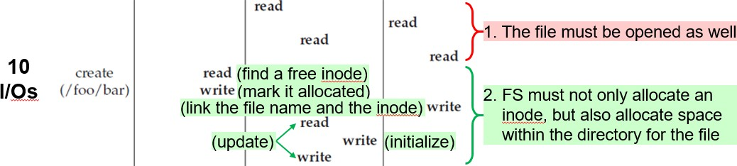
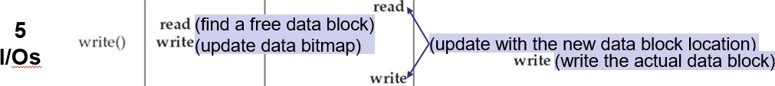
Access Path: Write (2/2)
10 I/Os are needed to walk the pathname and create file.
  If the directory needs to grow, additional I/Os are needed.
– i.e., to the data bitmap, and the new directory block.
Each data block write logically generates 5 I/Os.
  If write() involves indirect pointers, more I/Os are needed as well.
49

Slide 50
Outline
File System Organization
  Abstraction: Files and Directories
  Metadata Region and Data Region
File System Interface
File System Implementations
  UNIX File System
    Access Paths: Reading and Writing
    Caching and Buffering
  Fast File System (FFS)
    Disk Awareness
    Data Locality
  Crash Consistency
    File System Checker
    Journaling
I/O Stack
Application
User
Kernel
File System
Block Layer
Device Driver
I/O Device
50

Slide 51
Caching and Buffering
Like in UNIX file system, reading and writing files can be expensive, incurring many I/Os to the (slow) disk.
Most file systems leverage the system memory to:
  Cache some important or popular blocks
    To avoid repeated reads to the same blocks
    To avoid performing hundreds of reads to open a file with long pathname (e.g., /1/2/3/…/100/file.txt).
  Buffer a number of writes (for 5~30 seconds)
    To allow writes to the same location (in memory)
    To batch updates into a smaller set of I/Os
    To allow rescheduling of I/Os
  Cache/buffer trades reliability for performance!
    But not everyone likes it; some applications (e.g., databases) require frequent fsync() to avoid losing data kept in the write buffer.
51

Slide 52
Outline
File System Organization
  Abstraction: Files and Directories
  Metadata Region and Data Region
File System Interface
File System Implementations
  UNIX File System
    Access Paths: Reading and Writing
    Caching and Buffering
  Fast File System (FFS)
    Disk Awareness
    Data Locality
  Crash Consistency
    File System Checker
    Journaling
I/O Stack
Application
User
Kernel
File System
Block Layer
Device Driver
I/O Device
52

Slide 53

Revisit File System Organization (1/2)
“Old UNIX File System” by Ken Thompson:
The super block (S) contained the file system information:
  How big the volume is, how many inodes there are, a pointer to the head of a free list of blocks, and so forth.
The inode region contained all inodes for the file system.
Most of the disk space was taken up by data blocks.
Problem 1: Poor Performance
  The file system was delivering only 2% of disk bandwidth, because of expensive disk positioning costs.
    The data blocks of a file were often very far away from its inode.
– An expensive seek was induced whenever one first read the inode, and then read the file system block.
53

Slide 54


Revisit File System Organization (2/2)
“Old UNIX File System” by Ken Thompson:
Problem 2: Fragmentation
  External Fragmentation
    Free block space is not
contiguous.
    A large file may have blocks scattered across disk.
    Disk defragmentation tools may help by reorganization.
Internal Fragmentation
  Reads/writes are in units of
blocks.
  If a small file cannot cover a block, block space is wasted.
  Smaller blocks may have more positioning overhead.
After writing file E of four blocks
After writing file F of 1/2 block
54

Slide 55
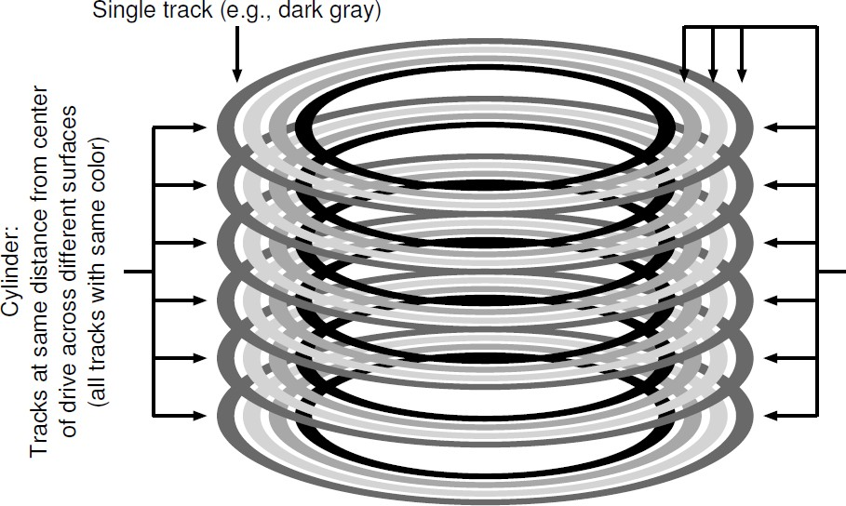
Fast File System (FFS) by Berkeley
Goal: Make the file system structures and allocation policies to be “disk-aware” to improve performance.
– By keeping the same file system interface (i.e., system calls) but
changing the internal implementation.
Key: FFS divides disk into cylinder groups.
Cylinder: Tracks at same distance from center across different surfaces (same color)
Cylinder Group: A set of 𝑁 consecutive cylinders (different color)
55

Slide 56

Fast File System (FFS) (2/3)
FFS aggregates 𝑁 consecutive cylinders into a group, and the disk is of a collection of cylinder groups.
…
Modern disks do not export cylinder information for the file system to explore.
Modern FSs instead organize disk into block groups.
– Each block group is of the consecutive block addresses (rather than consecutive cylinders).
56

Slide 57

Fast File System (FFS) (3/3)
FFS maintains similar structures for each group:
  A copy of superblock (S)
  Per-group inode bitmap (ib) and data bitmap (db)
  Per-group inode and data block regions.
FFS further explores the data locality to place files, directories, and associated metadata on disk:
keep related stuff together, keep unrelated stuff far apart
  ① Allocate data blocks of a file in the same group as its inode
  ② Place files of the same directory in the same group
  ③ Balance directories across groups
57

Slide 58
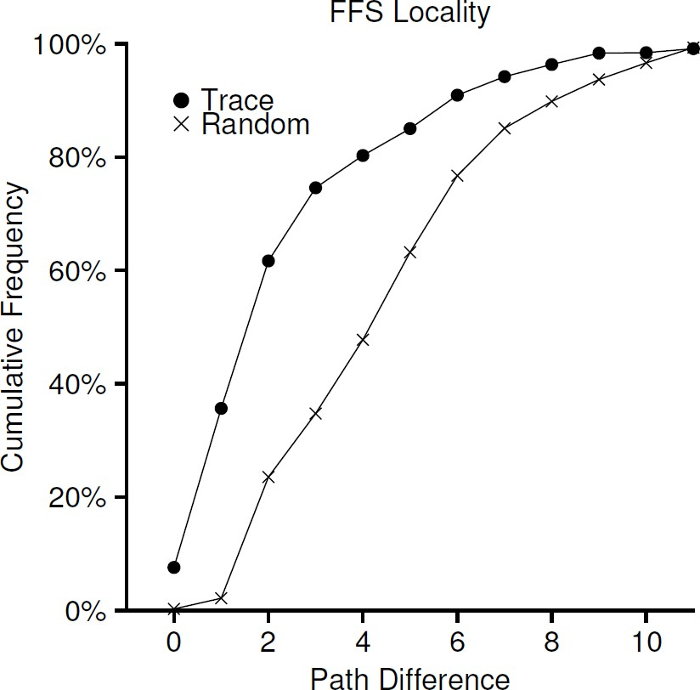
Data Locality
Locality (i.e., tendency) is found in real file accesses.
assume files are randomly accessed
another 25% were to files that had a distance of two
40% of file accesses were to either the same file or to one in the same directory (i.e., a difference of zero or one)
Locality: How far up the directory tree to find the common ancestor
58

Slide 59
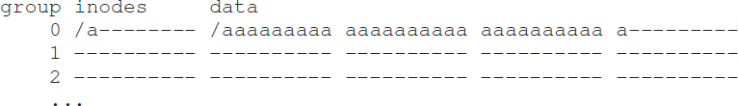
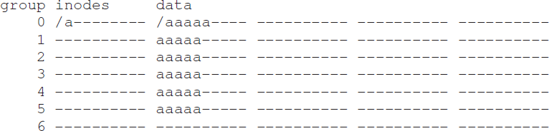
Large-File Exception
What if file size is larger than group size?
  Filling the whole group with a large file is undesirable.
  It prevents “related” files being placed in the same group.
FFS divides a file into chunks and stores chunks in different groups evenly.
– Large-enough chunk amortizes the positioning overhead.
59

Slide 60
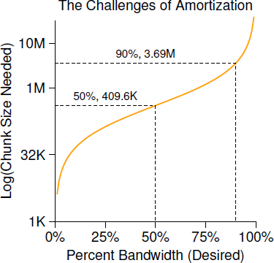

Discussion
Question: How big does a chunk have to be in order to spend half (i.e., 50%) of time in transfer?
Let’s assume that
  Data transfer rate: 40 MB/s
  Average disk positioning time: 10 ms
Answer:
  Half of time: 10 ms transferring
for every 10 ms positioning
  That is, how many data we can transfer in 10 ms?
60

Slide 61
Outline
File System Organization
  Abstraction: Files and Directories
  Metadata Region and Data Region
File System Interface
File System Implementations
  UNIX File System
    Access Paths: Reading and Writing
    Caching and Buffering
  Fast File System (FFS)
    Disk Awareness
    Data Locality
  Crash Consistency
    File System Checker
    Journaling
I/O Stack
Application
User
Kernel
File System
Block Layer
Device Driver
I/O Device
61

Slide 62
Crash Consistency
File system data structures must persist
Challenge: How to update persistent data structures despite the presence of power loss or system crash.
– The on-disk structure may be left in an inconsistent state.
Solutions to the crash-consistency problem:
① File System Checker (FSCK)
② Journaling (a.k.a. Write-ahead Logging)
62

Slide 63
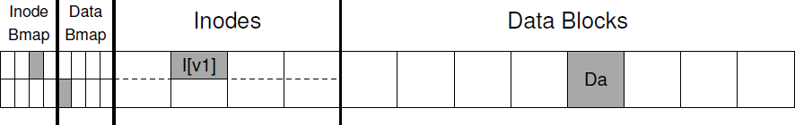
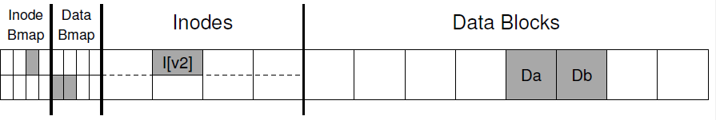
Crash Scenarios (1/3)
Consider appending a data block to an existing file:
The file system must perform three writes:
① the new data block (Db)
② the inode to point to the new block (I[v1] → I[v2])
③ the data bitmap to indicate the allocation (B[v1] → B[v2])
A crash may happen at any time. (How many types?)
②
③
①
63

Slide 64
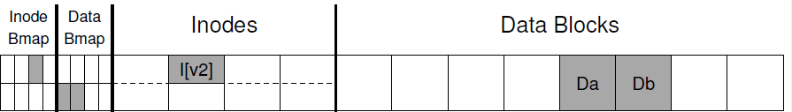
Crash Scenarios (2/3)
Consider only one single write succeeds:
  Just the data block (Db):
    File system remains consistent, but user loses data.
    It is as if the write never occurred.
  Just the updated inode (I[v2]):
    File system is inconsistent:
      Inode says it has data, but bitmap says otherwise (disagreement).
    If we trust inode, we will read garbage data (not Db) from the disk.
  Just the updated bitmap (B[v2]):
    File system is inconsistent:
      Bitmap says the block is allocated, but inode says otherwise.
    It would result in a space leak, as the block would never be used.
64

Slide 65
Crash Scenarios (3/3)
Consider two writes succeed:
  The inode (I[v2]) and bitmap (B[v2]):
    The file system “metadata” is completely consistent:
      Inode has a pointer to the block, and bitmap also indicates it is in use.
    But we will read garbage data (not Db) from the disk.
  The inode (I[v2]) and data block (Db):
    File system is inconsistent:
      Inode says it has data, but bitmap says otherwise (disagreement).
    If we trust inode, we might read right data (i.e., Db) from the disk.
  The bitmap (B[v2]) and data block (Db):
    File system is inconsistent.
    We have no idea which file Db belongs to, and face space leak.
65

Slide 66
Naive Solution
What we’d like to do ideally is move the file system from one consistent state to another atomically.
– E.g., (before the file got appended) → (after the inode, bitmap, and new
data block have been written to disk)
Unfortunately, we can’t do this easily.
  The disk only commits one write at a time.
  Crashes or power loss may occur between these updates.
66

Slide 67
Outline
File System Organization
  Abstraction: Files and Directories
  Metadata Region and Data Region
File System Interface
File System Implementations
  UNIX File System
    Access Paths: Reading and Writing
    Caching and Buffering
  Fast File System (FFS)
    Disk Awareness
    Data Locality
  Crash Consistency
    File System Checker
    Journaling
I/O Stack
Application
User
Kernel
File System
Block Layer
Device Driver
I/O Device
67

Slide 68
Solution #1: File System Checker
Early file systems took a simple approach.
– They let inconsistencies happen and then fix them later.
fsck is a UNIX tool for fixing such inconsistencies.
  It runs before the file system is mounted.
  It checks superblock, free blocks, inode state, inode links, duplicates, bad blocks, etc., to make sure the file system metadata is internally consistent.
    It does not understand the contents of user files; however, it can perform integrity checks on contents of directories.
Problems:
① It is very slow (especially for large disk volume).
② It cannot fix all problems: For example, the file system looks consistent
but the inode points to garbage data.
68

Slide 69
Outline
File System Organization
  Abstraction: Files and Directories
  Metadata Region and Data Region
File System Interface
File System Implementations
  UNIX File System
    Access Paths: Reading and Writing
    Caching and Buffering
  Fast File System (FFS)
    Disk Awareness
    Data Locality
  Crash Consistency
    File System Checker
    Journaling
I/O Stack
Application
User
Kernel
File System
Block Layer
Device Driver
I/O Device
69

Slide 70

Solution #2: Journaling
Journaling (or write-ahead logging) is the most popular solution to the consistency problem.
  It first writes a note to a separate log structure (somewhere else on the disk) before updating the structures in place.
  It adds a bit of work during updates; but the log tells what to fix after a crash without scanning the entire disk.
Linux ext3 incorporates journaling into FS as follows:
  The disk is divided into block groups as FFS, ext2, etc.
    Each group has its inode/data bitmap, inodes, and data blocks.
  Journal (log) occupies some small amount of space.
  Question: What should we note in the journal?
70

Slide 71
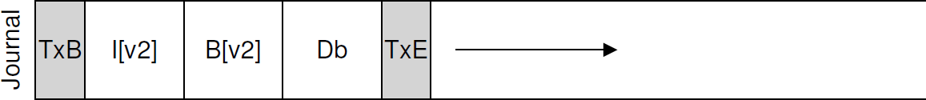
Data Journaling (1/4)
Consider the example of block appending with three writes: inode (I[v2]), bitmap (B[v2]), data block (Db).
Data Journaling: Write all of them into the log as a transaction, before updating them in place.
  The transaction begin (TxB) tells us about this update.
    Including information about this pending update (e.g., the addresses of the three blocks), and a transaction identifier (TID).
  The middle contains the exact contents of the three blocks.
  The final block (TxE) is a marker of the end with the TID.
Checkpoint: Write the pending data and metadata updates to the final locations in the file system.
71

Slide 72

Data Journaling (2/4)
Question: How should data journaling issue the five writes of a transaction (TxB, I[v2], B[v2], Db, TxE)?
Approach #1: Issue them one by one
  It is safe, but too slow.
Approach #2: Issue all five writes at once
  It turns five writes into a sequential one and thus be faster.
  It is unsafe, since the disk internally re-schedules I/Os.
    If disk loses power before writing any of them to the journal, the wrong contents are used during replay.
    For example, the garbage block “??” is copied to the final location of Db when the file system replays the transaction.
72

Slide 73


Data Journaling (3/4)
Approach #3: Issue writes in two steps
Step 1) Issue all writes except TxE at once
Journal Write
Step 2) Issue the write of TxE, leaving journal in the safe state
  To ensure the write of TxE is atomic, it must be a 512-byte write.
Journal Commit
The sequence of data journaling:
① Journal Write: Write transaction content except TxE
② Journal Commit: Write the transaction commit block (TxE)
③ Checkpoint: Write pending updates to final disk locations
73

Slide 74
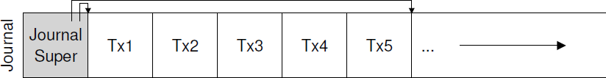
Data Journaling (4/4)
Recovery
  The file system scans the log and looks for transactions that have committed but not checkpointed yet.
  Committed transactions are replayed in order (a.k.a., redo).
    Redundant updates are possible, but they don’t hurt consistency.
Optimization(s)
  Batching Log Updates
    Some file systems (e.g., ext3) do not commit each update at a time, but buffer updates into a global transaction to reduce write traffic.
  Making The Log Finite
    The journal is a finite-sized circular log by marking the oldest and newest non-checkpointed transactions in the journal superblock.
74

Slide 75

Metadata Journaling (1/3)
Data journaling doubles write traffic to the disk.
Metadata Journaling (or Ordered Journaling): Log everything except the user data (i.e., Db).
Key Issue: The ordering of user data write is critical.
  Write Db after the transaction completes:
    The file system is consistent.
    But inode (I[v2]) may point to garbage data if the write of Db fails.
  Write Db before the transaction completes:
    Both file system and data consistency can be guaranteed.
75

Slide 76
Metadata Journaling (2/3)
The sequence of metadata journaling:
    ① Data Write: Write data to final location
    ② Journal Metadata Write: Write the begin block (TxB) and metadata (I[v2],
    B[v2]) to log
    ③ Journal Commit: Write the transaction commit block (TxE)
    ④ Checkpoint Metadata: Write the contents of metadata update to their final locations within the file system
    ⑤ Free: Mark the transaction free in the journal superblock
Notes:
  Forcing the data write to complete (Step 1) before issuing writes to the journal (Step 2) is not required.
  The only real requirement is that Steps 1 and 2 complete before the issuing of the journal commit block (Step 3).
76

Slide 77

Metadata Journaling (3/3)
Tricky Case: Block Reuse
    Let’s say we have a directory foo at block 1000.
    Suppose the user ① adds a new entry to the directory foo, ② deletes the directory content (nothing logged!), and ③ creates a new file foobar at block 1000 (by reusing it).
① ③
    The directory content is metadata and should be logged.
    What happens if we recover from a crash?
      The recovery process simply replays everything in the log, including the write of directory data (D[foo]) in block 1000.
      This overwrites the user data of new file foobar by directory data.
    Solution: Add a revoke record to avoid re-writing old data.
77

Slide 78
Wrap-up: Journaling Timeline
Data Journaling
TxB | Metadata | Data | TxE | Metadata | Data
Issue | Issue | Issue
Complete | Complete | Complete
 |  |  | Issue
 |  |  | Complete
 |  |  |  | Issue | Issue
 |  |  |  | Complete | Complete
Metadata Journaling
TxB | Metadata
Issue | Issue
Complete | Complete
TxE | Metadata | Data
 |  | Issue
 |  | Complete
Issue
Complete
 | Issue
 | Complete
78

Slide 79
Other Approaches
Copy-On-Write (COW)
  Never overwrites files or directories in place.
  Places new updates to previously unused locations on disk.
  Includes the newly updated structures after a number of updates are completed.
  Built on the design of the log-structured file system (LFS).
Backpointer-Based Consistency (BBC)
  Adds a backpointer to every data block.
  Achieves lazy crash consistency without ordering.
    By checking if the forward pointer (e.g., the address in the inode or direct block) points to a block that refers back to it.
79

Slide 80
summary
File System Organization
  Abstraction: Files and Directories
  Metadata Region and Data Region
File System Interface
File System Implementations
  UNIX File System
    Access Paths: Reading and Writing
    Caching and Buffering
  Fast File System (FFS)
    Disk Awareness
    Data Locality
  Crash Consistency
    File System Checker
    Journaling
I/O Stack
Application
User
Kernel
File System
Block Layer
Device Driver
I/O Device
80

Slide 81

Q & A
Thank you for your attention.
Notes:
Thank you for listening. Now, I would like to end today’s talk by the Q & A time.

