Slide 1

File and Storage System Lecture 04: File System Designs
Department of Computer Science and Information Engineering
Shuo-Han Chen (陳碩漢), shchen@ntut.edu.tw
Hong-Yue Technology Research Building 334
M 16:10 - 18:00 & W 11:10-12:00

Slide 2
Course Schedule
W | Date | Lecture | Notes | Homework
1 | Feb. 21 | Lecture 00: Course Information |  | HW00
2 | Feb. 28 | Peace Memorial Day | No Class
3 | Mar. 7 | Lecture 01: System Calls & I/O Devices
4 | Mar. 14 | Lecture 02: RAID and Data Integrity
5 | Mar. 21 | Lecture 03: File System Basics
6 | Mar. 28 | Lecture 04: File System Designs | Flipped | HW01
7 | Apr. 4 | Tomb Sweeping Day | No Class
8 | Apr. 11 | Lecture 05: Distributed File Systems | Flipped
9 | Apr. 18 | Midterm
10 | Apr. 25 | Lecture 06: Flash Memory | PHISON
11 | May 2 | Lecture 07: Next-generation Hard Disk Drive | Flipped | HW02
12 | May 9 | Lecture 06: Flash Memory | PHISON
13 | May 16 | Lecture 06: Flash Memory | PHISON
14 | May 23 | Lecture 06: Flash Memory | PHISON
15 | May 30 | Lecture 08: Persistent Memory | Flipped | HW04
16 | Jun. 6 | Final Presentation
17 | Jun. 13 | Final Presentation
18 | Jun. 20 | Final Presentation
2

Slide 3


Outline
I/O Stack
Log-structured File System (LFS)
Key Idea: Writing Sequentially
Indirect Mapping and Checkpoint Region
Directories
Garbage Collection
Crash Recovery
File Implementation: Block Allocation
Indexed Allocation
Linked Allocation
Contiguous Allocation
Application
User
Kernel
File System
Block Layer
Device Driver
I/O Device
3

Slide 4
Motivation: Why to develop LFS?
We need a file system that improves writes:
System memories are growing.
More data can be cached in memory to service reads effeciently.
Disk traffic increasingly consists of writes.
There is a large gap between random I/O and sequential I/O performance in disk.
Disk transfer bandwidth has increased a lot over the years.
– By packing more bits into the surface of a disk.
Seek and rotational delay costs have decreased slowly.
Existing file systems perform poorly.
FFS incurs many short seeks and rotational delays.
File systems are not RAID-aware.
Both RAID-4 and RAID-5 have the small-write problem.
Existing file systems do not avoid this RAID writing behavior.
4

Slide 5
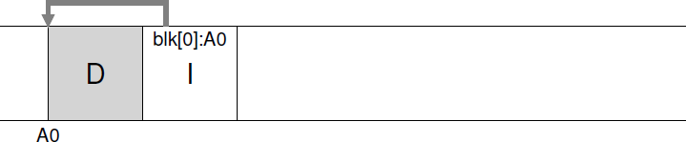
Log-structured File System (LFS)
Log-structured File System (LFS)
Writes everything (including data blocks and inodes, etc.) to the disk sequentially.
Ex: Writing a data block D and updated inode I to the disk.
Note: in most systems, data blocks are 4 KB in size, whereas an inode is much smaller (e.g., 128 B).
The idea looks simple, but the devil is in the details!
Several design issues must be handled carefully.
5

Slide 6
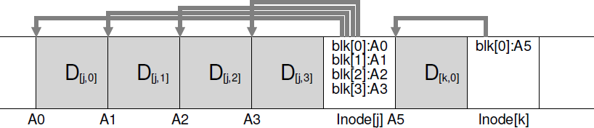
Writing Sequentially, and Effectively!
Writing to disk sequentially is not (alone) enough to guarantee efficient writes.
In-between the first and second writes, the disk has rotated.
LFS first buffers all writes in an in-memory segment; when the segment is large enough, LFS commits the segment to disk as a single large write.
This technique is well known as write buffering.
It is possible to buffer writes to different files in a segment.
6

Slide 7
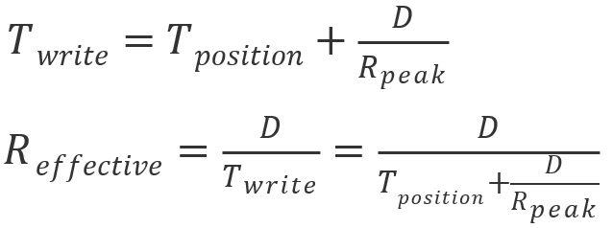
Issue #1: How Much to Buffer? (1/2)
Assume that
– 𝑇_{𝑝𝑜𝑠𝑖𝑡𝑖𝑜𝑛} is time to position (i.e., 𝑇_{𝑟𝑜𝑡𝑎𝑡𝑖𝑜𝑛} + 𝑇_{𝑠𝑒𝑒𝑘}) the disk head
𝑅_{𝑝𝑒𝑎𝑘} is the disk transfer rate
𝐷 is the amount of data to buffer
Then we can derive
The time to write the data:
The effective rate of write:
7

Slide 8

Issue #1: How Much to Buffer? (2/2)
How to get the effective rate close to the peak rate?
The effective rate is some fraction 𝐹 of the peak rate:
And we can solve for 𝑫 :
For example, if 𝑇_{𝑝𝑜𝑠𝑖𝑡𝑖𝑜𝑛} = 10 𝑚𝑠, 𝑅_{𝑝𝑒𝑎𝑘} = 100 𝑀𝐵/𝑠, and we want 𝐹 = 0.9 (i.e., 90% of the peak):
8

Slide 9
Outline
I/O Stack
Log-structured File System (LFS)
Key Idea: Writing Sequentially
Indirect Mapping and Checkpoint Region
Directories
Garbage Collection
Crash Recovery
File Implementation: Block Allocation
Indexed Allocation
Linked Allocation
Contiguous Allocation
Application
User
Kernel
File System
Block Layer
Device Driver
I/O Device
9

Slide 10
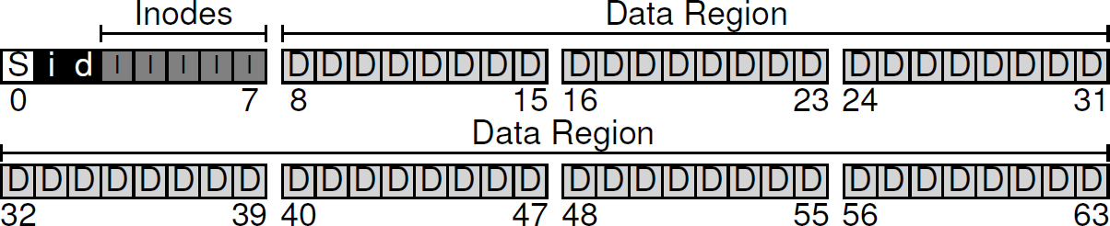
Issue #2: How to Find Inodes? (1/3)
UNIX file system keeps inodes at fixed locations.
In LFS, inodes are scattered throughout disk.
10

Slide 11
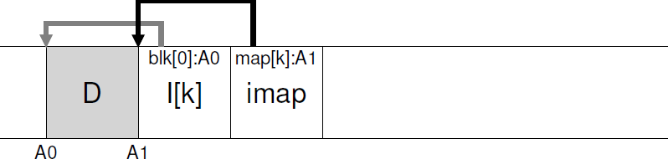
Issue #2: How to Find Inodes? (2/3)
Solution through Indirection: The Inode Map (imap)
Maps from an inode-number to the disk-address of the most recent version of the inode (i.e., one more mapping!).
Implemented as an array of 4 bytes (disk pointer) per entry.
Updated whenever an inode is written to disk.
LFS places the imap right next to where it is writing.
E.g., when appending a data block, the new data block (D), its node (I[k]), and imap are written to disk together:
Now we can find inodes: But how to find the imap?
11

Slide 12
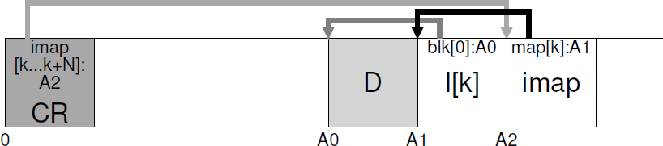
Issue #2: How to Find Inodes? (3/3)
The pieces of imap are also spread across the disk.
Every file system must have some fixed and known location on disk to being a file lookup.
Complete Solution: The Checkpoint Region (CR) records disk pointers to all latest pieces of imap.
– Flushed to disk periodically (e.g., every 30 seconds).
12

Slide 13
Example: Reading a File
To read a file from disk, LFS needs to
① Read the checkpoint region to find the latest imap;
② Read the latest imap to have the disk location of the inode;
③ Read the most recent version of the inode (I[k]);
④ Read data blocks using direct/indirect pointer as usual.
To perform the same number of I/Os as UNIX FS, LFS must cache the checkpoint region (CR) and the entire imap in the system memory.
① ④ ③ ②
13

Slide 14
Outline
I/O Stack
Log-structured File System (LFS)
Key Idea: Writing Sequentially
Indirect Mapping and Checkpoint Region
Directories
Garbage Collection
Crash Recovery
File Implementation: Block Allocation
Indexed Allocation
Linked Allocation
Contiguous Allocation
Application
User
Kernel
File System
Block Layer
Device Driver
I/O Device
14

Slide 15
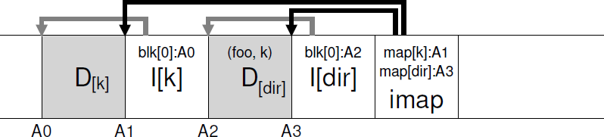
Issue #3: What about Directories? (1/2)
The directory structure of LFS is identical to UNIX FS.
The directory is a collection of (name, inode-num) entries.
When creating a file, LFS writes the data and the new inode, the directory and its inode, and the latest imap.
LFS will do so sequentially on the disk as follows:
When reading a file in the directory, LFS looks up ① imap (often cached in memory), ② directory inode, ③ directory data, ④ imap, ⑤ file inode, and ⑥ file data.
⑥ ⑤ ③ ② ① ④
15

Slide 16
Issue #3: What about Directories? (2/2)
Recursive Update Problem: A serious problem arisen in any file system that never updates in place.
Whenever an inode is updated, its location on disk changes.
To keep track of inodes, a directory may record a collection of (name, inode-location) entries.
This would have also entailed recursive updates to the directory that points to this file, the parent of that directory, …, all the way up the file system tree.
LFS cleverly avoids this problem with imap.
The directory is a collection of (name, inode-num) entries.
The imap keeps inode-num to inode-location mappings.
Even though the location of an inode may change, the change is never reflected in the directory itself.
16

Slide 17
Outline
I/O Stack
Log-structured File System (LFS)
Key Idea: Writing Sequentially
Indirect Mapping and Checkpoint Region
Directories
Garbage Collection
Crash Recovery
File Implementation: Block Allocation
Indexed Allocation
Linked Allocation
Contiguous Allocation
Application
User
Kernel
File System
Block Layer
Device Driver
I/O Device
17

Slide 18
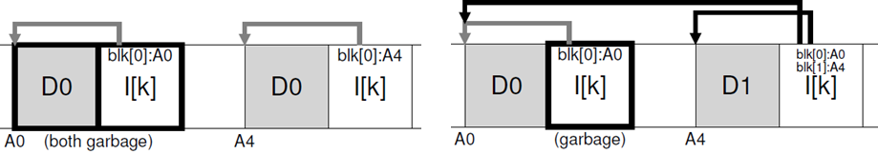
Issue #4: Garbage Collection (1/4)
LFS never overwrites but writes to free locations.
Multiple versions of data may co-exist across the disk.
The old version(s) of data are usually called garbage.
One could keep older versions and allow accessing.
Such a file system is known as a versioning file system.
LFS keeps only the latest live versions of data, and periodically cleans old dead versions of data.
The process of cleaning is called garbage collection (GC).
Case 1: Updating a data block D0 Case 2: Appending a data block D1
18

Slide 19
Issue #4: Garbage Collection (2/4)
LFS adopts a segment-based cleaning as follows:
Reads in 𝑀 partially-used segments;
Determines which blocks are live within these segments;
Compacts only live contents into 𝑁 new segments (𝑁 < 𝑀);
Writes out 𝑁 segments to disk in new locations;
Frees old M segments for subsequent writing.
Two more problems:
How to determine if a block is live (or dead)?
How often, and which segments to clean?
19

Slide 20
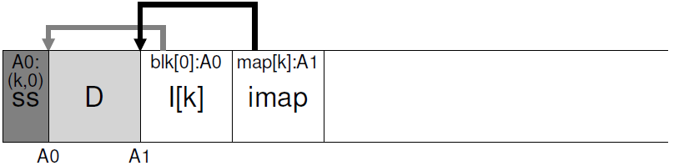
Issue #4: Garbage Collection (3/4)
LFS adds extra information, at the head of each segment, called the segment summary block (SS).
It records, for each data block D in the segment, its inode number N and its offset T (e.g., (k, 0)).
The liveness for a block D of address A can be determined:
(N, T) = SegmentSummary[A]; inode = Read(imap[N]);
if (inode[T] == A)
// block D is alive
else
// block D is garbage
Optimization:
Keeping a version number in both imap and SS, extra reads of inodes can be further avoided.
The version number should be incremented whenever the file is truncated or deleted.
20

Slide 21
Issue #4: Garbage Collection (4/4)
When to clean?
Either periodically, during idle time, or when the disk is full.
Which segments are worth cleaning?
LFS tries to segregate hot and cold segments.
A hot segment consists of frequently-over-written blocks.
A cold segment may only have a few over-written (dead) blocks.
LFS cleans cold segments sooner and hot segments later.
Since as time goes by, more and more blocks in the hot segment may get over-written (in new segments).
This policy is heuristic but not perfect.
21

Slide 22
Outline
I/O Stack
Log-structured File System (LFS)
Key Idea: Writing Sequentially
Indirect Mapping and Checkpoint Region
Directories
Garbage Collection
Crash Recovery
File Implementation: Block Allocation
Indexed Allocation
Linked Allocation
Contiguous Allocation
Application
User
Kernel
File System
Block Layer
Device Driver
I/O Device
22

Slide 23
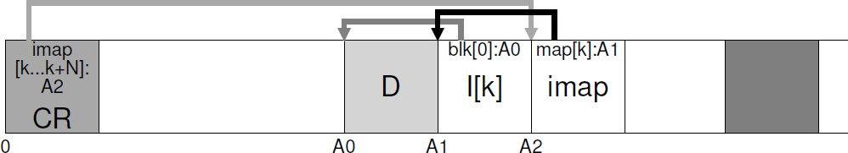
Issue #5: Crash Recovery
Crashes when writing to the checkpoint region:
Solution: Keeps two CRs (e.g., one at the head and one at the end) and writes to them alternately.
It first writes a header (with a timestamp), then the body of CR, and then an end marker (with a timestamp).
Inconsistent pair of timestamps implies an error.
Crashes when writing to a segment:
Roll Forwarding: Starts with the last checkpoint region and rebuilds all “non-checkpointed” but “committed” segments (please read the paper for details).
^{CR}old
23

Slide 24
Recall: Metadata Journaling
The sequence of metadata journaling:
① Data Write: Write data to final location
② Journal Metadata Write: Write the begin block (TxB) and metadata (I[v2], B[v2]) to log
③ Journal Commit: Write the transaction commit block (TxE)
④ Checkpoint Metadata: Write the contents of metadata update to their final locations within the file system
⑤ Free: Mark the transaction free in the journal superblock
Notes:
Forcing the data write to complete (Step 1) before issuing writes to the journal (Step 2) is not required.
The only real requirement is that Steps 1 and 2 complete before the issuing of the journal commit block (Step 3).
24

Slide 25
Outline
I/O Stack
Log-structured File System (LFS)
Key Idea: Writing Sequentially
Indirect Mapping and Checkpoint Region
Directories
Garbage Collection
Crash Recovery
File Implementation: Block Allocation
Indexed Allocation
Linked Allocation
Contiguous Allocation
Application
User
Kernel
File System
Block Layer
Device Driver
I/O Device
25

Slide 26
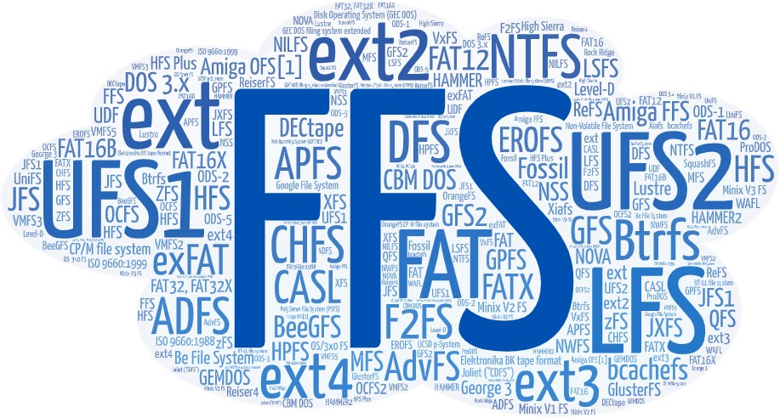
Big Family of File Systems
26

Slide 27
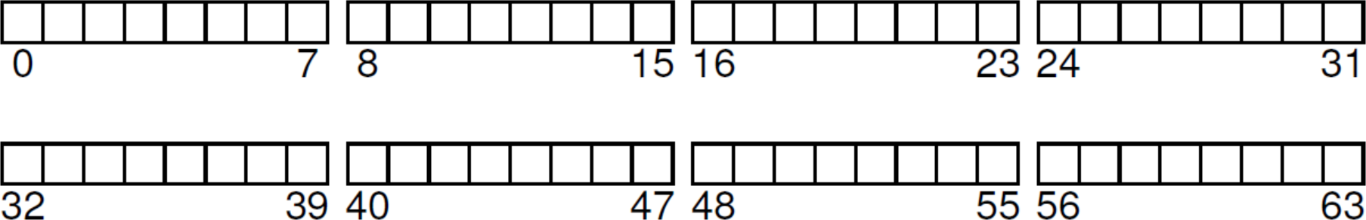
File Implementation: Block Allocation
Block Allocation: How to allocate disk space to files
It is a typical way to classify file system designs:
① Indexed Allocation: an index block keeps block pointers
Examples: UNIX FS, FFS, ext2, LFS
② Linked Allocation: each file is of linked blocks
Examples: FAT
③ Contiguous Allocation: each file is of contiguous blocks
Examples: ext4
27

Slide 28
Outline
I/O Stack
Log-structured File System (LFS)
Key Idea: Writing Sequentially
Indirect Mapping and Checkpoint Region
Directories
Garbage Collection
Crash Recovery
File Implementation: Block Allocation
Indexed Allocation
Linked Allocation
Contiguous Allocation
Application
User
Kernel
File System
Block Layer
Device Driver
I/O Device
28

Slide 29
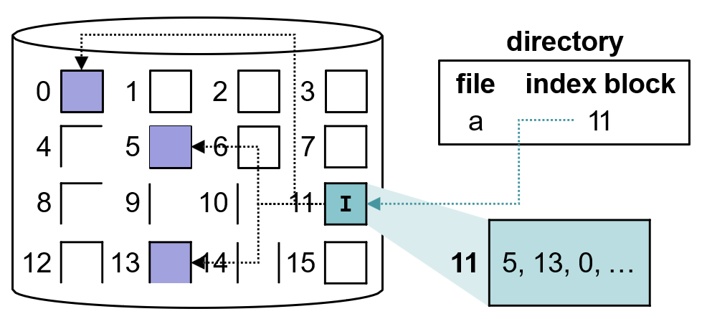
① Indexed Allocation
Each file has its own index block, which keeps track of all block pointers/locations of a file.
The 𝑖^{𝑡ℎ} entry in the index block points to the 𝑖^{𝑡ℎ} block.
Potential Issues:
The index block could be far away from data blocks.
Data blocks are scattered across the disk.
29

Slide 30
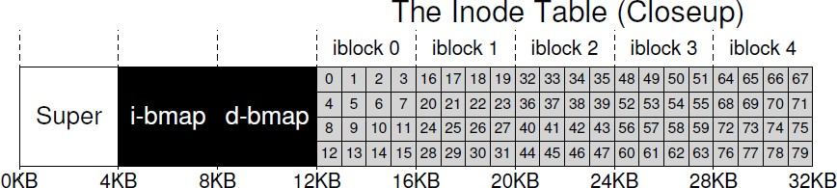
Recall: UNIX FS and its Variants
UNIX file system (and its variants FFS, ext, ext2, etc.) are typical representatives of indexed allocation.
Metadata Region: tracks data and file system information.
Data Region: stores user data and occupies most space.
30

Slide 31
Recall: UNIX FS and its Variants
UNIX file system (and its variants FFS, ext, ext2, etc.) are typical representatives of indexed allocation.
Metadata Region: tracks data and file system information.
Data Region: stores user data and occupies most space.
31

Slide 32
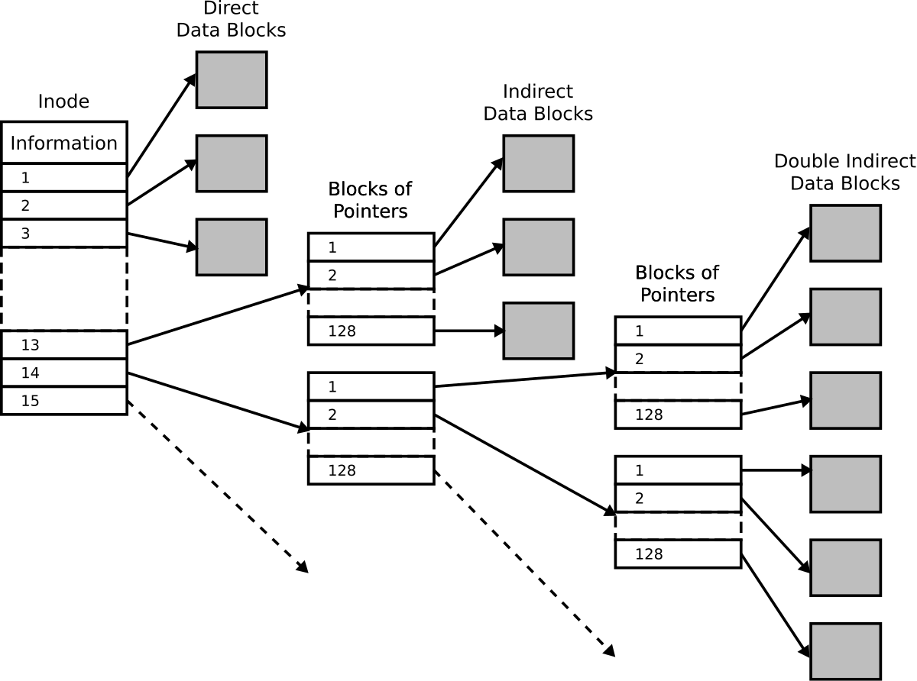
Recall: Multi-Level Index
Multi-level index supports files of big sizes.
Each ext2 inode
15 disk pointers:
12 direct pointers;
1 indirect pointer;
1 double indirect pointer;
1 triple indirect pointer
32

Slide 33
Recall: Log-structured File System
LFS can be also considered as indexed allocation, in which the indirection is further introduced:
The Checkpoint Region (CR):
Records disk pointers to all latest pieces of imap.
Flushed to disk periodically (e.g., every 30 seconds).
The Inode Map (imap)
Maps from an inode-number to the disk-address of the most recent version of the inode (i.e., one more mapping!).
Updated whenever an inode is written to disk.
Placed right next to where data block (D) and inode (I[k]) reside.
33

Slide 34
Outline
I/O Stack
Log-structured File System (LFS)
Key Idea: Writing Sequentially
Indirect Mapping and Checkpoint Region
Directories
Garbage Collection
Crash Recovery
File Implementation: Block Allocation
Indexed Allocation
Linked Allocation
Contiguous Allocation
Application
User
Kernel
File System
Block Layer
Device Driver
I/O Device
34

Slide 35
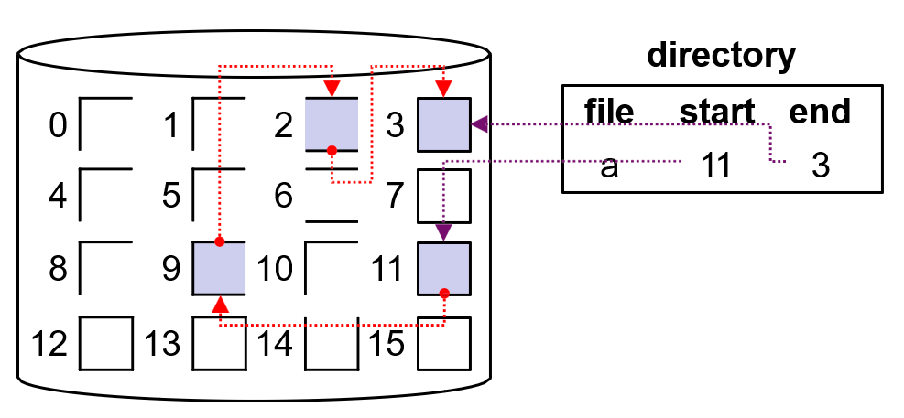
② Linked Allocation (1/2)
Each file is a linked list of disk blocks, which may be scattered anywhere on the disk.
The directory maintains the first and last blocks of the file; every block contains a pointer to the next block.
Each 512-byte block is of 508-byte user data and 4-byte pointer.
A file can easily continue to grow if there are free blocks.
35

Slide 36
② Linked Allocation (2/2)
Potential Issues:
It can be used effectively only for sequential-access files.
It is inefficient to arbitrarily access the 𝑖^{𝑡ℎ} block of a file.
It costs 0.78% (4 B / 512 B) of the disk space for pointers.
One solution is to collect multiple blocks into a cluster.
Any lost or damaged pointer makes a big mess.
Data blocks may be scattered across the disk.
36

Slide 37
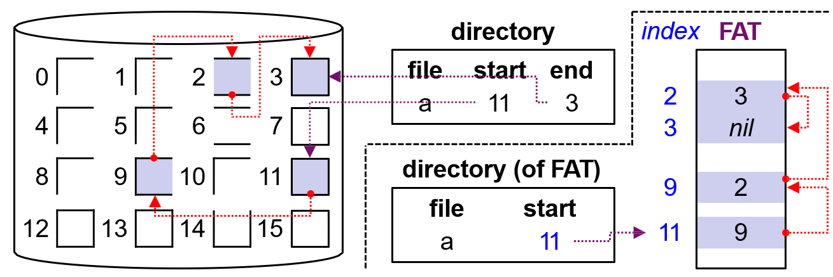
File Allocation Table (FAT)
File Allocation Table (FAT):
A variation on linked allocation (used by MS-DOS and OS/2).
A table indexed by block number (i.e., one entry per block).
The directory entry contains the block number of the first block.
Each FAT entry indicates the block number of the next block.
There is no need to maintain the 4B block pointer in each data block.
Problem: The in-disk FAT could be far away from blocks.
37

Slide 38
Outline
I/O Stack
Log-structured File System (LFS)
Key Idea: Writing Sequentially
Indirect Mapping and Checkpoint Region
Directories
Garbage Collection
Crash Recovery
File Implementation: Block Allocation
Indexed Allocation
Linked Allocation
Contiguous Allocation
Application
User
Kernel
File System
Block Layer
Device Driver
I/O Device
38

Slide 39
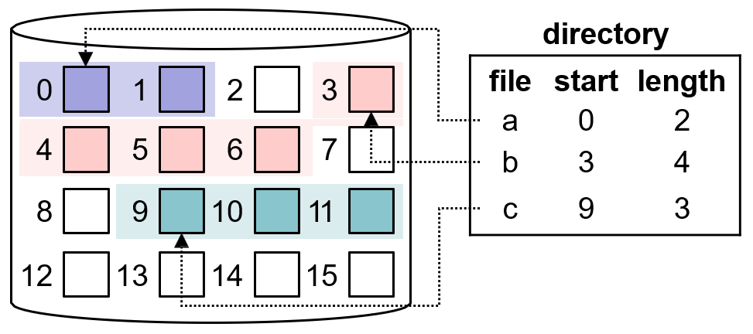
③ Contiguous Allocation
Each file occupy a set of contiguous blocks.
Block addresses define a linear ordering on the disk.
Every allocation is defined by the start address and length.
It is efficient for both sequential and direct access.
The difficulties are to 1) determine how much space is need, and 2) find contiguous space for a file.
39

Slide 40
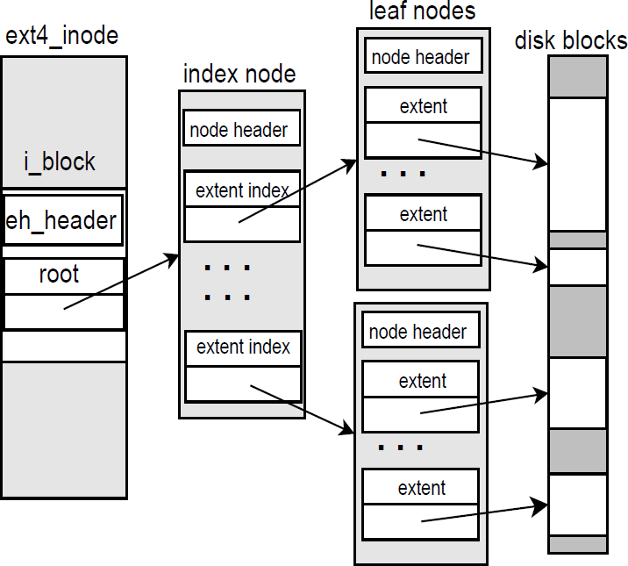
Extent
To avoid over-or-under allocation, some file systems (e.g., ext4) adopt a modified contiguous allocation.
– A chunk of contiguous and variable-sized space, extent, is allocated whenever the allocated space is insufficient.
Four extents can be kept in ext4 inode (not shown).
An extent tree is used to store the extents map for a big file.
40

Slide 41
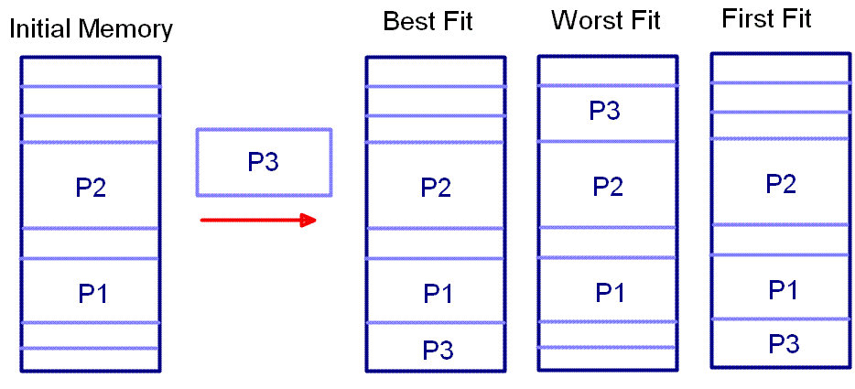
Dynamic Allocation Problem
How to satisfy a request of size 𝑛 from a list of holes ?
Common Solutions: best-fit, worst-fit, and first-fit.
– It is also a common problem of memory management.
Requested Size: 2
smallest but
largest
first
big enough
41

Slide 42
summary
I/O Stack
Log-structured File System (LFS)
Key Idea: Writing Sequentially
Indirect Mapping and Checkpoint Region
Directories
Garbage Collection
Crash Recovery
File Implementation: Block Allocation
Indexed Allocation
Linked Allocation
Contiguous Allocation
Application
User
Kernel
File System
Block Layer
Device Driver
I/O Device
42

Slide 43

Q & A
Thank you for your attention.
Notes:
Thank you for listening. Now, I would like to end today’s talk by the Q & A time.

