Slide 1

File and Storage System Lecture 05: Distributed File Systems
Department of Computer Science and Information Engineering
Shuo-Han Chen (陳碩漢), shchen@ntut.edu.tw
Hong-Yue Technology Research Building 334
M 16:10 - 18:00 & W 11:10-12:00

Slide 2
Course Schedule
W | Date | Lecture | Notes | Homework
1 | Feb. 21 | Lecture 00: Course Information |  | HW00
2 | Feb. 28 | Peace Memorial Day | No Class
3 | Mar. 7 | Lecture 01: System Calls & I/O Devices
4 | Mar. 14 | Lecture 02: RAID and Data Integrity
5 | Mar. 21 | Lecture 03: File System Basics
6 | Mar. 28 | Lecture 04: File System Designs | Flipped | HW01
7 | Apr. 4 | Tomb Sweeping Day | No Class
8 | Apr. 11 | Lecture 05: Distributed File Systems (Only slides) | Online to wrap for Midterm
9 | Apr. 18 | Midterm (Lec 01 – Lec 04)
10 | Apr. 25 | Lecture 06: Flash Memory | PHISON
11 | May 2 | Lecture 07: Next-generation Hard Disk Drive | Flipped | HW02
12 | May 9 | Lecture 06: Flash Memory | PHISON
13 | May 16 | Lecture 06: Flash Memory | PHISON
14 | May 23 | Lecture 06: Flash Memory | PHISON
15 | May 30 | Lecture 08: Persistent Memory | Flipped | HW04
16 | Jun. 6 | Final Presentation
17 | Jun. 13 | Final Presentation
18 | Jun. 20 | Final Presentation
2

Slide 3


Outline
I/O Stack
Network File System (NFS)
Client-Server Model
NFSv2: A Stateless File Protocol
Handling Server Failures
Client-side Caching / Buffering
Server-side Caching / Buffering
The Google File System (GFS)
Design Considerations and Assumptions
GFS Architecture
Record Appends
Relaxed Consistency
Application
User
Kernel
File System
Block Layer
Device Driver
I/O Device
3

Slide 4
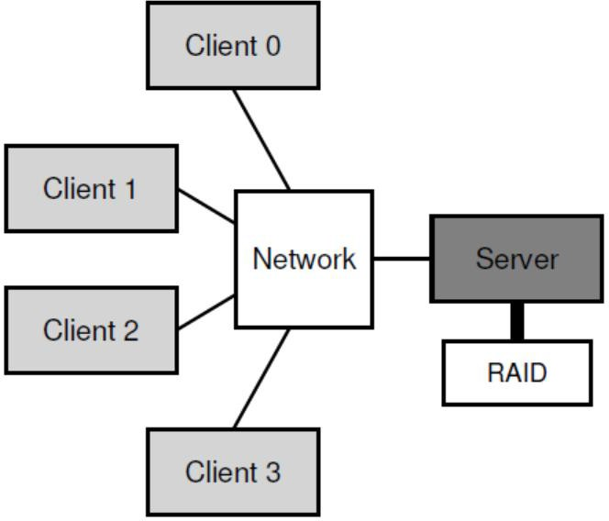
Client-Server Model (1/2)
Generic Client-Server Model:
One (or a few) server stores the data on its disks;
Multiple clients request data through protocol messages.
Centralized administration for data backup and security
Easy sharing of data across multi-clients
4

Slide 5
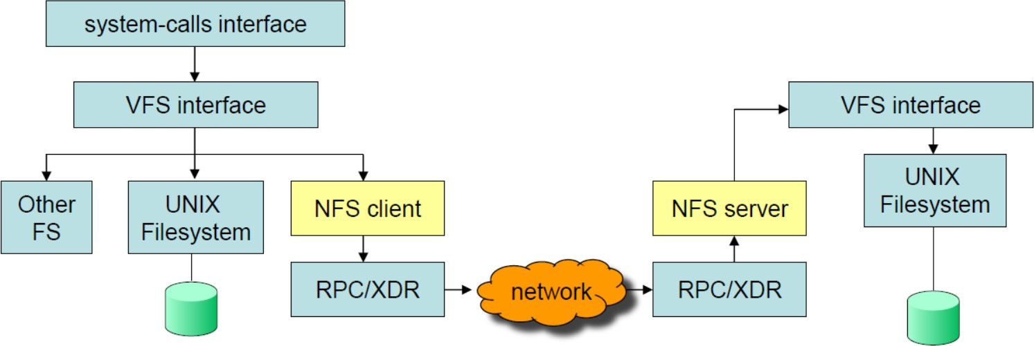
Client-Server Model (2/2)
Client
Issues system calls to the client-side file system to access files on the server.
Caches retrieved blocks in memory for future use.
Server
Accesses data blocks in the server-side file system (i.e., file server).
Caches and buffers reads/writes in memory.
Client
Server
5

Slide 6
Outline
I/O Stack
Network File System (NFS)
Client-Server Model
NFSv2: A Stateless File Protocol
Handling Server Failures
Client-side Caching / Buffering
Server-side Caching / Buffering
The Google File System (GFS)
Design Considerations and Assumptions
GFS Architecture
Record Appends
Relaxed Consistency
Application
User
Kernel
File System
Block Layer
Device Driver
I/O Device
6

Slide 7
Network File System (NFS)
Sun Network File System (NFS)
Developed by Sun Microsystems in 1980’s.
An open protocol that specifies the exact message formats for client-server communication.
Rather than a proprietary and closed system.
It worked: Many big companies sell NFS servers, including Oracle/Sun, NetApp, EMC, IBM, etc.
Current Standard: NFSv4 supports larger-scale protocol.
We focus on the NFS protocol version 2 (NFSv2):
Goals of NFSv2: simplicity and fast crash recovery
Crashes are common in distributed systems, due to power outages, software bugs, network disconnections, etc.
7

Slide 8
Fast Crash Recovery: Statelessness (1/2)
NFS is stateless: The file server doesn’t keep track of anything about the actions of clients.
Each client includes all information in the protocol request;
The server processes and then “forgets” the request.
Counter Ex: Shared state complicates crash recovery.
The client-side file system opens the file.
The file server opens the file and returns the descriptor (fd).
The client-side file system uses fd for subsequent reads.
char buffer[MAX];
int fd = open("foo", O_RDONLY); // get descriptor from server
read(fd, buffer, N); // read N bytes from foo via fd
...
close(fd);
// close file
8

Slide 9
Fast Crash Recovery: Statelessness (2/2)
Server Crashes
Imagine the server crashes between two consecutive reads.
After the server is up again, the client re-issues the read.
The server has no idea to which file fd is referring.
fd was keeping in server memory and lost when server crashed.
Client Crashes
Imagine a client opens a file and then crashes.
The open() uses up a file descriptor on the server.
– However, the server never receives a close().
For above reasons, NFS adopts a stateless design.
No fancy crash recovery is needed:
The server just starts running again;
A client, at worst, might have to retry a request.
9

Slide 10
NFSv2: A Stateless File Protocol (1/2)
Key to NFSv2 Protocol: The File Handle
A file handle uniquely identifies a file or a directory with three components:
① Volume Identifier: specifies a file system;
② Inode Number: specifies a file/directory in a file system;
③ Generation Number: is needed when reusing an inode.
By incrementing it whenever an inode number is reused.
The server ensures that a client with an old file handle cannot accidentally access the newly-allocated file.
A file handle is encoded into some forms of strings.
10

Slide 11
NFSv2: A Stateless File Protocol (2/2)
NFSPROC_LOOKUP
Obtain a file handle for a file or directory from the file server.
NFSPROC_READ
Pass the file handle, offset, and the number of bytes to read;
Obtain the retrieved data.
NFSPROC_WRITE
Pass the file handle, offset, the number of bytes, along with the data to write.
NFSPROC_GETATTR/NFSPROC_SETATTR
Get/Set metadata (e.g., last modified time) with a file handle.
Others: NFSPROC_CREATE, NFSPROC_REMOVE, NFSPROC_MKDIR, NFSPROC_RMDIR, NFSPROC_READDIR
11

Slide 12
Protocol Messages
The client-side file system tracks open files, and translates file system calls into protocol messages.
The server responds to protocol messages, which contains all information needed to complete a request.
Example: Reading a File
Client | Protocol Messages
fd = open(“/foo”, …); | NFSPROC_LOOKUP(rootdir FH, “foo”)
read(fd, buffer, N); | NFSPROC_READ(FH, offset=0, cnt=N)
read(fd, buffer, N); | NFSPROC_READ(FH, offset=N, cnt=N)
read(fd, buffer, N); | NFSPROC_READ(FH, offset=2*N, cnt=N)
close(fd); | (do nothing)
12

Slide 13
Outline
I/O Stack
Network File System (NFS)
Client-Server Model
NFSv2: A Stateless File Protocol
Handling Server Failures
Client-side Caching / Buffering
Server-side Caching / Buffering
The Google File System (GFS)
Design Considerations and Assumptions
GFS Architecture
Record Appends
Relaxed Consistency
Application
User
Kernel
File System
Block Layer
Device Driver
I/O Device
13

Slide 14
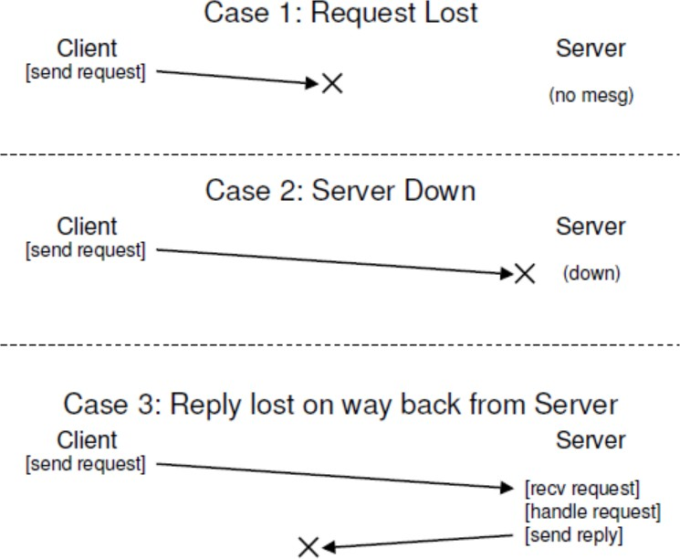
Handling Server Failures (1/3)
Three types of protocol message losses:
14

Slide 15


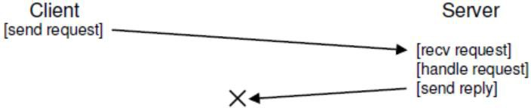
Handling Server Failures (2/3)
In NFSv2, a client detects the response timeout and simply retries the request.
Reason: Most NFS requests are idempotent.
The effect of performing the request multiple times is equivalent to that of performing the request a single time.
E.g., LOOKUP, READ, and WRITE requests are idempotent.
Case 1 Request Lost
Retry!
Case 2 Server Down
Retry!
Case 3 Reply Lost
Do It Again!
15

Slide 16
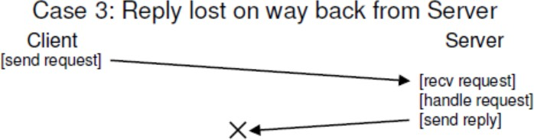
Handling Server Failures (3/3)
Some requests are hard to make idempotent.
For example, if the file server receives a MKDIR protocol message and executes it successfully;
But the reply is lost and the client may retry it (as Case 3).
The server must fail the retry (rather than re-do it).
Why? The effect of creating a directory twice is not equivalent to the effect of creating a directory once (i.e., not idempotent).
16

Slide 17
Outline
I/O Stack
Network File System (NFS)
Client-Server Model
NFSv2: A Stateless File Protocol
Handling Server Failures
Client-side Caching / Buffering
Server-side Caching / Buffering
The Google File System (GFS)
Design Considerations and Assumptions
GFS Architecture
Record Appends
Relaxed Consistency
Application
User
Kernel
File System
Block Layer
Device Driver
I/O Device
17

Slide 18
Client-side Caching / Buffering
Sending all read and write requests across the network can lead to a big performance problem.
Intuitive Solution: Client-side Caching / Buffering
The NFS client caches file data and metadata read from server in its local memory.
The first access is still expensive (via network communication);
Subsequent accesses are serviced quite quickly in memory.
The NFS client buffers data in its local memory before writing them out to server.
The write() system call succeeds immediately.
18

Slide 19
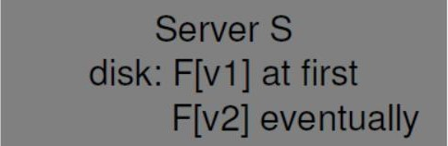
Cache Consistency Problem (1/2)
Consider a NFS with three clients and one server:
Client C1 reads a file F[v1], and keeps a copy in its cache.
Client C2 overwrites file F, but buffers F[v2] in its cache.
Client C3 has not yet accessed the file F.
Cache Consistency/Coherence Problems:
① Stale Cache (from read perspective)
The cache still holds not-yet-updated data.
② Update Visibility (from write perspective)
Updates are buffered in memory and not seen by others.
19

Slide 20
Cache Consistency Problem (2/2)
① Stale Cache: C1 has the stale F[v1] in its cache.
Solution: NFS clients first check whether a file has changed before using its cached contents.
How? Issuing a GETATTR request to server to know when the file was last modified (but raise flooding of GETATTR).
② Update Visibility: The update from C2 is not visible to C3: C3 only gets old copy F[v1] from the server.
Solution: NFS clients (C2) implement flush-on-close to ensure that a subsequent open will get the latest version.
Stale Cache
Update Visibility
20

Slide 21
Outline
I/O Stack
Network File System (NFS)
Client-Server Model
NFSv2: A Stateless File Protocol
Handling Server Failures
Client-side Caching / Buffering
Server-side Caching / Buffering
The Google File System (GFS)
Design Considerations and Assumptions
GFS Architecture
Record Appends
Relaxed Consistency
Application
User
Kernel
File System
Block Layer
Device Driver
I/O Device
21

Slide 22
Server-side Caching / Buffering
The file server can also cache read/write requests.
Write buffering needs to be carefully implemented:
The server must commit each write before informing the client of success.
To avoid write becoming the performance bottleneck:
The server may use battery-backed memory or the log- structured approach to improve write performance.
22

Slide 23
Outline
I/O Stack
Network File System (NFS)
Client-Server Model
NFSv2: A Stateless File Protocol
Handling Server Failures
Client-side Caching / Buffering
Server-side Caching / Buffering
The Google File System (GFS)
Design Considerations and Assumptions
GFS Architecture
Record Appends
Relaxed Consistency
Application
User
Kernel
File System
Block Layer
Device Driver
I/O Device
23

Slide 24
Google File System (GFS)
GFS is a scalable distributed file system for large distributed data-intensive applications.
GFS is driven by Google’s specific application workloads and technological environment.
As of 2003, multiple GFS clusters are deployed:
Over 1000 storage nodes;
Over 300TB disk storage;
Heavily accessed by hundreds of clients.
24

Slide 25
Considerations and Assumptions
① Component failures are the norm, not the exception.
The system is of inexpensive components that often fail.
② Files are huge: Multi-GB files are common.
③ Appending new data is much more common than overwriting existing data.
Random writes are uncommon; instead, clients may concurrently append large, sequential writes to files.
GFS fulfils record append and snapshot operations.
④ The read workloads consist of large streaming reads and small random reads.
⑤ It is more critical to sustain high bandwidth rather than low latency.
25

Slide 26
Outline
I/O Stack
Network File System (NFS)
Client-Server Model
NFSv2: A Stateless File Protocol
Handling Server Failures
Client-side Caching / Buffering
Server-side Caching / Buffering
The Google File System (GFS)
Design Considerations and Assumptions
GFS Architecture
Record Appends
Relaxed Consistency
Application
User
Kernel
File System
Block Layer
Device Driver
I/O Device
26

Slide 27
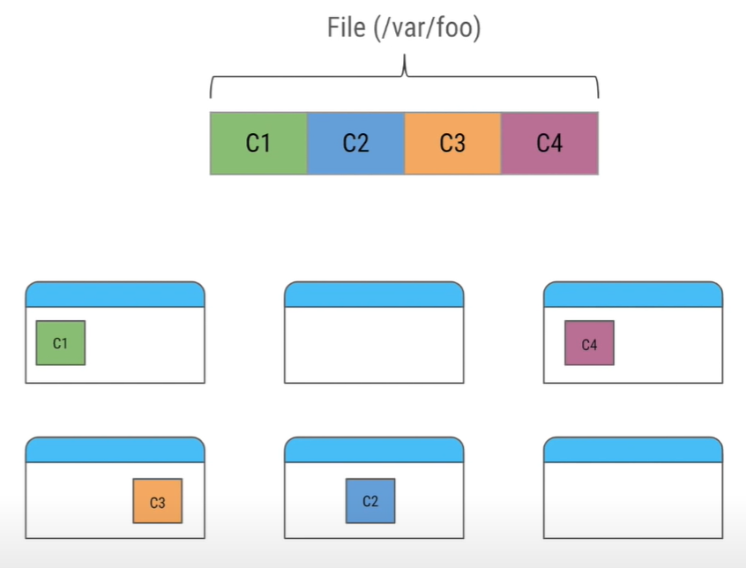
High Level View of GFS Architecture (1/3)
Files are split into chunks
Each chunk of 64 MB
Identified by 64 bit ID
Stored in Chunkservers
Chunks of a single files are distributed on multiple machines
27

Slide 28
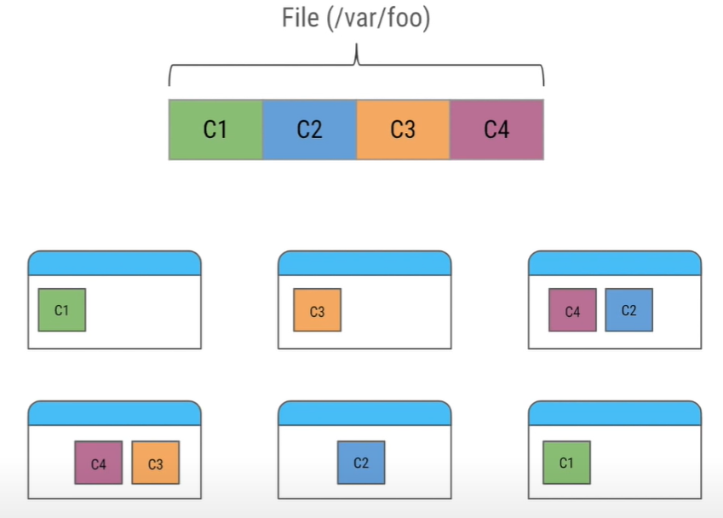
High Level View of GFS Architecture (2/3)
Server failures are very common
One or more servers are assumed to be down
Files has at least 3 replica over 3 servers to avoid data lost
Number of replica can be configured
28

Slide 29
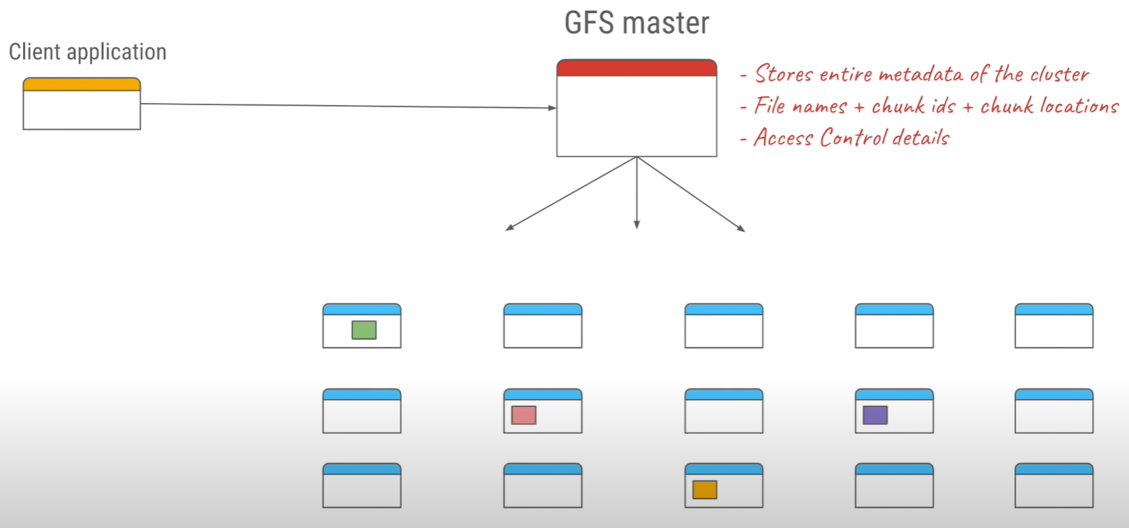
High Level View of GFS Architecture (3/3)
29

Slide 30
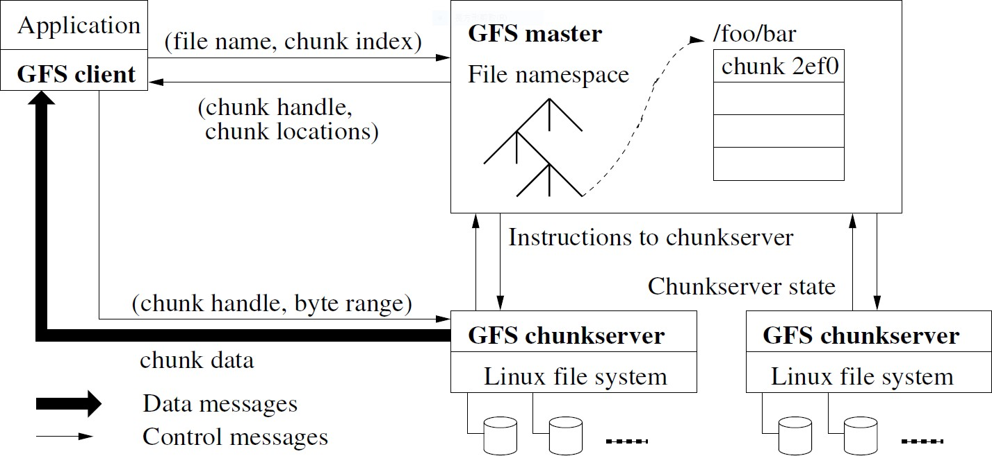
GFS Architecture
A GFS cluster consists ① a single master, ② multiple chunkservers, and is accessed by ③ multiple clients.
– Each of these is typically a commodity Linux machine running a user-level server process.
30

Slide 31
Single Master (1/2)
A GFS cluster consists ① a single master, ② multiple chunkservers, and is accessed by ③ multiple clients.
– Each of these is typically a commodity Linux machine running a user-level server process.
heart beats
31

Slide 32
Single Master (2/2)
Maintain all file system metadata:
Including namespace, access control information, the mapping from files to chunks, and the locations of chunks.
Control system-wide activities:
Chunk replica placement
Chunk release management
Chunk migration between chunkservers (i.e., rebalancing)
Garbage collection of orphaned chunks
Communicate periodically with each chunkserver in heartbeats to give it instructions and collect its state.
32

Slide 33
Multiple Chunkservers (1/2)
A GFS cluster consists ① a single master, ② multiple chunkservers, and is accessed by ③ multiple clients.
– Each of these is typically a commodity Linux machine running a user-level server process.
heart beats
33

Slide 34
Multiple Chunkservers (2/2)
Files are divided into fixed-size chunks, which can be identified by a unique chunk handle (like FH in NFS).
Chunks are stored on local disks of chunkservers as files.
Chunks are accessed by the chunk handle and byte range.
The chunk size (chosen 64 MB) is much larger than typical file system block sizes (e.g., 4 KB).
Reduce clients’ need to interact with the master;
Reduce the size of metadata stored on the master;
Reduce the network overhead for consecutive workloads (e.g.,
search) by keeping a stable TCP connection.
Chunks are replicated across chunkservers (by default, three copies) for reliability concerns.
Chunkservers need not cache file data.
Linux’s buffer cache keeps frequently-accessed data.
34

Slide 35
Multiple Clients (1/2)
A GFS cluster consists ① a single master, ② multiple chunkservers, and is accessed by ③ multiple clients.
– Each of these is typically a commodity Linux machine running a user-level server process.
heart beats
35

Slide 36
Multiple Clients (2/2)
GFS client code, linked into the upper application, offers the file system API to communicate with master and chunkservers.
Interact with the master for metadata operations
Clients can cache metadata to reduce the need to interact with the master.
Interact with chunkservers for direct data-bearing communications
Clients cache no file data in its local memory.
Avoidance of cache coherence/consistency issues (existed in NFS!)
Limited benefits with streaming of large files and large working sets
36

Slide 37
File System Metadata
The master maintains three types of FS metadata:
① The file and chunk namespaces (i.e., directory hierarchy) ;
② The mapping from files to chunks,
③ The locations of each chunk’s replicas.
The master keeps all three types of metadata in its memory for fast access.
Less than 64 bytes of metadata for each 64 MB chunk.
Less than 64 bytes per file if prefix compression is used.
The master persists ① namespaces and ② file-to- chunk mapping in its local disks as an operation log.
But the master does not persist the chunk locations.
It can be pulled from chunkservers at startup via heartbeats.
37

Slide 38
Working Example: Client Reads
① C translates (file name and offset) into a chunk index, and sends a request to M
② M replies C the chunk handle and chunk locations
③ C requests for chunk directly from the “closest” CS
①
②
③
The “closest” CS can be determined by IP address
heart beats
38
CSCI5550 Lec05: Distributed File Systems 34

Slide 39
Working Example: Client Writes (1/2)
A write must perform at all the chunk’s replicas.
A mutation is an operation that changes the contents or metadata of a single chunk over all replicas.
If a write exceeds the chunk boundary, the client must break it down into multiple mutation operations.
The master uses leases to maintain a consistent mutation order across replicas.
The master grants a lease to one of replicas called primary.
The lease is designed to minimize management overhead at master.
A lease has an initial timeout of 60 seconds.
A lease can be renewed through heartbeats; the master can also revoke a lease before it expires.
The primary picks a serial order for all mutations on other replicas called secondary.
39

Slide 40
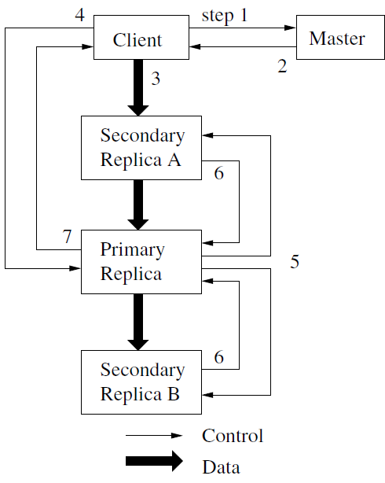
Working Example: Client Writes (2/2)
① C asks master for the CSs holding the primary and secondary replicas.
② M replies C.
③ C pushes the data to all the replicas in any order.
④ Once all acknowledged, C
sends a write to the primary.
⑤ The primary forwards the write to all secondary(s).
⑥ The secondary(s) all reply to primary upon completed.
⑦ The primary replies to C.
If some fail, retry ③~⑦ or all.
40

Slide 41
Outline
I/O Stack
Network File System (NFS)
Client-Server Model
NFSv2: A Stateless File Protocol
Handling Server Failures
Client-side Caching / Buffering
Server-side Caching / Buffering
The Google File System (GFS)
Design Considerations and Assumptions
GFS Architecture
Record Appends
Relaxed Consistency
Application
User
Kernel
File System
Block Layer
Device Driver
I/O Device
41

Slide 42
Record Appends
Workload Observation: Clients may concurrently append large, sequential writes to files.
– Concurrent writes to the same region are not serializable.
GFS offers an atomic operation called record append.
C pushes data to all replicas of the last chunk of the file.
C sends the record append request to the primary.
If record fits within a chunk, the primary appends data to its replica and asks secondary(s) to write at the exact offset; otherwise, the primary pads the chunk to the maximum size, and asks C to retry the operation on the “next” chunk.
If a record append fails at any replica, C must retry but may result in inconsistency: The GFS application must cope with it.
Note: The record append is restricted to be at most one-fourth (i.e., 16 MB) of the maximum chunk size (64 MB).
42

Slide 43
Outline
I/O Stack
Network File System (NFS)
Client-Server Model
NFSv2: A Stateless File Protocol
Handling Server Failures
Client-side Caching / Buffering
Server-side Caching / Buffering
The Google File System (GFS)
Design Considerations and Assumptions
GFS Architecture
Record Appends
Relaxed Consistency
Application
User
Kernel
File System
Block Layer
Device Driver
I/O Device
43

Slide 44
Relaxed Consistency (1/4)
GFS guarantees a “relaxed consistency” model.
File namespace operations are atomic: They are handled by the master exclusively.
The states of a file region depend on ① the operation type (i.e., write or record append), ② whether the operation succeeds or fails, and ③ whether there’re concurrent ones.
“Relaxed” Consistent: all clients see the same data in all replicas
Defined: ① a region is consistent after an operation, and ② clients see what the mutation has written in entirety
 | Write | Record Append
Serial Success | defined | defined interspersed with inconsistent
Concurrent Successes | consistent but undefined
Failure | inconsistent
44

Slide 45
Relaxed Consistency (2/4)
Consistent: all clients see the same data in all replicas
Defined: ① a region is consistent after an operation, and② clients see what the mutation has written in entirety
 | Write | Record Append
Serial Success | defined | defined interspersed with inconsistent
Concurrent Successes | consistent but undefined
Failure | inconsistent
Case: Write – Serial Success
defined
write(“Hello”, 9)
write(“World”, 10)
Case: Write – Failure
inconsistent
write(“Hello”, 9)
write(“World”, 10)
Chunk 1
9: Hello
10: World
Chunk 1’
9: Hello
10: World
Chunk 1
9: Hello
10: World
Chunk 1’
9: Hello
45

Slide 46
Relaxed Consistency (3/4)
Consistent: all clients see the same data in all replicas
Defined: ① a region is consistent after an operation, and② clients see what the mutation has written in entirety
 | Write | Record Append
Serial Success | defined | defined interspersed with inconsistent
Concurrent Successes | consistent but undefined
Failure | inconsistent
Case: Write – Concurrent Successes
consistent but undefined
write(“World”, 10:0 )
write(“5550”, 10:3 )
Case: Record Append
defined but inconsistent
write(“World”, 10:0 )
retry
Chunk 1
9: Hello
10: World
11: World
Chunk 1
9: Hello
10: Wor5550
Chunk 1’
9: Hello
10: Wor5550
Chunk 1’
9: Hello
11: World
46

Slide 47
Relaxed Consistency (4/4)
Concurrent writes may result in consistent but undefined:
All clients see the same data, but it may not reflect what any mutation has written.
The order is not guaranteed; a region may contain fragments from multiple clients.
Record append ensures a record is appended atomically at least once, but at an offset chosen by the primary.
– Applications need to deal with possible duplicates.
47

Slide 48
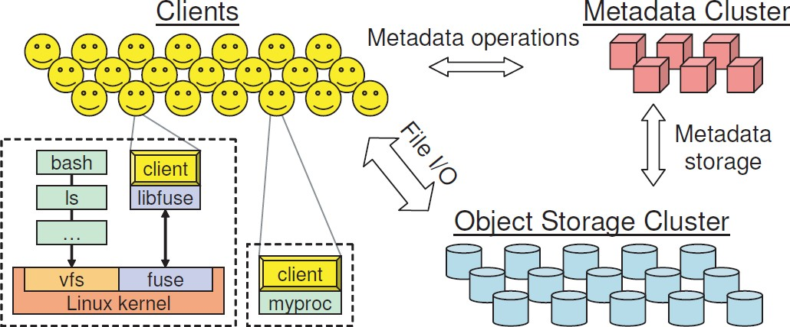
GFS Limitations
Relaxed consistency burdens the GFS applications.
Single master simplifies the coordination, but it may become the single point of failure.
– Ceph: A Scalable, High-Performance Distributed File System (OSDI’06)
48

Slide 49

Other Distributed File Systems
Ceph: A Scalable, High-Performance Distributed File System (OSDI’06)
Hadoop Distributed File System (by Yahoo!)
GlusterFS
49

Slide 50
Outline
I/O Stack
Network File System (NFS)
Client-Server Model
NFSv2: A Stateless File Protocol
Handling Server Failures
Client-side Caching / Buffering
Server-side Caching / Buffering
The Google File System (GFS)
Design Considerations and Assumptions
GFS Architecture
Record Appends
Relaxed Consistency
Application
User
Kernel
File System
Block Layer
Device Driver
I/O Device
50

Slide 51

Q & A
Thank you for your attention.
Notes:
Thank you for listening. Now, I would like to end today’s talk by the Q & A time.

