Slide 1
Linear Scan Register Allocation
Massimiliano Poletto (MIT)
and
Vivek Sarkar (IBM Watson)

Slide 2
Introduction
Register Allocation: The problem of mapping an unbounded number of virtual registers to physical ones
Good register allocation is necessary for performance
  Several SPEC benchmarks benefit an order of magnitude from good allocation
  Core memory (and even caches) are slow relative to registers
Register allocation is expensive
  Most algorithms are variations on Graph Coloring
  Non-trivial algorithms require liveness analysis
  Allocators can be quadratic in the number of live intervals

Slide 3
Motivation
On-line compilers need generate code quickly
  Just-In-Time compilation
  Dynamic code generation in language extensions (‘C)
  Interactive environments (IDEs, etc.)
Sacrifice code speed for a quicker compile.
  Find a faster allocation algorithm
  Compare it to the best allocation algorithms

Slide 4
Definitions
Live interval: A sequence of instructions, outside of which a variable v is never live.
  (For this paper, intervals are assumed to be contiguous)
Spilling: Variables are spilled when they are stored on the stack
Interference: Two live ranges interfere if they are simultaneously live in a program.

Slide 5
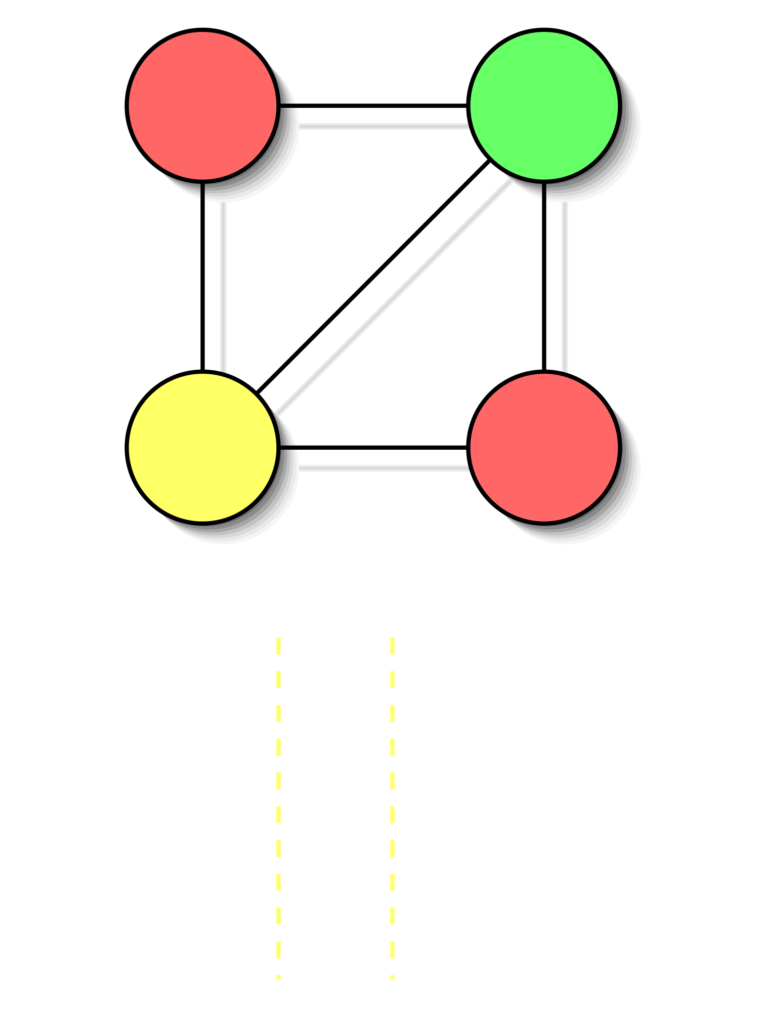
Ye Olde Graph Coloring
Model allocation as a graph coloring problem
Nodes represent live ranges
Edges represent interferences
Colorings are safe allocations
Order V² in live variables
(See Chaitin82 on PLDI list)

Slide 6
Linear Scan Algorithm
Compute live variable analysis
Walk through intervals in order:
  Throw away expired live intervals.
  If there is contention, spill the interval that ends furthest in the future.
  Allocate new interval to any free register
Complexity: O(V log R) for V vars and R registers

Slide 7
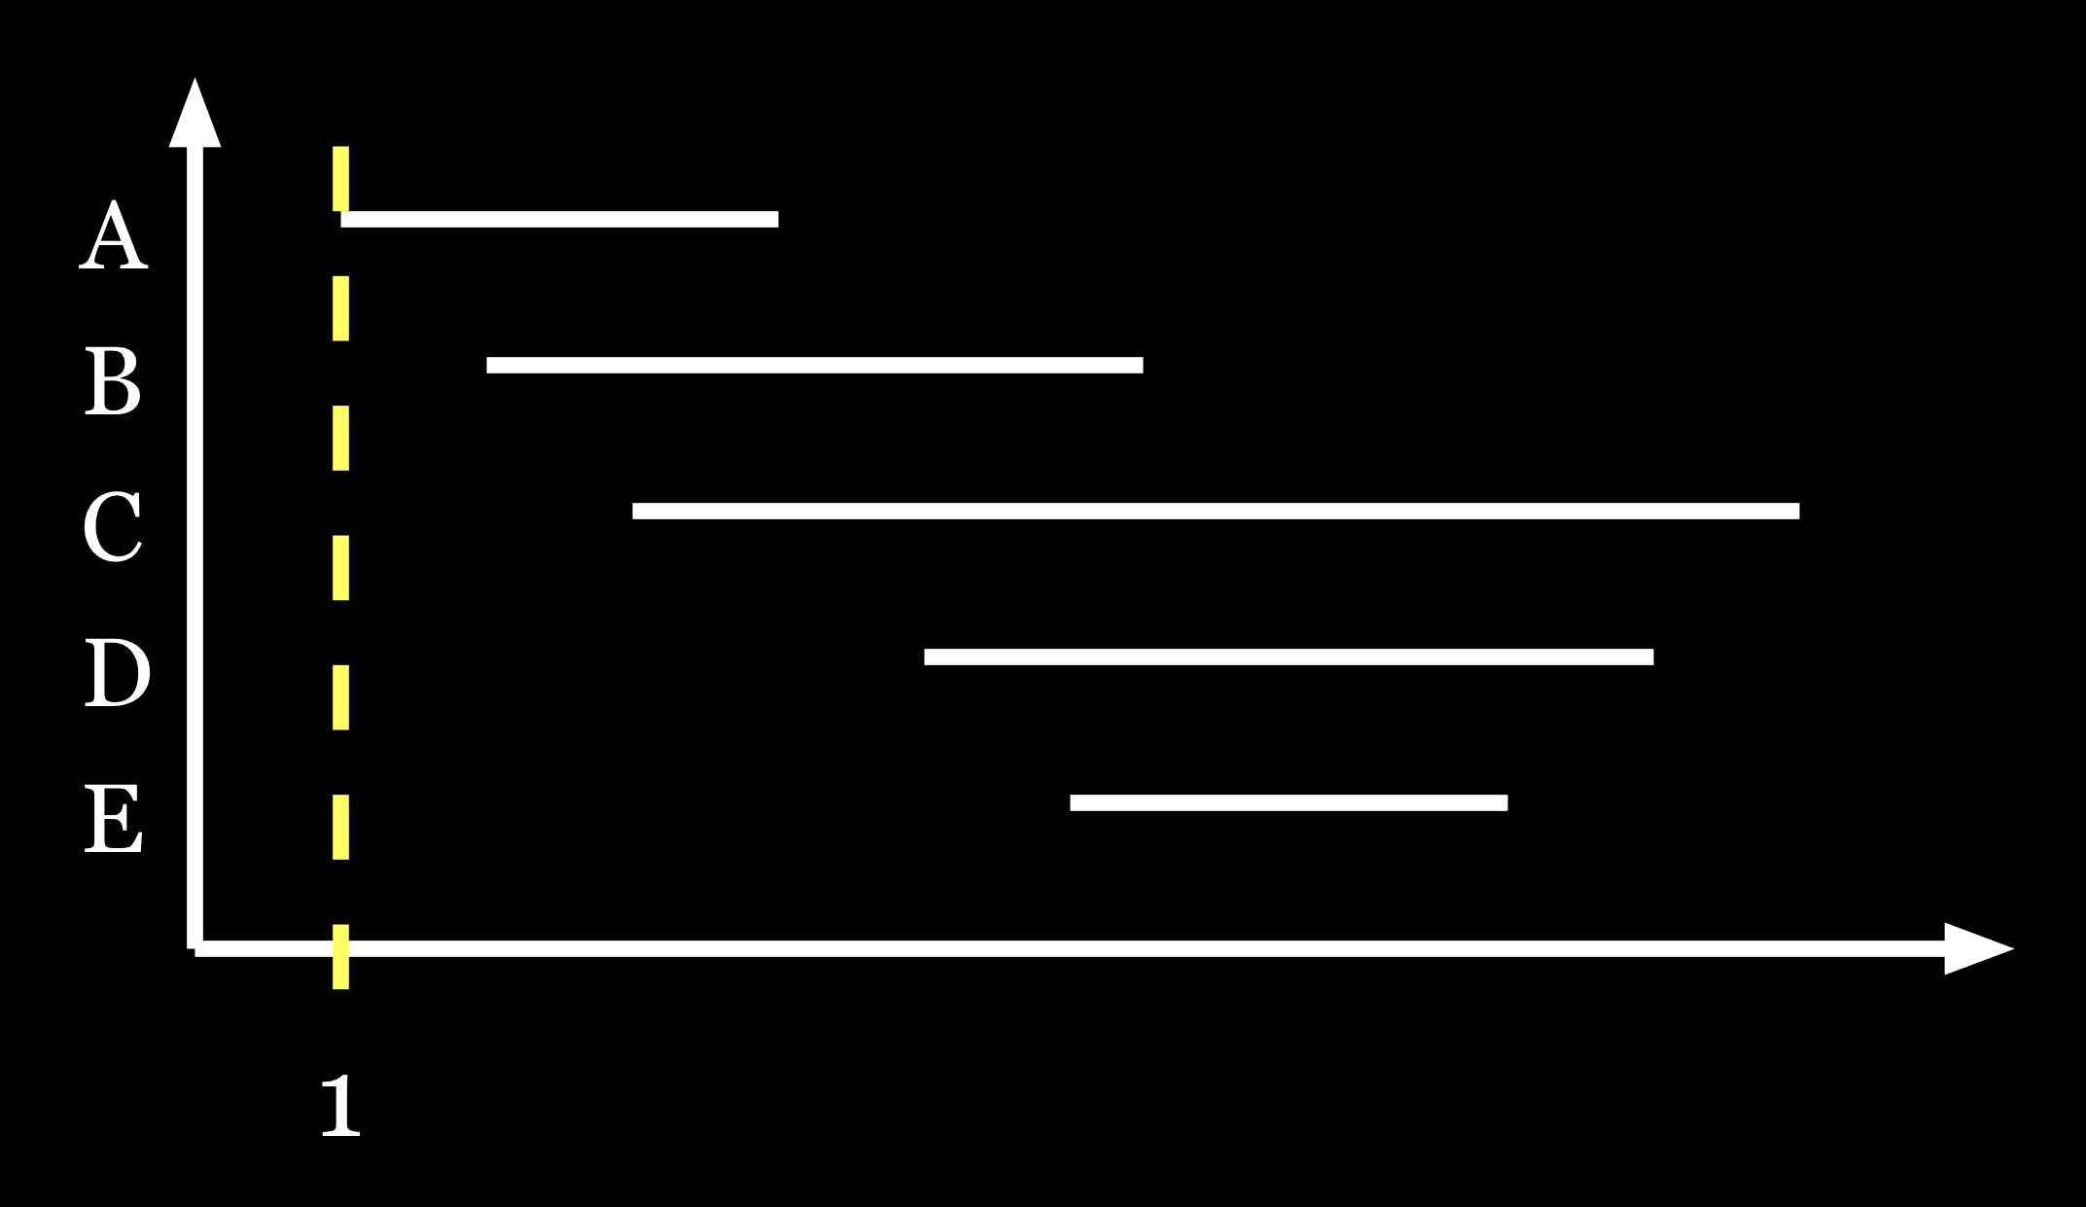
Example With Two Registers
1. Active = < A >

Slide 8
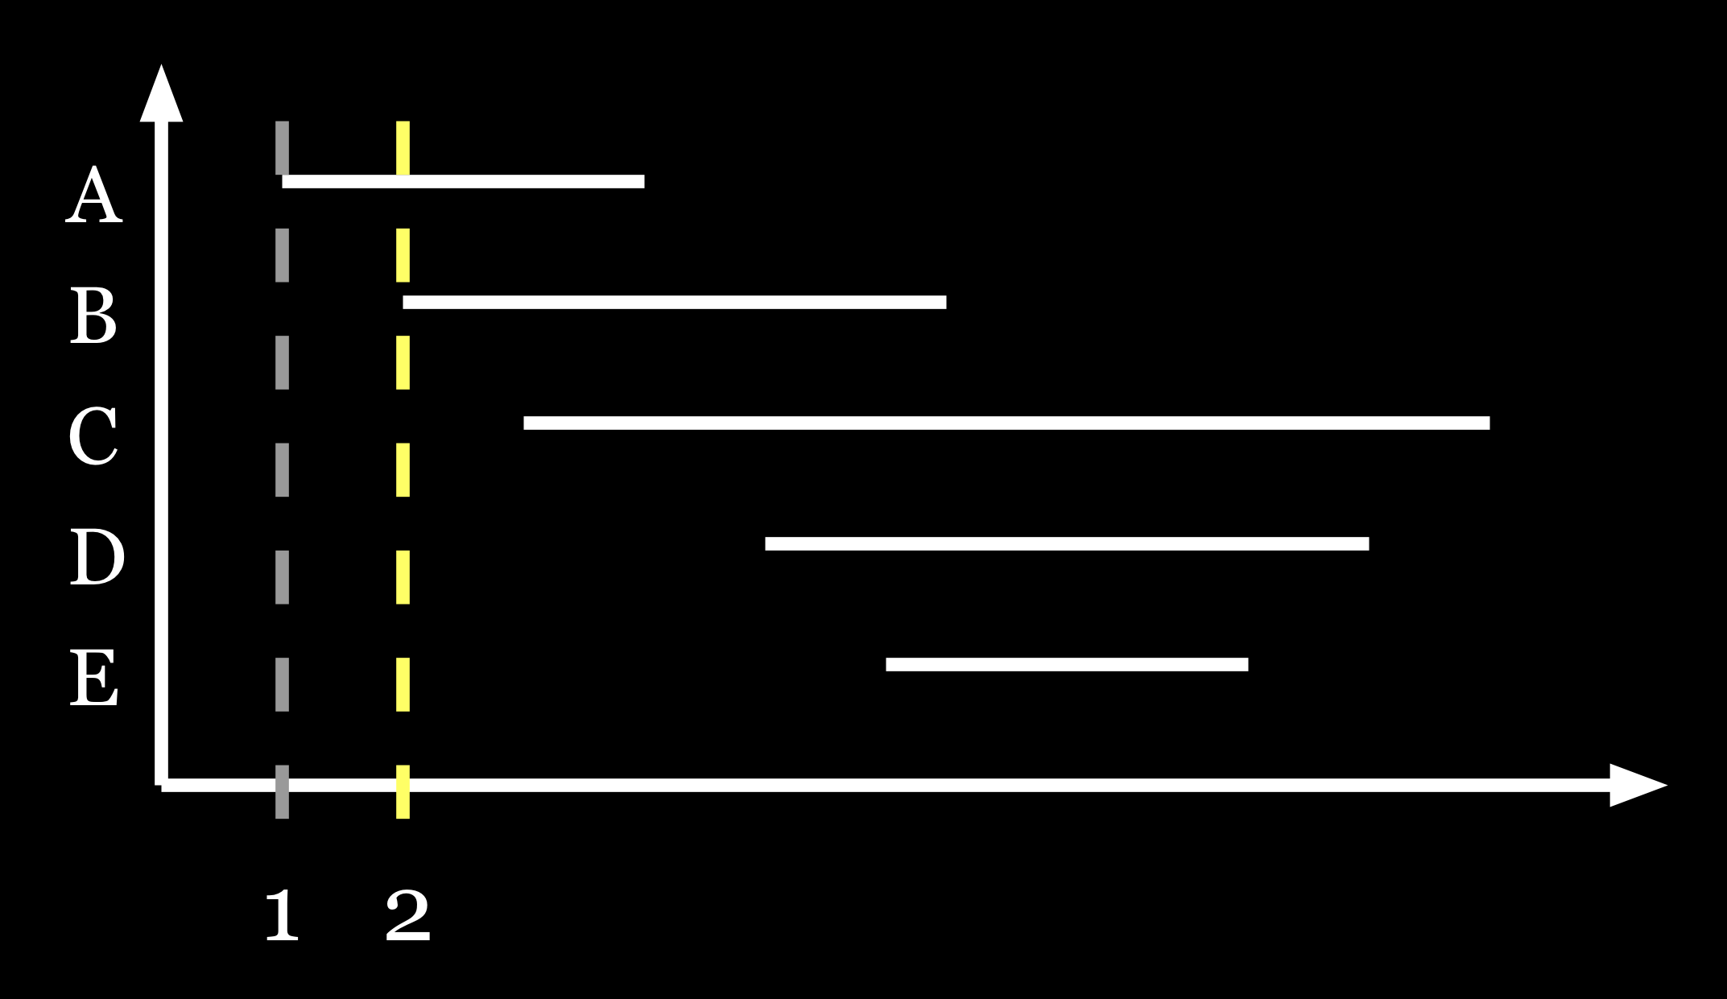
Example With Two Registers
1. Active = < A >
2. Active = < A, B >

Slide 9
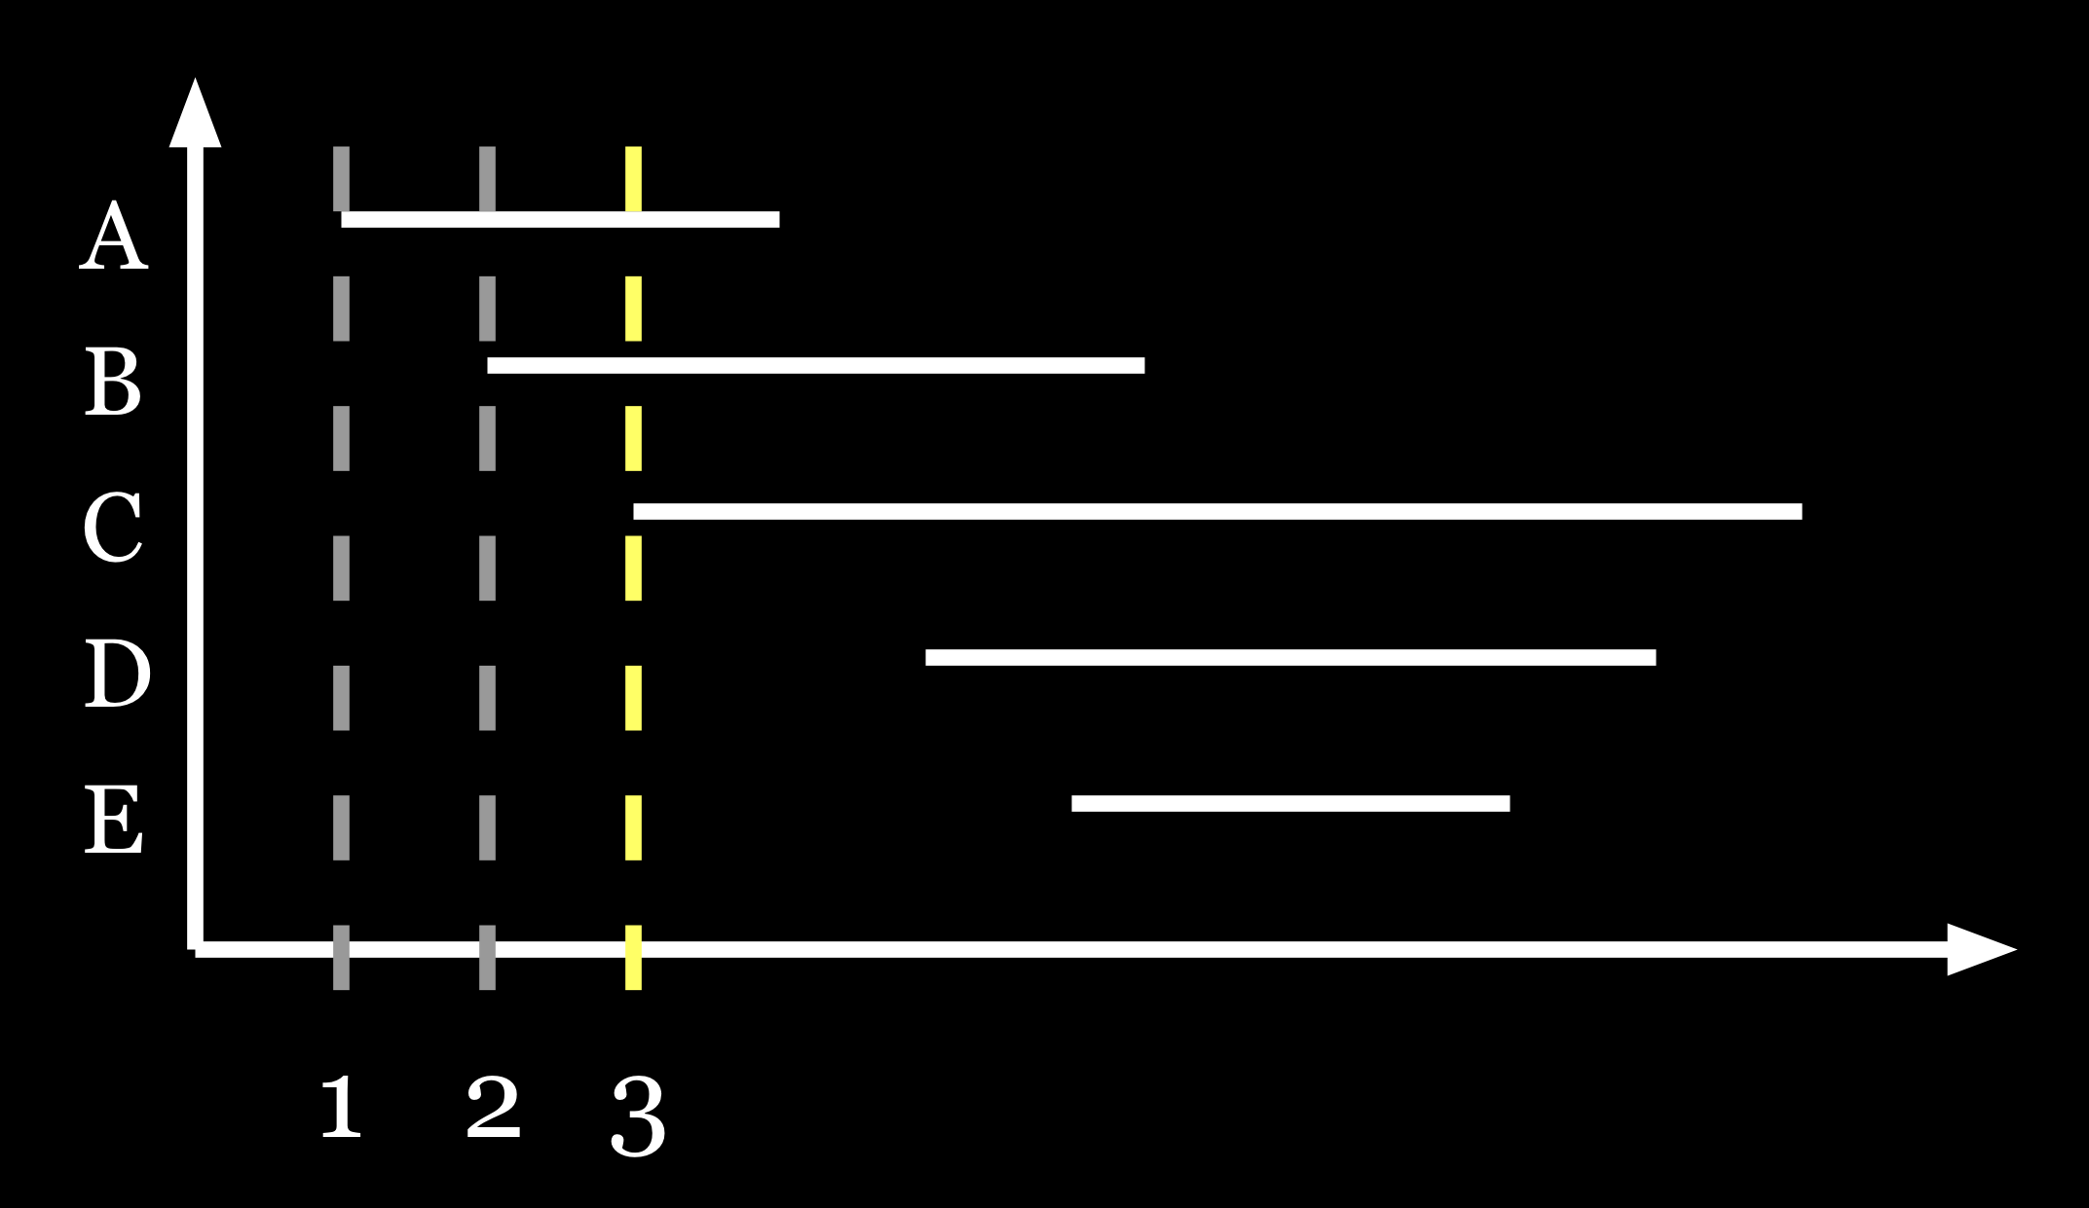
Example With Two Registers
1. Active = < A >
2. Active = < A, B >
3. Active = < A, B > ; Spill = < C >

Slide 10
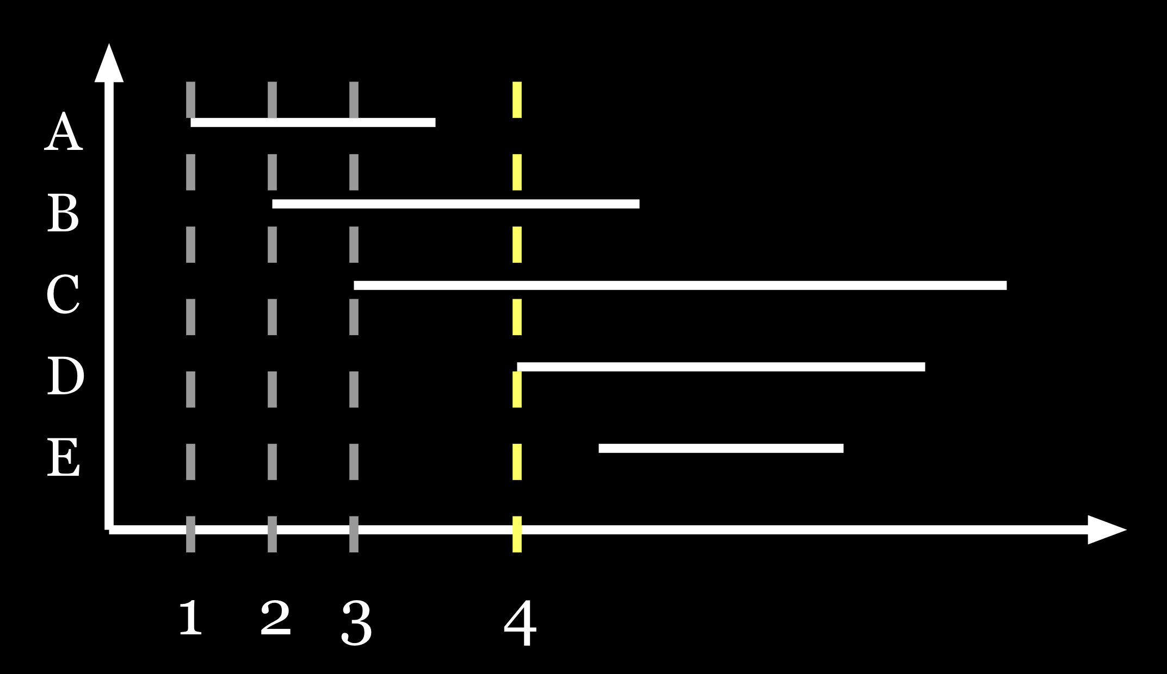
Example With Two Registers
1. Active = < A >
2. Active = < A, B >
3. Active = < A, B > ; Spill = < C >
4. Active = < D, B > ; Spill = < C >

Slide 11
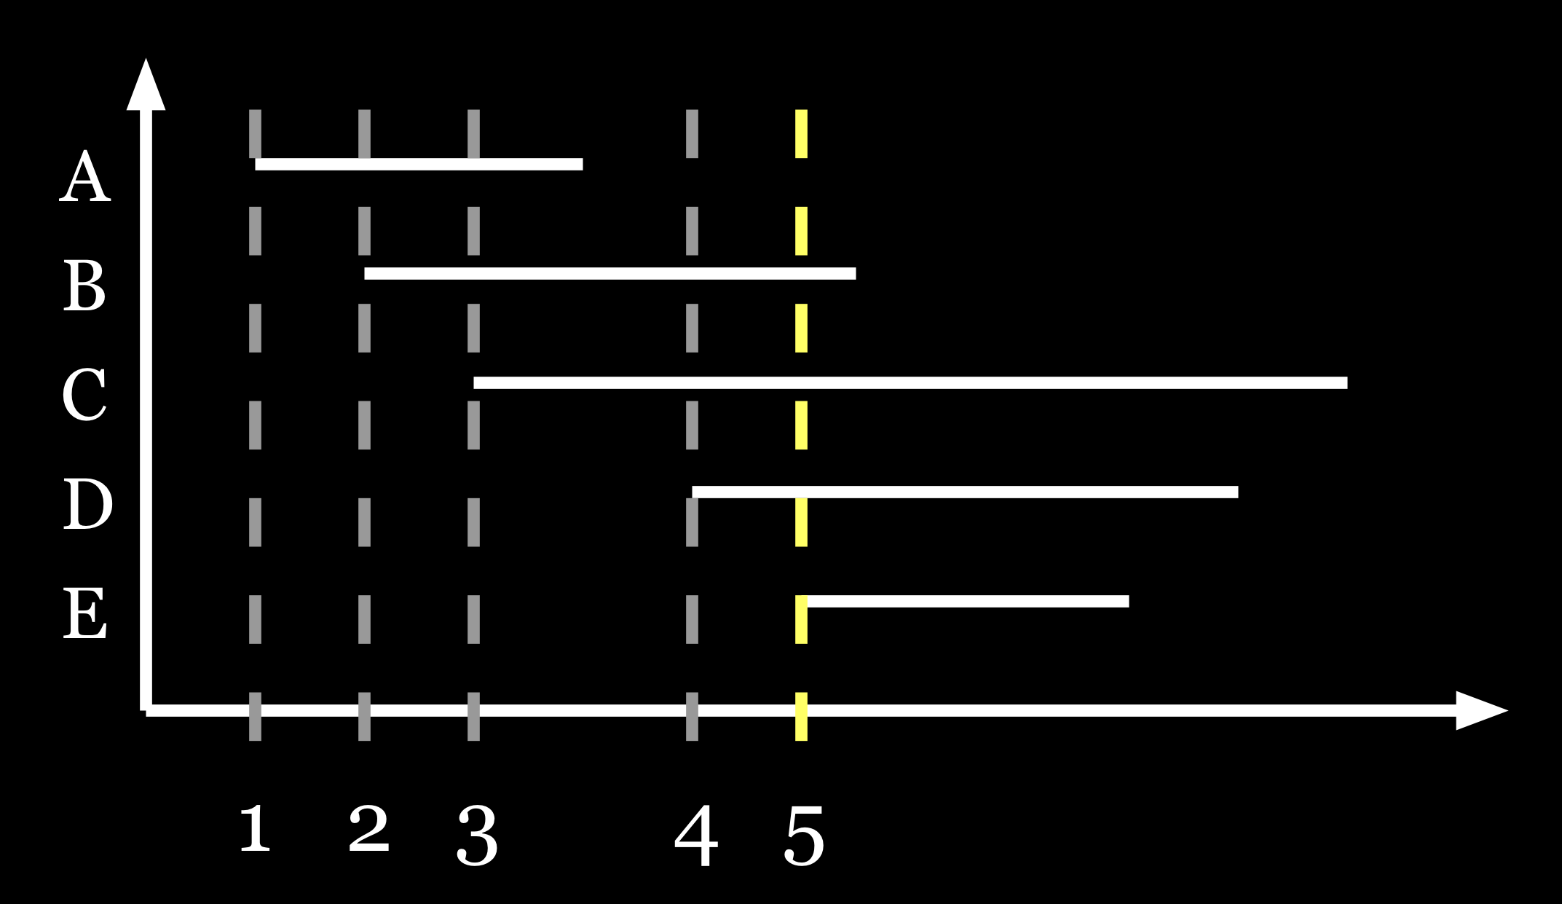
Example With Two Registers
1. Active = < A >
2. Active = < A, B >
3. Active = < A, B > ; Spill = < C >
4. Active = < D, B > ; Spill = < C >
5. Active = < D, E > ; Spill = < C >

Slide 12
Evaluation Overview
Evaluate both compile-time and run-time performance
Two Implementations
  ICODE dynamic ‘C compiler; (already had efficient allocators)
    Benchmarks from the previously used ICODE suite (all small)
    Compare against tuned graph-coloring and usage counts
    Also evaluate a few pathological program examples
  Machine SUIF
    Selected benchmarks from SPEC92 and SPEC95
    Compare against graph-coloring, usage counts, and second-chance binpacking
Compare both metrics on both implementations

Slide 13
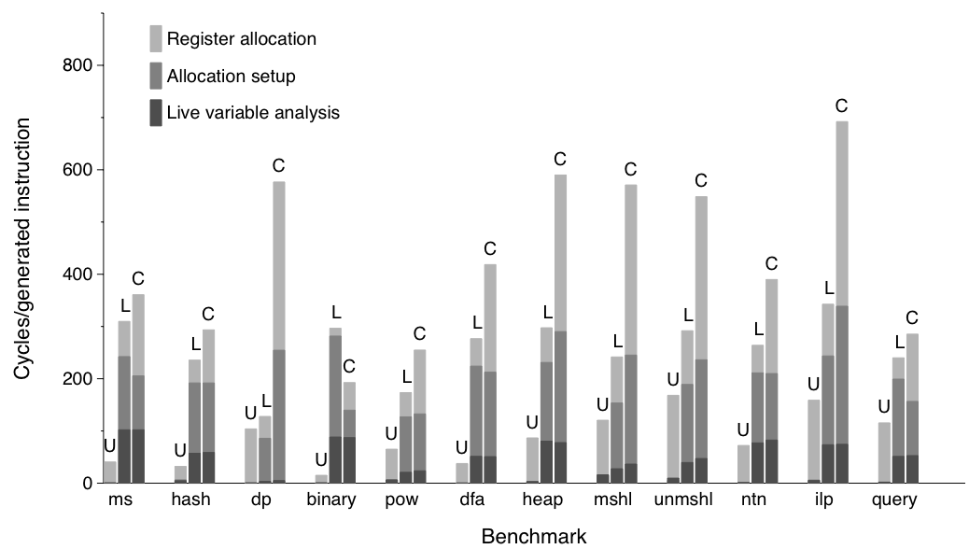
Compile-Time on ICODE ‘C
Usage Counts, Linear Scan, and Graph Coloring shown
Linear Scan allocation is always faster than Graph Coloring

Slide 14
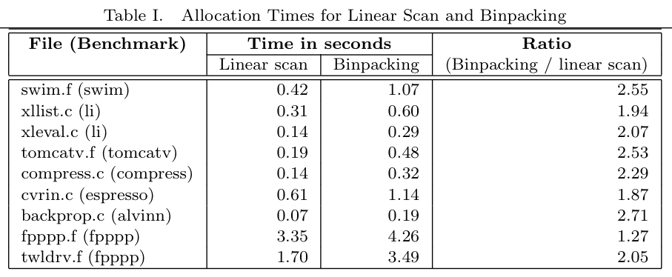
Compile-Time on SUIF
Linear Scan allocation is around twice as fast than Binpacking
  (Binpacking is known to be slower than Graph Coloring)

Slide 15
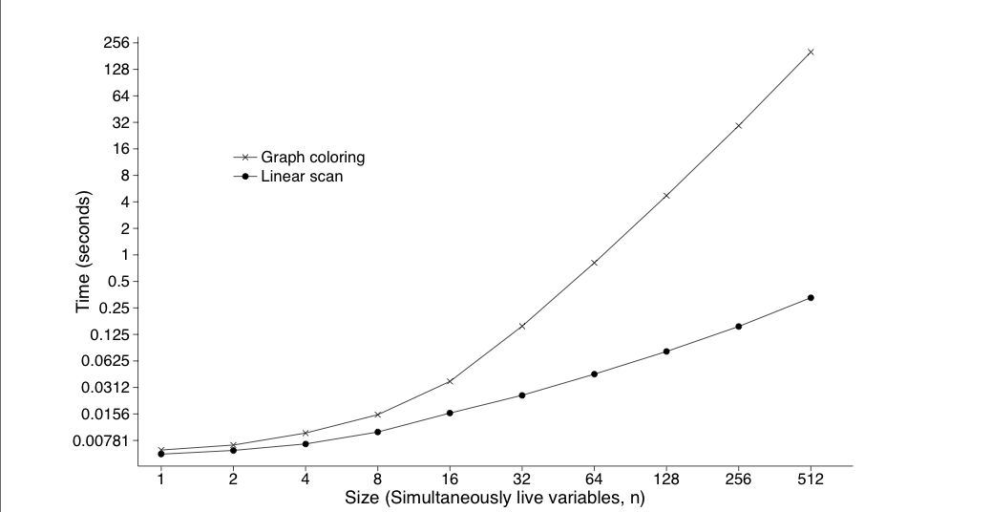
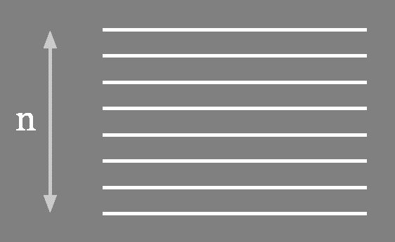
Pathological Cases
N live variable ranges interfering over the entire program execution
Other pathological cases omitted for brevity; see Figure 6.

Slide 16
Compile-Time Bottom Line
Linear Scan
  is faster than Binpacking and Graph Coloring
  works in dynamic code generation (ICODE)
  scales more gracefully than Graph Coloring
… but does it generate good code?

Slide 17
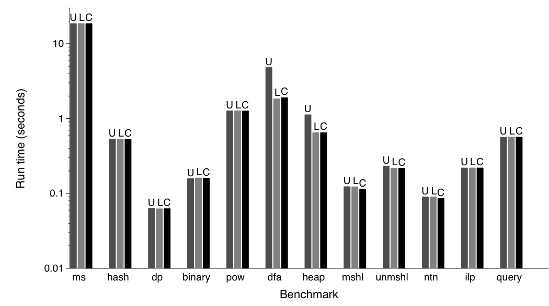
Run-Time on ICODE ‘C
Usage Counts, Linear Scan, and Graph Coloring shown
Dynamic kernels do not have enough register pressure to illustrate differences

Slide 18
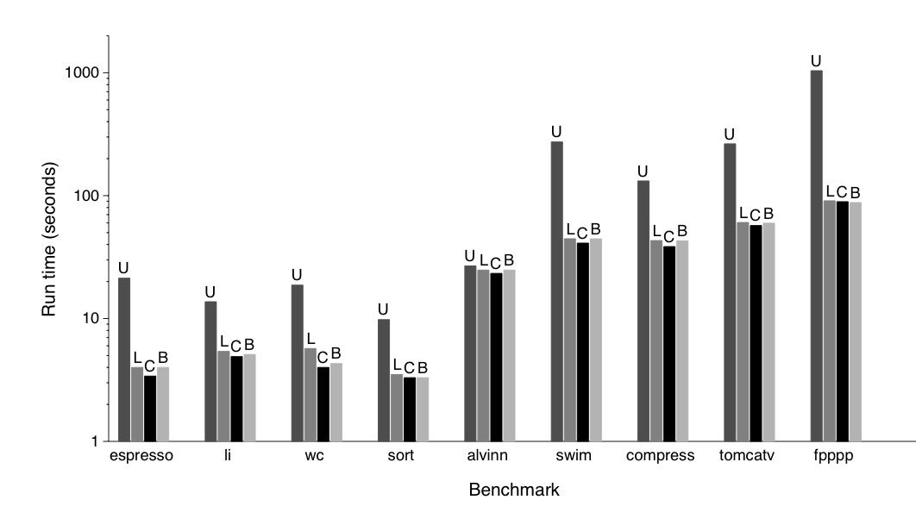
Run-Time on SUIF / SPEC
Usage Counts, Linear Scan, Graph Coloring and Binpacking shown
Linear Scan makes a fair performance trade-off (5% - 10% slower than G.C.)

Slide 19
Evaluation Summary
Linear Scan
  is faster than Binpacking and Graph Coloring
  works in dynamic code generation (ICODE)
  scales more gracefully than Graph Coloring
  generates code within 5-10% of Graph Coloring
Implementation alternatives evaluated in paper
  Fast Live Variable Analysis
  Spilling Hueristics

Slide 20
Conclusions
Linear Scan is a faster alternative to Graph Coloring for register allocation
Linear Scan generates faster code than similar algorithms (Binpacking, Usage Counts)
Where can we go from here?
  Reduce register interference with live range splitting
  Use register move coalescing to free up extra registers

Slide 21
Questions?

