Slide 1
Northwind Sales and Analysis Using databricks
By Terry Cleek
And Avary Edwards

Slide 2
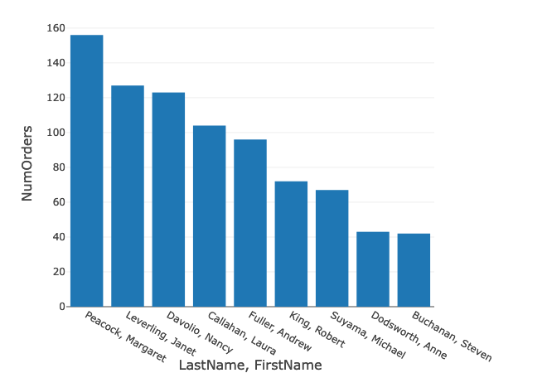
Our Top Sale Associates
We would like to recognize the top sales associates
Margaret Peacock :156
Janet Leverling: 127
Nancy Davolio: 123
Laura Callahan: 104
Andrew Fuller: 96

Slide 3
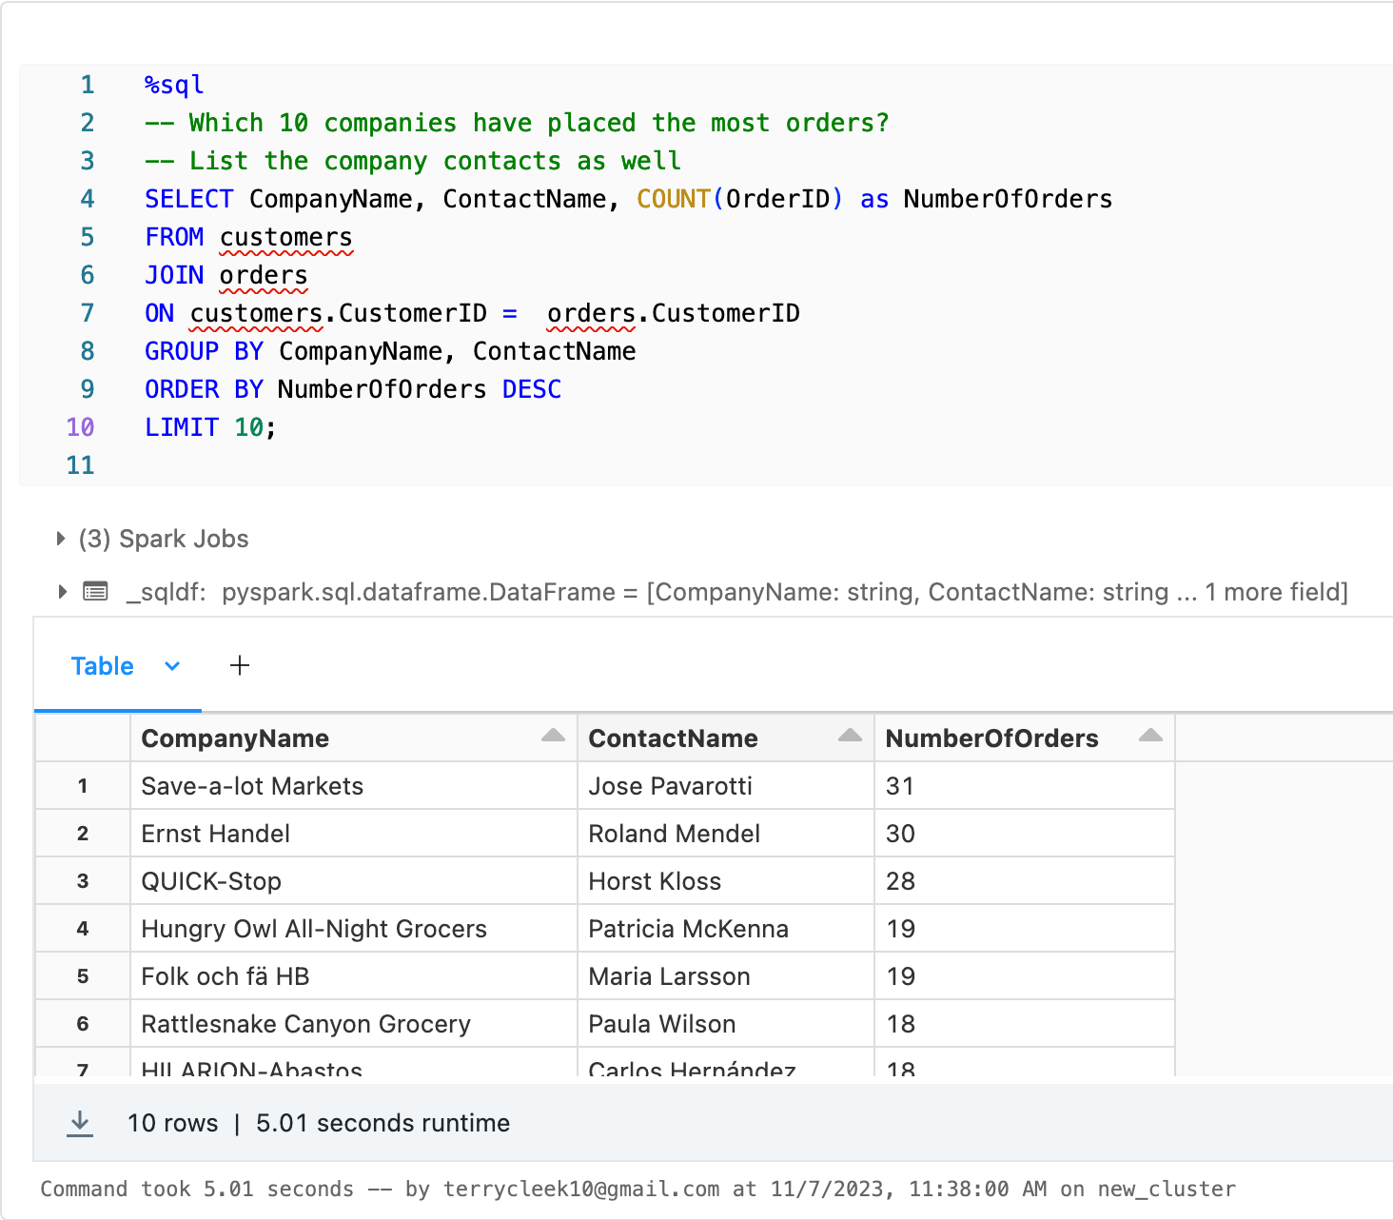
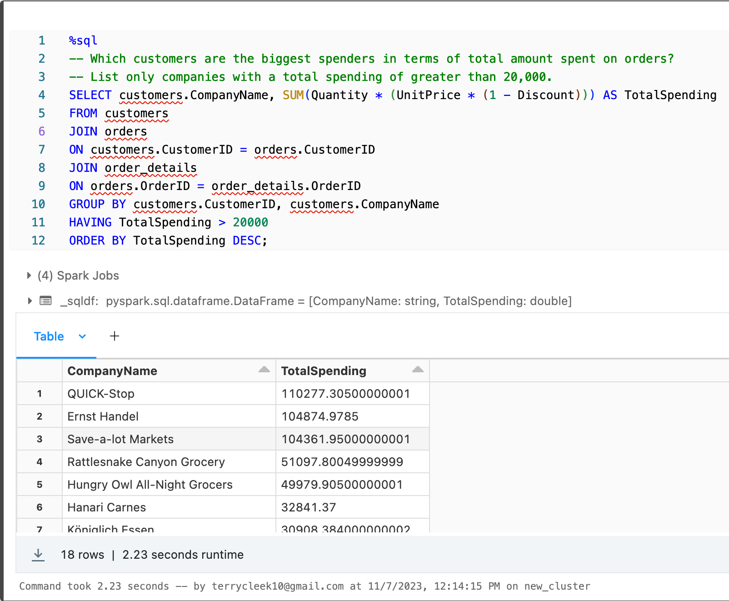
Our Key Customers
# of Orders
Total Spending $

Slide 4
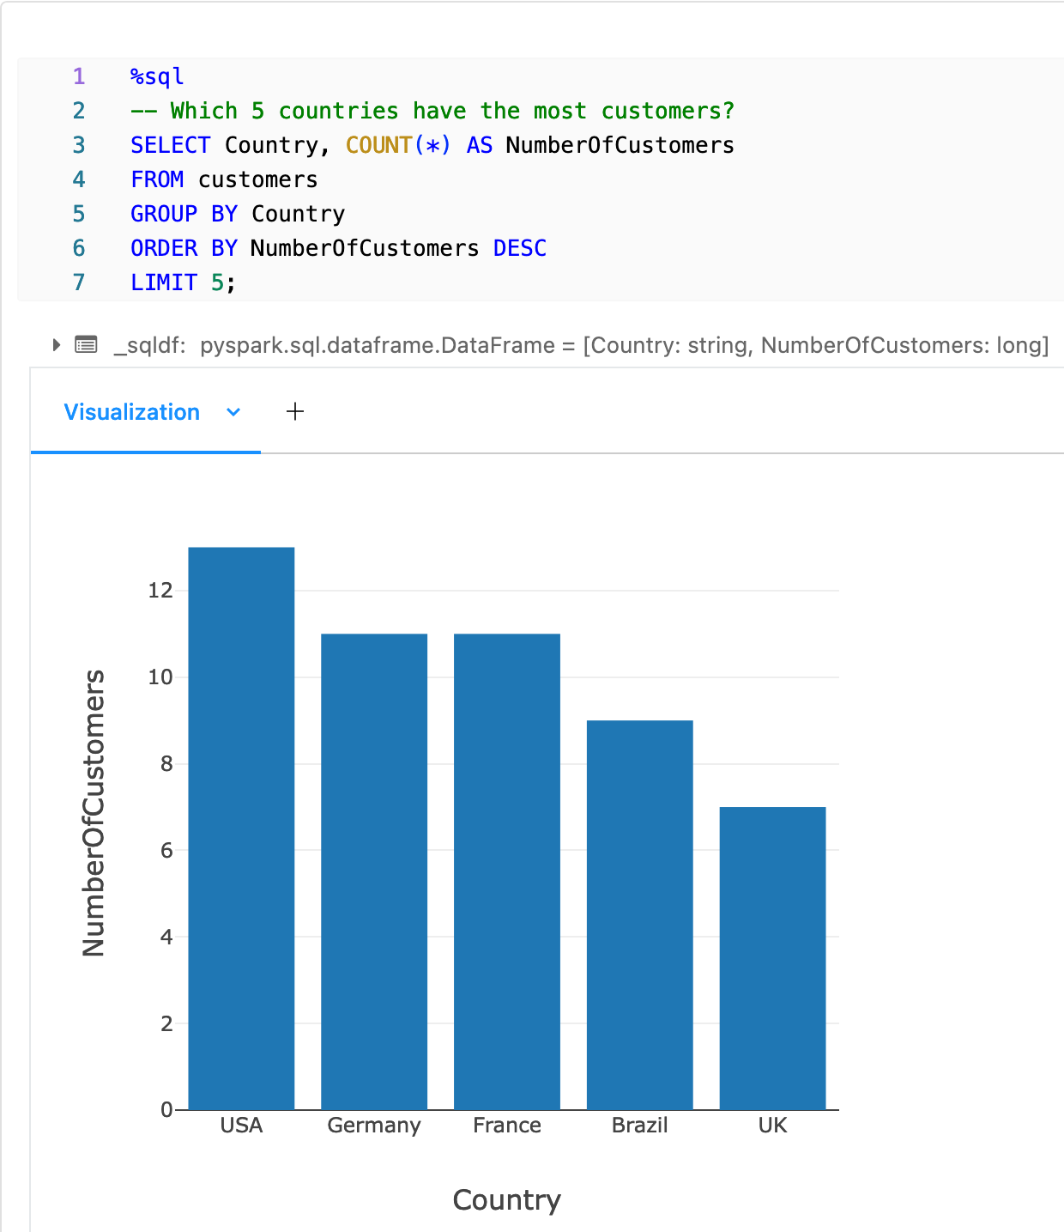
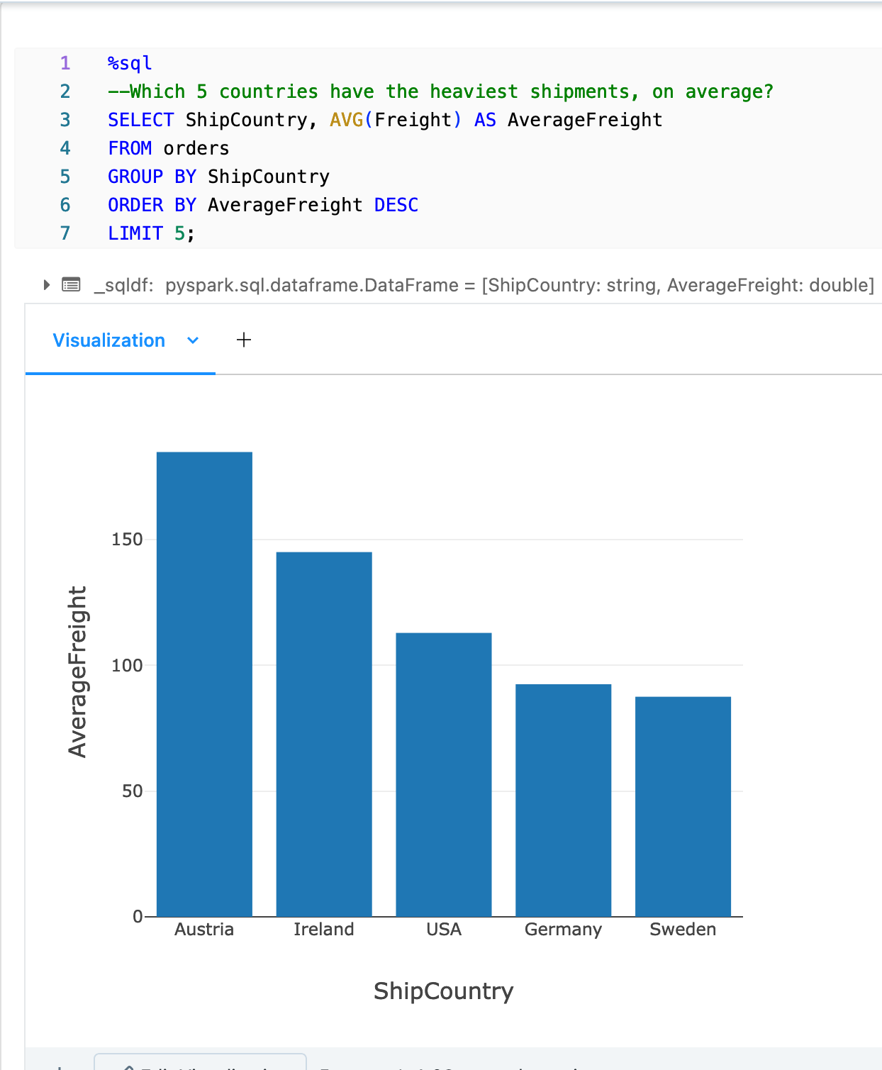
Regional Orders
Largest volume of Customers in USA. Largest shipments in Austria

