Slide 1

CS 557 PRESENTATION BUSINESS GROUP
A database model for an online business

Slide 2

Overview
General Information
What are we doing and why?
Business Rules
What constraints does the database operate within?
Complete ERD
Full overview of the database design.
ERD Breakdown
Different components of the database in further detail.
Questions / Feedback
We want to hear what you have to say!

Slide 3
General Information
Database purpose:
The purpose of this database is to help an online busines keep track of day-to-day activities.
Day-to-day Activities:
Contact Management
Inventory
Invoicing
Customer Referrals
Result:
This database will save the online business both time and money by centralizing all required business information and automating many of its processes.

Slide 4
Business Rules
An invoice must only have one customer
A customer can have multiple invoices
A customer can refer multiple customers
A customer can only be referred by one customer
A purchase order must have one supplier
A supplier can have many purchase orders
A purchase order must have many supply’s
A supply can have many purchase orders
A supply must have one preferred supplier
A supplier can be the preferred supplier for many supply’s
An invoice must have one or more products
All ID’s 0 to 99 are reserved, automatically generated ID’s cannot use these numbers
Any entity with a single attribute primary key can have many notes
A note must have an associate entity
A customer or supplier must have at least one address
An address must have at least one customer or supplier
A PO Must have an associated address
A supply must have at least one supplier
A supplier can have multiple supplies

Slide 5
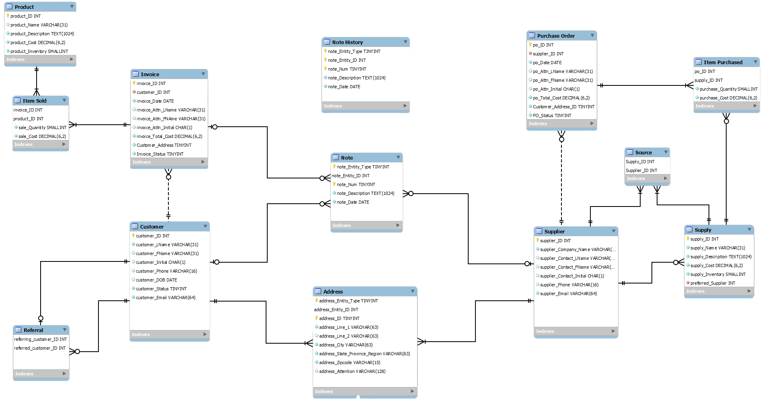
ERD - Complete

Slide 6
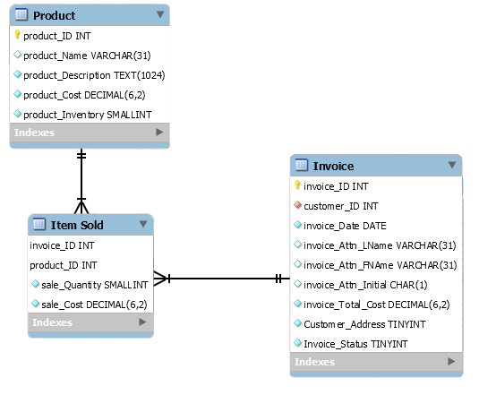
ERD - Breakdown
Applicable Business Rules
An invoice must have one or more products

Slide 7
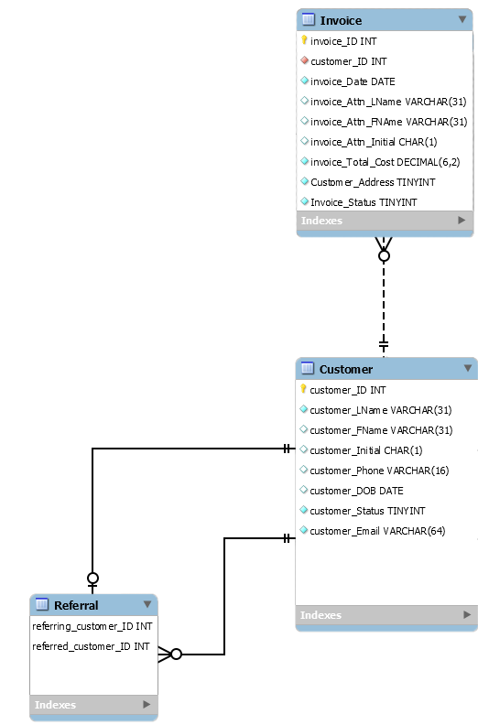
ERD - Breakdown
Applicable Business Rules
An invoice must only have one customer
A customer can have multiple invoices
A customer can refer multiple customers
A customer can only be referred by one customer

Slide 8
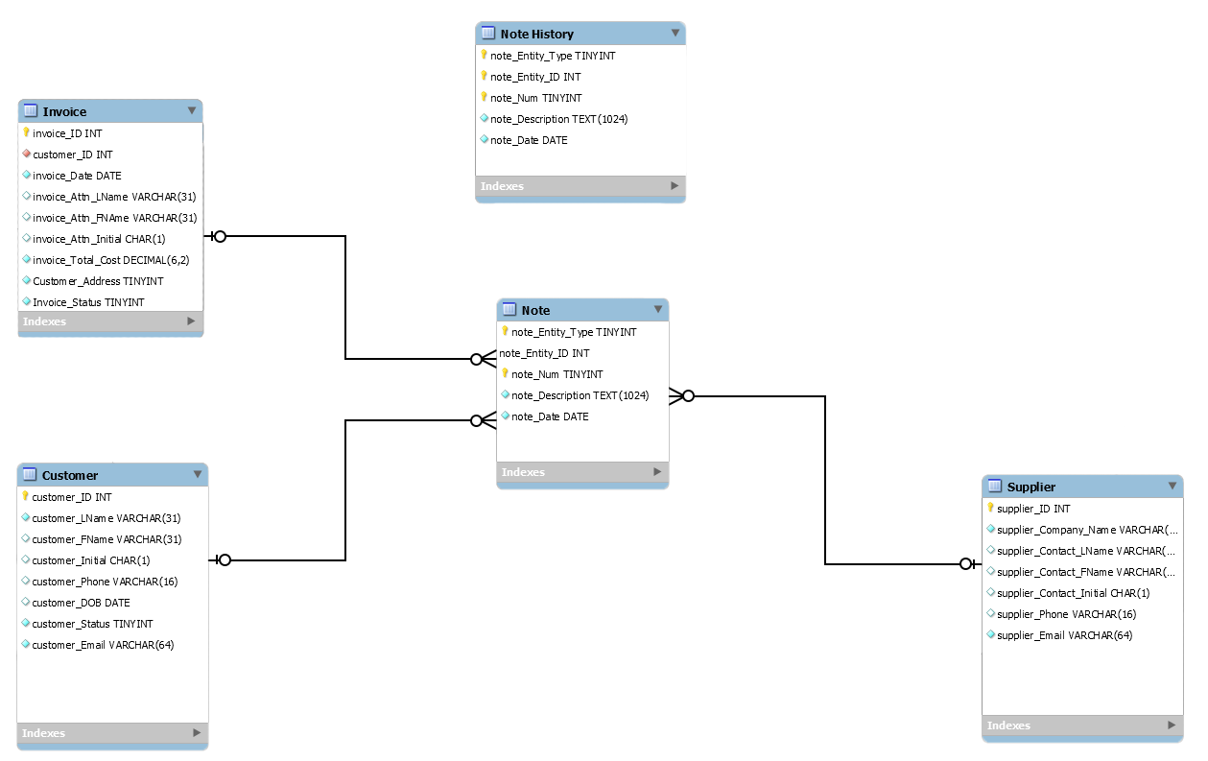
ERD - Breakdown
Applicable Business Rules
Any entity with a single attribute primary key can have many notes.
A note must have an associate entity

Slide 9
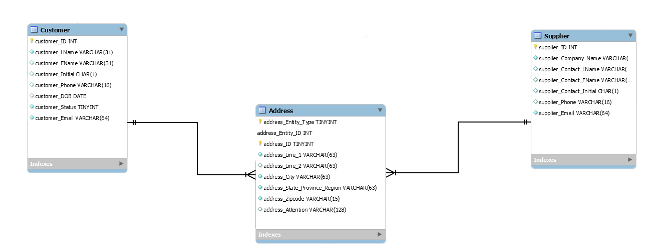
ERD - Breakdown
Applicable Business Rules
A customer or supplier must have at least one address.
An address must have at least one customer or supplier.

Slide 10
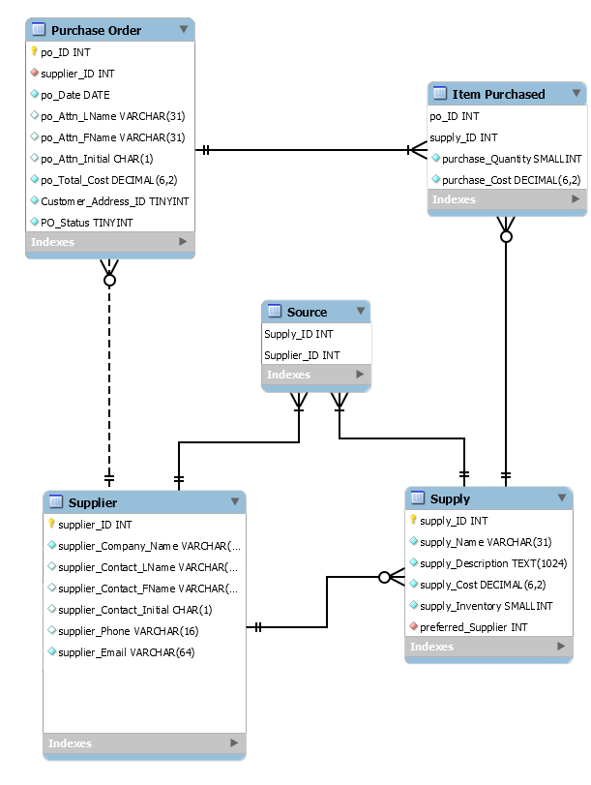
ERD - Breakdown
Applicable Business Rules
A purchase order must have one supplier
A supplier can have many purchase orders
A purchase order must have many supply’s
A supply can have many purchase orders
A supply must have one preferred supplier
A supplier can be the preferred supplier for many supply's
A PO Must have an associated address
A supply must have at least one supplier
A supplier can have multiple supplies

Slide 11
Questions

