Slide 1
RTT (Render-to-texture) using
FBO (Framebuffer Object) Extension
Ref: FBO101, FBO201

Slide 2

Motivation (dynamic texture)

Slide 3

Duplicated animation

Slide 4
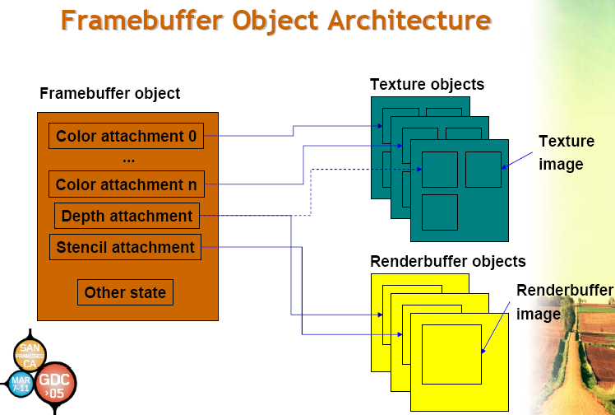

Slide 5
GLuint fbo; // Our handle to the FBO
GLuint depthBuffer; // Our handle to the depth render buffer
GLuint img; // Our handle to a texture
int width, height;
void initFBO() {
// Setup our FBO
glGenFramebuffersEXT(1, &fbo);
// bind for set up
glBindFramebufferEXT(GL_FRAMEBUFFER_EXT, fbo);
// Now setup a texture to render to
glGenTextures(1, &img);
glBindTexture(GL_TEXTURE_2D, img);
glTexImage2D(GL_TEXTURE_2D, 0, GL_RGBA8, width, height, 0, GL_RGBA, GL_UNSIGNED_BYTE, NULL);
glTexParameterf(GL_TEXTURE_2D, GL_TEXTURE_WRAP_S, GL_CLAMP_TO_EDGE);
glTexParameterf(GL_TEXTURE_2D, GL_TEXTURE_WRAP_T, GL_CLAMP_TO_EDGE);
glTexParameterf(GL_TEXTURE_2D, GL_TEXTURE_MAG_FILTER, GL_LINEAR);
glTexParameterf(GL_TEXTURE_2D, GL_TEXTURE_MIN_FILTER, GL_LINEAR);
// And attach it to the FBO so we can render to it
glFramebufferTexture2DEXT(GL_FRAMEBUFFER_EXT, GL_COLOR_ATTACHMENT0_EXT, GL_TEXTURE_2D, img, 0);
Clip Board (1/2)

Slide 6
Clip Board (2/2)
// Create the render buffer for depth
glGenRenderbuffersEXT(1, &depthBuffer);
glBindRenderbufferEXT(GL_RENDERBUFFER_EXT, depthBuffer);
glRenderbufferStorageEXT(GL_RENDERBUFFER_EXT,GL_DEPTH_COMPONENT, width, height);
// Attach the depth render buffer to FBO as it's depth attachment
glFramebufferRenderbufferEXT(GL_FRAMEBUFFER_EXT, GL_DEPTH_ATTACHMENT_EXT, GL_RENDERBUFFER_EXT, depthBuffer);
// Checking
GLenum status = glCheckFramebufferStatusEXT(GL_FRAMEBUFFER_EXT);
if(status != GL_FRAMEBUFFER_COMPLETE_EXT)
exit(1);
// Unbind the FBO for now
glBindFramebufferEXT(GL_FRAMEBUFFER_EXT, 0);
}
void ShutDown(GLvoid)
{
glDeleteFramebuffersEXT(1, &fbo);
glDeleteRenderbuffersEXT(1, &depthBuffer);
glDeleteTextures(1,&img);
}

Slide 7
FBO in Use
  “Render to texture” Pass
    Rendering using the current pipeline parameters; can be altered using glPushAttrib( )
  glBindFramebufferEXT(GL_FRAMEBUFFER_EXT, fbo);
Use FBO for texture
  glBindFramebufferEXT(GL_FRAMEBUFFER_EXT, 0);
  glBindTexture(GL_TEXTURE_2D, img);

