Slide 1
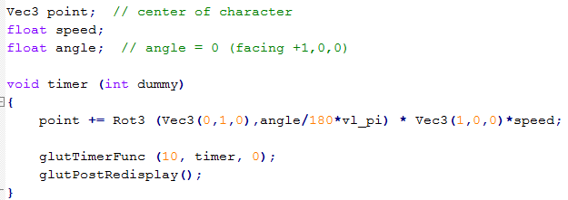
Drive 1/2
Three versions: Point, teapot, Yoshi
Displacement of centroid
Special keys to adjust speed and angle

Slide 2
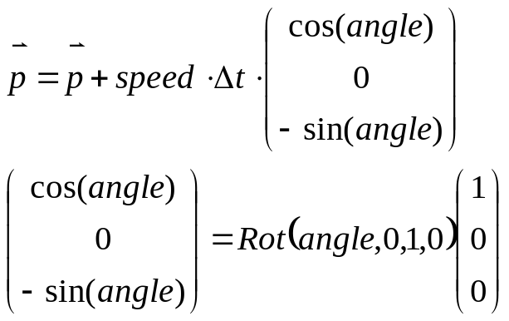
Drive 2/2
x
Vec3 pos;
double angle;
z

Slide 3
MD2 Pose
Three poses: 0 (stand), 1 (walk), 6 (jump)
Stand:
  When speed is 0.0
  After jump is done
Walk:
  Speed > 0 when currently stand
FSM implementation
Guesstimate how high Yoshi jumps

