Slide 1
Per-Pixel Shading

Slide 2
Introduction
Also known as Phong shading
Use this as an example to get to know shaders better

Slide 3

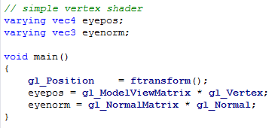
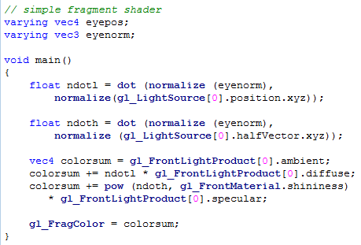
Directional Light

Slide 4
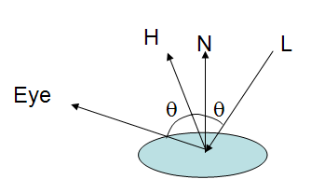

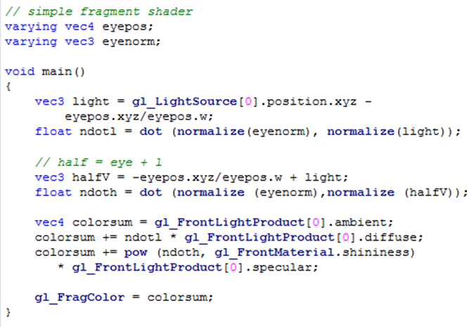

Point Light
Blinn-Phong

Slide 5

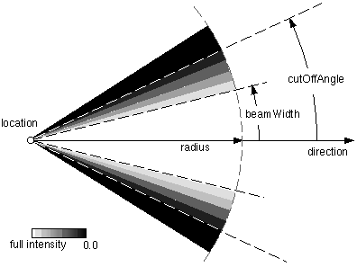
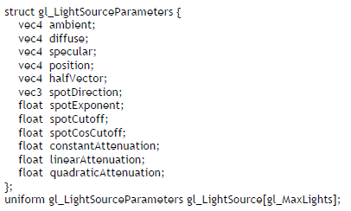
HW: Spot Light + attenuation
Reference (here)

