Slide 1

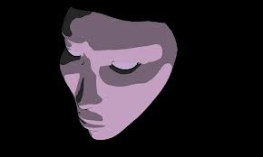
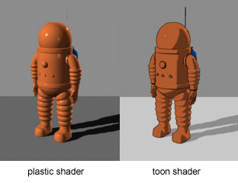
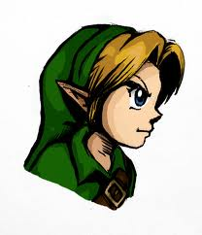

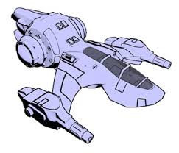
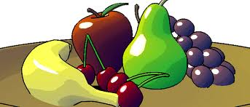
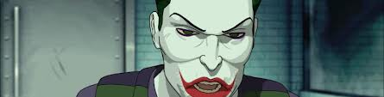
Toon-Shading

Slide 2
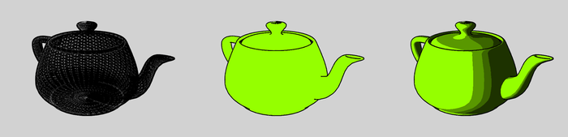
Introduction
The name comes from cels (short for celluloid), the clear sheets of acetate which are painted on for use in traditional 2D animation.
Also known as Cel-shading
Discrete diffuse shading
Shading colors:
Set to be the same hue, with different brightness

Slide 3
HSV & RGB Conversion
Check out color.ppt in OpenGL class
A good example to bring in your own C++ function into shaders
GLSL has no:
double (change to float)
Typedef
Type casting
Watch for keywords: in, out, …

Slide 4
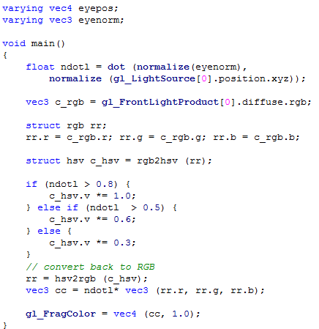
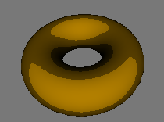
Fragment Shader

