Slide 1
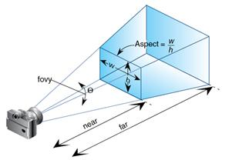
OpenGL Picking Notes

Slide 2
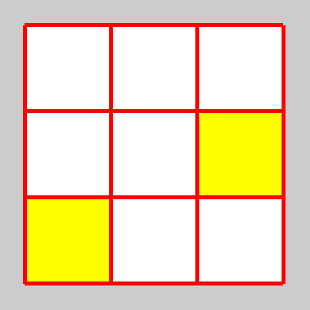
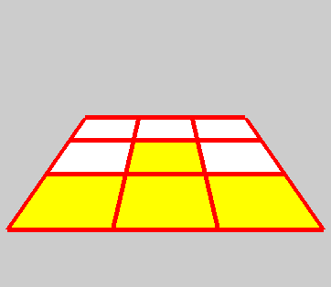
Picking 聽說很難，一定要學？
2D Pick
  Convert mouse coordinate to world coordinate
2½D
  Use gluUnProject to find the “mouse line” in object space
Fall 2013

Slide 3
twoDpick.cpp
(10,10)
3
0,2
1,2
2,2
3
0,1
1,1
2,1
0,0
1,0
2,0
(1,1)
Fall 2013

Slide 4
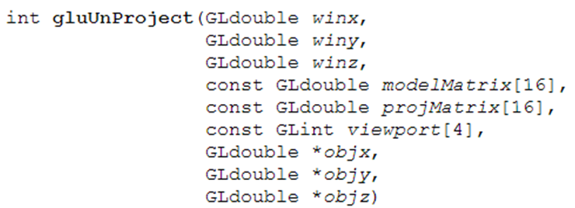
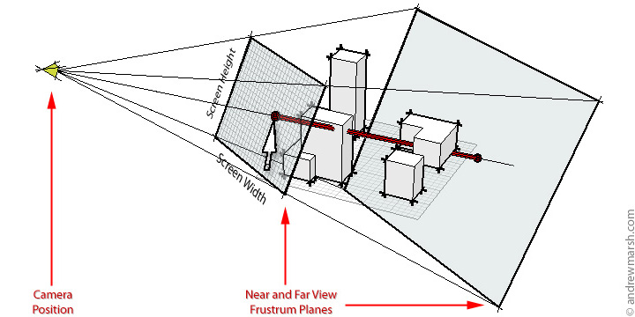
Fall 2013

Slide 5
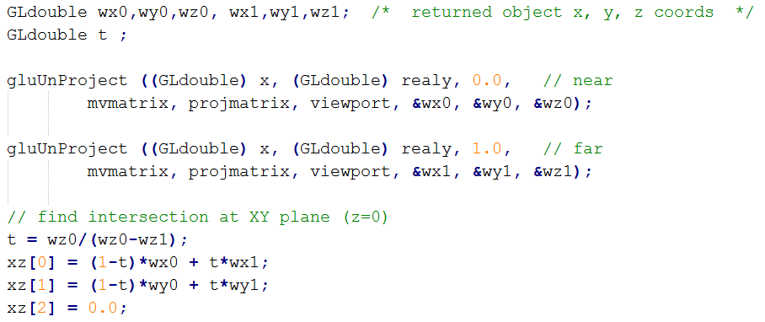
twohalfDpick.cpp & tracer.cpp
Fall 2013

Slide 6
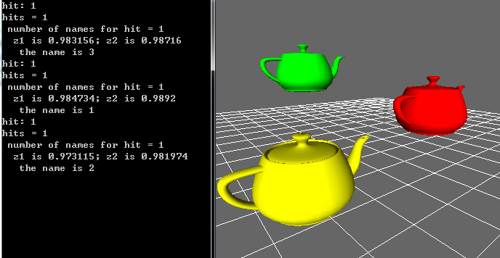
3D Pick
Fall 2013

Slide 7
Ideas
Trigger picking mechanism with mouse callback
Whatever intersect with the mouse frustum are reported, by their “names”
(Usually) the one closest to camera (i.e., smallest depth) is the one got picked
Fall 2013

Slide 8
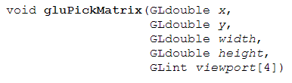
PickMatrix
OpenGL window coordinates
Fall 2013

Slide 9
When picking, need to “insert” a pick matrix in front of the projection matrix…
  Get the current projection matrix (and viewport)
GLint viewport[4];
GLfloat project[16];
glGetIntegerv(GL_VIEWPORT, viewport);
glGetFloatv (GL_PROJECTION_MATRIX, project);
glMatrixMode(GL_PROJECTION);
glPushMatrix();
glLoadIdentity();
// create 5x5 pixel picking region near cursor location
gluPickMatrix((GLdouble) x, (GLdouble) (viewport[3] - y), 5.0, 5.0, viewport);
glMultMatrixf (project);
// finish setting PROJECTION, back to MODELVIEW
glMatrixMode (GL_MODELVIEW);
Fall 2013

Slide 10
Set up selection buffer before enabling SELECT mode
Enter SELECT mode; Initialize (empty) name stack; draw scene with names
Restore PROJECTION matrix; process hit record
#define BUFSIZE 10
GLuint selectBuf[BUFSIZE];
glSelectBuffer(BUFSIZE, selectBuf);
glRenderMode (GL_SELECT);
glInitNames();
drawscene();
// restore PROJECTION matrix
glMatrixMode (GL_PROJECTION); glPopMatrix();
GLint hits = glRenderMode(GL_RENDER);
processHits(hits, selectBuf);
Fall 2013

Slide 11
Naming Objects
Name Stack
  The content of the stack determines the name
  All “names” are unsigned integers
APIs for name stack (next page)
  glPushName, glPopName, glLoadName, glInitNames
All naming APIs work in SELECT mode only
  glRenderMode (GL_SELECT);11
Fall 2013

Slide 12
API Summary
void glInitNames(void void);
  Initialize an empty name stack
void glLoadName(GLuint name);
  Replace top of stack
void glPushName(GLuint name);
void glPopName(void void);
GLint glRenderMode(GLenum mode);
  Three values are accepted: GL_RENDER (default), GL_SELECT, and GL_FEEDBACK.
void glSelectBuffer(GLsizei size, GLuint *buffer);
  must be issued before select mode is enabled
Fall 2013

Slide 13
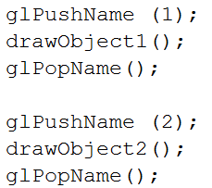
Naming Object
Then, draw the scene, with names associated with all pickable objects
Fall 2013

Slide 14
Process Hit Records
When the render mode is back to GL_RENDER, a hit record is generated
Record consists of (all 32-bit unsigned integers)
  Number of names
  zlo, zhi (divided by 0xffff ffff to get [0,1])
  {names}
  Use int *ptr to read data
#define BUFSIZE 100
GLuint selectBuf[BUFSIZE];
GLint hits;
hits = glRenderMode(GL_RENDER);
processHits(hits, selectBuf);
Fall 2013

Slide 15
Clipboard
void processHits(GLint hits, GLuint buffer[])
{
unsigned int i, j;
GLuint names, *ptr;
printf("hits = %d\n", hits);
ptr = (GLuint *) buffer;
for (i = 0; i < hits; i++) { /* for each hit */
names = *ptr;
printf(" number of names for hit = %d\n", names); ptr++;
printf(" z1 is %g;", (float) *ptr/0xffffffff); ptr++;
printf(" z2 is %g\n", (float) *ptr/0xffffffff); ptr++;
printf(" the name is ");
for (j = 0; j < names; j++) { /* for each name */
printf("%d ", *ptr); ptr++;
}
printf("\n");
}
}
Fall 2013

Slide 16
ViewerAddClicker
Viewer uses mouse function (left button) to rotate camera; adding your mouse callback disables this function
“Clicker” is a function added for this purpose
  It is process first, then continue with the viewer camera setting
  You can then use “right button” to pick
Fall 2013

