Slide 1
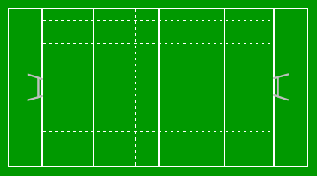
Scrum

Slide 2
https://en.wikipedia.org/wiki/Scrum_(software_development)
Scrum is an iterative and incremental agile software development framework for managing product development. It defines "a flexible, holistic product development strategy where a development team works as a unit to reach a common goal", challenges assumptions of the "traditional, sequential approach" to product development, and enables teams to self-organize by encouraging physical co-location or close online collaboration of all team members, as well as daily face-to-face communication among all team members and disciplines involved.
A key principle of Scrum is the dual recognition that customers will change their minds about what they want or need (often called requirements volatility) and that there will be unpredictable challenges—for which a predictive or planned approach is not suited. As such, Scrum adopts an evidence-based empirical approach—accepting that the problem cannot be fully understood or defined up front, and instead focusing on how to maximize the team's ability to deliver quickly, to respond to emerging requirements, and to adapt to evolving technologies and changes in market conditions.

Slide 3


Slide 4
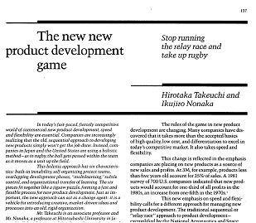

Slide 5

Empirical Approach
(unpredictable outputs)
Transparency
Adaption
Inspection

Slide 6



All work should be visible to all
Regular inspection to highlight deviation
Adjust the process if needed

Slide 7





Commitment
Respect
Courage
Openess
Focus

Slide 8

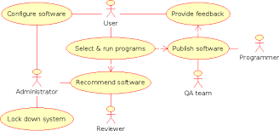



Slide 9







Slide 10


Slide 12




One to four weeks, usually two weeks

Slide 13



One to four weeks, usually two weeks

Slide 14
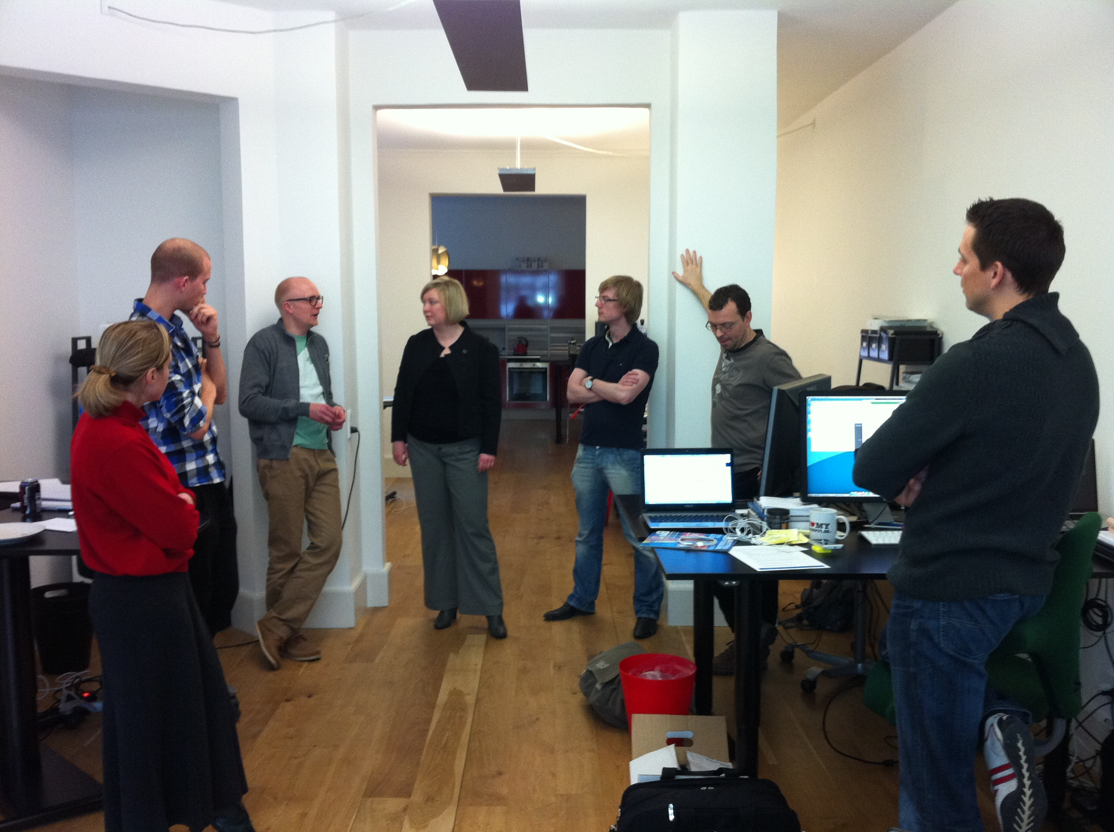
A “standup” scrum meeting

Slide 15








Slide 16






Slide 17
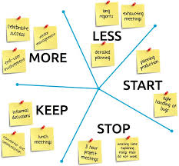
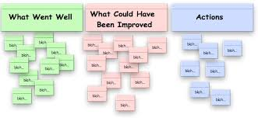
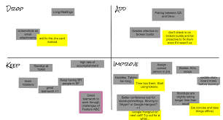

Slide 18

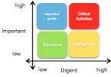


Slide 20
