Slide 1
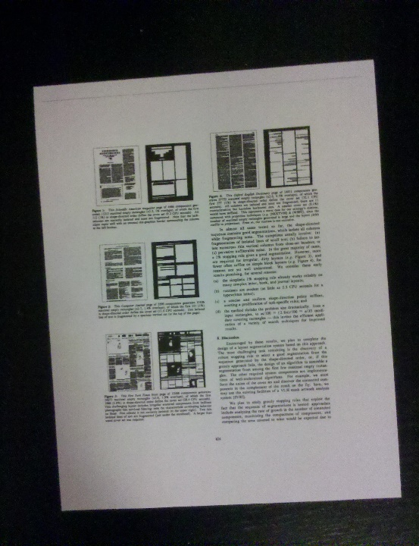
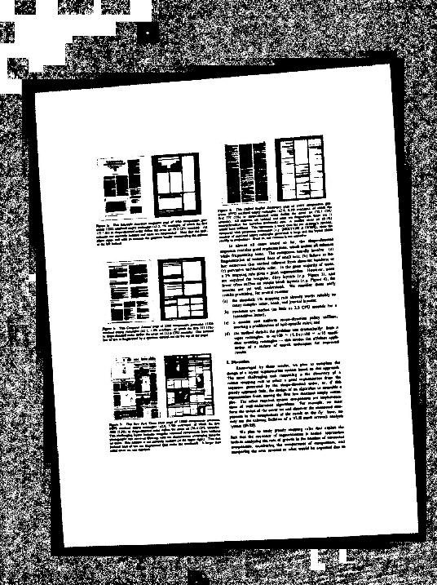
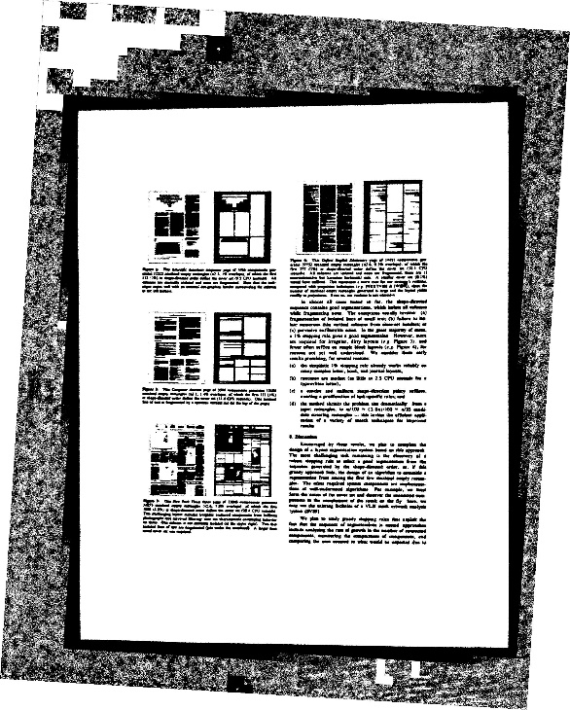
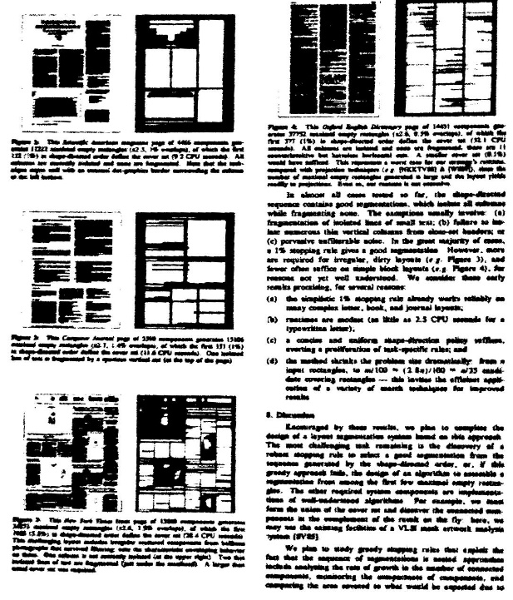
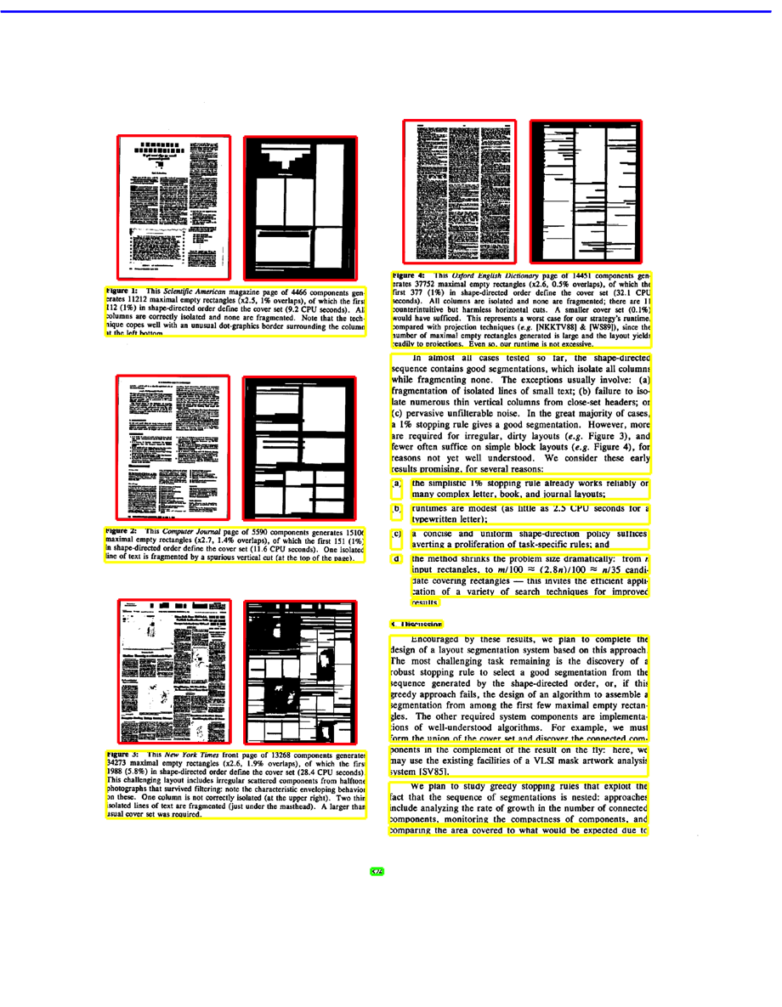
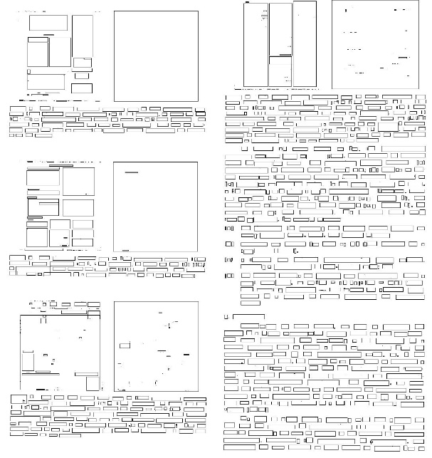
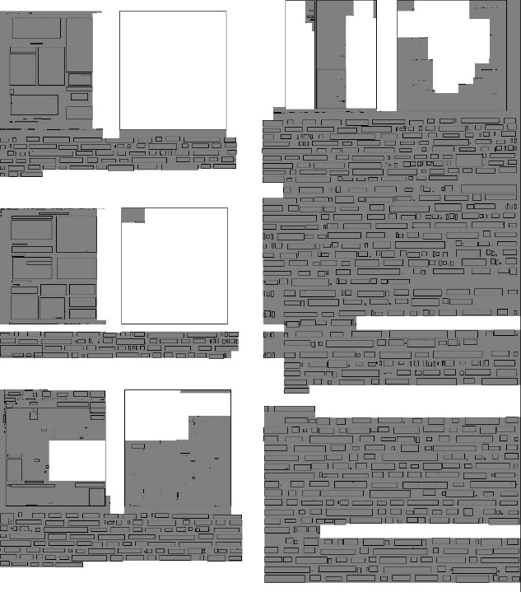
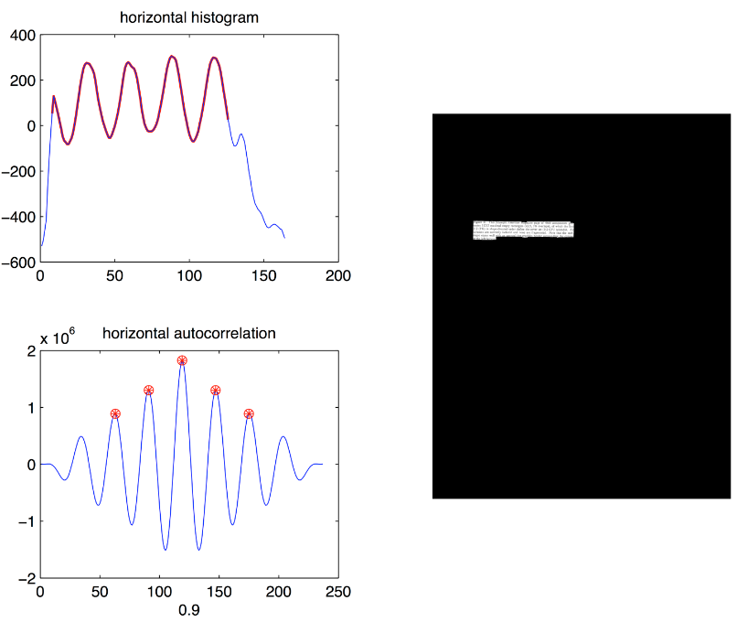
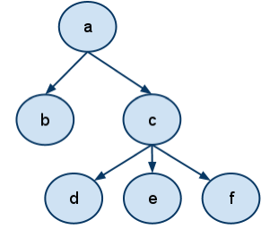
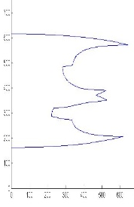
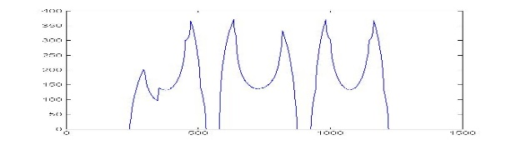
Decomposing LaTeX Documents from Geometrical and Logical Layout
Vincent Deo, Terry Kong, Maisy Wieman
Department of Electrical Engineering, Stanford University
LaTeX is a low-level markup and programming language that produces aesthetically pleasing PDF documents with diverse content. This project aims to analyze the layout of mobile images of LaTeX documents to simplify the generation of LaTeX source code. Input is captured from an Android phone, and the results are computed on a server.
Overview
Methodology
Results
Preprocessing
Find Maximal White Rectangles
Classify Regions
Color | Type
Red | Figures
Yellow | Text
Green | Page No.
Blue | No type
Input
Adaptive Binarization
Skew Correction
Margin Removal
Scan Image for black CCs
Create and balance binary tree of white rectangles
Largest 100 Rectangles
Future Work
Use the results of layout decomposition to generate code for a LaTeX template for the given document
Add text recognition to generate the entire LaTeX document
368
Global and Local Feature Comparison
References
Determine CC Statistics
Use Horizontal Projections
H.S. Baird, S.E. Jones and S.J. Fortune, "Image Segmentation by Shape-Directed Covers,"Proc. Int',l Conf. Pattern Recognition, pp. 820-825, 1990.

