Slide 1
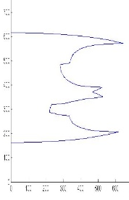
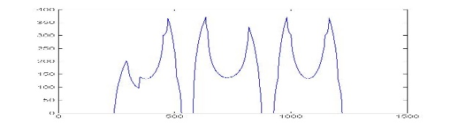
Decomposing LaTeX Documents from Geometrical and Logical Layout
Vincent Deo, Terry Kong, Maisy Wieman
Department of Electrical Engineering, Stanford University
LaTeX is a low-level markup and programming language that produces aesthetically pleasing PDF documents with diverse content. This project aims to analyze the layout of mobile images of LaTeX documents to simplify the generation of LaTeX source code.
Overview
Methodology
Android Application
Preprocessing
Find Maximal White Rectangles
Classify Regions
Screenshot of Something w/ phone
Mention server use?
Or perhaps this section should just be results beyond what methodology shows?
Adaptive Local Binarization
Skew Detection & Correction
Margin Removal
EE
368
Output image
here
Scan Image for black CCs
Create and balance binary tree of white rectangles
Future Work
Use the results of layout decomposition to generate code for a LaTeX template for the given document
Add text recognition to generate the entire LaTeX document
368
References
Determine region (CC?) statistics
Threshold to classify
H.S. Baird, S.E. Jones and S.J. Fortune, "Image Segmentation by Shape-Directed Covers,"Proc. Int',l Conf. Pattern Recognition, pp. 820-825, 1990.

