Slide 1




Heart Disease… a silent threat
By: The hAPI Campers
Alon
Terry
Kat
Leticia

Slide 2
Motivation
The Lipid Heart Hypothesis (1950s)
Cholesterol and Saturated Fat = Heart Disease
Recent studies point to sugar and processed carbs
What is the relationship between the presence of heart disease and:
Cholesterol?
Fasting Blood Sugar?
Resting Blood Pressure?
Age? Sex?
Type of Chest Pain?
Maximum Heart Rate?

Slide 3
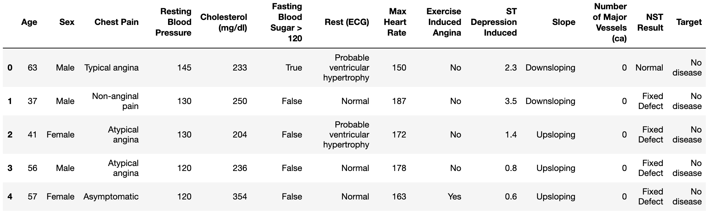
LIMITATIONS
Data Limitations
Sample Size: 296
Continuous versus Categorical Data
Definition?

Slide 4
SUMMARY
Cholesterol is not a good indicator of heart disease
Males have higher incidence of heart disease
Exercise-Induced Angina (Chest Pain) is a cause for concern
Older population more affected
Heart disease patients are often asymptomatic
Inconclusive on fasting blood sugar – need continuous data
Heart disease patients have lower maximum HR

Slide 5
QUESTIONS & DATA
What is the relationship between the presence of heart disease and:
Cholesterol?
Continuous cholesterol and, ideally, CAC scores
Categorical identifier (Disease/No Disease) is a major limiting factor
Fasting Blood Sugar?
Resting Blood Pressure?
Age? Sex?
Type of Chest Pain?
Maximum Heart Rate?

Slide 6
THE MISSING LINK
CAC (Coronary Artery Calcification) Scores

Slide 7
Data Cleanup & Exploration
Exploration and Cleanup
Kaggle Data Preview - Questionable
Kaggle Discussion - Helpful
Pandas DataFrame from CSV → Rename Columns → Start Plotting!
New Insights
Predispositions to heart disease based on various factors
Problems and Resolutions
Dirty Data
NaNs
Number Mismatches
Unclear Column Names

Slide 8
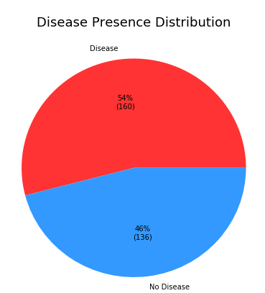
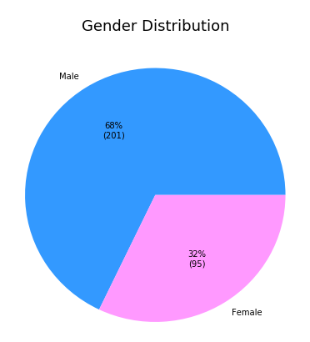
Population Preview

Slide 9
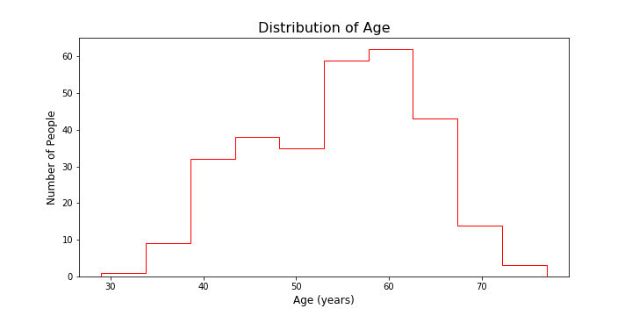
Interesting figures

Slide 10
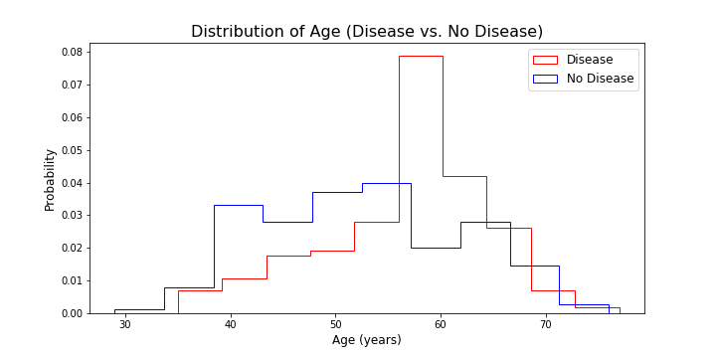
Interesting figures

Slide 11
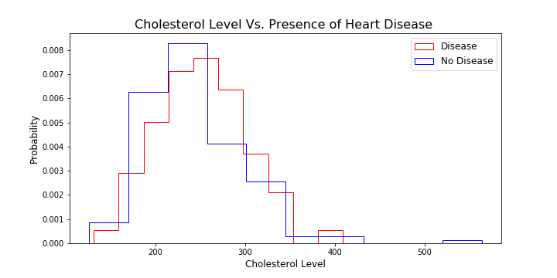
Interesting figures

Slide 12
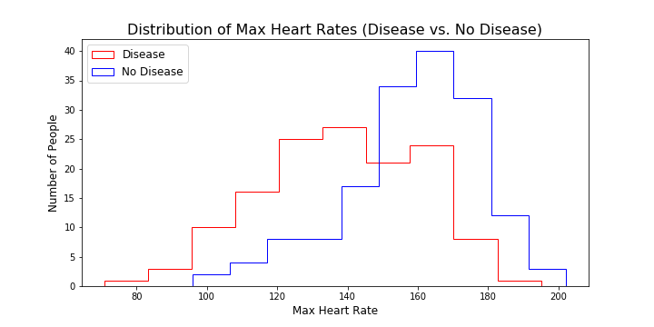
Interesting figures

Slide 13
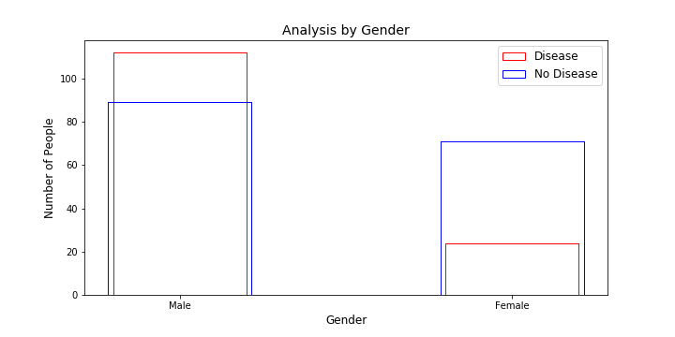
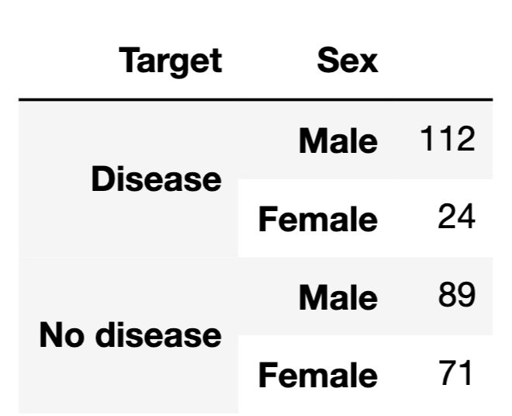
Interesting figures
55.7% of males have heart disease
25.3% of females have heart disease

Slide 14
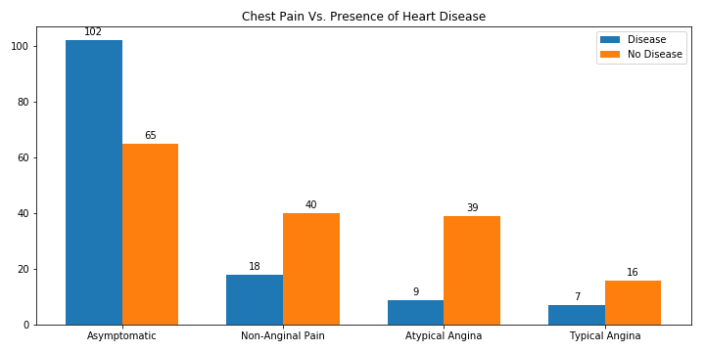
Interesting figures

Slide 15
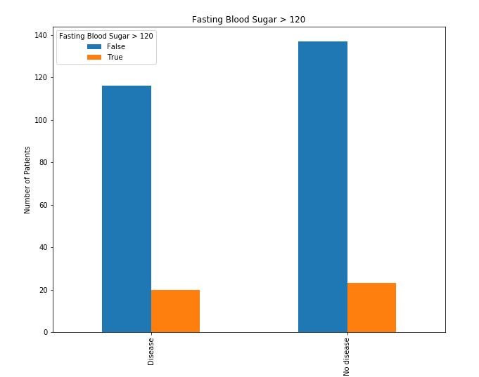
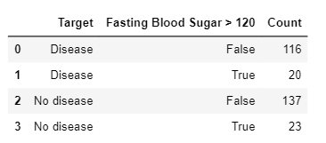
Interesting figures

Slide 16
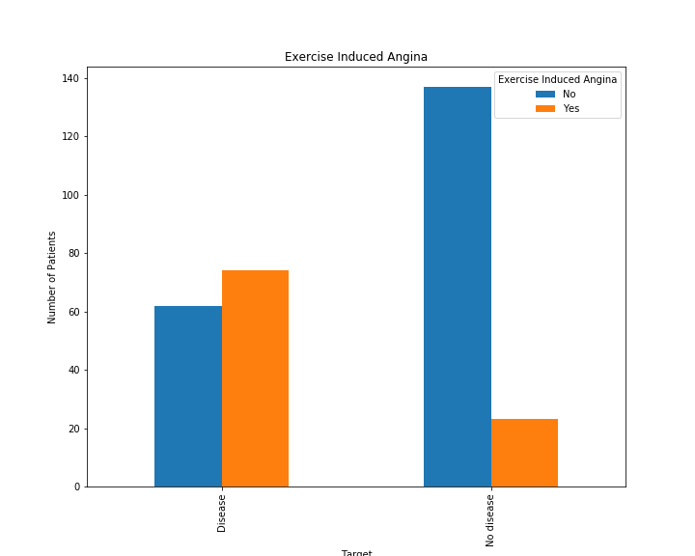
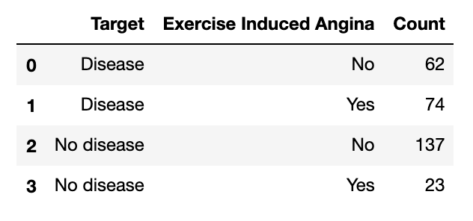
Interesting figures

Slide 17
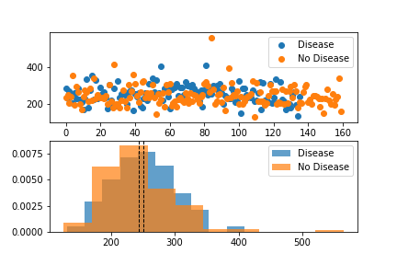
Interesting figures

Slide 18
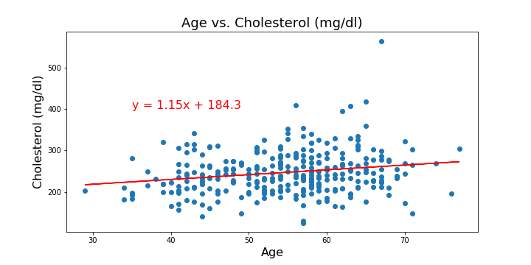
Interesting figures
Correlation Coefficient: 0.2

Slide 19
Data Analysis
Analysis Steps
Clean DataFrame
Remove NaNs
Rename Columns
Separate necessary variables
Plot variables
Analyze
Format plot

Slide 20
Discussion
Potential Indicators of Heart Disease
Cholesterol Weak Correlation = 0.2 T-Test P-Value = 0.18 Fasting Blood Sugar Data limited Inconclusive Resting Blood Pressure Slight inclination to higher resting BP for disease patients Age Patients with disease tend to be older (55 and older) | Sex 55.7% of Men 25.3% of Women Type of Chest Pain Disease patients typically asymptomatic Maximum Heart Rate Lower max HR in disease patients

Slide 21
Post Mortem
Difficulties
Data was dirty and some column names were unclear
Found an answer in the discussion
Additional Questions & Further Research
How does the study define disease vs. no disease?
Relationship between heart disease and post-prandial blood sugar?
Correlations with CAC scores
Significance of Insulin vs. Blood Sugar

