Slide 1
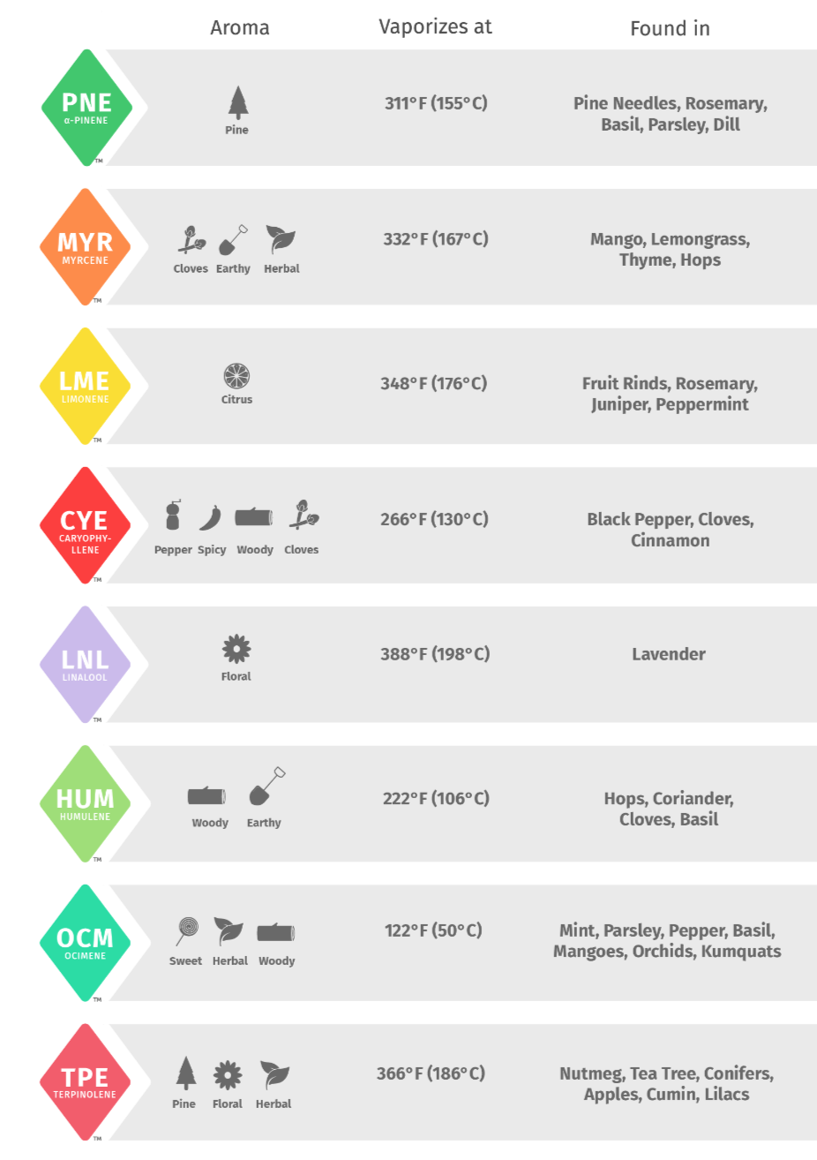
Terpene Strain Hunt
Link to extensive terpene info...

Slide 2
Terpene Analysis Results Oct 30, 2018
By programming a web scraper in python, I checked each web page in the Analytical360 archive for lab reports that included terpene analysis (500k web pages total)
After editing the raw data and removing repeat data, extracts, edibles, and nonsense, the resulting data set contained 14491 terpene profiles from 3354 distinct strains
Box plots showing the distribution and outliers of all the samples within a strain are obtained
The mean and median for both the absolute (dry weight) total and individual terpene % as well as the relative individual terpene % for all samples of the same strain are obtained
While both median and mean are obtained, median is the preferred metric to avoid influence of outliers
To avoid superfluous strains that will be “difficult” to procure and to minimize the effects of bad samples, I only show results for strains having 3 or more samples
I only show the top 20 results for each category but if none of those are able to be found, the data exists for the subsequent results

Slide 3
There are three ways to potentially take advantage of the terpene data:
Breed the plants to maximize total dry weight terpene %, regardless of the specific terpene. There is a possibility that the loci for total terpene % is independent from the loci for the specific terpenes.
Similar to how the loci for thc % and total cannabinoid % are independent
Breed the plants to maximize absolute dry weight terpene % for each specific terpene, even if the total terpene % is not the highest.
This will give us the strongest terpene expression
Breed the plants to maximize relative terpene % for each specific terpene, even if the dry weight % is not that high. There is a possibility that terpenes are not expressed independently within a terpene profile in a strain. Thus, by focusing on the high relative %, we are selecting for independence.
This will give us the purest terpene expression

Slide 4
Analytical360
Top # Samples
 | Strain | # samples | alpha-pinene | caryophyllene | humulene | limonene | linalool | myrcene | terpinolene | TOTAL %
1 | blue_dream | 359 | 0.51 | 0.56 | 0.36 | 0 | 0 | 0.44 | 0 | 2.88
2 | dutch_treat | 311 | 0 | 0.39 | 0.31 | 0 | 0 | 0.33 | 0.01 | 3.35
3 | girl_scout_cookies | 264 | 0.43 | 0.63 | 1.03 | 0 | 0 | 0.16 | 0 | 3.76
4 | harlequin | 205 | 0.22 | 0.25 | 0.16 | 0 | 0 | 0.34 | 0 | 2.36
5 | cinex | 167 | 0.24 | 0.37 | 0.84 | 0 | 0 | 0.07 | 0 | 2.35
6 | og_kush | 127 | 0.23 | 0.55 | 0.83 | 0 | 0 | 0.2 | 0 | 3.47
7 | green_crack | 123 | 0.163 | 0.4 | 0.3 | 0 | 0 | 0.17 | 0 | 1.95
8 | grand_daddy_purple | 119 | 0.72 | 0.41 | 0.54 | 0 | 0 | 0.507 | 0 | 2.91
9 | platinum_cookies | 103 | 0.55 | 0.69 | 1.15 | 0 | 0 | 0.12 | 0 | 3.82
10 | blackberry_kush | 103 | 0.17 | 0.4 | 0.64 | 0 | 0 | 0.21 | 0 | 2.8
11 | sour_diesel | 100 | 0.595 | 0.5 | 0.99 | 0 | 0 | 0.215 | 0 | 4.24
12 | blueberry | 97 | 0.52 | 0.66 | 0.37 | 0 | 0 | 0.6 | 0 | 3.68
13 | tahoe_og | 95 | 0.58 | 0.42 | 0.88 | 0 | 0 | 0.14 | 0 | 2.98
14 | jack_herer | 94 | 0.01 | 0.3445 | 0.24 | 0 | 0 | 0.147 | 0 | 2.315
15 | pineapple_express | 93 | 0.16 | 0.59 | 0.75 | 0 | 0 | 0.24 | 0 | 3.17
16 | white_widow | 91 | 0 | 0.43 | 0.5 | 0 | 0 | 0.37 | 0 | 3.82
17 | bubba_kush | 91 | 0.012 | 0.57 | 1.22 | 0 | 0 | 0.11 | 0 | 3.44
18 | super_lemon_haze | 89 | 0 | 0.73 | 0.35 | 0 | 0 | 0.15 | 0 | 3.04
19 | grape_ape | 89 | 0.73 | 0.43 | 0.43 | 0 | 0 | 0.39 | 0 | 2.8
20 | chernobyl | 88 | 0.47 | 0.455 | 0.51 | 0 | 0 | 0.14 | 0 | 2.76

Slide 5
Analytical360
Absolute Total Terpene % Median
(>2 Samples)
 | Strain | # samples | alpha-pinene | caryophyllene | humulene | limonene | linalool | myrcene | terpinolene | TOTAL %
1 | 619_diesel_og | 5 | 0.92 | 0.93 | 3.79 | 0 | 1.51 | 0.38 | 0 | 8.29
2 | buddhas_on_moonshine | 4 | 0.965 | 0.51 | 1.055 | 0 | 3.875 | 1.435 | 0 | 7.82
3 | jacks_haze | 6 | 0 | 0.71 | 0.6 | 1.88 | 2.535 | 0.09 | 0 | 7.54
4 | golden_pineapple | 5 | 0 | 0.65 | 0.2 | 2.26 | 5.06 | 0.32 | 0 | 7.35
5 | dragon_lady | 4 | 0.225 | 0.585 | 0.255 | 0.3 | 1.825 | 0.535 | 0 | 7.25
6 | plushberry_kush | 3 | 0.78 | 0.59 | 0.29 | 2.05 | 1.78 | 0.76 | 0 | 7.2
7 | red_diesel | 4 | 0.755 | 0.575 | 0.21 | 1.275 | 2.555 | 0.66 | 0.04 | 7.115
8 | flog | 3 | 0.44 | 0.16 | 3.07 | 0 | 0.86 | 1.79 | 0 | 7.07
9 | red_og | 3 | 0.88 | 1.04 | 0.74 | 0 | 1.72 | 1.9 | 0.11 | 7.06
10 | critical_jack | 7 | 0 | 0.32 | 0.21 | 3.29 | 0.81 | 0 | 0 | 7.02
11 | death_star | 7 | 0.91 | 1.65 | 1.5 | 0 | 0.849 | 0.5 | 0 | 7.02
12 | lemon_wreck | 4 | 0.215 | 0.895 | 0.035 | 2.555 | 1.99 | 0.245 | 0.395 | 6.94
13 | precious_og | 3 | 1.11 | 0.42 | 1.71 | 0 | 2.1 | 0.75 | 0 | 6.93
14 | ghost_og_kush | 3 | 0.7 | 0.57 | 0.42 | 1.48 | 2.2 | 0.49 | 0 | 6.67
15 | lemon_drop | 3 | 0.63 | 0.33 | 0.48 | 0 | 1.05 | 0.1 | 0 | 6.54
16 | burmese | 5 | 0 | 0.52 | 0.6 | 0 | 3.57 | 0.14 | 0 | 6.53
17 | dawg | 3 | 0.8 | 0.61 | 0.96 | 0 | 2.94 | 0.36 | 0 | 6.53
18 | jagermeister | 3 | 1.83 | 0.94 | 3.73 | 0 | 0 | 0.169 | 0 | 6.5
19 | black_water | 3 | 1.34 | 0.68 | 1.46 | 0 | 2.42 | 0.23 | 0 | 6.43
20 | deep_purple | 15 | 0.82 | 0.99 | 0.81 | 0 | 1.81 | 0.14 | 0 | 6.36

Slide 6
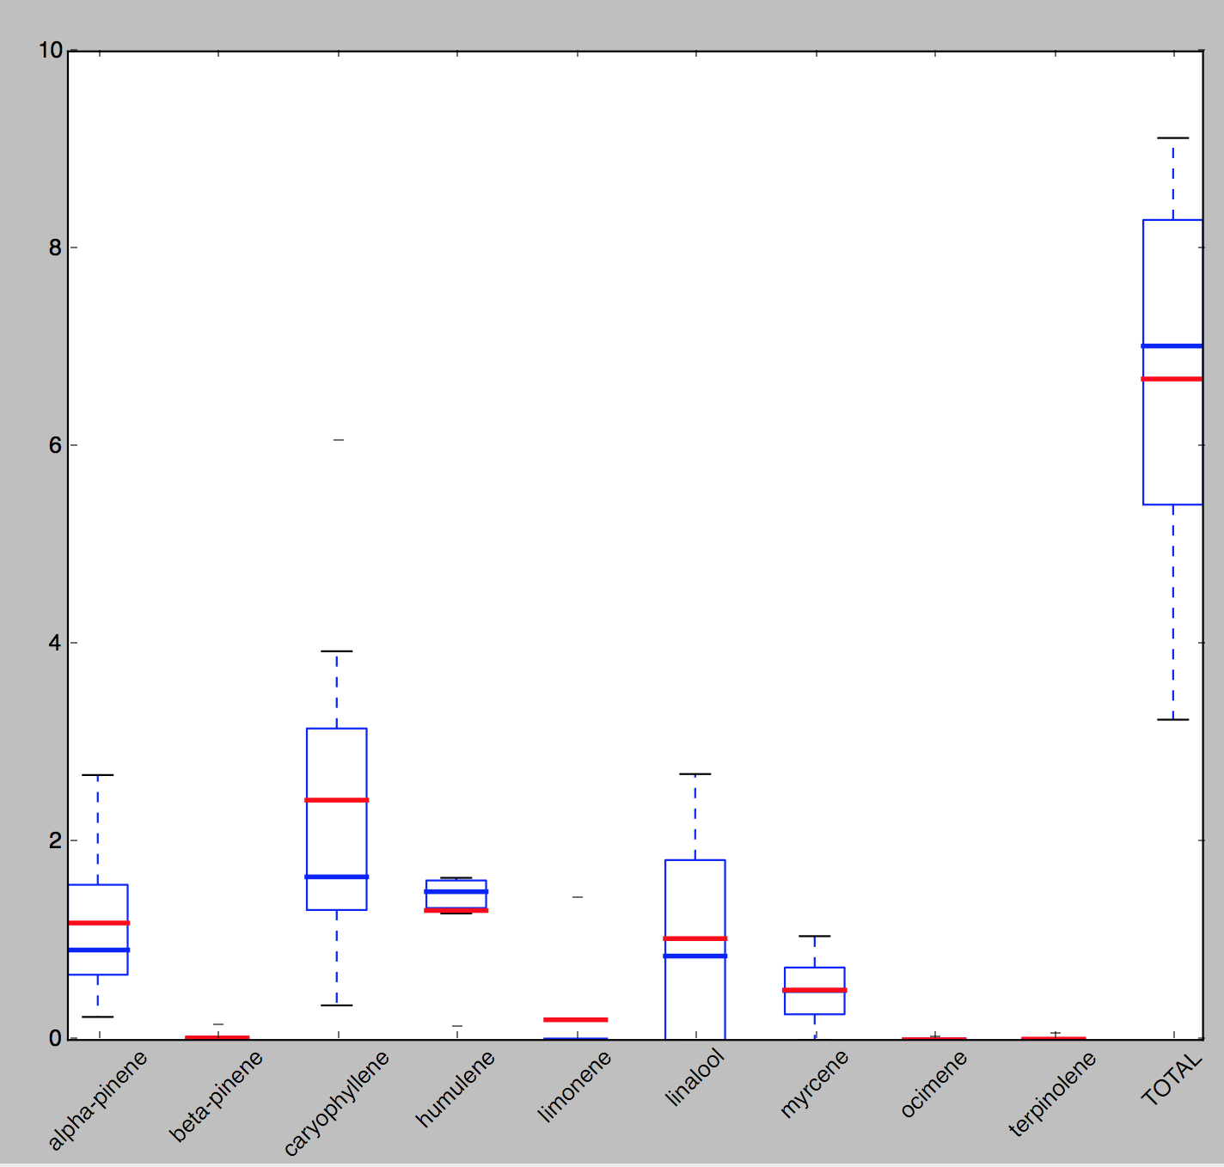
Typical boxplot showing distribution of samples within a strain
Death Star
(7 samples)
maximum
3rd quartile
median
mean
outlier
1st quartile
minimum

Slide 7
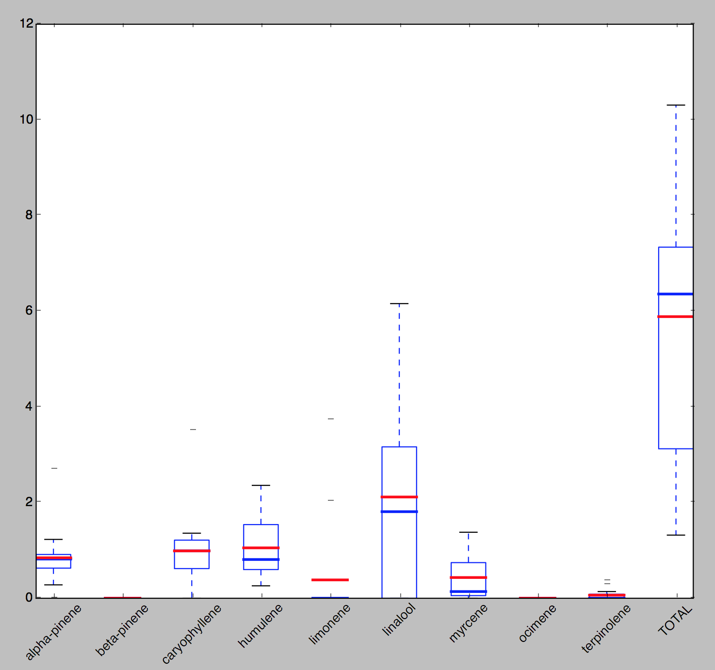
Deep Purple
(15 samples)

Slide 8
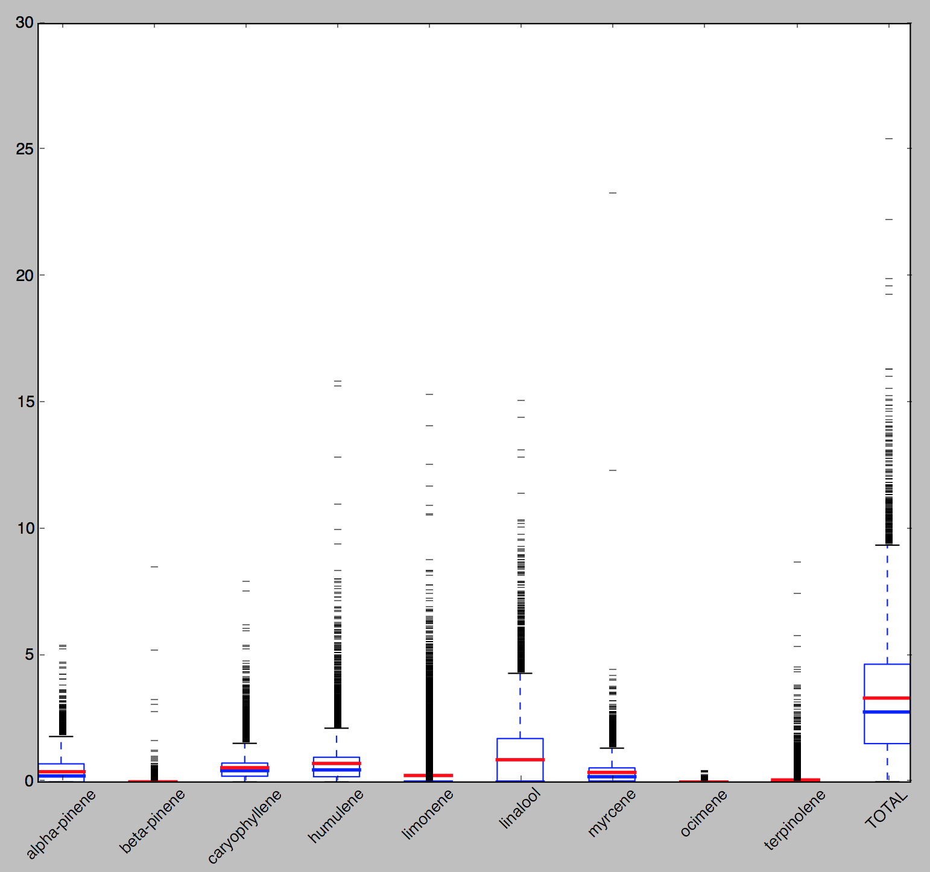
All the Data…
(14491 samples)

Slide 9
Analytical360
Absolute Alpha-Pinene % Median
(>2 Samples)
 | Strain | # samples | alpha-pinene | caryophyllene | humulene | limonene | linalool | myrcene | terpinolene | TOTAL %
1 | indian | 3 | 1.92 | 0.41 | 0.56 | 0 | 0 | 0.48 | 0 | 4.92
2 | jagermeister | 3 | 1.83 | 0.94 | 3.73 | 0 | 0 | 0.169 | 0 | 6.5
3 | gala | 5 | 1.55 | 0 | 1.4 | 0 | 0 | 0.73 | 0 | 3.68
4 | green_dragon | 3 | 1.36 | 0.45 | 0.61 | 0 | 0 | 0 | 0 | 5.3
5 | black_water | 3 | 1.34 | 0.68 | 1.46 | 0 | 2.42 | 0.23 | 0 | 6.43
6 | sensiberry_wonder | 3 | 1.31 | 0.76 | 0.81 | 0 | 0.75 | 0 | 0 | 3.39
7 | tora_bora | 6 | 1.285 | 0.11 | 0.295 | 0 | 0 | 0.47 | 0 | 4.42
8 | strawberry_ice | 7 | 1.27 | 0.47 | 0 | 0 | 0 | 0.97 | 0 | 2.9
9 | mindscape | 5 | 1.27 | 0.37 | 0.57 | 0 | 0 | 0 | 0 | 2.13
10 | yoda_og | 5 | 1.2 | 0.28 | 0.19 | 0 | 0 | 0 | 0 | 2.42
11 | pink_og_kush | 3 | 1.16 | 0.77 | 1.82 | 0 | 0 | 0 | 0 | 5.31
12 | maple_leaf | 3 | 1.15 | 0.18 | 0.34 | 0 | 0 | 0.88 | 0 | 2.12
13 | cherry_cookies | 6 | 1.125 | 0.43 | 0.365 | 0 | 0 | 0.245 | 0.265 | 2.435
14 | precious_og | 3 | 1.11 | 0.42 | 1.71 | 0 | 2.1 | 0.75 | 0 | 6.93
15 | royal_humbolt_kush | 3 | 1.09 | 0.21 | 2.31 | 0 | 0 | 0.35 | 0 | 4.55
16 | the_gump | 3 | 1.09 | 0.54 | 1.35 | 0 | 0 | 0.13 | 0 | 2.95
17 | love_triangle | 6 | 1.06 | 0.34 | 0.285 | 0.84 | 0.84 | 0.03 | 0 | 4.105
18 | royal_chem | 7 | 1.05 | 0.38 | 1.32 | 0 | 0 | 0.38 | 0 | 2.99
19 | stardawg | 10 | 1.04 | 0.375 | 2.505 | 0 | 0 | 0.115 | 0 | 4.41
20 | sherkle | 6 | 1.025 | 0.39 | 1.695 | 0 | 0.62 | 0.515 | 0 | 4.925

Slide 10
Analytical360
Absolute Caryophyllene % Median
(>2 Samples)
 | Strain | # samples | alpha-pinene | caryophyllene | humulene | limonene | linalool | myrcene | terpinolene | TOTAL %
1 | mr_bud | 5 | 0 | 2.2 | 0 | 0 | 0 | 0.92 | 0 | 5.33
2 | jack_diesel | 3 | 0 | 1.89 | 1.19 | 0 | 2.97 | 0 | 0 | 6.07
3 | tko | 4 | 0 | 1.8 | 3.035 | 0 | 0 | 0 | 1.09 | 6.115
4 | mayweather | 3 | 0.125 | 1.751 | 0.831 | 0.345 | 0.013 | 0.11 | 0 | 3.299
5 | death_star | 7 | 0.91 | 1.65 | 1.5 | 0 | 0.849 | 0.5 | 0 | 7.02
6 | sunset_sherbert | 3 | 0.09 | 1.65 | 1.04 | 0 | 0 | 0 | 0 | 2.78
7 | sour_banana_sherbert | 3 | 0.58 | 1.6 | 0.82 | 0 | 0 | 0 | 0 | 5.058
8 | sour_cookies | 4 | 0.17 | 1.535 | 0.657 | 0.4865 | 0.2985 | 0.362 | 0.0045 | 3.984
9 | blueberry_cheesecake | 5 | 0.96 | 1.53 | 0.35 | 0 | 1.6 | 0.41 | 0 | 5.12
10 | hawaiian_snow | 5 | 0.71 | 1.41 | 0.3 | 0 | 1.34 | 0.35 | 0 | 4.01
11 | 3d_crack | 3 | 0 | 1.37 | 0.39 | 0 | 0 | 0 | 0 | 3.21
12 | twilight | 3 | 0 | 1.34 | 0.54 | 0 | 2.34 | 0.07 | 0 | 4.34
13 | girl_scout_cookies_forum_cut | 5 | 0.58 | 1.33 | 0.95 | 0 | 0 | 0.21 | 0 | 2.99
14 | the_void | 3 | 0 | 1.32 | 0.17 | 0 | 1.11 | 0.1 | 0 | 3.09
15 | space_candy | 4 | 0.245 | 1.305 | 0.39 | 0 | 0 | 0.035 | 0.2 | 2.185
16 | hawaiian_rush | 3 | 0 | 1.27 | 1.37 | 0 | 0 | 0.21 | 0 | 4.55
17 | animal_og | 4 | 0.685 | 1.24 | 1.025 | 0 | 0 | 0.075 | 0 | 2.98
18 | snow | 3 | 0.83 | 1.23 | 0.32 | 0 | 0 | 0.41 | 0 | 3.72
19 | cherry_og | 4 | 0 | 1.215 | 2.03 | 0 | 0 | 0.42 | 0 | 3.905
20 | cheese_quake | 27 | 0 | 1.19 | 0.36 | 0 | 1.57 | 0.21 | 0 | 4.01

Slide 11
Analytical360
Absolute Humulene % Median
(>2 Samples)
 | Strain | # samples | alpha-pinene | caryophyllene | humulene | limonene | linalool | myrcene | terpinolene | TOTAL %
1 | 619_diesel_og | 5 | 0.92 | 0.93 | 3.79 | 0 | 1.51 | 0.38 | 0 | 8.29
2 | jagermeister | 3 | 1.83 | 0.94 | 3.73 | 0 | 0 | 0.169 | 0 | 6.5
3 | flog | 3 | 0.44 | 0.16 | 3.07 | 0 | 0.86 | 1.79 | 0 | 7.07
4 | tko | 4 | 0 | 1.8 | 3.035 | 0 | 0 | 0 | 1.09 | 6.115
5 | gorilla_glue_4 | 66 | 0.8045 | 0.68 | 2.605 | 0 | 0 | 0 | 0 | 4.075
6 | stardawg | 10 | 1.04 | 0.375 | 2.505 | 0 | 0 | 0.115 | 0 | 4.41
7 | dawg_waltz | 4 | 0.8 | 0.58 | 2.36 | 0 | 1.26 | 1 | 0 | 5.845
8 | royal_humbolt_kush | 3 | 1.09 | 0.21 | 2.31 | 0 | 0 | 0.35 | 0 | 4.55
9 | cherry_og | 4 | 0 | 1.215 | 2.03 | 0 | 0 | 0.42 | 0 | 3.905
10 | captain_cook | 3 | 0 | 0.82 | 2.03 | 0 | 0 | 0 | 0 | 2.99
11 | secret_recipe | 8 | 0.395 | 0.6085 | 1.915 | 0 | 0 | 0 | 0 | 3.715
12 | gorilla_glue | 40 | 0.84 | 0.595 | 1.915 | 0 | 0 | 0.06 | 0 | 3.475
13 | guard_dog | 3 | 0.02 | 0.28 | 1.87 | 0 | 0 | 0.32 | 0 | 2.06
14 | blackwater | 6 | 0.86 | 0.285 | 1.84 | 0 | 0 | 0.36 | 0 | 4.185
15 | monster_cookies | 5 | 0.56 | 1.07 | 1.83 | 0 | 0 | 0.13 | 0 | 3.39
16 | pink_og_kush | 3 | 1.16 | 0.77 | 1.82 | 0 | 0 | 0 | 0 | 5.31
17 | yeehaw_og | 4 | 0.755 | 0.33 | 1.79 | 0 | 0 | 0.03 | 0 | 3.05
18 | epoxy_og | 3 | 0.92 | 0.65 | 1.73 | 0 | 0 | 0.05 | 0 | 3.43
19 | precious_og | 3 | 1.11 | 0.42 | 1.71 | 0 | 2.1 | 0.75 | 0 | 6.93
20 | sherkle | 6 | 1.025 | 0.39 | 1.695 | 0 | 0.62 | 0.515 | 0 | 4.925

Slide 12
Analytical360
Absolute Limonene % Median
(>2 Samples)
 | Strain | # samples | alpha-pinene | caryophyllene | humulene | limonene | linalool | myrcene | terpinolene | TOTAL %
1 | critical_jack | 7 | 0 | 0.32 | 0.21 | 3.29 | 0.81 | 0 | 0 | 7.02
2 | golden_goat | 4 | 0.115 | 0.115 | 0.13 | 3.06 | 0 | 0.205 | 0.335 | 3.525
3 | lemon_wreck | 4 | 0.215 | 0.895 | 0.035 | 2.555 | 1.99 | 0.245 | 0.395 | 6.94
4 | panama_treat | 3 | 0 | 0.76 | 0.39 | 2.47 | 0 | 0.54 | 0.03 | 5.77
5 | lime_chernobyl | 4 | 0.815 | 0.94 | 0.1 | 2.445 | 0 | 0.09 | 0.24 | 4.48
6 | golden_pineapple | 5 | 0 | 0.65 | 0.2 | 2.26 | 5.06 | 0.32 | 0 | 7.35
7 | lemon_cheesecake | 7 | 0 | 0.65 | 0.15 | 2.18 | 0 | 0.09 | 0.01 | 4.02
8 | afghani_bullrider | 7 | 0.72 | 0.7 | 0.81 | 2.1 | 1.88 | 0.07 | 0.16 | 4.21
9 | west_seattle | 4 | 0 | 0.395 | 0.255 | 2.07 | 1.4 | 0.07 | 0 | 5.46
10 | plushberry_kush | 3 | 0.78 | 0.59 | 0.29 | 2.05 | 1.78 | 0.76 | 0 | 7.2
11 | alien_treat | 4 | 0 | 0.36 | 0.23 | 1.965 | 1.88 | 0.42 | 0 | 5.15
12 | jacks_haze | 6 | 0 | 0.71 | 0.6 | 1.88 | 2.535 | 0.09 | 0 | 7.54
13 | middle_fork | 14 | 0 | 0.335 | 0.05 | 1.775 | 0.0785 | 0.615 | 0 | 3.7465
14 | flight | 4 | 0 | 0.175 | 0.44 | 1.685 | 0.58 | 0.475 | 0 | 3.62
15 | ghost_og_kush | 3 | 0.7 | 0.57 | 0.42 | 1.48 | 2.2 | 0.49 | 0 | 6.67
16 | ripped_bubba_kush | 4 | 0 | 0.605 | 0.25 | 1.39 | 2.315 | 0.11 | 0 | 4.26
17 | purple_thai | 3 | 0 | 0 | 0.21 | 1.37 | 1.54 | 0.08 | 0 | 3.23
18 | red_diesel | 4 | 0.755 | 0.575 | 0.21 | 1.275 | 2.555 | 0.66 | 0.04 | 7.115
19 | maui_skunk | 4 | 0.765 | 0.34 | 0.495 | 1.16 | 1.18 | 0.36 | 0.025 | 5.315
20 | kaboom | 4 | 0.305 | 0.915 | 0.34 | 0.975 | 2.155 | 0.3 | 0 | 5.23

Slide 13
Analytical360
Absolute Linalool % Median
(>2 Samples)
 | Strain | # samples | alpha-pinene | caryophyllene | humulene | limonene | linalool | myrcene | terpinolene | TOTAL %
1 | golden_pineapple | 5 | 0 | 0.65 | 0.2 | 2.26 | 5.06 | 0.32 | 0 | 7.35
2 | lambs_bread_mango | 4 | 0 | 0.345 | 0.575 | 0.1305 | 4.105 | 0.08 | 0.11 | 6.09
3 | oregon_trainwreck | 3 | 0 | 0.43 | 0.27 | 0 | 3.97 | 0.14 | 0 | 5.07
4 | buddhas_on_moonshine | 4 | 0.965 | 0.51 | 1.055 | 0 | 3.875 | 1.435 | 0 | 7.82
5 | illmatic | 3 | 0.75 | 0.49 | 0.53 | 0 | 3.79 | 0.25 | 0 | 5.32
6 | x_men | 3 | 0 | 0.49 | 0.15 | 0 | 3.74 | 0.37 | 0.14 | 4.86
7 | willy_nelson | 3 | 0.54 | 0.41 | 0.19 | 0 | 3.59 | 0.33 | 0 | 5.52
8 | burmese | 5 | 0 | 0.52 | 0.6 | 0 | 3.57 | 0.14 | 0 | 6.53
9 | sweet_black_angel | 7 | 0.05 | 0.28 | 0.37 | 0 | 3.56 | 0.28 | 0 | 4.95
10 | mazar | 11 | 0.83 | 0.37 | 0.54 | 0 | 3.51 | 0.44 | 0 | 5.65
11 | game_warden | 4 | 0.6 | 1.105 | 0.055 | 0 | 3.34 | 0.475 | 0 | 5.67
12 | white_siberian | 4 | 0 | 0.64 | 0.47 | 0 | 3.215 | 0.105 | 0 | 4.71
13 | purple_god_bud | 6 | 0.555 | 0.48 | 0.175 | 0 | 3.195 | 0.035 | 0 | 4.98
14 | green_love_potion | 3 | 0.84 | 0.32 | 0.42 | 0 | 3.1 | 0.07 | 0 | 4.85
15 | doa | 3 | 0.38 | 0.1 | 0.43 | 0 | 3.04 | 0.68 | 0 | 5.09
16 | glindas_tonic | 3 | 0 | 0.49 | 0 | 0 | 3.03 | 0.97 | 0 | 4.99
17 | big_wreck | 3 | 0.39 | 0.61 | 0.51 | 0 | 2.99 | 0.1 | 0 | 5.41
18 | jack_diesel | 3 | 0 | 1.89 | 1.19 | 0 | 2.97 | 0 | 0 | 6.07
19 | hamster | 3 | 0.43 | 0.4 | 0.41 | 0 | 2.96 | 0.55 | 0.26 | 4.56
20 | dawg | 3 | 0.8 | 0.61 | 0.96 | 0 | 2.94 | 0.36 | 0 | 6.53

Slide 14
Analytical360
Absolute Myrcine % Median
(>2 Samples)
 | Strain | # samples | alpha-pinene | caryophyllene | humulene | limonene | linalool | myrcene | terpinolene | TOTAL %
1 | red_og | 3 | 0.88 | 1.04 | 0.74 | 0 | 1.72 | 1.9 | 0.11 | 7.06
2 | flog | 3 | 0.44 | 0.16 | 3.07 | 0 | 0.86 | 1.79 | 0 | 7.07
3 | blue_thai_haze | 3 | 0.732 | 0.18 | 0 | 0 | 0 | 1.59 | 0 | 3.064
4 | juanita_la_lagrimosa | 3 | 0.8 | 0.45 | 0.12 | 0 | 2.46 | 1.59 | 0 | 5.49
5 | 4_corners | 3 | 0.47 | 0.32 | 0.59 | 0 | 2.25 | 1.47 | 0 | 5.95
6 | buddhas_on_moonshine | 4 | 0.965 | 0.51 | 1.055 | 0 | 3.875 | 1.435 | 0 | 7.82
7 | black_84 | 15 | 0.23 | 0.15 | 0.17 | 0 | 2.4 | 1.42 | 0 | 4.97
8 | og_purple_kush | 4 | 0 | 0 | 1.65 | 0 | 0 | 1.405 | 0 | 3.02
9 | alien_on_moonshine | 3 | 0.98 | 0.37 | 0.79 | 0 | 1.51 | 1.33 | 0 | 4.14
10 | purple_dog_shit | 3 | 0.7 | 0.64 | 0.17 | 0 | 0.76 | 1.23 | 0 | 3.56
11 | violet_delight | 3 | 0.79 | 0.48 | 0.08 | 0 | 2.3 | 1.21 | 0 | 4.8
12 | lunch_box | 3 | 0.78 | 0.68 | 0.51 | 0 | 1.46 | 1.2 | 0 | 4.6
13 | wonder_woman | 4 | 0.22 | 0.16 | 0.92 | 0 | 0.015 | 1.125 | 0 | 3.645
14 | plum | 3 | 0.39 | 0.09 | 0.35 | 0 | 0 | 1.11 | 0 | 1.57
15 | alien_moonshine | 6 | 0.84 | 0.295 | 0.395 | 0 | 2.345 | 1.075 | 0 | 5.165
16 | pink_panther | 3 | 0 | 0.69 | 0.45 | 0 | 2.25 | 1.07 | 0.04 | 4.69
17 | mean_green | 4 | 0.555 | 0.83 | 0.42 | 0 | 2.2 | 1.035 | 0 | 5.57
18 | atomic_blueberry | 7 | 0.97 | 0.51 | 0.62 | 0 | 2.86 | 1.02 | 0 | 5.85
19 | doctors_choice | 3 | 0.18 | 0.38 | 0.08 | 0 | 0.86 | 1.02 | 0 | 1.93
20 | white_domina | 3 | 0 | 0.61 | 1.03 | 0 | 1.63 | 1.01 | 0 | 4.5

Slide 15
Analytical360
Absolute Terpinolene % Median
(>2 Samples)
 | Strain | # samples | alpha-pinene | caryophyllene | humulene | limonene | linalool | myrcene | terpinolene | TOTAL %
1 | nevilles_haze | 3 | 0.109 | 0.18 | 0 | 0 | 0.015 | 0.845 | 1.32 | 3.285
2 | tko | 4 | 0 | 1.8 | 3.035 | 0 | 0 | 0 | 1.09 | 6.115
3 | willy_wonka | 5 | 0 | 0.45 | 0.47 | 0 | 0 | 0.113 | 0.685 | 1.89
4 | chernobyl_golden_ticket | 3 | 0.97 | 0.32 | 0.26 | 0 | 0 | 0.1 | 0.64 | 2.24
5 | euro_sour_diesel | 3 | 0.08 | 0.21 | 0.15 | 0 | 0 | 0.2 | 0.61 | 1.04
6 | bubba_76 | 3 | 0 | 0.38 | 0.24 | 0 | 0 | 0.19 | 0.61 | 1.68
7 | lemon_dutch | 5 | 0 | 0.2 | 0.38 | 0 | 0 | 0.06 | 0.53 | 1.57
8 | golden_ticket | 5 | 1.02 | 0.15 | 0.49 | 0 | 0 | 0.1 | 0.51 | 2.17
9 | critical_haze | 3 | 0 | 0.22 | 0.24 | 0 | 0 | 0.06 | 0.484 | 0.931
10 | burn_out | 3 | 0 | 0.22 | 0.6 | 0 | 0 | 0.1 | 0.43 | 1.35
11 | island_sweet_skunk | 4 | 0.195 | 0.82 | 0.515 | 0 | 0.845 | 0.075 | 0.43 | 3.73
12 | bull_rider | 3 | 0 | 0.66 | 0.72 | 0 | 0 | 0.37 | 0.42 | 4.92
13 | dt13 | 9 | 0 | 0.34 | 0.133 | 0.149 | 0 | 0.317 | 0.42 | 2.366
14 | hawaiian_frost | 4 | 0.43 | 0.395 | 0.295 | 0 | 0 | 0.32 | 0.405 | 2.28
15 | otto | 10 | 0 | 0.005 | 0 | 0 | 0 | 0.155 | 0.4 | 0.89
16 | super_cookies | 4 | 0.305 | 0.29 | 0.72 | 0 | 0 | 0.03 | 0.4 | 1.95
17 | lemon_wreck | 4 | 0.215 | 0.895 | 0.035 | 2.555 | 1.99 | 0.245 | 0.395 | 6.94
18 | schrom | 12 | 0.095 | 0.495 | 0.37 | 0 | 0 | 0.045 | 0.39 | 2.645
19 | dutch_haze | 4 | 0 | 0.435 | 0.5 | 0 | 2.495 | 0.03 | 0.37 | 5.71
20 | golden_goat | 4 | 0.115 | 0.115 | 0.13 | 3.06 | 0 | 0.205 | 0.335 | 3.525

Slide 16
Relative Terpene Percent Profiles

Slide 17
Analytical360
Relative Alpha-Pinene % Median
(>2 Samples)
 | Strain | # samples | alpha-pinene | caryophyllene | humulene | limonene | linalool | myrcene | terpinolene
1 | crippled_rhino | 3 | 75.19% | 8.33% | 0.00% | 0.00% | 0.00% | 13.64% | 0.00%
2 | tango | 3 | 69.65% | 8.96% | 21.39% | 0.00% | 0.00% | 0.00% | 0.00%
3 | mindscape | 5 | 61.27% | 7.17% | 21.78% | 0.00% | 0.00% | 0.00% | 0.00%
4 | university_of_washington_purple_kush | 3 | 58.06% | 11.28% | 17.62% | 0.00% | 0.00% | 12.80% | 0.00%
5 | girl_scout_cookies_cbd | 3 | 56.25% | 7.14% | 5.71% | 0.00% | 0.00% | 32.24% | 0.00%
6 | yoda_og | 5 | 52.07% | 8.16% | 11.52% | 0.00% | 0.00% | 0.00% | 0.00%
7 | radiant_og | 3 | 50.25% | 39.68% | 31.40% | 0.00% | 0.00% | 0.00% | 0.00%
8 | tora_bora | 6 | 49.29% | 2.25% | 9.08% | 0.00% | 0.00% | 11.39% | 0.00%
9 | killer_skunk | 3 | 48.00% | 8.90% | 9.33% | 0.00% | 0.00% | 0.00% | 0.00%
10 | purple_chemdawg | 6 | 47.57% | 8.71% | 18.76% | 0.00% | 0.00% | 0.69% | 0.00%
11 | golden_ticket | 5 | 47.00% | 11.28% | 18.80% | 0.00% | 0.00% | 4.61% | 24.64%
12 | sits | 3 | 45.60% | 22.91% | 28.80% | 0.00% | 0.00% | 5.59% | 0.00%
13 | chernobyl_golden_ticket | 3 | 44.13% | 14.29% | 11.74% | 0.00% | 0.00% | 5.49% | 23.13%
14 | indian | 3 | 43.99% | 8.94% | 14.75% | 0.00% | 0.00% | 9.76% | 0.00%
15 | white_romulan | 4 | 43.74% | 26.56% | 8.35% | 0.00% | 0.00% | 2.15% | 0.00%
16 | sensiberry_wonder | 3 | 42.61% | 22.42% | 23.89% | 0.00% | 24.43% | 0.00% | 0.00%
17 | humboldt | 8 | 42.32% | 32.70% | 21.81% | 0.00% | 0.00% | 1.34% | 0.00%
18 | gala | 5 | 42.12% | 0.00% | 38.04% | 0.00% | 0.00% | 17.62% | 0.00%
19 | super_bud | 5 | 41.13% | 21.22% | 33.06% | 0.00% | 0.00% | 2.04% | 0.00%
20 | purple_nepal | 19 | 40.99% | 15.61% | 17.86% | 0.00% | 0.00% | 14.74% | 0.00%

Slide 18
Analytical360
Relative Caryophyllene % Median
(>2 Samples)
 | Strain | # samples | alpha-pinene | caryophyllene | humulene | limonene | linalool | myrcene | terpinolene
1 | stoney_starfighter | 6 | 0.00% | 80.23% | 16.80% | 0.00% | 0.00% | 0.00% | 0.00%
2 | mt_rainier | 3 | 0.00% | 79.73% | 14.08% | 0.00% | 0.00% | 0.00% | 0.00%
3 | hawk_eye | 3 | 0.00% | 73.33% | 0.00% | 0.00% | 0.00% | 26.67% | 0.00%
4 | manna_from_heaven | 3 | 7.56% | 62.50% | 2.80% | 0.00% | 0.00% | 11.05% | 0.00%
5 | the_void | 3 | 0.00% | 58.90% | 4.38% | 0.00% | 35.92% | 3.24% | 0.00%
6 | chocolate_fondue | 6 | 0.00% | 58.25% | 25.15% | 0.00% | 0.00% | 3.37% | 0.00%
7 | pink_haze | 3 | 0.00% | 57.07% | 33.33% | 0.00% | 0.00% | 0.00% | 0.00%
8 | mint_chocolate_chip | 3 | 0.00% | 56.15% | 28.39% | 0.00% | 0.00% | 0.00% | 0.00%
9 | mr_bud | 5 | 0.00% | 54.17% | 0.00% | 0.00% | 0.00% | 27.39% | 0.00%
10 | cream_crack | 3 | 0.00% | 53.52% | 46.48% | 0.00% | 0.00% | 3.25% | 0.00%
11 | fireboldt | 4 | 0.00% | 52.72% | 45.99% | 0.00% | 0.00% | 0.00% | 0.00%
12 | mayweather | 3 | 3.79% | 51.80% | 24.35% | 10.46% | 0.38% | 5.21% | 0.00%
13 | black_spirit | 8 | 0.00% | 50.77% | 45.53% | 0.00% | 0.00% | 2.77% | 0.00%
14 | holy_ole | 3 | 0.00% | 50.00% | 13.94% | 0.00% | 0.00% | 4.33% | 0.00%
15 | queen | 4 | 0.00% | 49.66% | 5.32% | 0.00% | 0.00% | 11.13% | 0.00%
16 | cookies_and_cream | 64 | 0.00% | 48.76% | 33.81% | 0.00% | 0.00% | 2.14% | 0.00%
17 | strawberry_haze | 4 | 1.72% | 47.91% | 21.40% | 0.00% | 0.00% | 4.55% | 0.00%
18 | space_bomb | 3 | 0.00% | 47.56% | 6.99% | 0.00% | 0.00% | 18.29% | 0.00%
19 | blue_chemberry | 3 | 0.00% | 47.54% | 0.00% | 0.00% | 0.00% | 0.00% | 0.00%
20 | vip | 3 | 0.00% | 47.47% | 26.83% | 0.00% | 0.00% | 10.10% | 0.00%

Slide 19
Analytical360
Relative Humulene % Median
(>2 Samples)
 | Strain | # samples | alpha-pinene | caryophyllene | humulene | limonene | linalool | myrcene | terpinolene
1 | golden_panda | 3 | 6.90% | 12.88% | 77.93% | 0.00% | 0.00% | 1.45% | 0.00%
2 | blue_power | 5 | 0.00% | 0.00% | 77.53% | 0.00% | 0.00% | 5.61% | 0.00%
3 | amherst_sour_diesel | 3 | 6.22% | 0.00% | 76.17% | 0.00% | 0.00% | 5.00% | 0.00%
4 | sage_chemdawg | 3 | 0.00% | 24.32% | 75.68% | 0.00% | 0.00% | 9.94% | 0.00%
5 | smelliot | 5 | 5.80% | 2.19% | 74.88% | 0.00% | 0.00% | 10.14% | 0.00%
6 | underdog_og | 5 | 16.99% | 3.35% | 71.17% | 0.00% | 0.00% | 0.00% | 0.00%
7 | south_county_kush | 3 | 1.09% | 23.50% | 71.04% | 0.00% | 0.00% | 4.37% | 0.00%
8 | alien_cake | 3 | 0.00% | 12.36% | 68.54% | 0.00% | 0.00% | 19.10% | 0.00%
9 | captain_cook | 3 | 0.00% | 27.42% | 67.89% | 0.00% | 0.00% | 0.00% | 0.00%
10 | grand_fire | 3 | 0.00% | 19.53% | 67.44% | 0.00% | 0.00% | 0.00% | 0.00%
11 | las_vegas_purple_kush | 3 | 0.00% | 23.58% | 66.28% | 0.00% | 0.00% | 0.00% | 0.00%
12 | extreme_og | 7 | 18.81% | 16.82% | 65.60% | 0.00% | 0.00% | 0.00% | 0.00%
13 | great_white | 3 | 0.00% | 21.97% | 65.15% | 0.00% | 0.00% | 12.88% | 0.00%
14 | seattle_sour_diesel | 4 | 19.75% | 12.07% | 63.50% | 0.00% | 0.00% | 1.61% | 0.00%
15 | og_skunk | 7 | 5.65% | 3.27% | 63.00% | 0.00% | 0.00% | 10.81% | 0.00%
16 | stink_bomb | 4 | 10.59% | 20.84% | 62.08% | 0.00% | 0.00% | 2.76% | 0.00%
17 | yeehaw_og | 4 | 25.86% | 11.22% | 61.93% | 0.00% | 0.00% | 1.01% | 0.00%
18 | jacks_dragon | 3 | 0.00% | 36.55% | 61.38% | 0.00% | 0.00% | 2.10% | 0.00%
19 | purple_master_kush | 4 | 15.10% | 7.85% | 61.25% | 0.00% | 0.00% | 1.17% | 0.00%
20 | dj_short_f_13 | 3 | 0.00% | 14.86% | 61.11% | 0.00% | 0.00% | 16.90% | 0.00%

Slide 20
Analytical360
Relative Limonene % Median
(>2 Samples)
 | Strain | # samples | alpha-pinene | caryophyllene | humulene | limonene | linalool | myrcene | terpinolene
1 | golden_goat | 4 | 2.91% | 2.54% | 1.34% | 57.72% | 0.00% | 5.59% | 5.35%
2 | flight | 4 | 0.00% | 2.13% | 20.14% | 52.37% | 7.06% | 13.09% | 0.00%
3 | lime_chernobyl | 4 | 15.11% | 13.66% | 1.35% | 49.66% | 0.00% | 1.11% | 4.77%
4 | afghani_bullrider | 7 | 8.57% | 13.06% | 16.89% | 44.29% | 19.23% | 1.42% | 1.90%
5 | alien_treat | 4 | 0.00% | 6.88% | 4.50% | 42.60% | 33.84% | 9.46% | 0.00%
6 | purple_thai | 3 | 0.00% | 0.00% | 6.86% | 42.41% | 51.70% | 2.40% | 0.00%
7 | critical_jack | 7 | 0.00% | 7.16% | 4.67% | 39.76% | 25.96% | 0.00% | 0.00%
8 | panama_treat | 3 | 0.00% | 13.69% | 13.52% | 36.98% | 0.00% | 9.36% | 0.45%
9 | lemon_cheesecake | 7 | 0.00% | 13.09% | 3.00% | 36.21% | 0.00% | 1.49% | 0.12%
10 | dutch_thunder_fuck | 9 | 20.00% | 1.32% | 6.57% | 34.75% | 0.00% | 14.18% | 0.00%
11 | jacks_haze | 6 | 0.00% | 8.57% | 6.09% | 34.32% | 29.94% | 2.90% | 0.00%
12 | lemon_wreck | 4 | 2.37% | 15.32% | 0.39% | 33.89% | 21.89% | 4.13% | 7.37%
13 | middle_fork | 14 | 0.00% | 7.45% | 0.82% | 31.50% | 1.95% | 9.92% | 0.00%
14 | golden_pineapple | 5 | 0.00% | 8.10% | 3.12% | 30.51% | 50.96% | 4.08% | 0.00%
15 | west_seattle | 4 | 0.00% | 7.56% | 3.76% | 29.65% | 22.99% | 1.45% | 0.00%
16 | renegade | 3 | 0.00% | 12.35% | 15.52% | 28.82% | 0.00% | 20.59% | 0.00%
17 | head_wreck | 3 | 0.00% | 2.30% | 34.30% | 27.16% | 0.00% | 3.49% | 0.00%
18 | unicorn_horn | 8 | 0.00% | 13.50% | 27.63% | 27.15% | 0.00% | 2.78% | 0.00%
19 | plushberry_kush | 3 | 10.83% | 10.13% | 3.77% | 26.62% | 24.72% | 20.39% | 0.00%
20 | ghost_og_kush | 3 | 7.56% | 6.00% | 6.30% | 25.69% | 30.63% | 6.08% | 0.00%

Slide 21
Analytical360
Relative Linalool % Median
(>2 Samples)
 | Strain | # samples | alpha-pinene | caryophyllene | humulene | limonene | linalool | myrcene | terpinolene
1 | illmatic | 3 | 12.88% | 8.36% | 9.87% | 0.00% | 71.24% | 5.08% | 0.00%
2 | x_men | 3 | 0.00% | 9.02% | 1.45% | 0.00% | 69.51% | 9.02% | 1.35%
3 | white_siberian | 4 | 0.00% | 13.30% | 8.50% | 0.00% | 68.09% | 1.62% | 0.00%
4 | lambs_bread_mango | 4 | 0.00% | 5.16% | 9.08% | 3.25% | 66.60% | 1.36% | 1.97%
5 | planet_rock | 3 | 13.87% | 16.31% | 3.13% | 0.00% | 65.82% | 0.39% | 0.00%
6 | willy_nelson | 3 | 12.50% | 9.60% | 3.44% | 0.00% | 65.04% | 6.83% | 0.00%
7 | oregon_trainwreck | 3 | 0.00% | 9.62% | 13.21% | 0.00% | 64.87% | 2.04% | 0.00%
8 | green_love_potion | 3 | 17.32% | 6.24% | 8.66% | 0.00% | 63.92% | 1.07% | 0.00%
9 | kali_mist | 5 | 0.00% | 16.85% | 3.58% | 0.00% | 63.08% | 4.51% | 0.00%
10 | devils_trainwreck | 3 | 0.00% | 16.08% | 1.19% | 0.00% | 61.70% | 18.71% | 0.00%
11 | mystery_machine | 3 | 15.75% | 8.68% | 11.98% | 0.00% | 61.53% | 3.50% | 0.00%
12 | sweet_and_sour_widow | 11 | 10.06% | 11.07% | 6.25% | 0.00% | 61.21% | 6.43% | 0.00%
13 | doa | 3 | 5.94% | 2.11% | 6.88% | 0.00% | 59.72% | 13.53% | 0.00%
14 | sweet_black_angel | 7 | 0.76% | 6.09% | 12.27% | 0.00% | 59.63% | 7.27% | 0.00%
15 | blue_og | 3 | 0.00% | 11.07% | 19.19% | 0.00% | 59.41% | 10.33% | 0.00%
16 | purple_god_bud | 6 | 9.61% | 10.60% | 2.14% | 0.00% | 58.76% | 5.22% | 0.00%
17 | glindas_tonic | 3 | 0.00% | 12.89% | 0.00% | 0.00% | 58.45% | 19.44% | 0.00%
18 | beaver_dawg | 7 | 15.48% | 23.15% | 2.58% | 0.00% | 57.94% | 4.62% | 0.00%
19 | mango_haze | 8 | 13.52% | 2.98% | 2.59% | 0.00% | 57.76% | 13.73% | 0.00%
20 | cascadia_crush | 4 | 3.28% | 14.26% | 8.36% | 0.00% | 57.19% | 12.67% | 0.00%

Slide 22
Analytical360
Relative Myrcene % Median
(>2 Samples)
 | Strain | # samples | alpha-pinene | caryophyllene | humulene | limonene | linalool | myrcene | terpinolene
1 | blue_thai_haze | 3 | 19.15% | 6.43% | 0.00% | 0.00% | 0.00% | 54.37% | 0.00%
2 | malawi_haze | 3 | 12.05% | 9.73% | 0.00% | 0.00% | 0.00% | 46.99% | 0.00%
3 | ak_buddha | 5 | 0.00% | 23.08% | 0.00% | 0.00% | 0.00% | 46.61% | 0.00%
4 | herbie | 7 | 22.92% | 1.91% | 0.00% | 0.00% | 0.00% | 46.17% | 0.00%
5 | nordle | 3 | 0.00% | 6.40% | 39.20% | 0.00% | 0.00% | 45.45% | 0.00%
6 | g_force | 5 | 11.81% | 19.55% | 6.10% | 2.75% | 5.58% | 44.33% | 0.00%
7 | og_purple_kush | 4 | 0.00% | 0.00% | 44.59% | 0.00% | 0.00% | 43.67% | 0.00%
8 | grape_krush | 5 | 0.00% | 0.00% | 12.77% | 0.00% | 0.00% | 43.62% | 0.00%
9 | purple_dog_shit | 3 | 17.13% | 14.02% | 6.83% | 0.00% | 21.35% | 42.13% | 0.00%
10 | scoobie_doobie | 3 | 1.22% | 5.88% | 14.12% | 0.00% | 0.00% | 40.85% | 0.00%
11 | gigabud | 3 | 0.00% | 11.96% | 12.17% | 0.00% | 0.00% | 38.43% | 0.00%
12 | satori | 3 | 0.00% | 0.00% | 30.11% | 0.00% | 0.00% | 38.13% | 0.00%
13 | tsunami | 3 | 20.38% | 14.38% | 20.38% | 0.00% | 0.00% | 37.58% | 0.00%
14 | golden_star | 3 | 0.00% | 0.00% | 20.00% | 0.00% | 0.00% | 37.50% | 24.49%
15 | white_urkle | 3 | 17.35% | 6.46% | 32.58% | 0.00% | 0.00% | 37.41% | 0.00%
16 | cherry_bomb | 3 | 0.00% | 17.49% | 0.58% | 0.00% | 0.00% | 36.67% | 0.00%
17 | frank | 7 | 15.96% | 5.15% | 29.90% | 0.00% | 0.00% | 36.07% | 0.00%
18 | aliens_on_moonshine | 7 | 24.65% | 11.90% | 13.33% | 0.00% | 0.00% | 34.39% | 0.00%
19 | plum | 3 | 6.86% | 6.35% | 22.29% | 0.00% | 0.00% | 34.31% | 0.00%
20 | blue_bastard | 3 | 0.00% | 6.15% | 17.69% | 0.00% | 0.00% | 34.16% | 0.00%

Slide 23
Analytical360
Relative Terpinolene % Median
(>2 Samples)
 | Strain | # samples | alpha-pinene | caryophyllene | humulene | limonene | linalool | myrcene | terpinolene
1 | euro_sour_diesel | 3 | 5.15% | 21.13% | 13.92% | 0.00% | 0.00% | 12.37% | 57.14%
2 | otto | 10 | 0.00% | 0.18% | 0.00% | 0.00% | 0.00% | 17.23% | 52.58%
3 | dt13 | 9 | 0.00% | 4.04% | 4.27% | 6.30% | 0.00% | 12.00% | 44.17%
4 | nevilles_haze | 3 | 3.32% | 7.53% | 0.00% | 0.00% | 0.46% | 23.43% | 40.18%
5 | lemon_dutch | 5 | 0.00% | 12.74% | 28.15% | 0.00% | 0.00% | 3.82% | 39.26%
6 | bubba_76 | 3 | 0.00% | 22.62% | 8.23% | 0.00% | 0.00% | 12.03% | 38.61%
7 | burn_out | 3 | 0.00% | 16.30% | 44.12% | 0.00% | 0.00% | 7.41% | 33.33%
8 | critical_haze | 3 | 0.00% | 28.21% | 27.27% | 0.00% | 0.00% | 6.98% | 33.33%
9 | sasquatch_kush | 4 | 0.00% | 32.00% | 32.22% | 0.00% | 0.00% | 0.00% | 29.51%
10 | conquest | 3 | 0.00% | 14.38% | 31.25% | 0.00% | 0.00% | 5.45% | 28.13%
11 | black_velvet | 3 | 8.97% | 26.90% | 31.03% | 0.00% | 0.00% | 4.83% | 28.00%
12 | willy_wonka | 5 | 0.00% | 23.81% | 21.56% | 0.00% | 0.00% | 2.51% | 27.91%
13 | golden_ticket | 5 | 47.00% | 11.28% | 18.80% | 0.00% | 0.00% | 4.61% | 24.64%
14 | golden_star | 3 | 0.00% | 0.00% | 20.00% | 0.00% | 0.00% | 37.50% | 24.49%
15 | super_cookies | 4 | 15.41% | 22.43% | 30.43% | 0.00% | 0.00% | 1.34% | 23.69%
16 | ak_lemon | 3 | 0.00% | 32.91% | 19.64% | 0.00% | 0.00% | 5.06% | 23.53%
17 | chernobyl_golden_ticket | 3 | 44.13% | 14.29% | 11.74% | 0.00% | 0.00% | 5.49% | 23.13%
18 | schrom | 12 | 4.31% | 25.13% | 20.58% | 0.00% | 0.00% | 1.25% | 20.73%
19 | oregon_sunshine | 3 | 0.00% | 38.37% | 15.46% | 0.00% | 0.00% | 5.81% | 19.77%
20 | fat_albert | 3 | 3.13% | 19.35% | 54.69% | 0.00% | 0.00% | 3.23% | 19.67%

Slide 24
Next Steps:
Compile a list of strains from the 3354 analytical360 results that can be found in the MCR laboratory database
Obtain all terpene profiles (including terpenes not found in the analytical360 database) from the MCR database and edit as before obtaining the absolute and relative means and medians.
Join the two database results for final results and pick strains to be purchased

