Slide 1
Debiased Projected Two-Sample Comparison for Single-cell Differential Expression Analysis
Tianyu Zhang
Statistics & Data Science
Carnegie Mellon University
Notes:
Today we are going to talk about a statistical framework on single-cell differential expression analysis

Slide 2


a joint work with
Jing Lei
Kathryn Roeder
Notes:
A joint work with Jing and Kathryn

Slide 3




Case-control / CRISPR
Genes
Genes
Control/
Non-targeting
Cells
Case/
Treatment
Cells
Expression Profiles
Notes:
Consider a typical CRISPR gene editing experiment, collect control cells and treatment cells.
Interested in the difference between their avg expression profiles. So we know what treatment does and infer gene function.

Slide 4
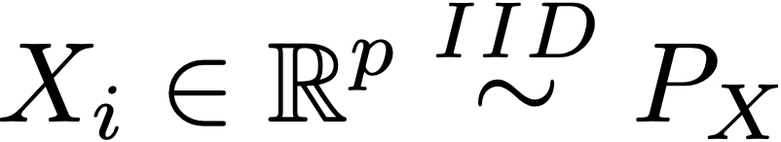
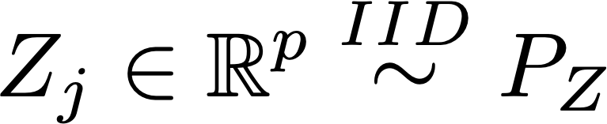
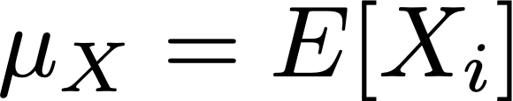

High-Dimensional Mean Comparison
Testing the expected gene profile:
where
Challenge: too many genes and too few cells.
Notes:
Mathematically, formulate this simple question as a high-dim mean comp problem.
X control, Z case.
Test if these two rv having same mean.
The dimension, p , is too large. Need to handle signal and noise properly to avoid false positive and get some power.

Slide 5



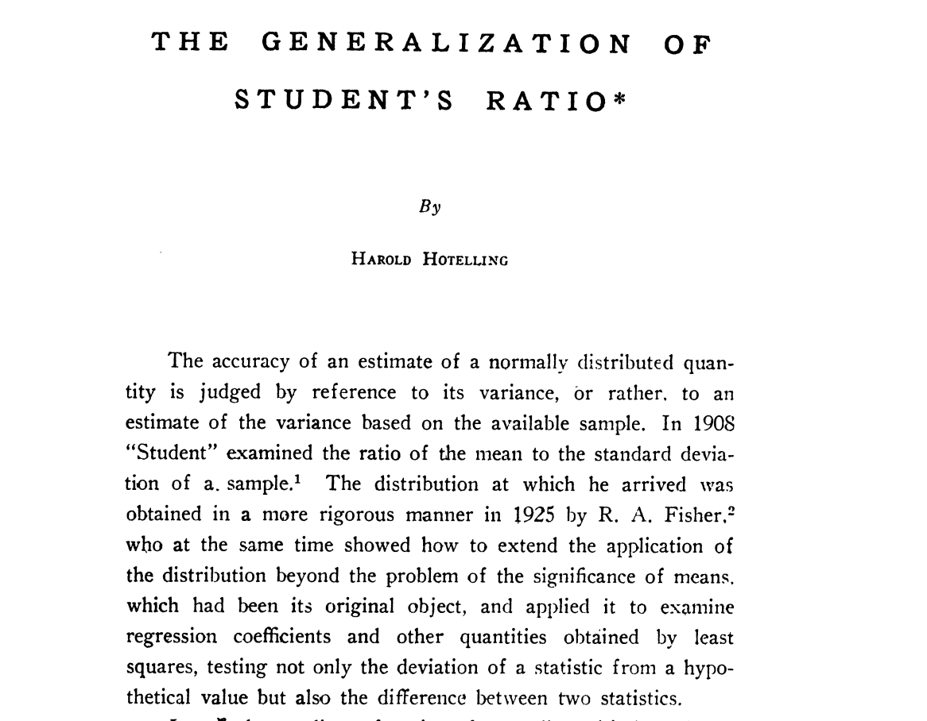
A Rich Literature from Statistics
T-test for each gene plus Bonferroni correction
Hotelling’s
: Multivariate but dimension needs to be small
(1932)
(1996- )
—type tests: accumulate the weak signal of all genes
—type tests:
Properly use the dimension with the largest difference
(2014- )
More ‘adaptive’ tests
(2016- )
Powerful frequentist test, p-value
Notes:
Mean comparison problem one of the most basic, univariate to high-dim has been extensively studied in stat

Slide 6
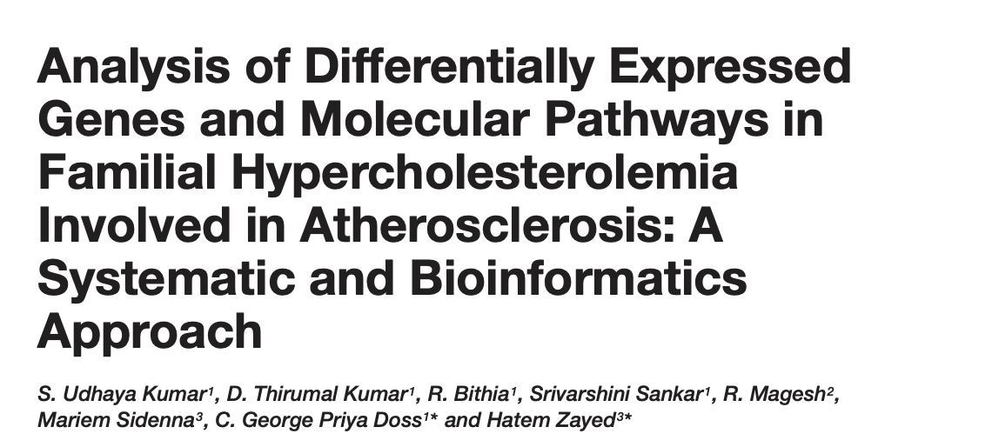
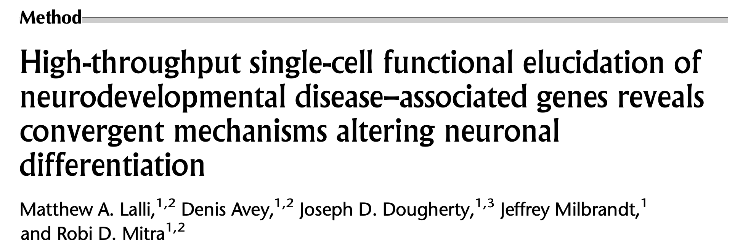
Meanwhile scientific community
Not only p-values.
Additional structural insight.
Notes:
Meanwhile scientists are developing their own methods to tackle this basic stat problem.
To me one obvious reason, statistical procedures mentioned above focuses on getting a more powerful test but offer little beyond p-value. More interpretable information. A given CRISPR mutation has more systematic impact on the cell. Pathway, genes related to a function.

Slide 7
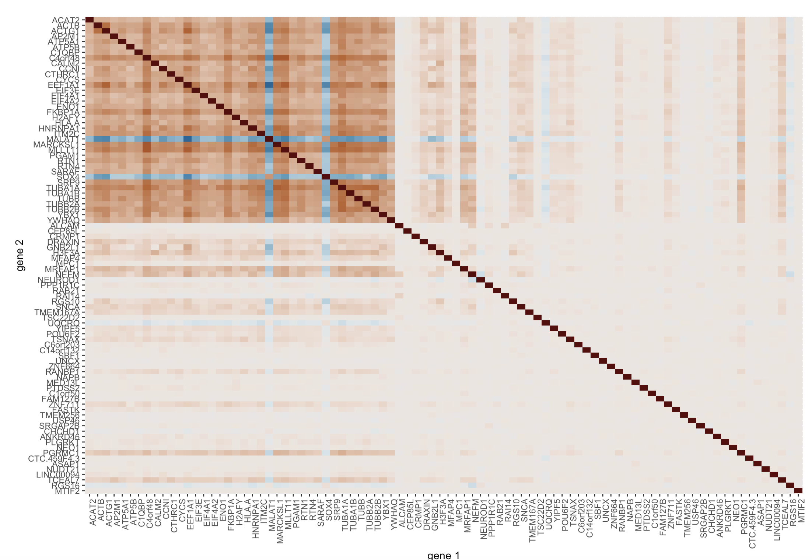
Correlated genes ~ Related functions
Genes with large loadings in
top PC vector
PC1
support genes
Some random chosen genes
Notes:
Genes having related functions usually have correlated expression level.
Heatmap Pearson correlation between genes. White means no correlation, colored means positive or negative correlation.
Here some randomly chosen genes. Correlation between certain genes more visible. PCA of the data and pick genes with ”large” loadings. PC1 support genes. They are more correlated.
PCA is one of the ways to find correlated genes and hopefully they have similar functions.

Slide 8
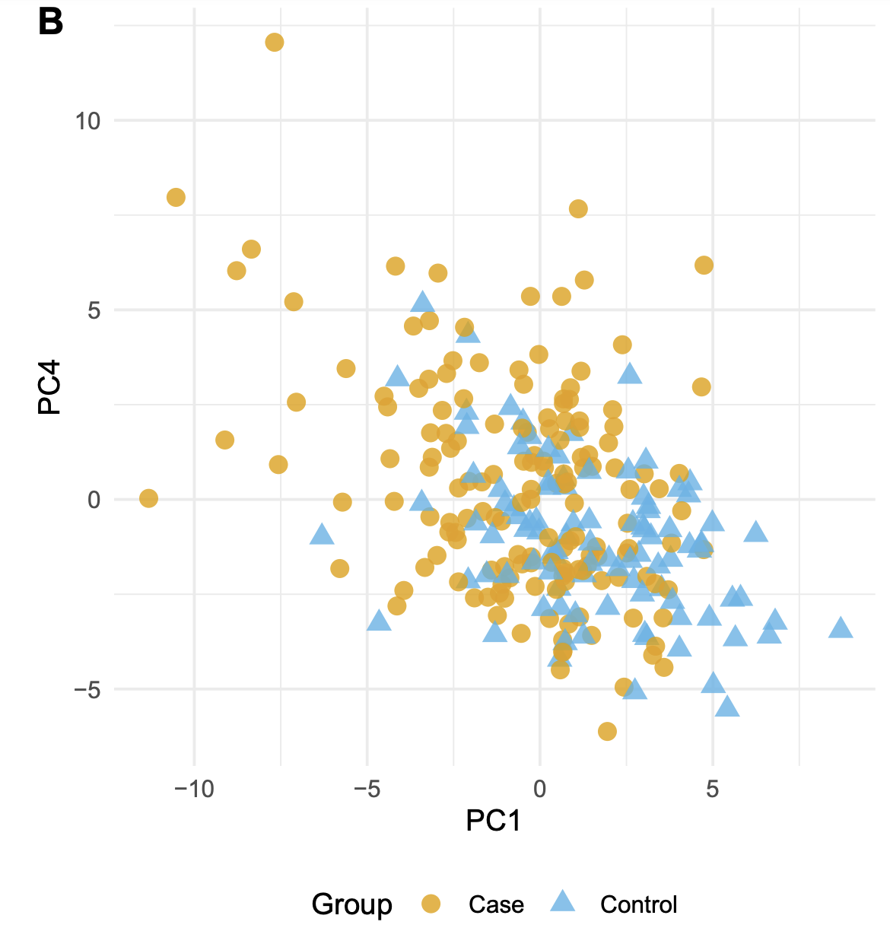


And, the “PC score” plots
PC4
PC1 direction
Case
Control
Project cell’s expression onto PC directions
Notes:
Also the PC score plots. Project the cell profile onto PC directions and visualize the high-dim distribution.
I plot PC4 in the y-axis because there is no difference on PC2,PC3.
Tackling high-dimensional comparison leveraging correlation information that one-gene-at-a-time analysis because we can test on the gene-module level. Stablize the noise and have interpretation.

Slide 9
Overview of the proposed procedure
Notes:
We are going to propose a frequentist comparison framework that is also very practiaclly feasible. And sometimes very straightforward.

Slide 10


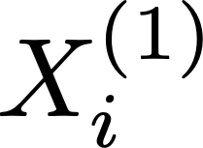
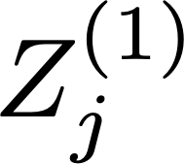
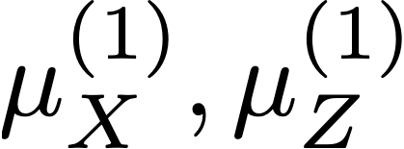

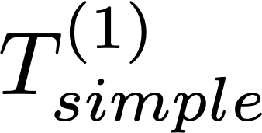


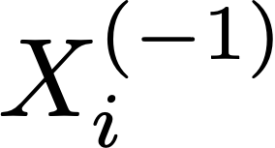
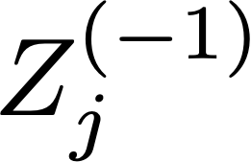
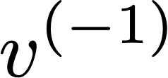
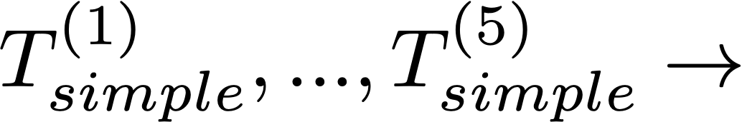

Swap the roles and aggregate to avoid loss of efficiency due to sample splitting.
Notes:
Treatment and control cells. Split into two parts, 20% - 80%. Use 20 to calculate the mean, 80% to calculate the PC1. Projection and calculate a test statistics. When there is no diff, we expect this inner product to be small.
Swap and aggregate

Slide 11
Theorem #1
1. PC1 support genes, identical expression level between groups.
2. Applying “support conservative” PC1 vector estimators,
Omitting the variability of estimating PC vector
(Only mean-estimation variability)
Notes:
We state an informal version of our result.
(read)
Means the estimate does not include genes that do not belong to true PC1. This can be achieved using sparse inducing PCA see very soon.
Under these two conditions we will have an approximately normal test statistics.
The most important technical detail and what makes this procedure relevant in practice is we can omit (read) Because it is not an easy task compared with mean variability. Somehow we can omit it.
Wasn't expected, too good to be true.

Slide 12
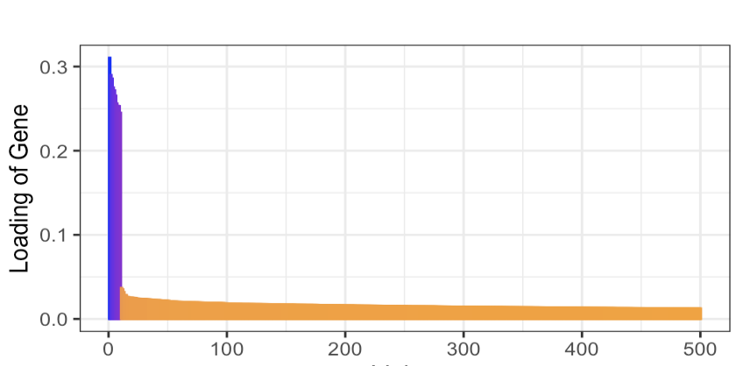
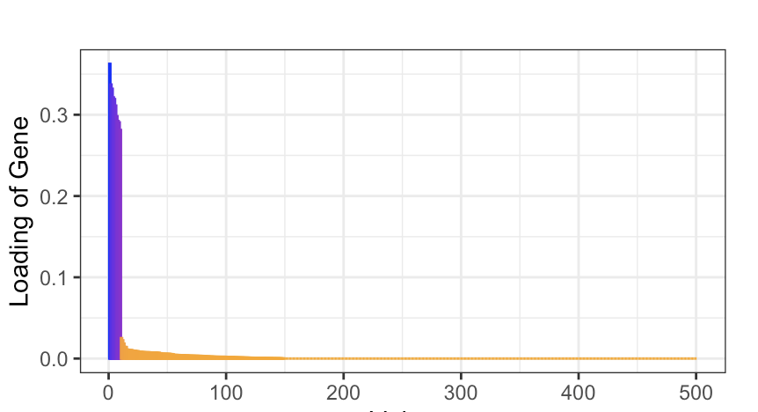
Alignment with true PC1
Best = 1
Standard PCA
0.85
Sparse PCA
0.99
Gene Index
Notes:
We talked about support conservative. Little bit more details regarding estimating PCA.
We have the standard PCA. Plot the loading of genes in the PC1. Few genes have large loading and many have a small but non-zero loadings. This will go on, we have 500 here. Check the inner product, 0.85. Pretty good.
In many settings relevant to high-dim data analysis, we can also sparse. Properly shrink, cv determine threshold, loading decays to zero much faster. Better estimate.

Slide 13
General PC-k genes.
WGCNA eigengene
Well-defined population-level projection direction +
support conservative estimate
Notes:
This procedure can be generalized to PC-k

Slide 14
Back to the PC score plot
Notes:
Go back … assess what we have established

Slide 15
Case
for all PC1 genes
Control
Notes:
We proposed a procedure that can be used to test…
But it is different from the statement that the mean profiles having same projection score.
One implies the other but not the other way.

Slide 16
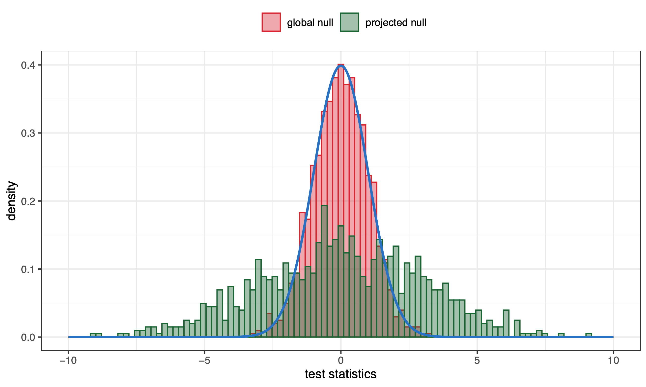
A
Thin blue curve: standard normal.
for all PC1 genes
B
But
Notes:
In fact, our estimate is very close to normal 0,1 but overdispersed under the second scenario.
Although these two settings look very alike, one need to determine which one they are actually interested in.

Slide 17
?
A Harder Task to Determine
does not have tractable distribution, high-dimensional setting.
Previously presented procedure omitted variability of estimating PC1
Debiased/ one-step/ double-machine learning/ doubly-robust estimator of
+ “correction terms”
Notes:
In fact, it is a much harder task to determine if the projection scores are identical.
Problem comes from ……..
We propose a ………… of the projection score difference. I list all the names in case you have heard one or some of them that appear in the literature.

Slide 18
Another perspective, maximizing test power

Slide 19
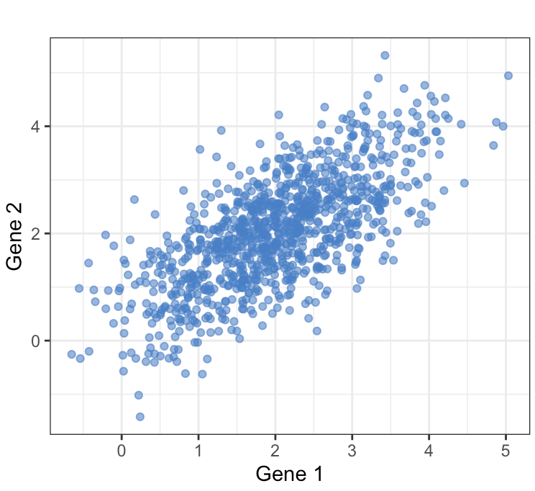
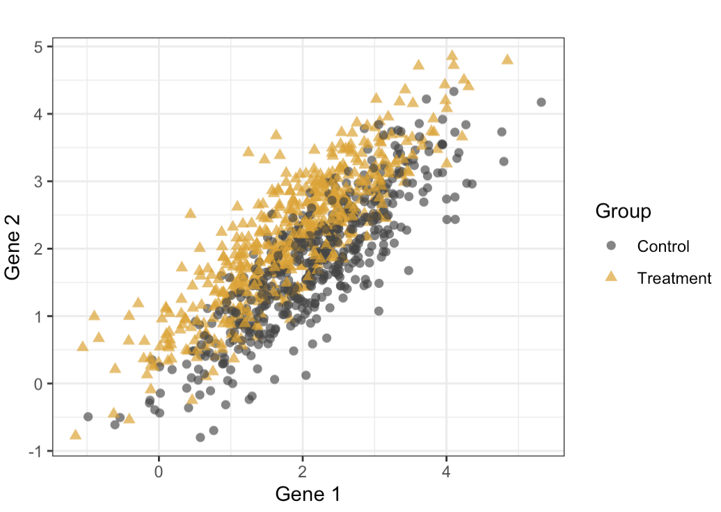
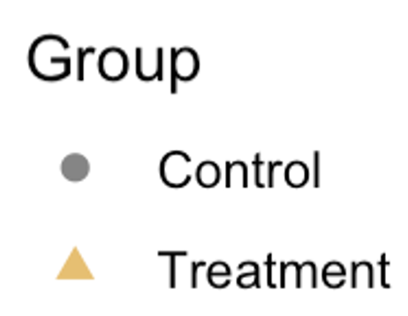
Linear discriminant direction
PC direction - variation
Notes:
So far we have discussed PC projection that explain most variation. Many settings the only thing we can rely on. Emphasize gene-gene correlation.
But in a treatment control experiment we can also leverage group label of the cell. Mathematically the linear discriminant direction is different from PC direction.

Slide 20
Notes:
Rememeber this is our sample splitting scheme from PC1 projection

Slide 21
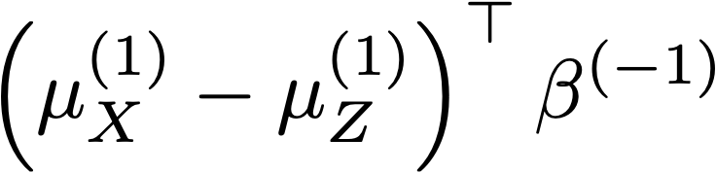
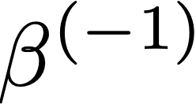
Supervised classifier
(e.g. LASSO)
Gene vector
Group label
1 for
, 0 for
Notes:
Now we can instead train a classifier rather than estimating the PC direction.
This can be done fitting a classification model, using gene vector to predict which group the cells come from. After getting the classifier direction beta, project onto that direction instead.

Slide 22
Theorem #3
A variation of the above procedure, asymptotically normal
when
Adaptive projection direction:
No difference: PC1 direction.
Exist DE genes: gradually shift to discriminant direction
DE genes having non-zero loadings
Notes:
(read)
The projection direction is PC1 direction when there is no difference. It gradually shift to the discriminant direction where …..
We can not always project onto the discriminant direction because it is not defined.
JOINTLY GIVE US POWER,

Slide 23
P-value = 0.004
Case
Control
P-value = 0.047
Projection on LASSO direction
p-value < 0.001
Notes:
Apply different methods to the same data, depending on the purpose. We have p-value for each task.

Slide 24
Thank You~
R CRAN Package: HMC
Paper title same as the talk title

