Slide 1
Adaptive Projected Multiple Sample Comparison
Tianyu Zhang
Statistics and Applied Probability
University of California, Santa Barbara
Notes:
Today we are going to talk about a statistical framework on single-cell differential expression analysis

Slide 2



two joint projects with
Ergan Shang
Carnegie Mellon University
Jing Lei
Carnegie Mellon University
Kathryn Roeder
Carnegie Mellon University
Notes:
A joint work with Jing and Kathryn

Slide 3




Perturb-seq data analysis:
Gene Expression Levels
Genes
Control
Cells
Treatment
Cells
Expression Profiles
Notes:
Consider a typical CRISPR gene editing experiment, collect control cells and treatment cells.
Interested in the difference between their avg expression profiles. So we know what treatment does and infer gene function.

Slide 4
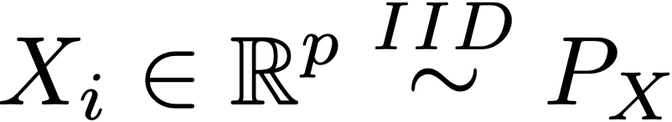
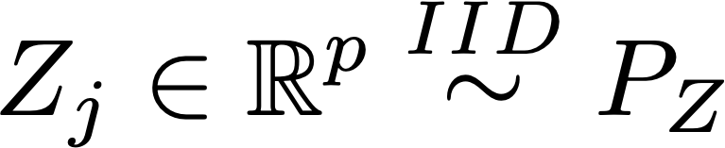
High-Dimensional Mean Comparison
Testing the expected gene profile:
where
Classical problem. More interpretable results than a single p-value.
Notes:
Mathematically, formulate this simple question as a high-dim mean comp problem.
X control, Z case.
Test if these two rv having same mean.
The dimension, p , is too large. Need to handle signal and noise properly to avoid false positive and get some power.

Slide 5
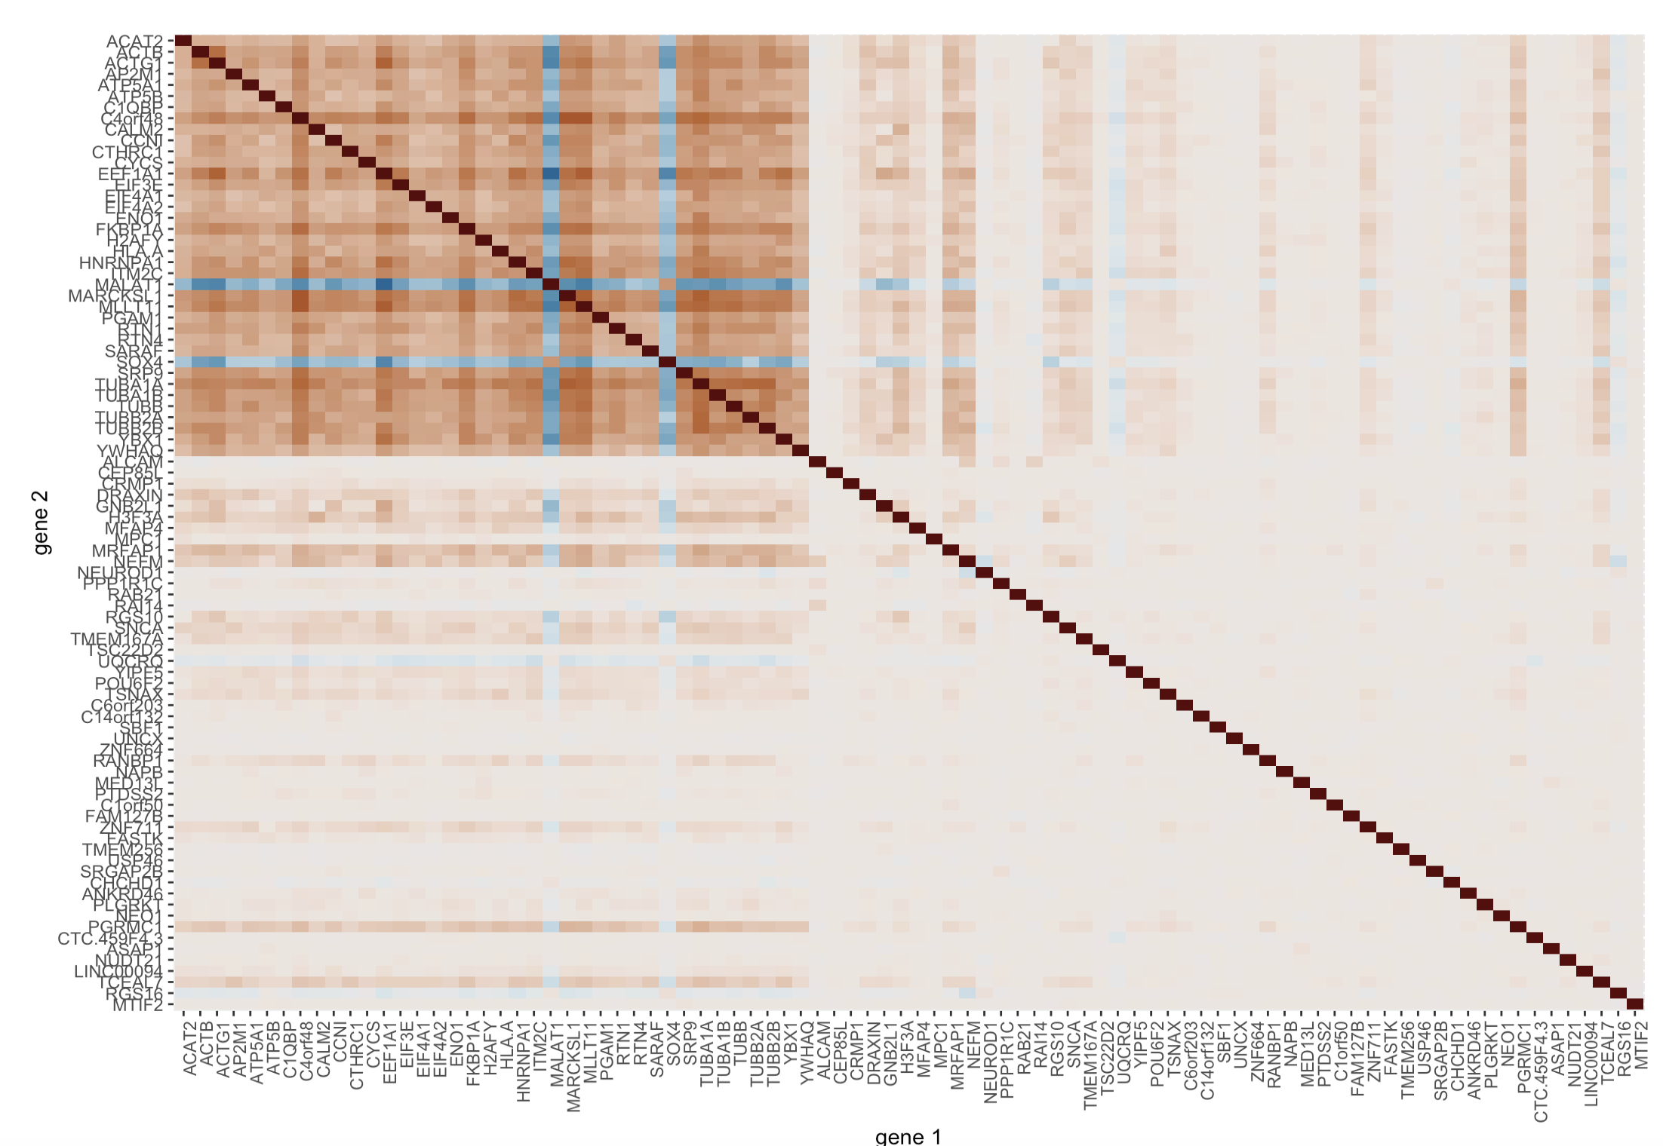
Correlated gene expression levels ~ Related functions
Genes with non-zero loadings in
the PC vector
Estimated PC1
support genes
Some random chosen genes
Notes:
Genes having related functions usually have correlated expression level.
Heatmap Pearson correlation between genes. White means no correlation, colored means positive or negative correlation.
Here some randomly chosen genes. Correlation between certain genes more visible. PCA of the data and pick genes with ”large” loadings. PC1 support genes. They are more correlated.
PCA is one of the ways to find correlated genes and hopefully they have similar functions.

Slide 6


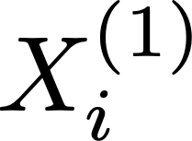
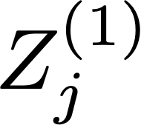
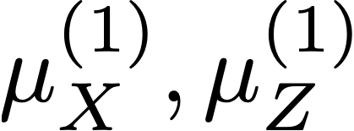



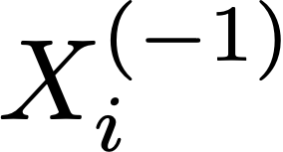
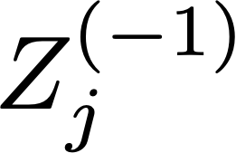
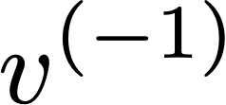
Adaptive projection for mean comparison, prototype
When p = number of genes is large
is not Gaussian.
Notes:
Treatment and control cells. Split into two parts, 20% - 80%. Use 20 to calculate the mean, 80% to calculate the PC1. Projection and calculate a test statistics. When there is no diff, we expect this inner product to be small.
Swap and aggregate

Slide 7
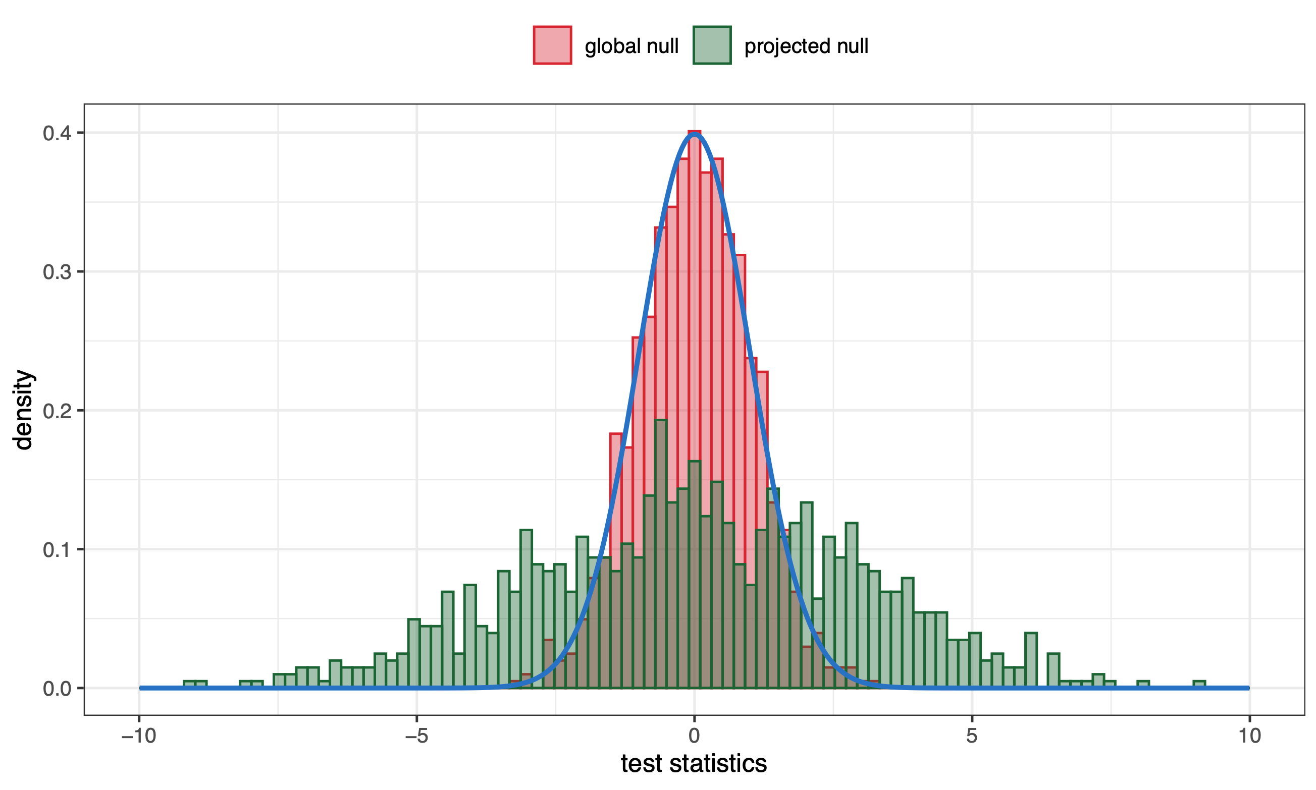
An unexpected normality
A
for all PC1 genes
B
But
for all PC1 genes
Thin blue curve: standard normal.
Notes:
In fact, our estimate is very close to normal 0,1 but overdispersed under the second scenario.
Although these two settings look very alike, one need to determine which one they are actually interested in.

Slide 8
A useful theorem
1. PC1 support genes, identical expression level between groups.
2. Applying “support conservative” PC1 vector estimators (sPCA),
Omitting the variability of estimating PC vector
(Only mean-estimation variability)
Notes:
We state an informal version of our result.
(read)
Means the estimate does not include genes that do not belong to true PC1. This can be achieved using sparse inducing PCA see very soon.
Under these two conditions we will have an approximately normal test statistics.
The most important technical detail and what makes this procedure relevant in practice is we can omit (read) Because it is not an easy task compared with mean variability. Somehow we can omit it.
Wasn't expected, too good to be true.

Slide 9
Two methods to enhance power (1 of 2)
Swap the roles and aggregate, still Gaussian!
Notes:
Treatment and control cells. Split into two parts, 20% - 80%. Use 20 to calculate the mean, 80% to calculate the PC1. Projection and calculate a test statistics. When there is no diff, we expect this inner product to be small.
Swap and aggregate

Slide 10
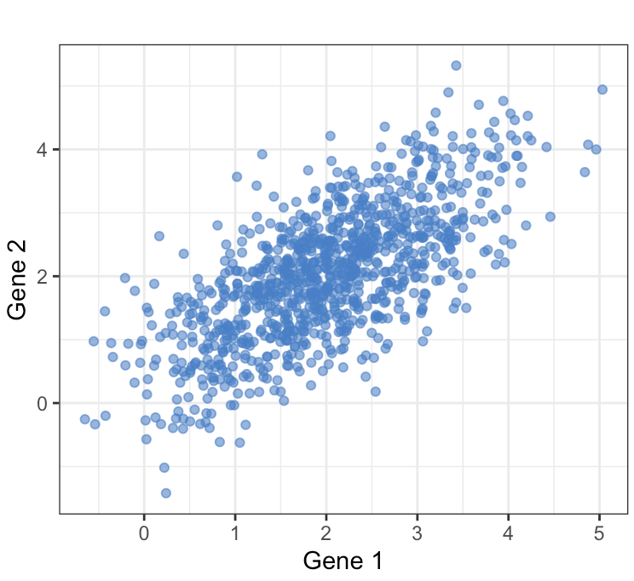
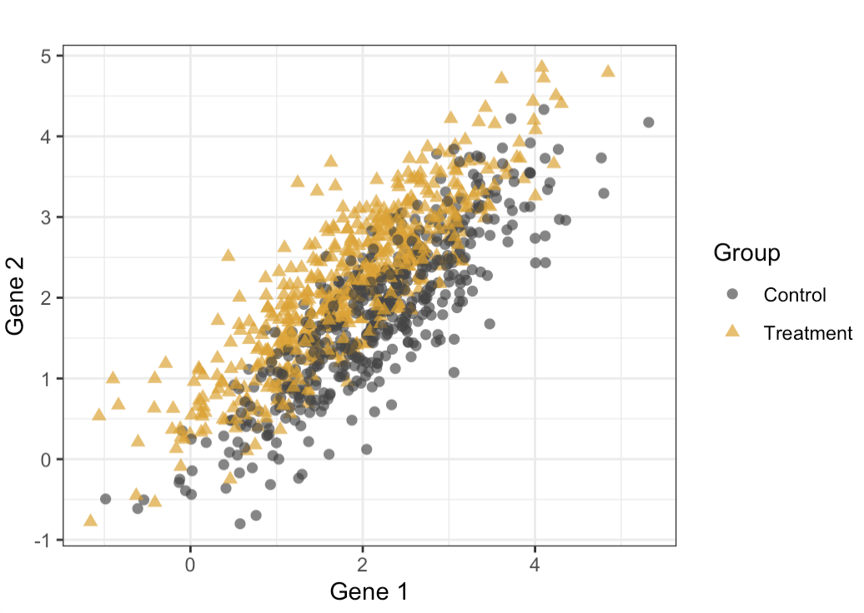
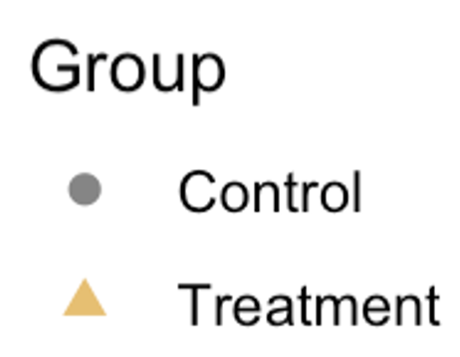
Two methods to enhance power (2 of 2)
PC direction - variation
Linear discriminant direction
Notes:
So far we have discussed PC projection that explain most variation. Many settings the only thing we can rely on. Emphasize gene-gene correlation.
But in a treatment control experiment we can also leverage group label of the cell. Mathematically the linear discriminant direction is different from PC direction.

Slide 11
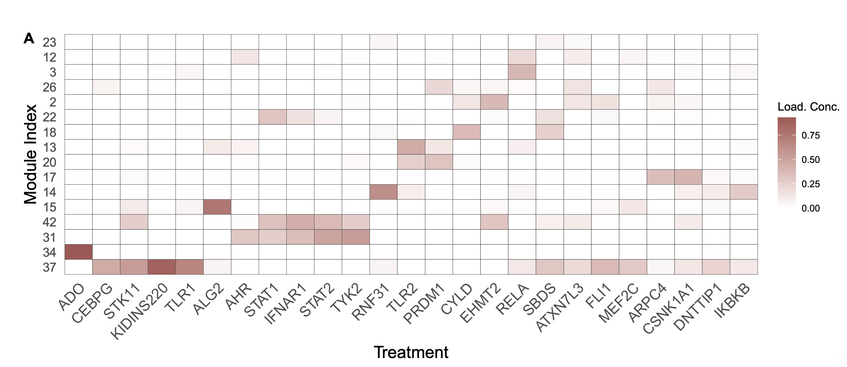
A Perturb-seq Example
Perturb one gene of interest
Measure many genes’ expression level
Compare with the control group
Data: Yao et al., 2023 Compressed perturb-seq

Slide 12
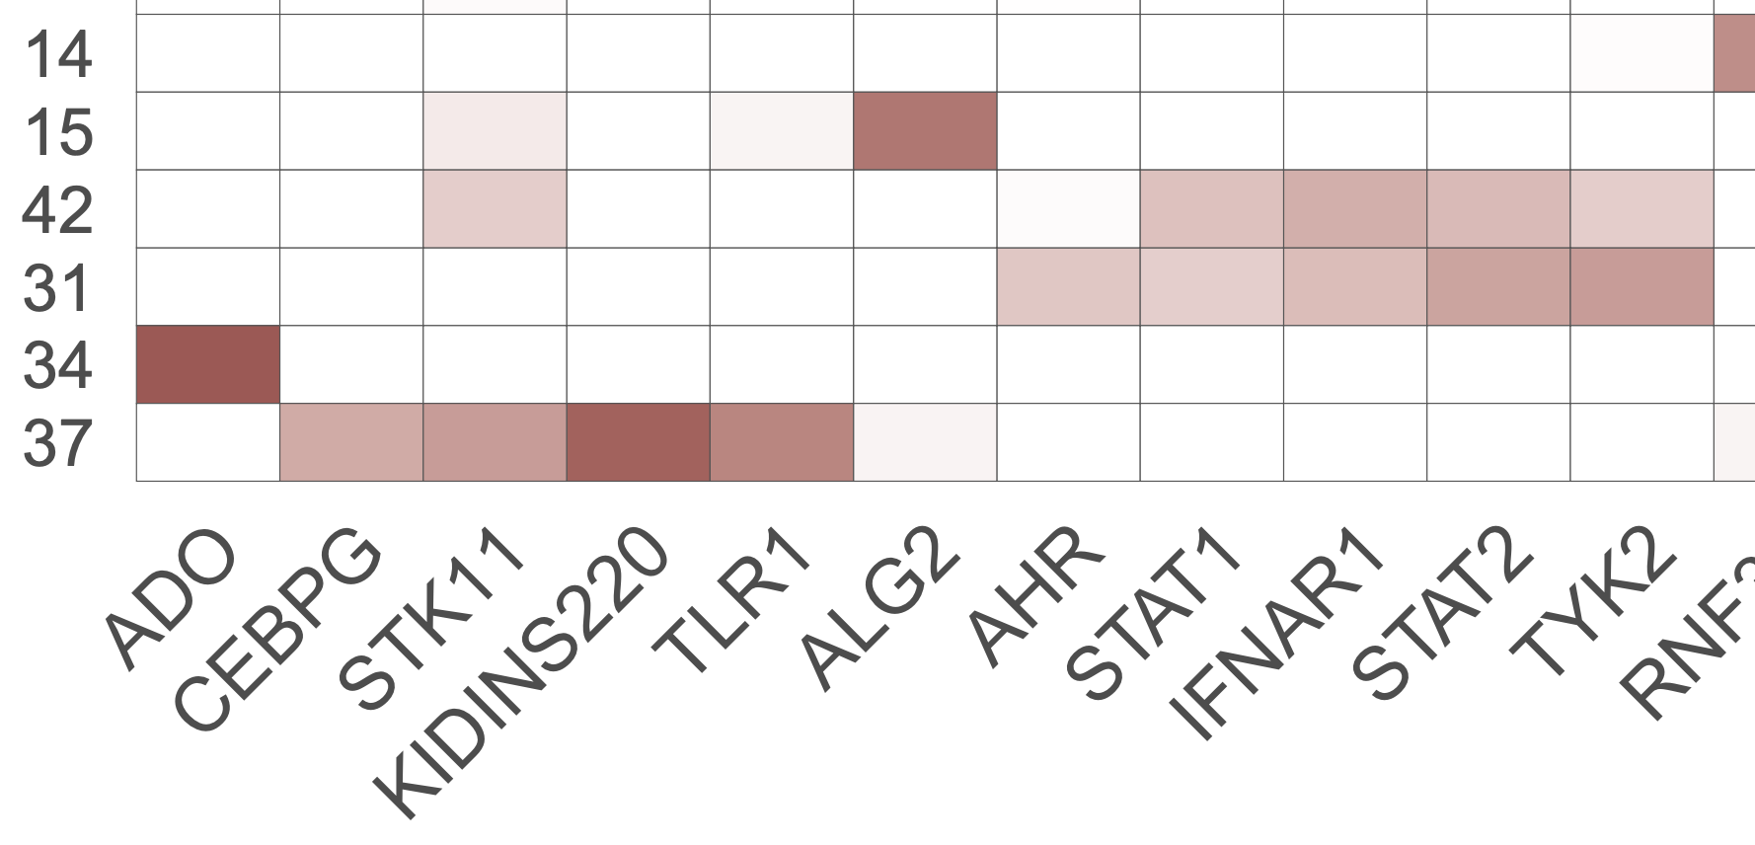
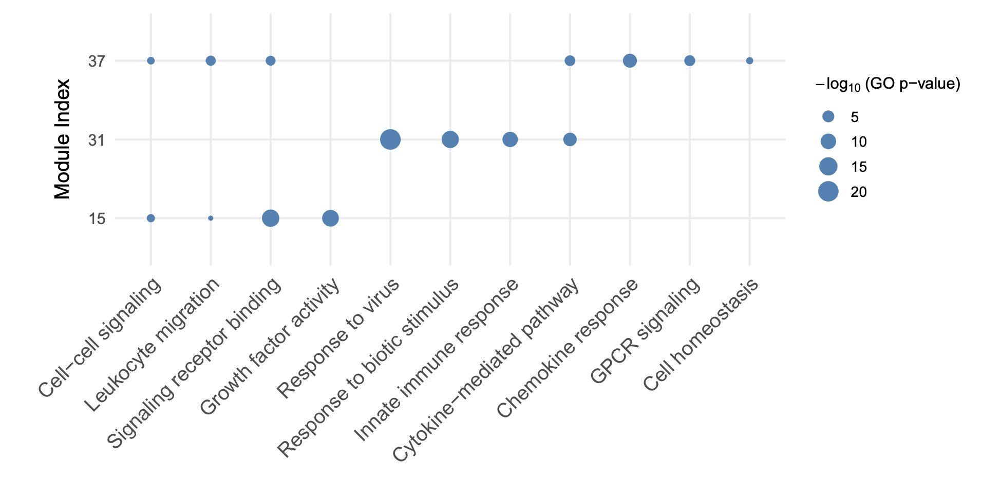
Go analysis
Relate each gene module to biological functions

Slide 13
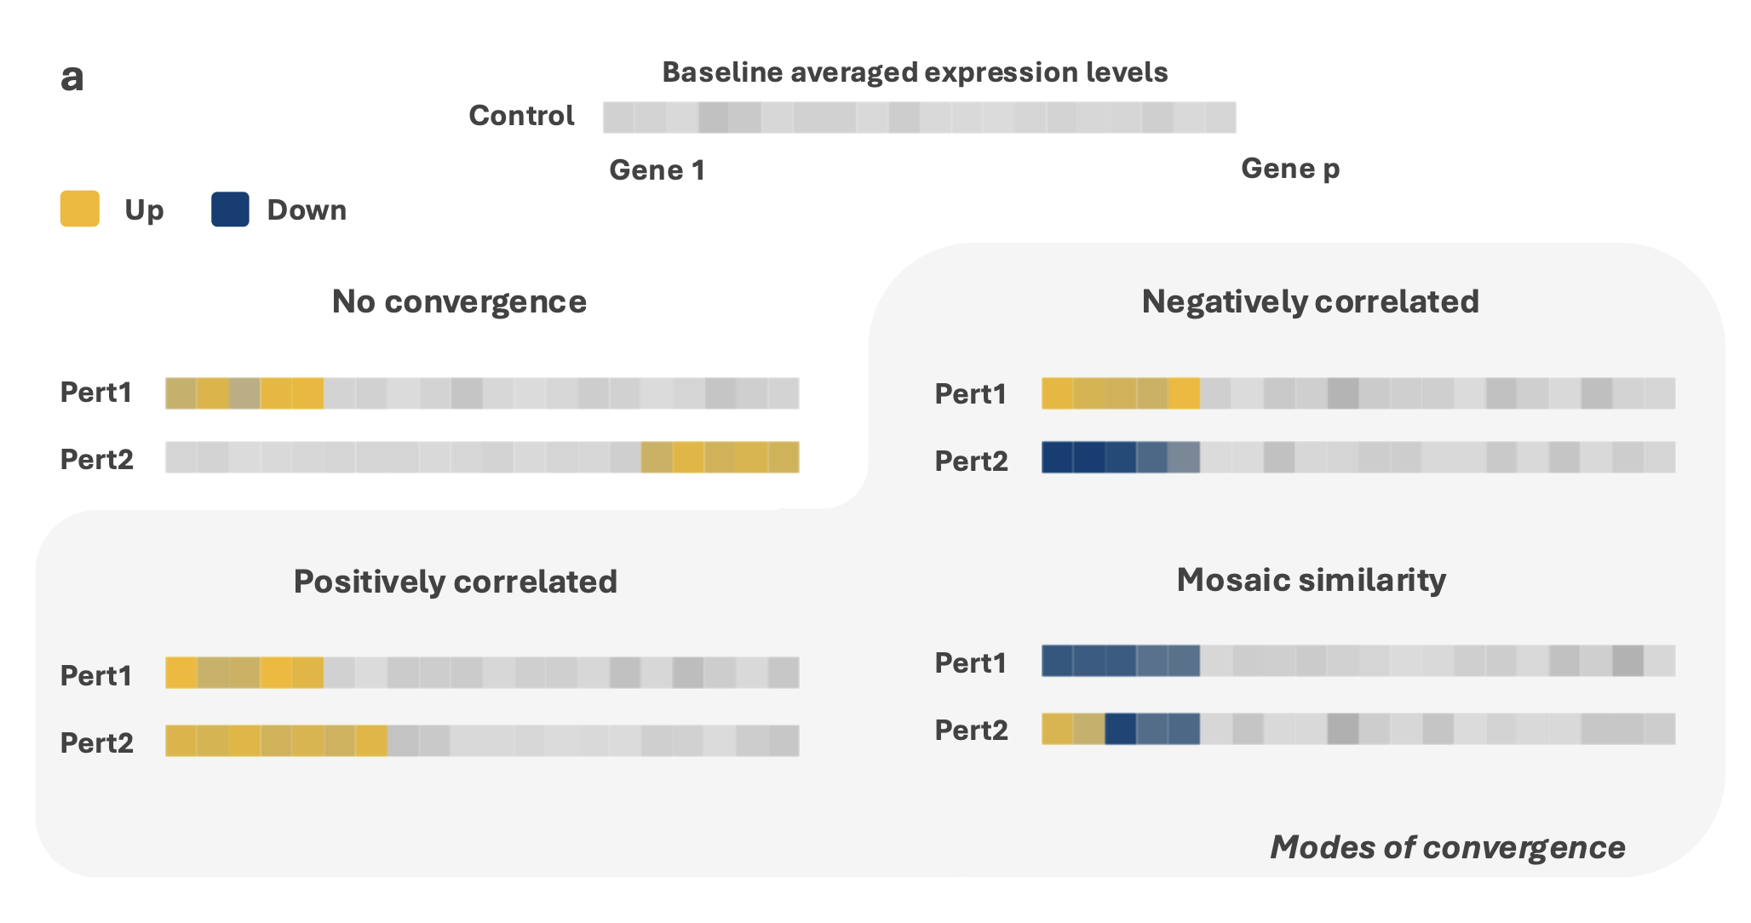
Another application:
Genetic convergence analysis

Slide 14
Why genetic convergence
Mutating/perturbing two genes induces similar expression levels changes of other genes
Each gene regulates (many) other downstream genes’ expression level
The mutated genes have similar biological functions in wild-type cells.
Often, the mutated genes are associated with major diseases/disorders. May be related to phenotype through common pathways.

Slide 15
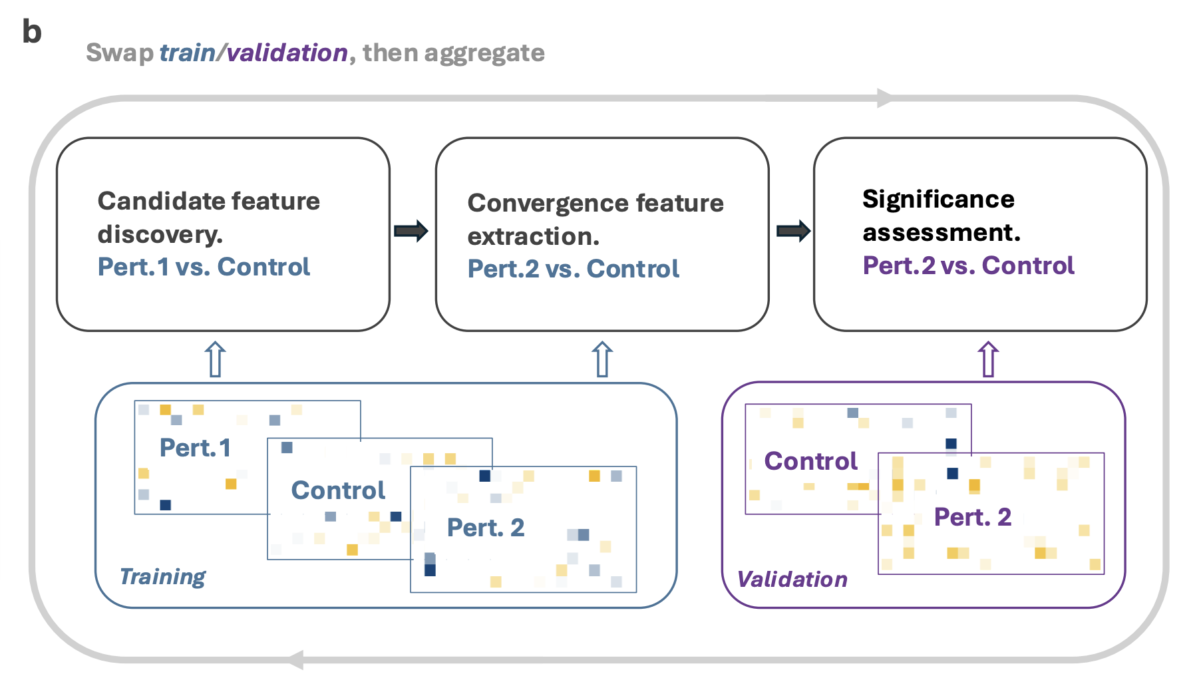
Method pipeline

Slide 16
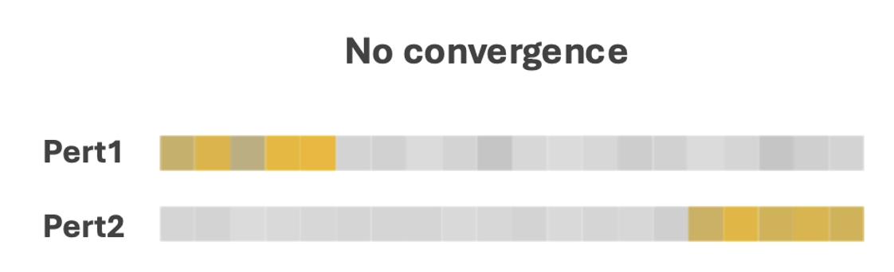
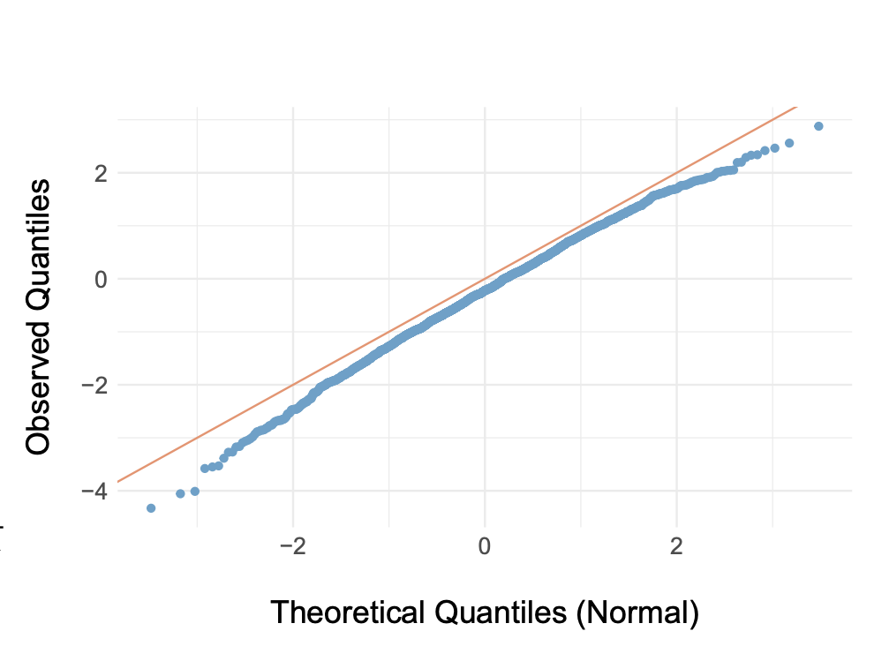
Normality under the null
Sample size ~ 150 per group dimension / # of genes ~ 1.5k

Slide 17
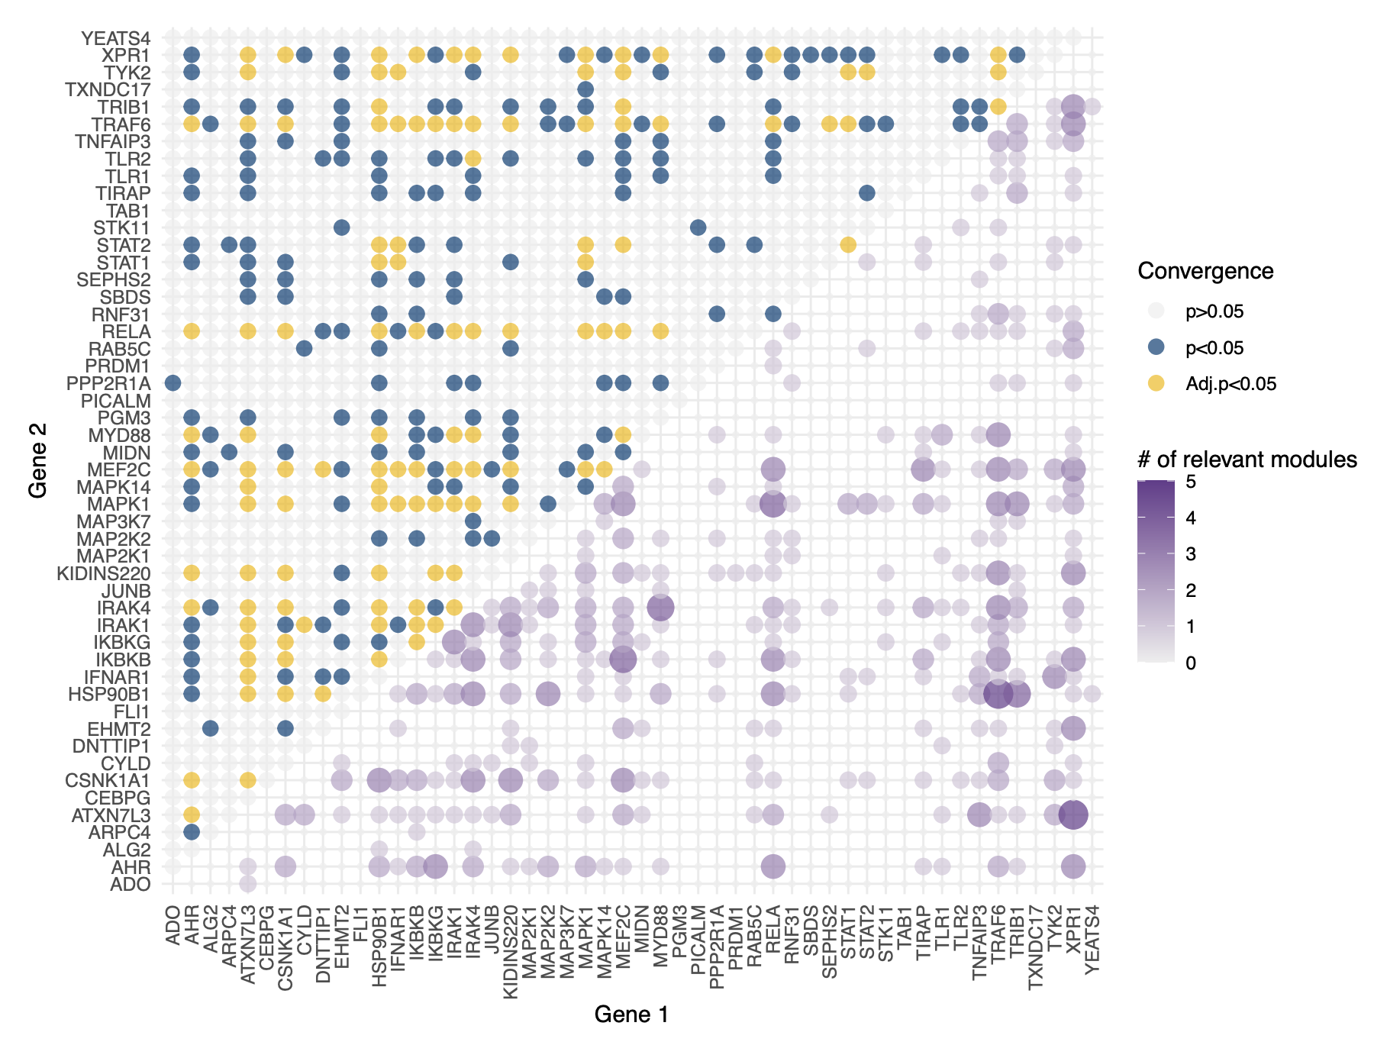
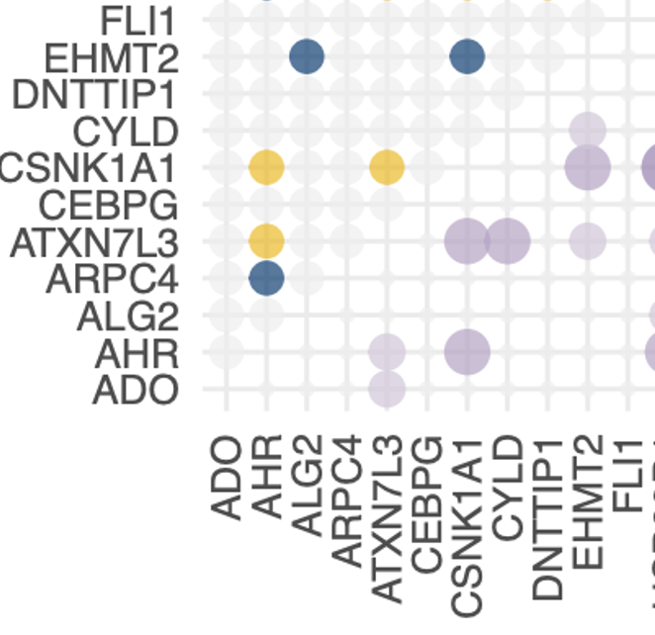
Application to the same data set

Slide 18
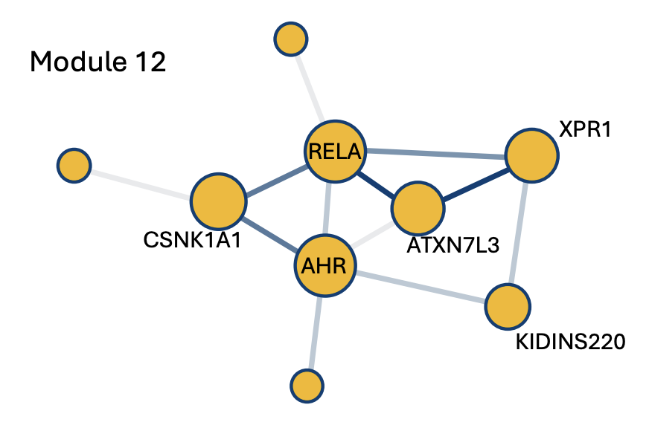
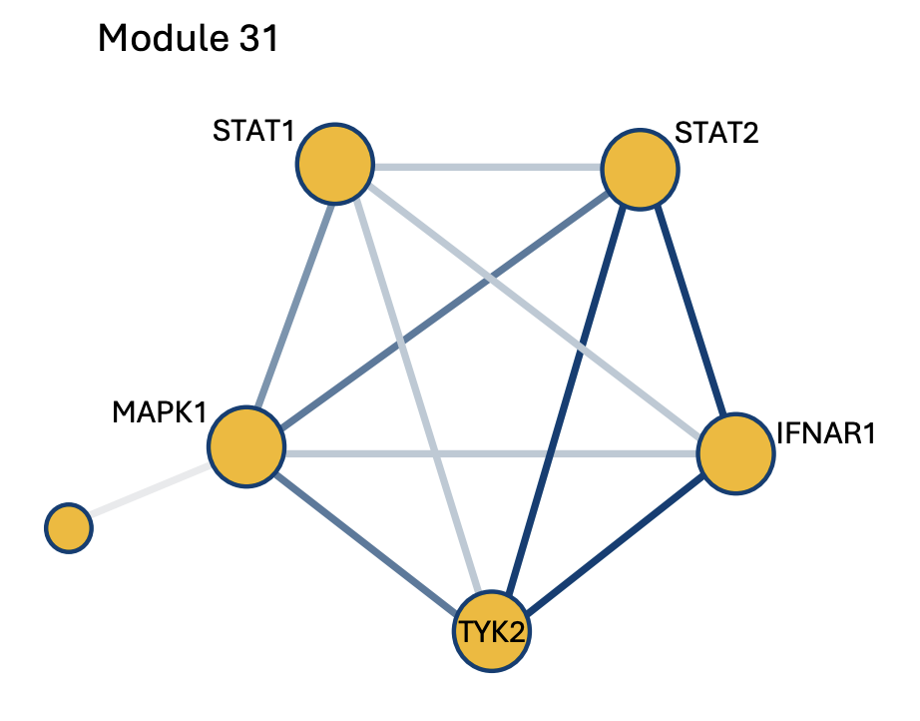
Another dimension to assess
STAT1 and STAT2 are convergent
Module 31 was active when constructing the projection direction.

Slide 19
Summary
An almost painfully simple framework.
Versatile across applications.
Power comes from out-of-sample predictive capacity.
Thank you!

Slide 20



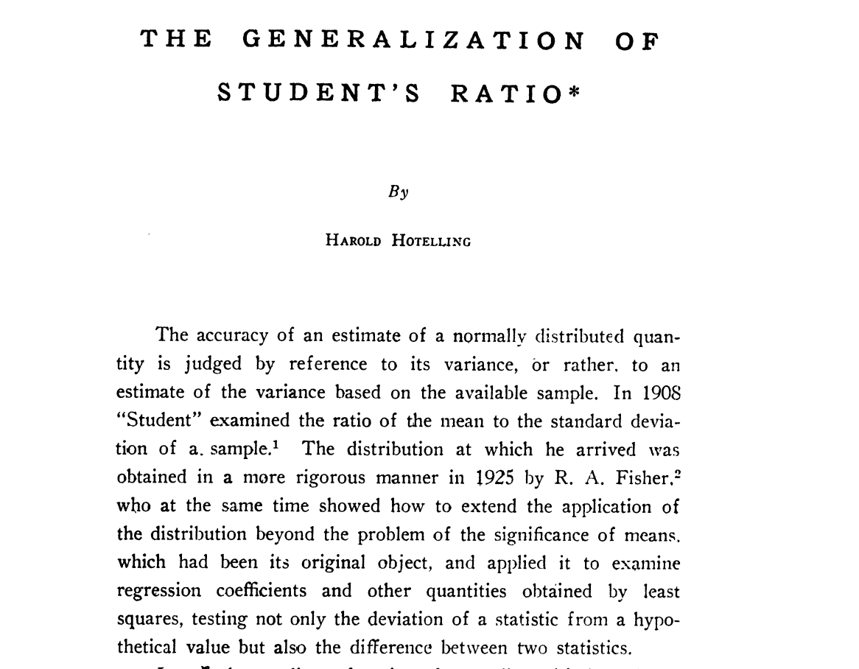
A Rich Literature from Statistics
T-test for each gene plus Bonferroni correction
Hotelling’s
: Multivariate but dimension needs to be small
(1932)
(1996- )
—type tests: accumulate the weak signal of all genes
—type tests:
Properly use the dimension with the largest difference
(2014- )
More ‘adaptive’ tests
(2016- )
Powerful frequentist test, p-value
Notes:
Mean comparison problem one of the most basic, univariate to high-dim has been extensively studied in stat

Slide 21
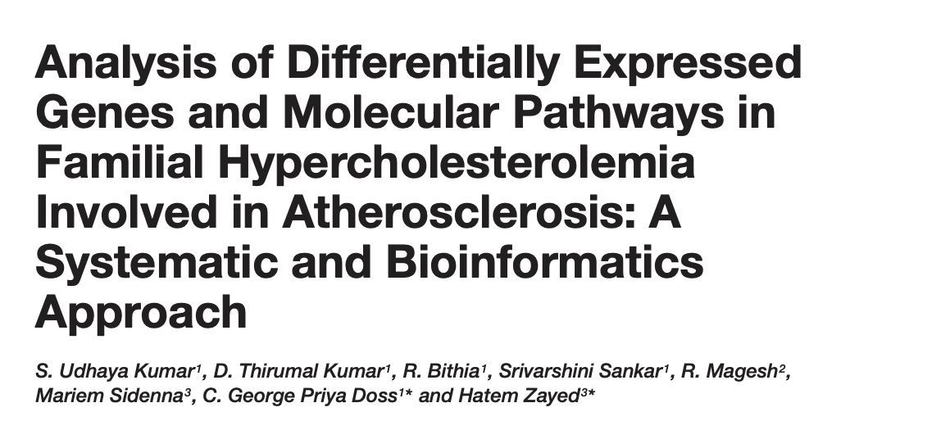
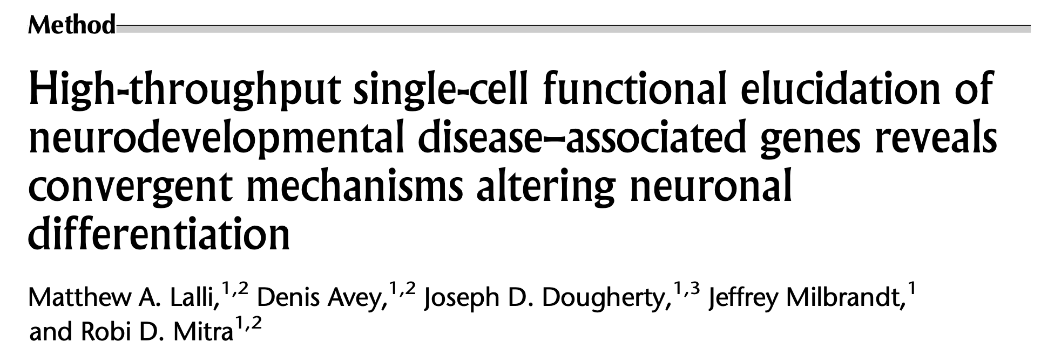
Meanwhile scientific community
Not only p-values.
Additional structural insight.
Notes:
Meanwhile scientists are developing their own methods to tackle this basic stat problem.
To me one obvious reason, statistical procedures mentioned above focuses on getting a more powerful test but offer little beyond p-value. More interpretable information. A given CRISPR mutation has more systematic impact on the cell. Pathway, genes related to a function.

Slide 22
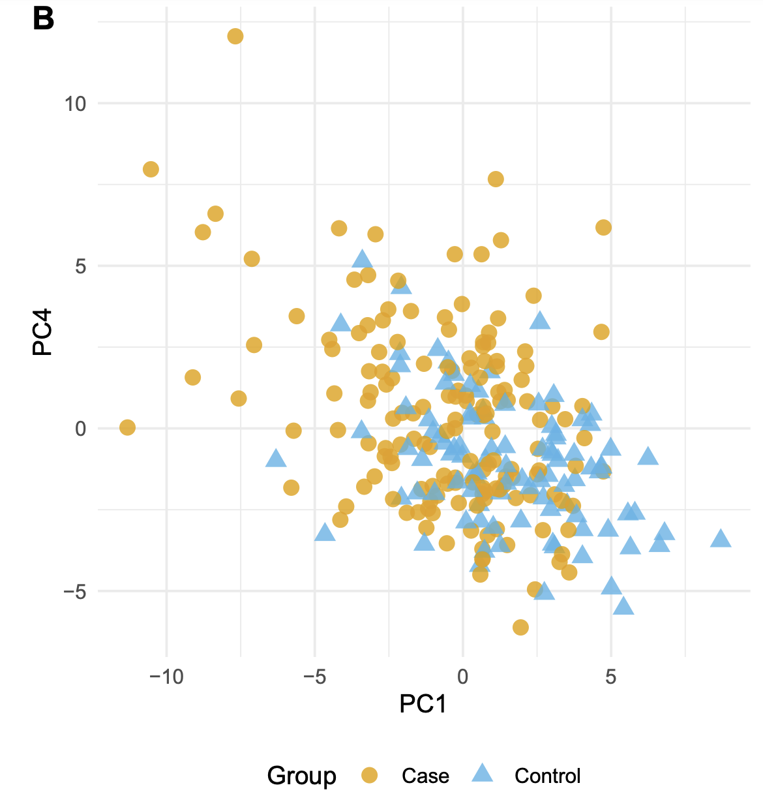


And, the “PC score” plots
PC4
PC1 direction
Case
Control
Project cell’s expression onto PC directions
Notes:
Also the PC score plots. Project the cell profile onto PC directions and visualize the high-dim distribution.
I plot PC4 in the y-axis because there is no difference on PC2,PC3.
Tackling high-dimensional comparison leveraging correlation information that one-gene-at-a-time analysis because we can test on the gene-module level. Stablize the noise and have interpretation.

Slide 23
Overview of the proposed procedure
Notes:
We are going to propose a frequentist comparison framework that is also very practiaclly feasible. And sometimes very straightforward.

Slide 24
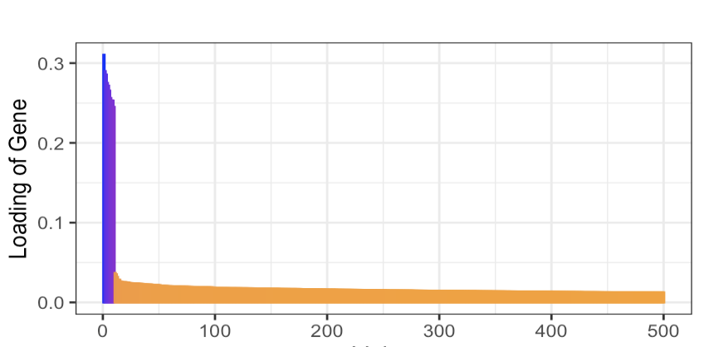
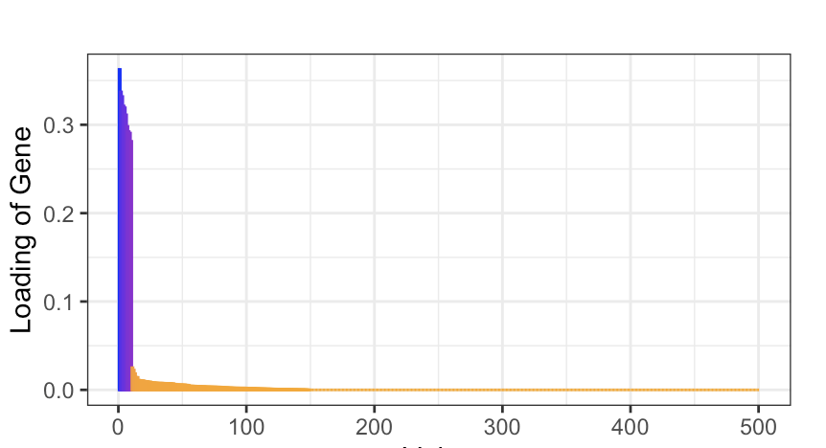
Alignment with true PC1
Best = 1
Standard PCA
0.85
Sparse PCA
0.99
Gene Index
Notes:
We talked about support conservative. Little bit more details regarding estimating PCA.
We have the standard PCA. Plot the loading of genes in the PC1. Few genes have large loading and many have a small but non-zero loadings. This will go on, we have 500 here. Check the inner product, 0.85. Pretty good.
In many settings relevant to high-dim data analysis, we can also sparse. Properly shrink, cv determine threshold, loading decays to zero much faster. Better estimate.

Slide 25
General PC-k genes.
WGCNA eigengene
Well-defined population-level projection direction +
support conservative estimate
Notes:
This procedure can be generalized to PC-k

Slide 26
Back to the PC score plot
Notes:
Go back … assess what we have established

Slide 27
Case
for all PC1 genes
Control
Notes:
We proposed a procedure that can be used to test…
But it is different from the statement that the mean profiles having same projection score.
One implies the other but not the other way.

Slide 28
?
A Harder Task to Determine
does not have tractable distribution, high-dimensional setting.
Previously presented procedure omitted variability of estimating PC1
Debiased/ one-step/ double-machine learning/ doubly-robust estimator of
+ “correction terms”
Notes:
In fact, it is a much harder task to determine if the projection scores are identical.
Problem comes from ……..
We propose a ………… of the projection score difference. I list all the names in case you have heard one or some of them that appear in the literature.

Slide 29
Another perspective, maximizing test power

Slide 30
Notes:
Rememeber this is our sample splitting scheme from PC1 projection

Slide 31
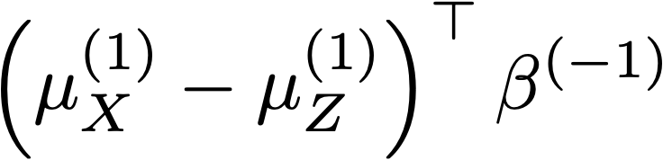
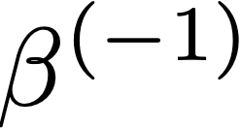
Supervised classifier
(e.g. LASSO)
Gene vector
Group label
1 for
, 0 for
Notes:
Now we can instead train a classifier rather than estimating the PC direction.
This can be done fitting a classification model, using gene vector to predict which group the cells come from. After getting the classifier direction beta, project onto that direction instead.

Slide 32
Theorem #3
A variation of the above procedure, asymptotically normal
when
Adaptive projection direction:
No difference: PC1 direction.
Exist DE genes: gradually shift to discriminant direction
DE genes having non-zero loadings
Notes:
(read)
The projection direction is PC1 direction when there is no difference. It gradually shift to the discriminant direction where …..
We can not always project onto the discriminant direction because it is not defined.
JOINTLY GIVE US POWER,

Slide 33
P-value = 0.004
Case
Control
P-value = 0.047
Projection on LASSO direction
p-value < 0.001
Notes:
Apply different methods to the same data, depending on the purpose. We have p-value for each task.

Slide 34
Thank You~
R CRAN Package: HMC
Paper title same as the talk title

