Slide 1




CLAUDE PROJECTS & ARTIFACTS
Beyond the Chat
Building Reusable Workspaces and Apps with Claude Projects and Artifacts
CHAT
PROJECT
ARTIFACT
30 minutes · Product, UX, engineering & QA audiences
Notes:
0:00–0:03, per 05-presenter-runbook.md. Suggested opening: “Most of us begin using generative AI one conversation at a time. That works well for isolated questions, but it becomes inefficient when the work has shared terminology, reference material, safety constraints, and multiple stakeholders.” Do not spend time explaining every possible Claude feature — move into the agenda quickly.

Slide 2
Session Flow
30 minutes, live throughout
0:00–0:03
Problem and concept
Slides 1–2
0:03–0:07
Explore the Pet Care Coach Project
▶ Live Claude Project
0:07–0:12
Run grounded prompts in two chats
▶ Live Claude chats
0:12–0:19
Explore the Journey Explorer Artifact
▶ Live Artifact
0:19–0:25
Add QA Coverage Mode
▶ Live Artifact enhancement
0:25–0:28
Explain what happened
Slide 3
0:28–0:30
Decision guide and takeaway
Slide 4
The schedule includes a small amount of buffer. If live generation runs slowly, move directly from the prebuilt Artifact to Slide 3.
Beyond the Chat
Notes:
Walk the room through the 30-minute shape before diving in. Hard checkpoints from 05-presenter-runbook.md: move to the Artifact no later than 12:00, move to the live enhancement no later than 19:00, and stop waiting on generation at the 24:00 hard cutoff — open the prebuilt QA-enhanced Artifact instead. That is not a failure; it reinforces good demo practice.

Slide 3
Beyond the Chat
A normal chat is useful for a question. A Project is useful for a body of work. An Artifact is useful when the output should become something people can use.
CHAT
PROJECT
ARTIFACT
One conversation
One immediate task
Shared instructions
Shared knowledge
Multiple conversations
Document
Visualization
Prototype
Interactive application
Beyond the Chat
Notes:
This is the outline's ‘Slide 1: Beyond the Chat,’ covered 0:00–0:03 per 05-presenter-runbook.md. Suggested line: “Today I want to show a simple progression: a chat answers a question, a Project creates a reusable workspace, and an Artifact turns that workspace into something interactive.” Keep this brief — the live Project walkthrough starting at 0:03 does the real work of proving the point.

Slide 4


What Persists Where?
Capability | Normal chat | Claude Project | Artifact
Immediate conversation context | Yes | Yes | Uses creation conversation
Shared instructions | No | Yes | Encoded in the result
Shared reference files | No | Yes | Can be represented in the result
Reused across multiple chats | No | Yes | Shared as a standalone output
Interactive user experience | Limited | Limited | Yes
Suitable for team knowledge | Limited | Yes | Yes, for a focused experience
The important distinction is not simply “more context.” It is the separation of:
Conversation
history
Reusable
instructions
Reusable
knowledge
Reusable
output
Beyond the Chat
Notes:
Outline's ‘Slide 2: What Persists Where?,’ also 0:00–0:03. Suggested explanation: “A Project separates three things we often mix together: the current conversation, reusable instructions, and reusable knowledge. That means I can open several chats for different tasks without copying the same product background into every prompt. An Artifact is a separate idea — a substantial output, such as a document, visualization, or application, created from that context.” Transition into the live demo: “Let’s look at a small fictional product workspace.”

Slide 5
LIVE DEMONSTRATION
Pet Care Coach, start to finish
Knowledge files
Claude Project
Multiple grounded conversations
Interactive Artifact
Live product enhancement
Notes:
Full script in 05-presenter-runbook.md, section 3. Recommended browser tabs: slide deck, Project home, Chat A, Chat B, prebuilt Journey Explorer Artifact, prebuilt QA-enhanced Artifact, and this runbook — keep the prebuilt QA-enhanced version separate from the one you modify live. 0:03–0:07 Project — open Pet Care Coach Product Workspace, show Project Instructions briefly (do not read in full), then the Knowledge file list. Say: “This is not intended to be an enormous document repository. It is a curated body of knowledge for a specific product.” Optional question: “Which of these files would your own team already have in some form?” — cap discussion at 30 seconds. 0:07–0:12 Two chats — run Prompt A in Chat A; point out journey-stage names, human responsibility, safety considerations, source filenames. Switch to Chat B, run Prompt B; point out stakeholder perspectives, feature IDs, acceptance-criteria IDs, source/approval distinctions. Core teaching point: “The Project is not simply a long chat. It is a reusable context boundary for a body of work.” Fallback: if Prompt A is slow, show a pre-generated response, skip Prompt B live, summarize it verbally. Move on by 12:00. 0:12–0:19 Artifact — open the completed Journey Explorer. Show the header, then the Journey tab (switch Pet Owner → Clinic Team → Product & QA), then Home Care (toggle two tasks, point out source/approval, no invented dosage), then Evidence (apply one filter). Fallback: perspective switching + one task toggle + Evidence tab only. Move on by 19:00. 0:19–0:25 QA Coverage Mode — switch to Product & QA perspective, paste Prompt C. Before submitting, highlight: “This must be an enhancement to the existing Artifact, not a replacement application.” When done, demonstrate the QA Coverage toggle, coverage summary, coverage filter, one Given/When/Then scenario, and reset. Hard cutoff 24:00: stop waiting, open the prebuilt QA-enhanced Artifact instead — not a failure, reinforces good demo practice.

Slide 6

What We Just Built
PRODUCT KNOWLEDGE
SUGGESTED TALKING POINTS
Overview
Personas
Journey
Requirements
One Project supported multiple roles.
Safety guidance
Demo data
Acceptance criteria
The Artifact reused existing identifiers and acceptance criteria.
PROJECT CONTEXT — shared across conversations
Product and safety constraints remained available during iteration.
ARTIFACT — JOURNEY EXPLORER
A new QA feature was added without recreating the product context.
Journey Explorer
Home-care interactions
Evidence view
QA coverage
The result is still a prototype, but it is a more durable prototype than a one-off chat response.
Notes:
0:25–0:28, per 05-presenter-runbook.md. Summarize in sequence: “We started with structured product knowledge. We reused it across different conversations. We converted it into an interactive application. We then added a QA feature using acceptance criteria already stored in the Project.” Emphasize reusable context, cross-functional use, traceability, and iterative artifact development. Avoid implying the Artifact is automatically production-ready — suggested caution: “This is still a prototype. Generated code and product logic require review, testing, security analysis, and normal engineering practices before production use.”

Slide 7
Which Claude Feature Should I Use?
Need | Best starting point
One question or short task | Normal chat
Repeated work using common context | Project
A reusable document, visualization, or app | Artifact
High-fidelity visual design exploration | Claude Design
Source-controlled production software | Claude Code or a development stack
“
Move reusable context into a Project, then turn the most useful results into Artifacts.
The key idea is not that every chat should become an application. The key idea is that once work becomes repeatable, shared, or multi-step, we should stop treating it as an isolated prompt.
Notes:
0:28–0:30, per 05-presenter-runbook.md. Suggested close: “Use a normal chat when the task is isolated. Use a Project when the work has shared knowledge, vocabulary, instructions, or multiple conversations. Use an Artifact when the output should become something reusable or interactive. The broader lesson is that once work becomes repeatable, shared, or multi-step, we should stop treating it as an isolated prompt.” Final sentence: “Move reusable context into a Project, then turn the most useful results into Artifacts.”

Slide 8

Backup: Common Limitations
Project knowledge must be curated.
Shared context does not guarantee perfect grounding.
Generated interfaces still require review.
Artifacts are prototypes unless engineered and tested for production.
Sensitive or regulated information requires appropriate controls.
Beyond the Chat — Backup

Slide 9
Backup: Project Contents
Files uploaded as Project Knowledge
Product overview
Personas
Journey
Features and requirements
Domain model
Safety guidance
Demo data
Acceptance criteria
Beyond the Chat — Backup

Slide 10
BACKUP SLIDES
Use only if needed during the live session.

Slide 11
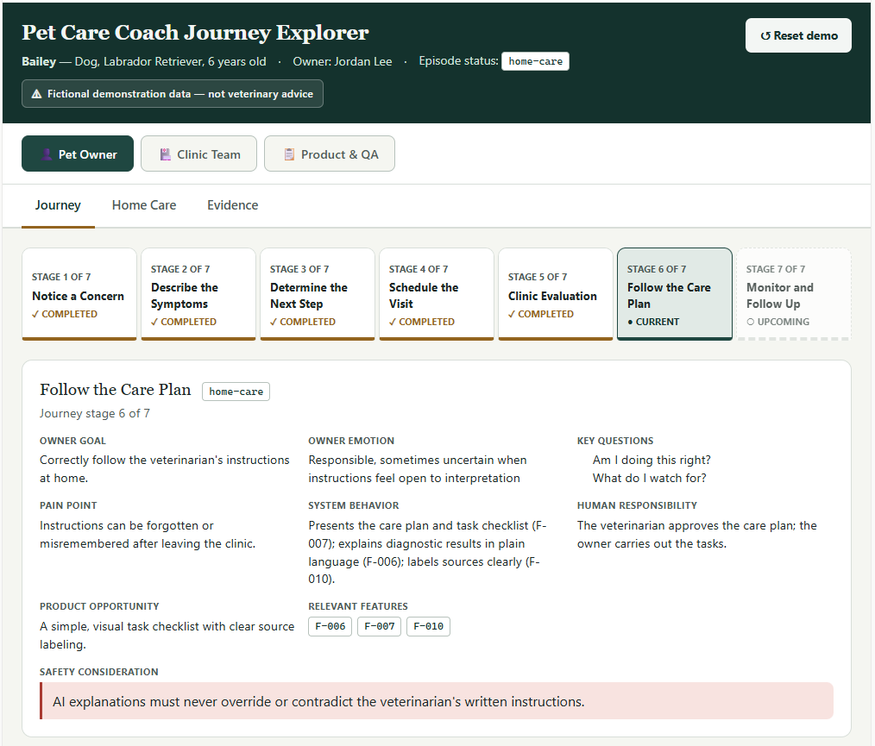
Backup: Completed Artifact
Use this slide only if the live Artifact does not load.
Beyond the Chat — Backup

Slide 12
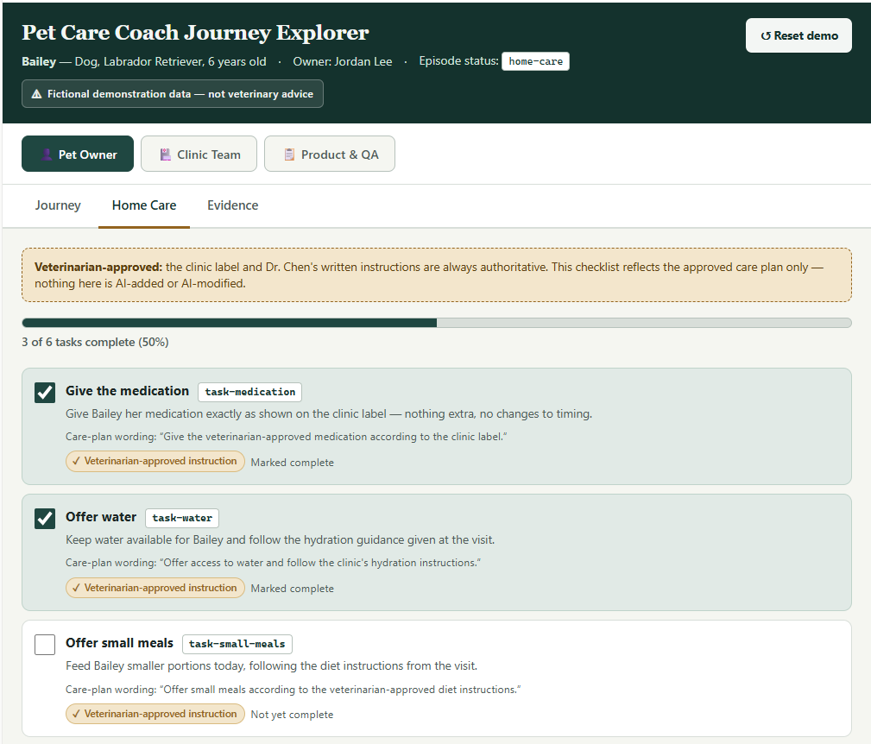
Backup: Completed Artifact
Use this slide only if the live enhancement takes too long.
Beyond the Chat — Backup

Slide 13
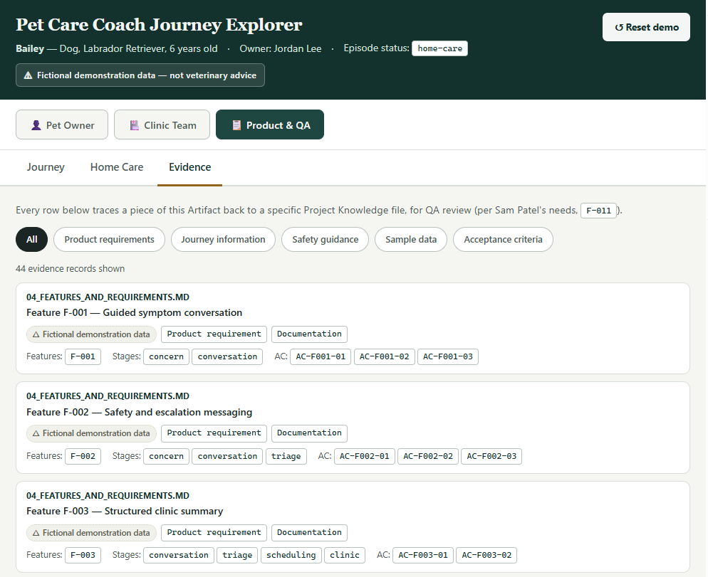
Backup: Completed Artifact
Use this slide only if the live enhancement takes too long.
Beyond the Chat — Backup

