Slide 1

Making Memories
From General Models to Intelligent Context
Promptly At 9 – 2026.01.12

Slide 2
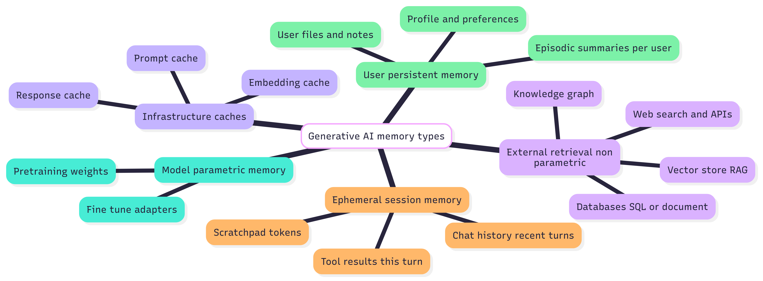
GenAI – “Memory” Classifications
Notes:
Model parametric memory
Pretraining weights: The model’s baked-in knowledge learned from large corpora; global and fixed until retrained.
Fine-tune adapters: Lightweight parameter deltas (e.g., LoRA/adapters) or full fine-tunes that add domain style or skills without changing core weights.
Ephemeral session memory
Chat history (recent turns): The rolling window of prior messages included in the current prompt; disappears as the window overflows or the session ends.
Scratchpad tokens: Temporary intermediate notes/computations placed in the prompt or tool schema to help the model reason; not persisted.
Tool results (this turn): Live outputs from tools/APIs retrieved during the request; used immediately unless written elsewhere.
External retrieval (non-parametric)
Vector store (RAG): Embeds documents and retrieves semantically similar chunks at query time to ground answers and enable citations.
Knowledge graph: Structured entities/relations that support precise queries, disambiguation, and multi-hop joins across sources.
Databases (SQL or document): Authoritative records (transactions, configs, logs) fetched on demand to ensure truth and freshness.
Web search & APIs: On-the-fly access to external knowledge and services for the latest facts or long-tail details.
User persistent memory
Profile & preferences: Durable per-user facts (role, format preferences, tone) that personalize prompts and outputs across sessions.
Episodic summaries (per user): Compact summaries of interactions/tasks that keep long-term context while staying within token budgets.
User files & notes: Uploaded or saved artifacts indexed for retrieval so future answers can reference the user’s own materials.
Infrastructure caches
Prompt cache: Stores normalized prompts to reuse prior model results and cut latency/cost when identical inputs recur.
Response cache: Saves final answers keyed by input/context; great for speed, but requires staleness controls for time-sensitive data.
Embedding cache: Reuses computed vectors for identical text during ingestion and querying to avoid unnecessary recomputation.

Slide 3
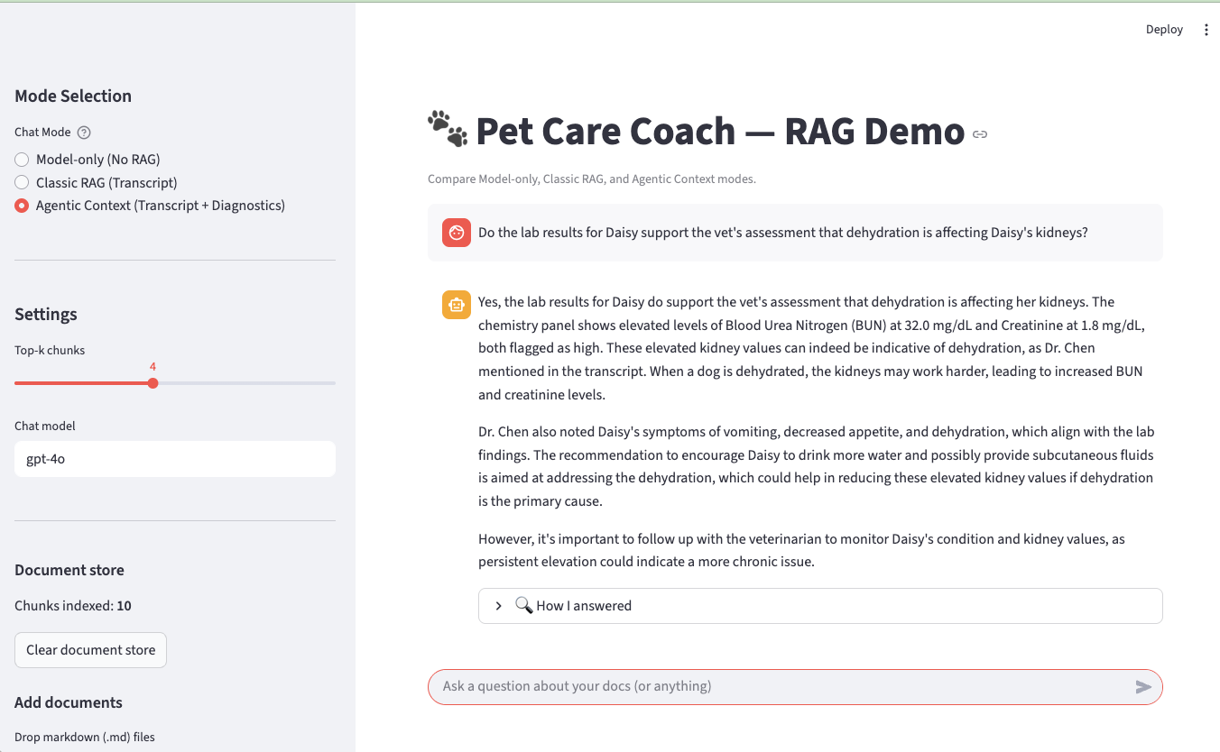
Demonstration App - Pet Care Coach
One app, one question — three AI behaviors
Prompt-only vs. RAG vs. Agent-driven reasoning
Shows how added context changes answer quality
Moves from “guessing” to “grounded advice”
Demonstrates why context design matters

Slide 4
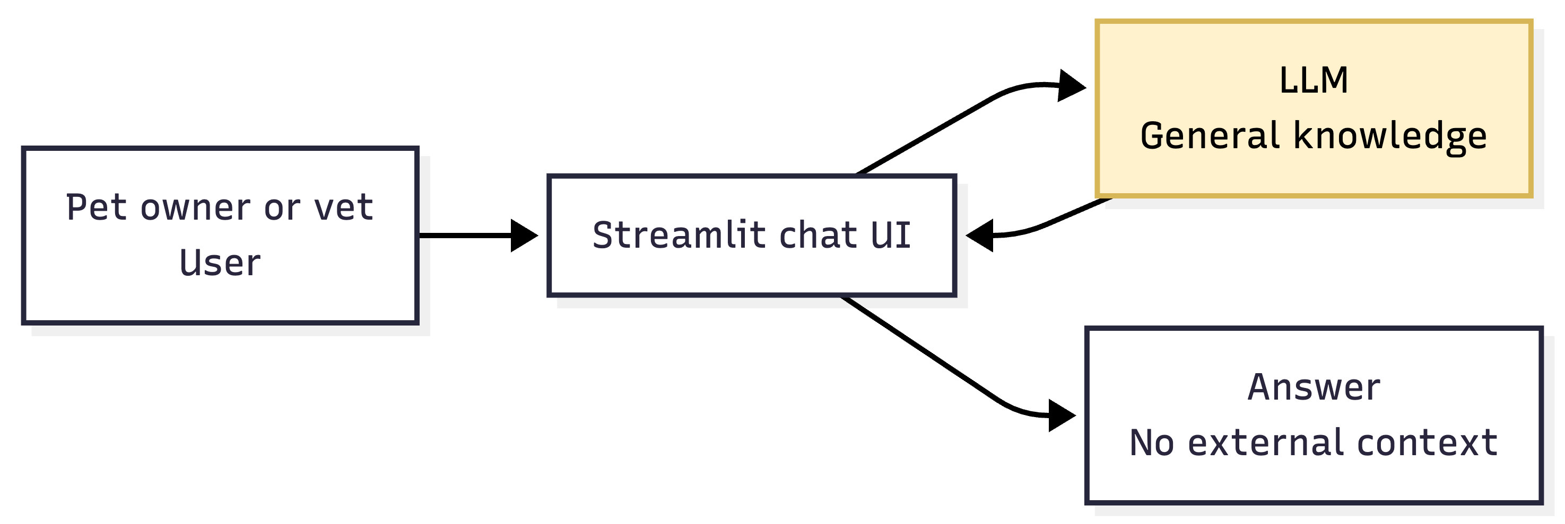
Early Days – General LLM Models
Context comes only from what the user types in this session
Fast and simple, but can sound confident without being grounded (hallucinates)
No access to clinic-specific facts, visit history, or diagnostics

Slide 5
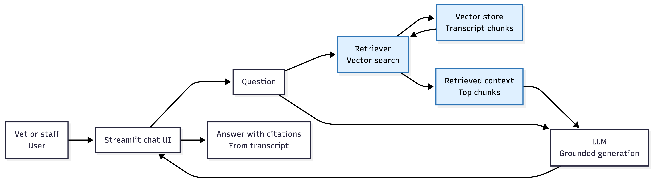
LLM Models Plus Retrieval Augmented Generation (RAG)
Adds “after the visit” memory via the transcript stored as searchable chunks
Improves accuracy and recall of what was said in the exam room
Still limited when answers require structured facts or calculations

Slide 6
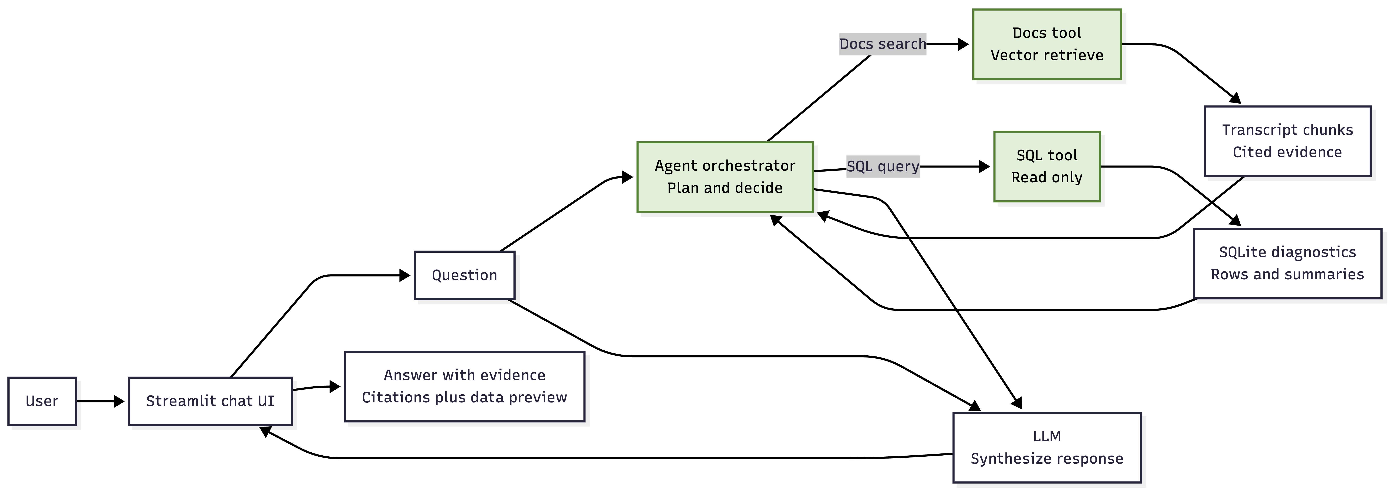
“Agentic RAG” – LLM plus Docs plus Live Data plus Orchestration
Uses a controller that can choose tools and loop for better evidence
Combines unstructured memory and structured diagnostics for decision support
Produces more trustworthy outputs by showing sources and data used

