Slide 1
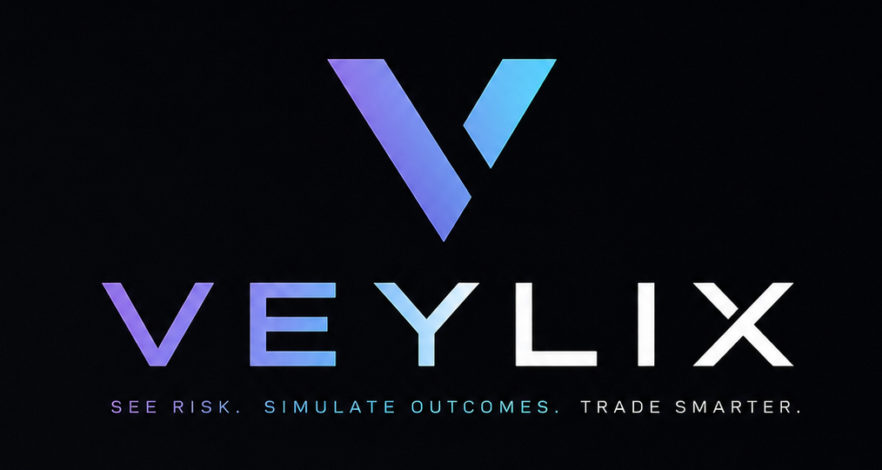
ENCODE × BLOCKCHAIN FOR GOOD · AI TRADING & STRATEGY
Pre-trade risk visibility for retail crypto. Institutional risk math, made legible — and honest.
Team Veylix Terry · Ashish · Raj · Jia · Lilian · Patti

Slide 2

THE PROBLEM
Retail can act in one tap — and can't see the risk.
They buy, sell, and hold the most volatile assets on the market instantly — and trade on:
~80%
Price charts
A PnL screen
A tip from Discord
Vibes
of retail traders using leverage lose money over any sustained period.
Sources: crypto research firms, 2024–25; NFTEvening 2025 (84% in year one)
The downside stays invisible until it's already realised.
VEYLIX 02 / 21

Slide 3
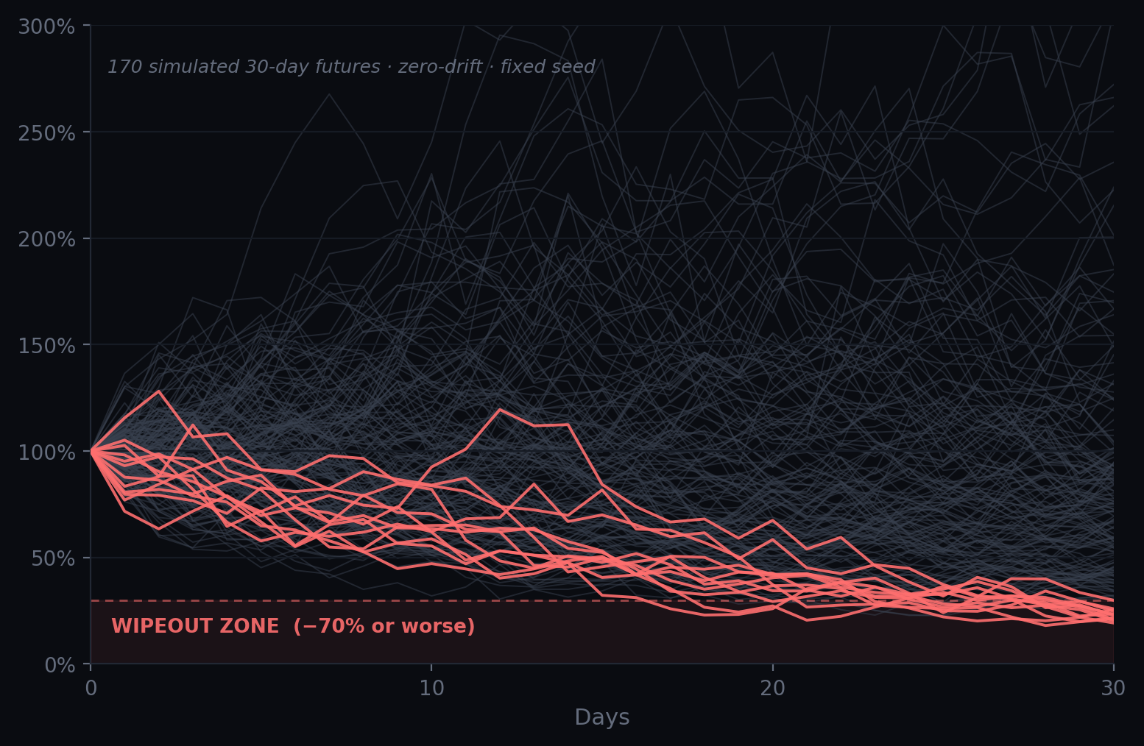
THE BLIND SPOT
Your risk isn't one line. It's all of them.
1 in 11
of simulated 30-day futures for a leveraged retail portfolio end in near-total wipeout — a fall of 70% or more.
Illustrative · 10,000-path zero-drift Monte Carlo · fixed seed · high-risk portfolio
VEYLIX 03 / 21

Slide 4

THE INFORMATION GAP
Institutions manage uncertainty. Retail just hopes.
INSTITUTIONS HAVE
RETAIL HAS
Monte Carlo simulations
Scenario & stress analysis
Hedge ratios & beta targeting
Drawdown & Value-at-Risk models
Real-time risk desks
A price chart
A PnL number
A Discord tip
FOMO
Vibes
Same markets. Wildly unequal tools. Veylix closes that gap.
VEYLIX 04 / 21

Slide 5

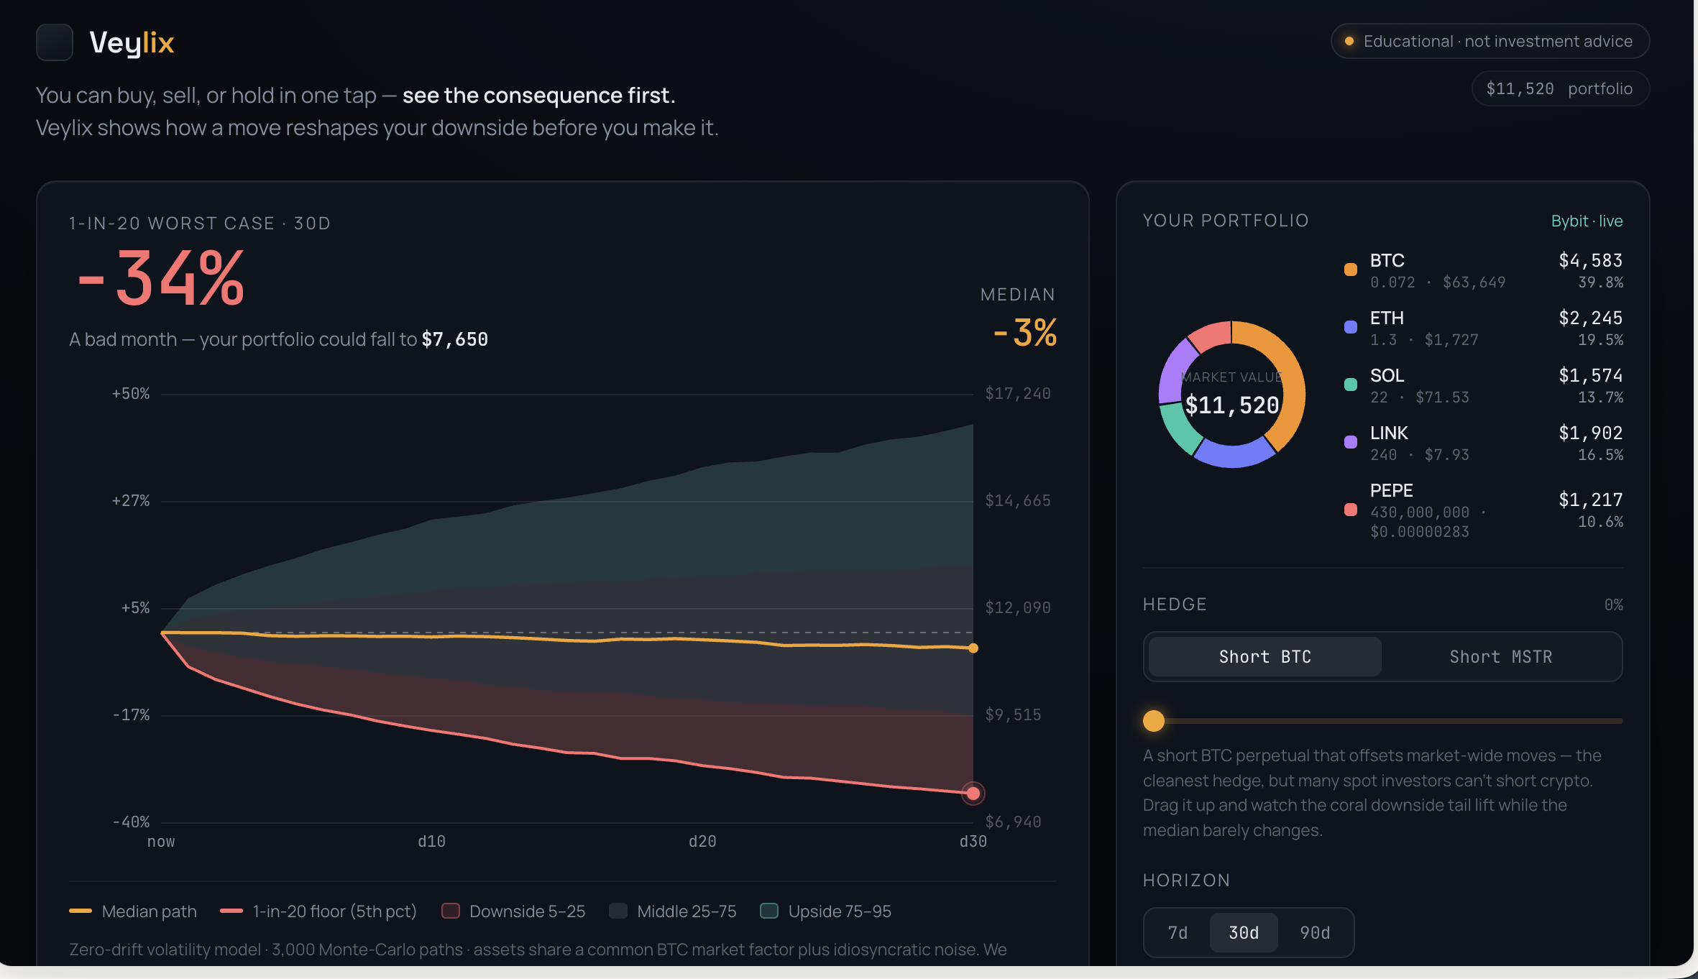



THE PRODUCT
Veylix shows the consequence before the click.
Connect your live portfolio
Real holdings via Bybit — quantities, prices, weights.
Simulate any move
Buy, sell, hold, or hedge — watch the outcome cone reshape live.
Understand it
Every number explained. No advice, no black box, no extraction.
VEYLIX 05 / 21

Slide 6



HOW IT WORKS
Institutional risk math, running in your browser.
1 · Connect
2 · Simulate
3 · Cost the hedge
4 · See & understand
Live portfolio pulled from Bybit (on-chain wallets next).
3,000-path Monte Carlo + Value-at-Risk. BTC factor + idiosyncratic noise. Zero-drift — risk, not prediction.
Real Bybit funding rates price what a hedge actually costs you.
The outcome cone + an AI layer explaining every number in plain language.
Meaningful Bybit use: live holdings + funding-rate data = the true, current cost of hedging your portfolio — not a guess.
VEYLIX 06 / 21

Slide 7


WHAT MAKES IT DIFFERENT
Honest by design.
Pre-trade, not post-mortem
Explainable, not black-box
Education, not advice
Risk before you act — not PnL after the damage is done.
Every number traced to its driver. Methodology on screen, fixed-seed reproducible.
Surfaces risk, never recommends. No custody, no execution, no extraction.
We don't predict prices — we make downside legible. Prediction is what burns retail; clarity is what protects it.
VEYLIX 07 / 21

Slide 8

LANDSCAPE
Nobody gives retail forward-looking risk.
Capability | Veylix | CoinStats | Zerion | Bybit calc | Aladdin
Live portfolio · your account | ✓ | ✓ | ✓ | ~ | ✗
Forward outcome cone (MC) | ✓ | ✗ | ✗ | ✗ | ✓
Portfolio tail risk · VaR | ✓ | ✗ | ✗ | ✗ | ✓
Interactive hedge + live cost | ✓ | ✗ | ✗ | ✗ | ~
Plain-language explainer | ✓ | ✗ | ✗ | ✗ | ✗
Reproducible / inspectable | ✓ | ✗ | ✗ | ~ | ✗
Built for retail | ✓ | ✓ | ✓ | ✓ | ✗
Price | Free | $9.99/mo | Free | Free | Enterprise
Grounded in the market: trackers (CoinStats, Zerion, Delta) show holdings and past P&L; Bybit's calculator prices one position; forward portfolio risk lives only in institutional engines like Aladdin. Veylix is first to bring it to retail — live, explained, free.
VEYLIX 08 / 21

Slide 9



DEFENSIBILITY
Why this compounds.
A trust brand
An integration network
“Honest by default” is structurally hard for volume-driven incumbents to copy — their model depends on you trading more.
Embedded in exchanges and wallets, each integration becomes distribution other tools can't reach.
A risk-literacy flywheel
Verifiable methodology
Education → community → engagement → data that sharpens the models.
On-chain, reproducible risk runs (roadmap) turn transparency into proof — a credibility moat.
VEYLIX 09 / 21

Slide 10


BUILT-IN, NOT BOLTED ON
Ethics, privacy & safety.
Read-only by design
No custody, ever
Your data stays with you
Connects to Bybit read-only. Veylix can never place a trade or move your funds.
We never hold your assets, keys, or balances. Nothing to seize, nothing to hack.
The simulation runs client-side — your portfolio never leaves your browser.
Reproducible & auditable
No advice, no predictions
GDPR-aligned by default
Fixed-seed math, assumptions on screen. Same inputs, same outputs — every time.
Surfaces risk; never recommends. Models dispersion, not future returns.
Minimal data, clear purpose. No third-party ad use, no resale.
VEYLIX 10 / 21

Slide 11
IMPACT · SUSTAINABLE DEVELOPMENT GOALS
Built for impact.
SDG 10
SDG 8
SDG 4
~80%
741M
1 in 20
OF LEVERAGED RETAIL TRADERS LOSE MONEY
CRYPTO OWNERS EXPOSED TO VOLATILE RISK
THE WORST CASE, FINALLY MADE VISIBLE
Reduced Inequalities
Decent Work & Growth
Quality Education
Retail gets the same pre-trade risk visibility institutions have — closing the asymmetry.
Seeing and limiting avoidable, leverage-driven losses builds a healthier market.
Education, not advice — every number explained. Risk literacy before the trade.
We're not rewarding the biggest bet. We're building a fairer system — the one institutions kept to themselves.
VEYLIX 11 / 21

Slide 12
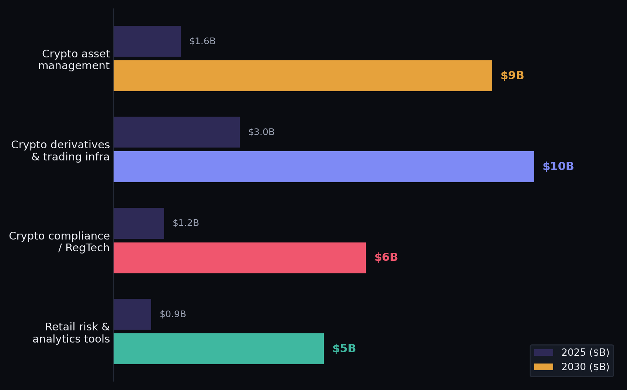
MARKET — THE OPPORTUNITY
A multi-billion-dollar convergence.
THREE FORCES, ONE MOMENT
$30B+
Combined TAM by 2030 across adjacent crypto markets
~30%
Crypto asset-management CAGR to 2030
741M
Crypto owners exposed — and ~80% lose money. Plus MiCA & FCA forcing transparency now.
Crypto asset management: Fortune Business Insights / Grand View, 2025. Adjacent segments illustrative estimates.
VEYLIX 12 / 21

Slide 13

GO-TO-MARKET
Land where the risk already lives.
01
02
03
04
Beachhead
Wedge
Channels
Expand
Launch on Bybit — live data + an 80M-user base, and our hackathon partner.
A free risk lens on the account you already have. Zero switching cost.
Crypto communities (X, Discord, Reddit), risk-literacy content, exchange & wallet partnerships.
Multi-exchange + on-chain wallets, risk alerts, then B2B embeds.
The motion: a free risk lens wins retail at zero switching cost → usage proves the value → platforms license the layer they can't build themselves. Acquisition is free; revenue is B2B.
VEYLIX 13 / 21

Slide 14
PRICING
Free for retail. No subscription.
ALWAYS FREE
FREE
PLUS
TEAM + API
ENTERPRISE
$0 forever
$49 once
Usage
Custom
Retail — curious & active
Power retail traders
Prop desks · DAOs · devs
Exchanges · funds · banks
Full risk lens — cone, hedge, explainer
Live portfolio: Bybit + on-chain
Unlimited use, no caps
Investor archetypes
Advanced Monte Carlo: custom params + stress tests
Multi-portfolio + red-flag history
PDF / CSV exports
One-time — own it forever
Risk-run API — priced per run
Multi-connection + custom archetypes
No seats, no monthly fee
Scales with usage
Embed / license the engine
White-label + audit logs
MiCA / FCA compliance pack
SLA + dedicated support
Retail free forever — no subscription. Power unlocks once; teams & platforms pay by usage or licence. We never take a cut of your trades. · Indicative pricing.
VEYLIX 14 / 21

Slide 15
REVENUE MODEL & THE ASK
Multiple revenue streams. One free wedge.
FREE
for retail, forever
3
revenue streams
£50k+
per exchange licence
0%
cut of your trades, ever
Retail SaaS
Free → £49 once
Full risk lens, free forever
Owns the default; builds the data
Exchange white-label
£50k+ licence + usage
Embed the engine; protect users
API + licence fees, MiCA-ready
Developer API
Usage-based
Per-run pricing, no seats
Risk-as-a-service; scales with use
The motion: free retail wins distribution at zero switching cost → usage proves the value → platforms license the layer they can’t build. Acquisition is free; revenue is B2B. The raise: pre-seed to ship on-chain proofs + multi-exchange + the B2B layer.
VEYLIX 15 / 21

Slide 16
WHY NOW
The window is open now — and closing fast.
Regulation is forcing it — now
Demand is peaking right now
MiCA is in force across the EU today; the UK's FCA crypto regime lands in 2026. Both demand transparency and responsible-trading tools right now — post-FTX, honest risk tooling is no longer optional.
Retail derivatives participation stays massive, and ~80% lose money. Appetite for non-extractive, honest risk tooling is at a high.
The tech just became free
The gap is open — for now
Client-side Monte Carlo now runs 3,000 paths live in the browser — sophisticated risk visualisation, zero backend.
No tool combines live portfolio + probabilistic cone + interactive hedge + non-advice. The white space is real, unclaimed — and the first mover sets the standard.
VEYLIX 16 / 21

Slide 17

ROADMAP
From risk lens to risk layer.
NOW · LIVE MVP
shipped
Live Bybit portfolio + the outcome cone
BTC / MSTR hedge priced by real funding rates
Explainable Monte Carlo · non-advice
1
NEXT · ON-CHAIN
Q3 2026
2
WalletConnect — on-chain wallets
Risk flags: liquidity, concentration, rug
Risk-alerts / monitoring agent
THEN · PLATFORMS
Q4 2026
Multi-exchange coverage
B2B embed / license + usage API
White-label risk layer for platforms
3
LATER · EXECUTION
2027
4
Non-custodial, self-directed hedge execution
On-chain auditable runs (Walrus / Sui)
Embeddable SDK for any app
VEYLIX 17 / 21

Slide 18
HOW WE BUILT IT
No backend. No black box.
The data contract
The simulation
The stack
A frozen v1 JSON contract — per-asset beta, idiosyncratic vol, BTC factor vol, carry — plus Bybit wallet-shape portfolios. Engine produces it; the frontend consumes it.
veylix-sim.js: a single-factor, zero-drift dispersion model. ~3,000 paths, fixed seed (0x5EED5). Same inputs always reproduce the same numbers.
Client-side by design — no backend, no server to trust. The model runs in the browser, so anyone can open it and verify the math. quant_engine → frontend.
model v1 · frozen schema
3,000 paths · fixed seed
0 backend · 100% client-side
Verifiable, not trusted: the math lives in the page — anyone can open it, re-run it, and get the identical result.
VEYLIX 18 / 21

Slide 19
AGAINST THE RUBRIC
How Veylix scores.
CRITERION | HOW WE HIT IT
BGA ethos · 20 | Institutional Monte Carlo for retail; reduces information asymmetry; no advice, no extraction.
Innovation & tech · 20 | Novel AI for transparency, not prediction; Monte Carlo + VaR; deterministic, client-side by design; meaningful Bybit use — beyond a thin wrapper.
Strategy & risk · 15 | Zero-drift — nothing to overfit; read-only — no execution or runaway; surfaces drawdown, volatility & liquidation risk.
Transparency · 15 | Every number explained; methodology on screen; fixed-seed reproducible; on-chain runs (roadmap).
Real-world impact · 10 | A real, costly problem; connects live accounts; accessible to non-institutions.
Accessibility & UX · 10 | One screen, dark and legible; complex risk made simple.
Execution & demo · 10 | Working MVP on live Bybit data; the hedge-drag demo moment.
Also built for Solvimon · business: a real company — clear customer, validated problem, sensible monetisation (slides 7–11).
VEYLIX 19 / 21

Slide 20
THE PEOPLE BEHIND IT
Our team.
T
A
R
J
L
P
Terry
Ashish
Raj
Jia
Lilian
Patti
Product Manager
Tech Lead
Tech Advisor
Tech Advisor
Tech Advisor
UX & Design Lead
Product & vision
Architecture & build
+ core contributor
Engineering
Engineering
Research & strategy
VEYLIX 20 / 21

Slide 21

TRY IT — LIVE IN YOUR BROWSER
SCAN ME
Try it.
Right now.
See your real downside on your own portfolio — free, in your browser. No signup.
01 Connect your wallet
02 See your worst case
03 Hedge it in one move
team-veylix-r656.vercel.app
Free · No signup · Works on mobile
Veylix — see the consequence first.
BUILT BY TEAM VEYLIX · TERRY · ASHISH · RAJ · JIA · LILIAN · PATTI · GITHUB.COM/TERRYTRL100/TEAM-VEYLIX · MIT

