Slide 1

Focus on Your Content, Not on Ingesting Your Content
Terry Brady
Applications Programmer Analyst
Georgetown University Library
twb27@georgetown.edu
https://github.com/organizations/Georgetown-University-Libraries

Slide 2
Goals of our Repository Managers
Create new collections
Grow collections
Accurately describe collection contents
Showcase our repository content

Slide 3
Our story
Using simple tools to facilitate these goals

Slide 4
Imagine that you have content to load into your repository

Slide 5


Scenario: One Item to Add to DSpace

Slide 6
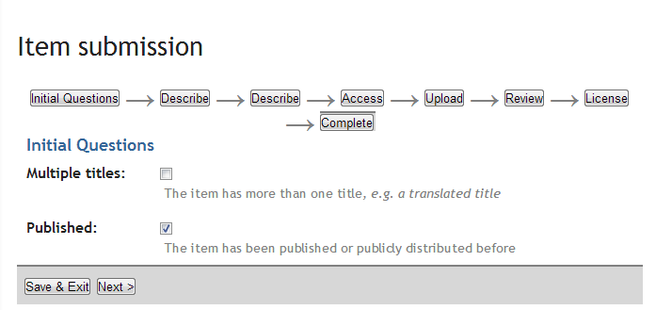
One Item to Add: Item Submission
Click through 7 item submission screens authoring metadata as you go

Slide 7
Scenario: Three Items to Add to DSpace

Slide 8
Three Items to Add: Item Submission
Click through 3x7 item submission screens authoring metadata as you go

Slide 9
Scenario: 50 newspaper issues to add to DSpace (very similar metadata)
50 Items

Slide 10
50 Items to Add: Individual Item Submission is impractical

Slide 11
Next Option
DSpace Bulk Ingest Process

Slide 12
DSpace Bulk Ingest
50 Items

Slide 13





Ingest Folder
Media File
Thumbnail (optional)
Contents File
Metadata File
License File (optional)

Slide 14
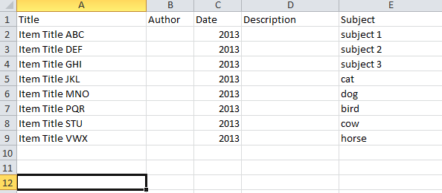
Bulk Ingest:
Build a Metadata Spreadsheet
50 Items

Slide 15
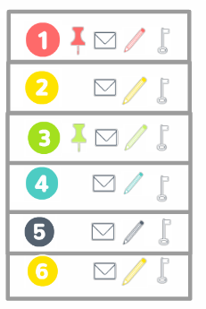
Bulk Ingest:
Build Ingest Folders
50 Items

Slide 16
Bulk Ingest: For Each Item
Copy Item to Folder
50 Items
.PDF

Slide 17
Bulk Ingest: For Each Items
Create a unique Contents File
50 Items
.PDF
.TXT

Slide 18
Bulk Ingest: For Each Items
Create a Dublin Core File
50 Items
.PDF
.TXT
.XML

Slide 19
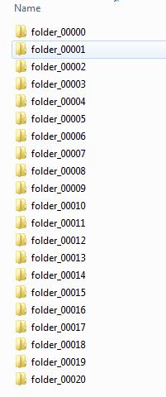
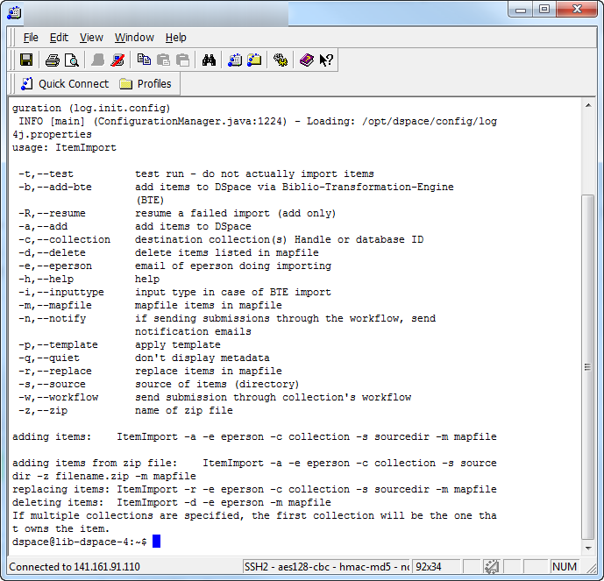
Bulk Ingest:
Initiate Import from a Terminal Window
50 Items
.PDF
.TXT
.XML

Slide 20
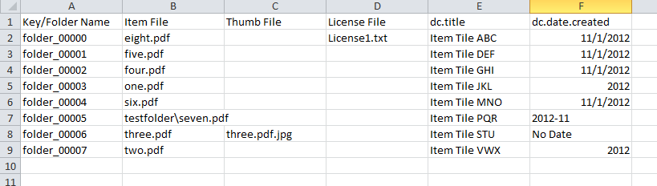
Bulk Ingest: For Each Items
Create a Dublin Core File
50 Items
.PDF
What if you make a mistake?
.TXT
What if you need to refine the metadata?
.XML

Slide 21
The Challenge
Want to grow the collections
But, the ingest process is daunting

Slide 22
The conversation focused on HOW to ingest the content
Rather than on the content itself

Slide 23
Our Approach

Slide 24
Our Approach:
Empower Content Owners
Automate the tedious tasks
Make metadata entry the focus of the effort
Hide the command line from content owners

Slide 25
Our Approach:
Simple Tools
Work around the tedious steps
Without constructing a complex workflow

Slide 26
Our Tools
File Analyzer
Desktop Application for File System Traversal
DSpace QC Tools
Web application for Batch Process Submission
Both of these tools are available on GitHub
Georgetown-University-Libraries

Slide 27
File Analyzer
Desktop Application for File Processing

Slide 28
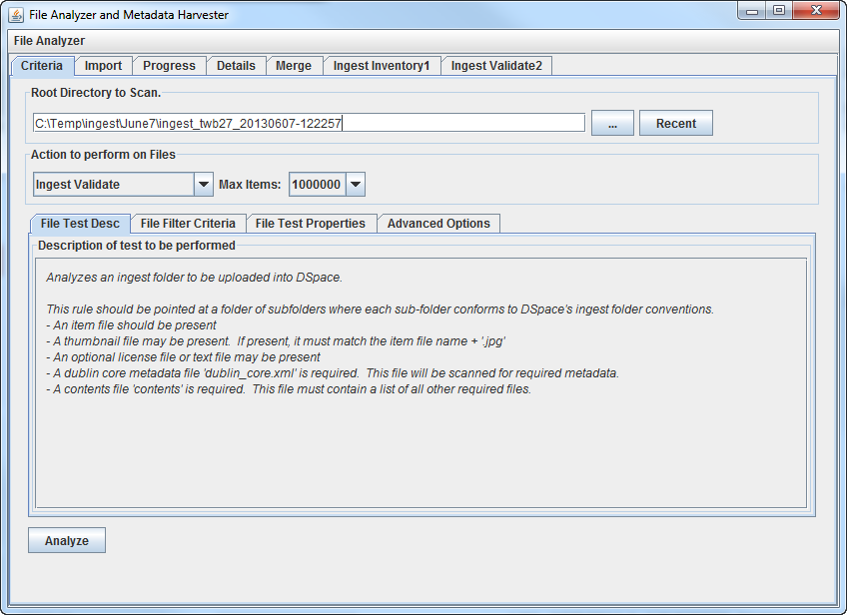
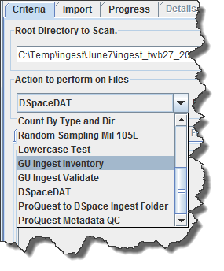

Slide 29
What we need
50 Items

Slide 30
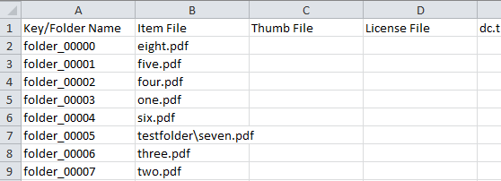
Step 1: Automatically Generate an Ingest Inventory based on existing files
50 Items

Slide 31
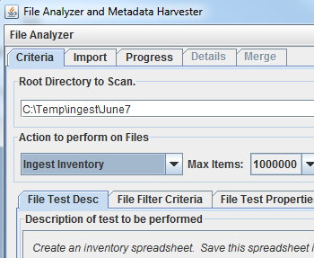

Slide 32
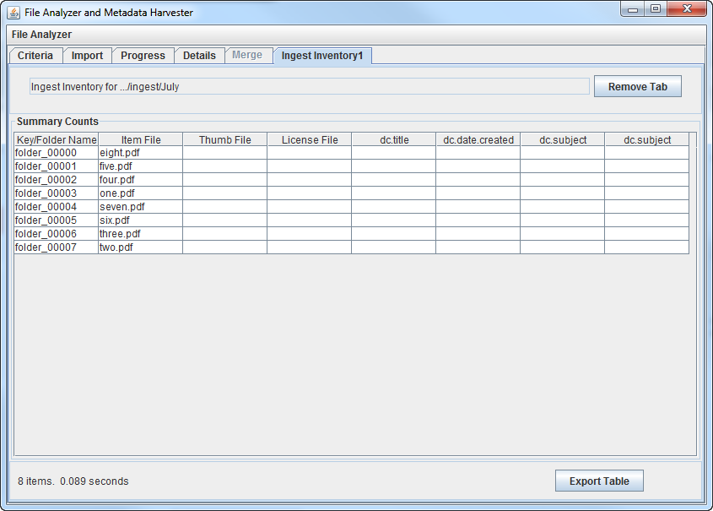
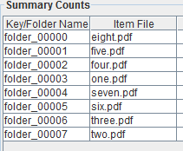
Export the Generated Inventory

Slide 33
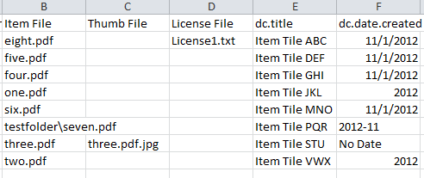
Step 2: Edit the Ingest Inventory as a Spreadsheet

Slide 34
Step 3: Generate the Ingest Folders from the Inventory Spreadsheet
Generate Contents File
Generate Dublin Core Metadata File
Include custom thumbnails if applicable

Slide 35
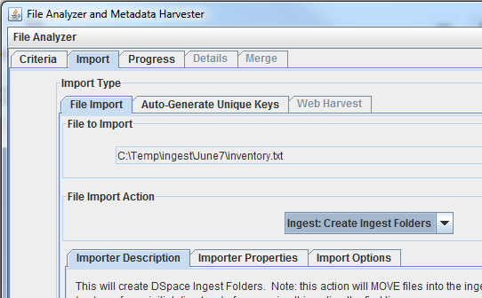

Slide 36
Create Ingest Folders
An error message will appear if files are missing (or misspelled)
Process can be rerun if the metadata spreadsheet needs to change

Slide 37
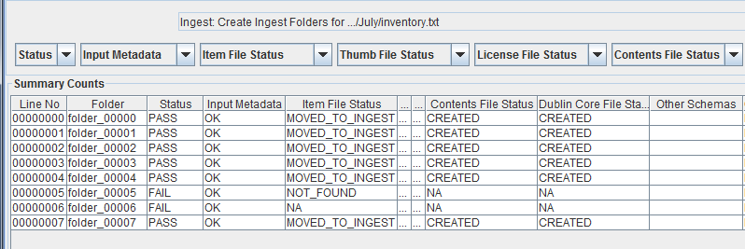
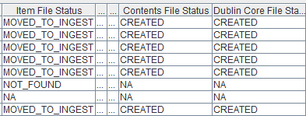
Ingest Folder Creation Report

Slide 38
Step 4: Validate Ingest Folders
Identify Missing Files
Required Metadata
Validate Files
Contents
Dublin Core

Slide 39
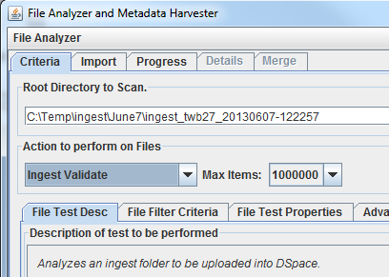

Slide 40
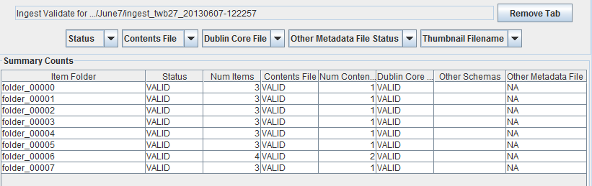
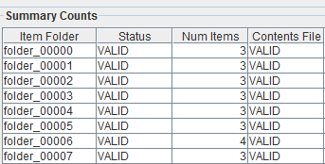
Validation Status Report

Slide 41
Step 5: Move Ingest Folders to Server and Initiate Bulk Ingest

Slide 42
Web Tools
for Batch Process Submission

Slide 43
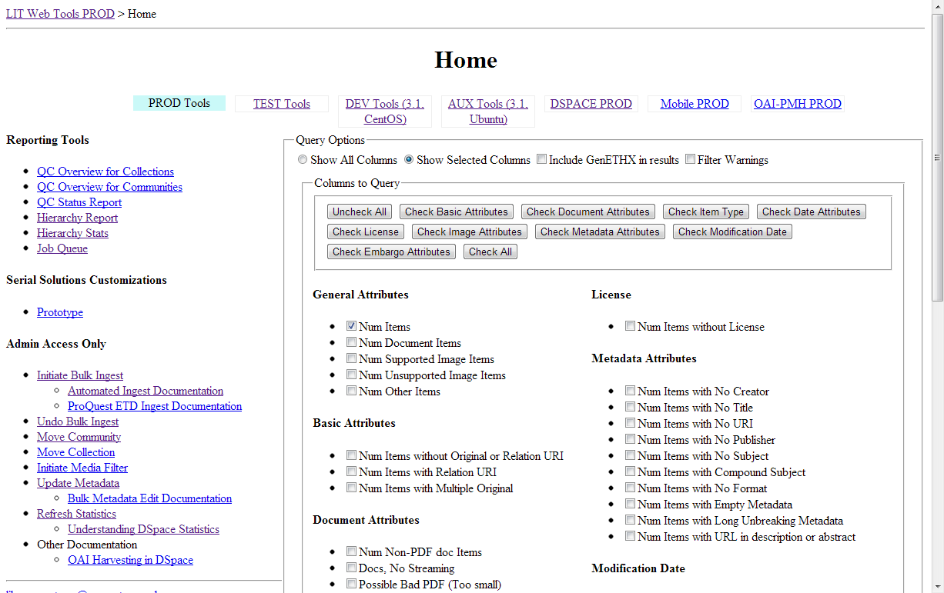

Slide 44
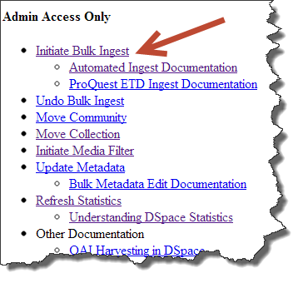
Web Tools,
Tutorials co-located with tools

Slide 45
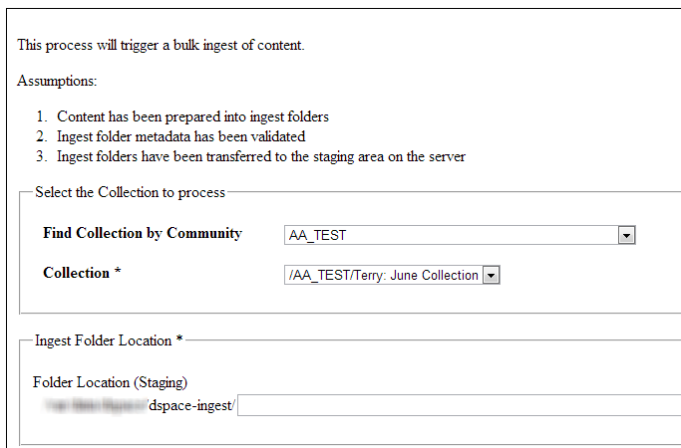
Collection
Folder Location

Slide 46
Processes run by Bulk Ingest
import
filter-media [collection]
update-discovery-index
oai-import
stats-util
Content is visible, searchable, and thumbnails are present!

Slide 47
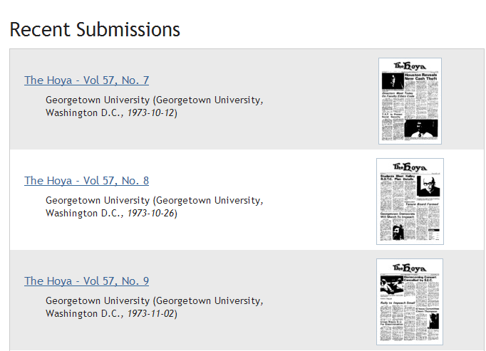

Slide 48
Results
Empowered Librarians
Iterative metadata refinement
At the right point of the workflow
Significant growth in repository content
Decreasing IT involvement
Rapid development of support tools

Slide 49
Derived Tools
Generate Ingest Folders for ProQuest ETD's
Filter Media

Slide 50
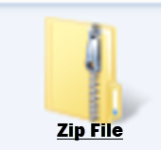
Ingest ETD's from ProQuest

Slide 51
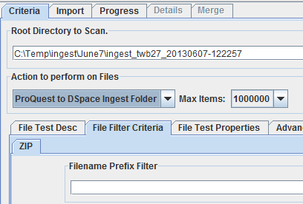
ProQuest ETD Ingest Rule

Slide 52
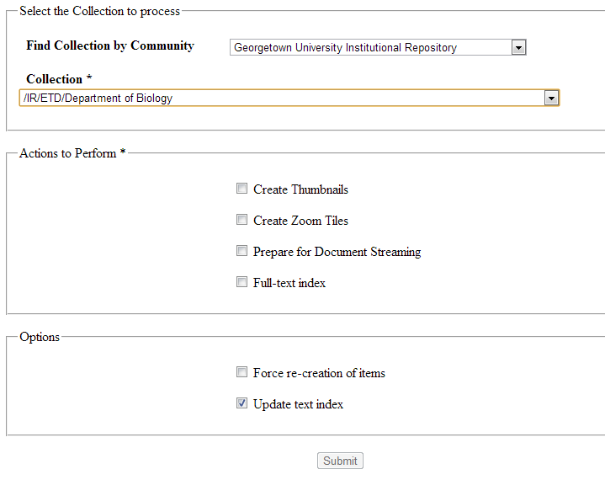
Filter Media Tool
for Items Submitted One by One
Collection
Filter Media Tasks
Re-index?

Slide 53
Benefits
Companion tools easy to learn
Users are very comfortable with them
De-mystify DSpace-specifics
Users trained other users!

Slide 54
Other Tools Created
Automation
Undo Bulk Ingest
Update Metadata
Move Community/Collection
Reporting
Data Quality Reports
Statistics Reports

Slide 55
More Tools (time permitting)

Slide 56
Data Quality Reports
Items with multiple media files
Non-PDF Document Items
Items missing a Thumbnail
"Non-standard" Media Types
Items modified last 30 days
Items with Embargo
Items missing a metadata field
Item metadata containing a URL

Slide 57
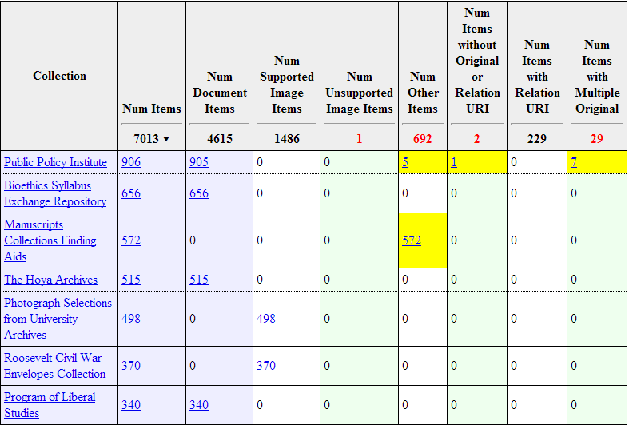
Collection QC Report

Slide 58
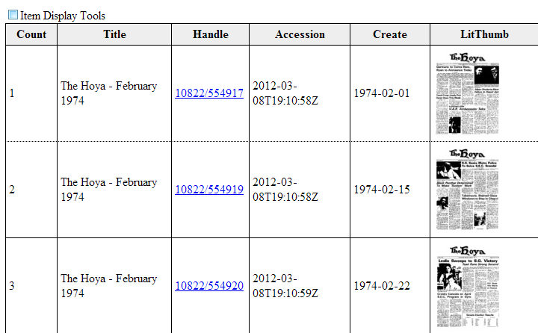
Item QC Report

Slide 59
Usage Statistics Reports
Not confident in the out of the box reports
Wanted to understand underlying data
Filter Stats
On campus
Within the library

Slide 60
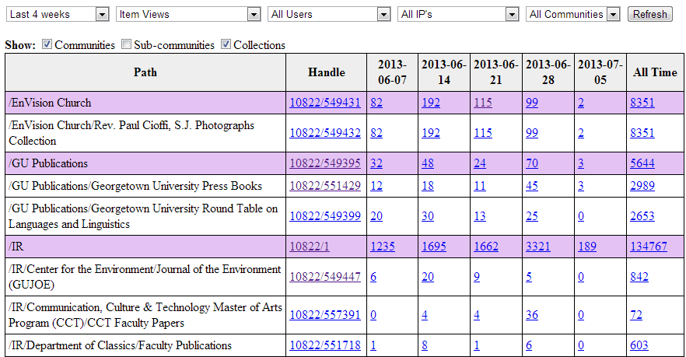

Slide 61
Try it yourself
GitHub: Georgetown-University-Libraries
File Analyzer & Metadata Harvester
Just need a Java Compiler
Contains several utilities for digitization workflows
Links to tutorials
DSpace QC Tools
PHP Code
Sample code, not ready to run
Links to tutorials
Please let me know how these work for you!

Slide 62
Terry Brady
Applications Programmer Analyst
Georgetown University Library
twb27@georgetown.edu
https://github.com/organizations/Georgetown-University-Libraries

