Slide 1

Driving Change with Interactive Admin Tools for DSpace
Terry Brady
terry.brady@georgetown.edu
https://github.com/terrywbrady/info

Slide 2
https://github.com/terrywbrady/info
Sample Code
Pull Request
Video Demonstration of Prototype

Slide 3
Overview
What QC/Report tools exist in DSpace?
What we built at Georgetown
Impact of those tools
Proposed Integration of this functionality into DSpace

Slide 4
What QC/Report Tools exist in DSpace?

Slide 5
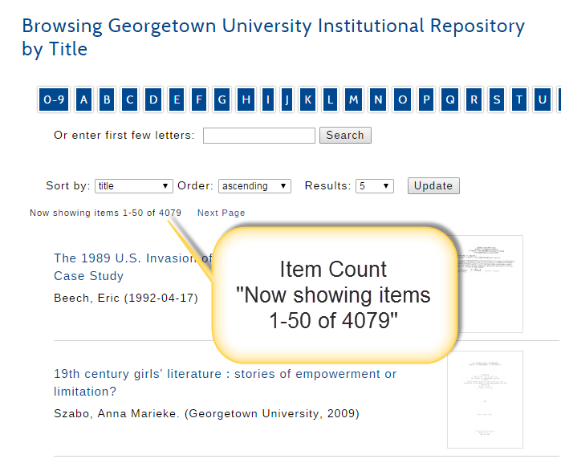
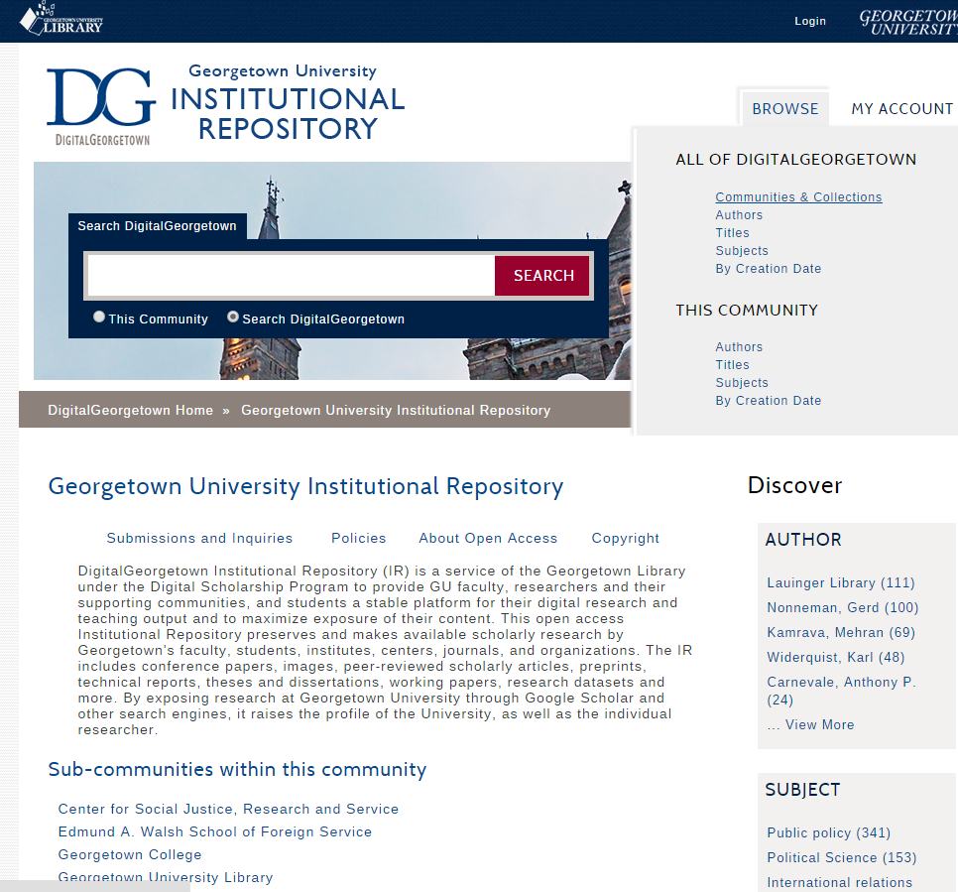
Existing tools: Browse & Navigate
Facet Counts

Slide 6
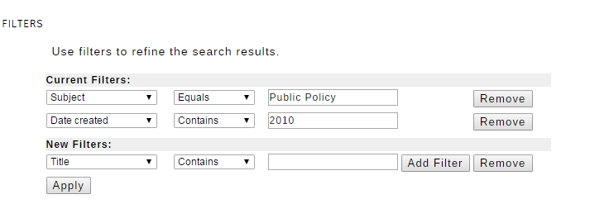
Existing Tools: Advanced Search
Compose a complex query
searching multiple metadata fields
Provided a filter exists for the field of interest.
Note: some filters search multiple fields at once

Slide 7
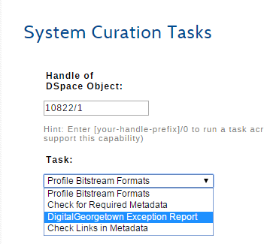
Existing Tools: Curation
Benefits
Can be launched at a repository, community, collection, or item level
Can be queued if resource intensive
Limitations
No parameters
Text only output
No output from queued task

Slide 8
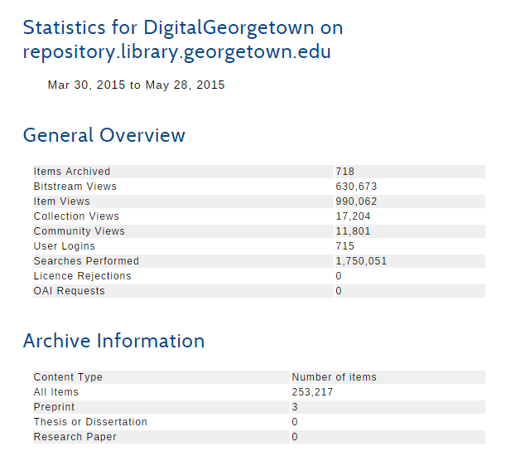
Existing Tools: Usage Reports
Available at repository, community, collection and item level
Limitations
Item/bitstream counts do not roll up to collection
Cannot filter usage records
by IP

Slide 9
Google Analytics for DSpace?
No awareness of DSpace collection hierarchy

Slide 10
Our QC (Quality Control) Reports

Slide 11
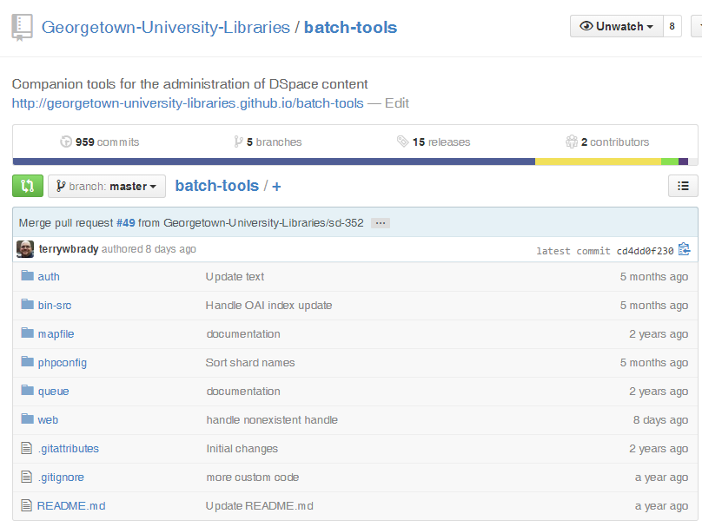
Our Initial Solution: PHP Tools with Read Only Access
Access restricted to library staff.
https://github.com/Georgetown-University-Libraries/batch-tools

Slide 12
QC Report: Collection Item Counts

Slide 13
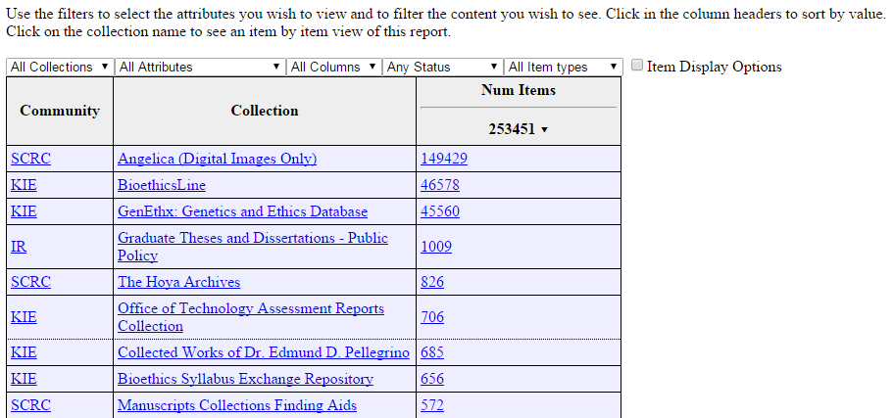
Our QC Reports: Item Counts by Collection
Item Count for a Collection
(Links to a list of items)

Slide 14
QC Report: Filter By Use Case

Slide 15
Our QC Reports: Filter by Use Case
Filter by interesting use cases
private item
has embargo
item has link to media streaming service

Slide 16
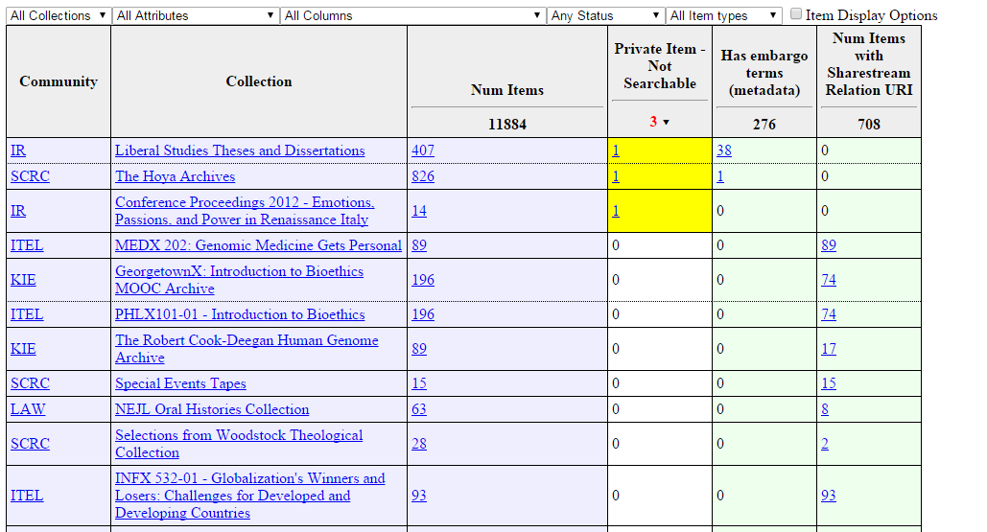
Use cases appear in the header
Links will present a list of items that match the use case for a collection

Slide 17
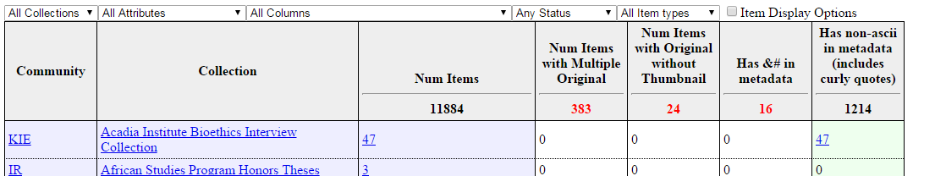
Our QC Reports: Additional Use Cases
Click on a count link to view a list of relevant items
multiple original bitstreams
thumbnail missing
non-ASCII characters in metadata
improper character entity in metadata

Slide 18
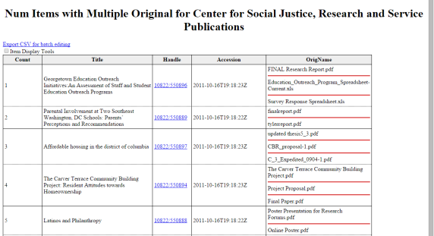
Our QC Reports: Viewing Filtered Results
item title
item handle

Slide 19
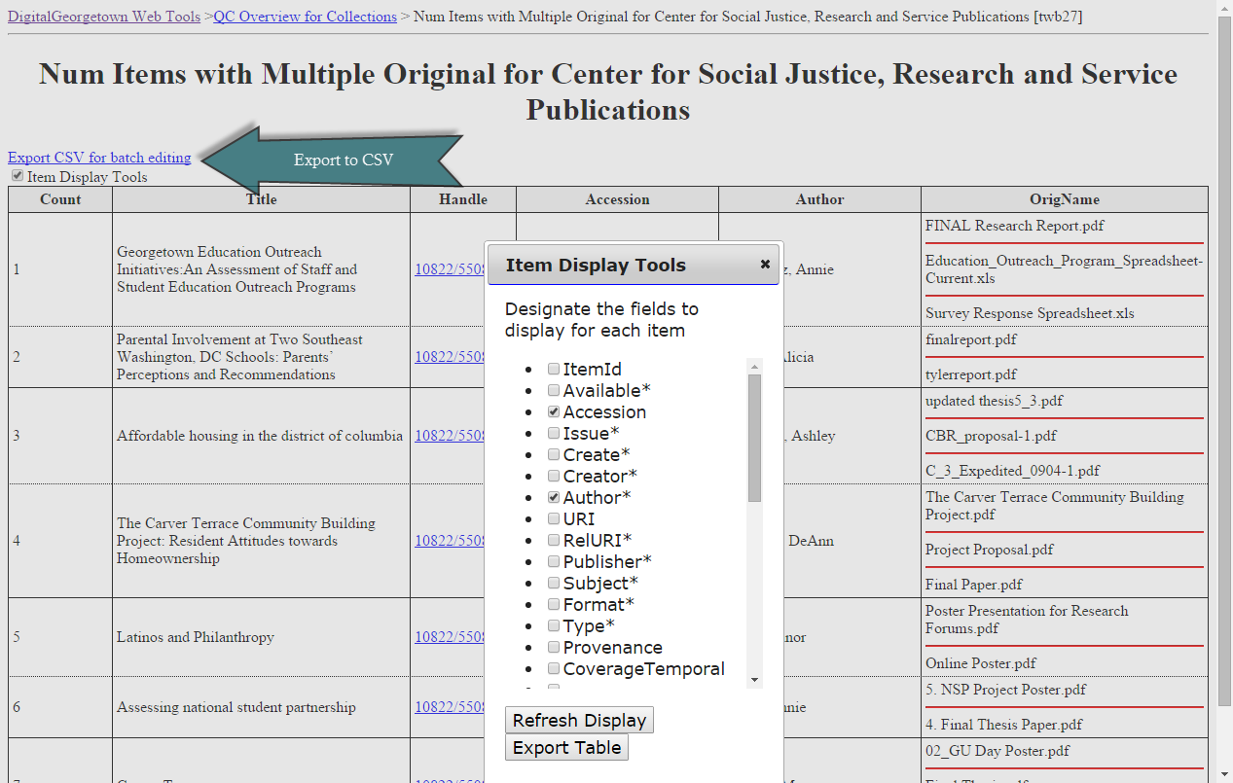
Our QC Reports: Augmenting Results
Select metadata fields to include in report

Slide 20
Our QC Reports: Exporting Results
CSV Export
DSpace Bulk Metadata Edit

Slide 21

Our QC Reports: Examples
Kate Dohe, Digital Services Librarian uses these tools to resolve routine problems
Corrupted character entities from our ETD Provider
Identifying excessively large or unusually small PDF’s
Streamable media requiring companion assets

Slide 22
Our QC Reports: Character Entity Corruption in ETD’s
ETD’s are loaded into 65 collections
Our ETD provider incorrectly escapes non-ASCII characters
After ingest, look for incorrect character entities across the IR community
Generate metadata export file
Use DSpace Bulk Metadata Update to fix

Slide 23
Our QC Reports: Excessively large PDF’s
Look for excessively large PDF’s in IR
Analyze with Acrobat Preflight
Downsample images?
Split PDF for accessibility?
If digitized material, re-generate PDF?

Slide 24
Our QC Reports: Unusually small PDF’s
Harder to resolve
Alert submitter and request new copy
Attempt to fix with Adobe Distiller

Slide 25
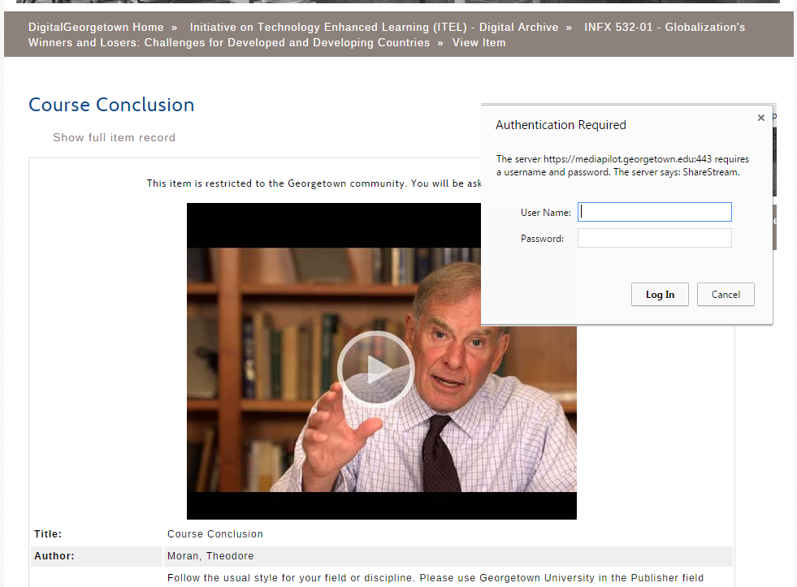
For Streaming Media Requiring Authentication...
Ensure that a relevant image is uploaded with the video

Slide 26
Our Metadata Query Tool

Slide 27
Our Metadata Query Tool: Example
Search IR Community
For items
Publisher starts with Georgetown
Subject exists
Along with the item
Display publisher and subject
Filter
Exclude private and withdrawn items
Item must have an original bitstream

Slide 28
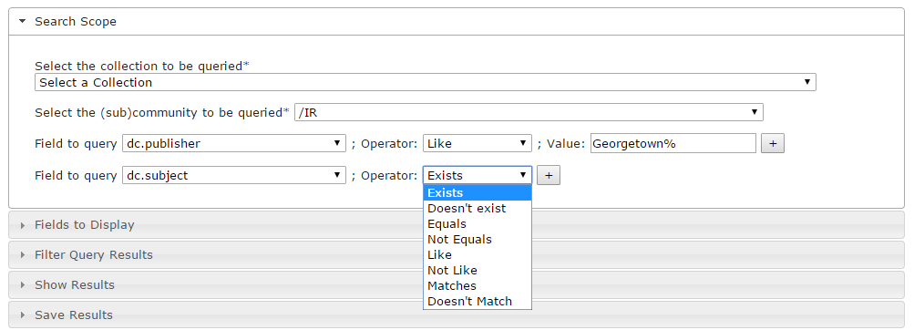
Search the IR
Select IR Community

Slide 29
by publisher and subject
Search operator
Search for “Georgetown”
Search publisher
Search subject

Slide 30
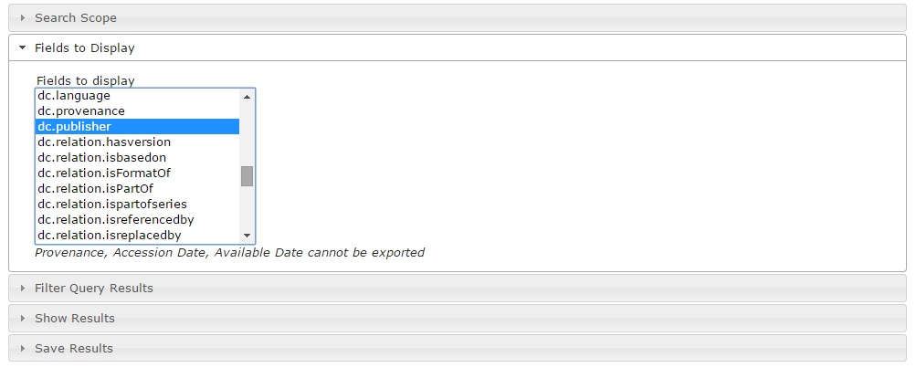
Include publisher and subject in results
Select metadata field(s) to include in report

Slide 31
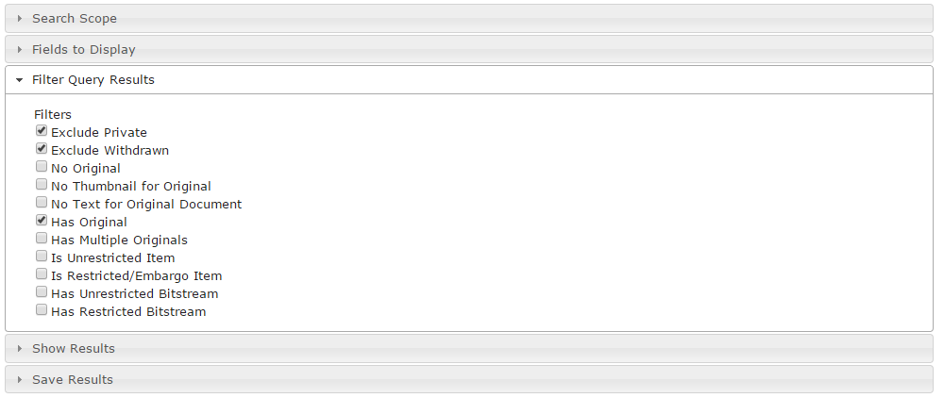
Exclude Private and Withdrawn Items.
Items must have original bitstream
Filter results by common properties

Slide 32
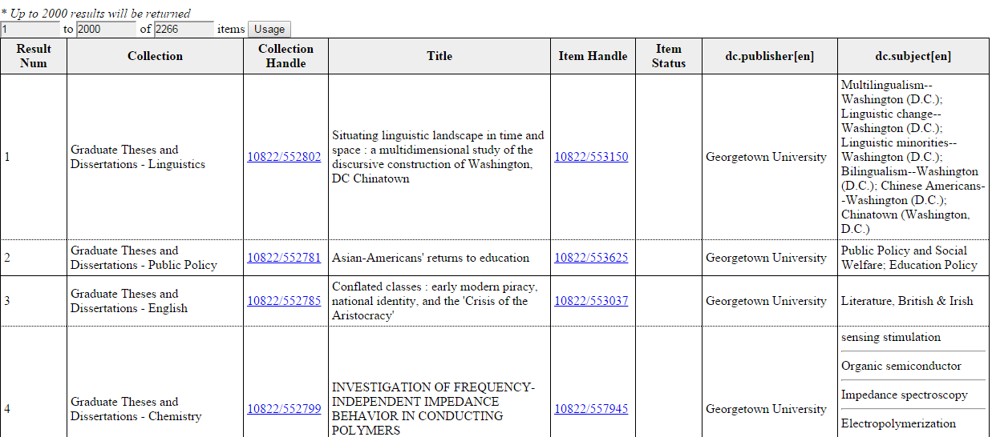
Review Search Results
metadata fields to Include
item results include title and handle

Slide 33
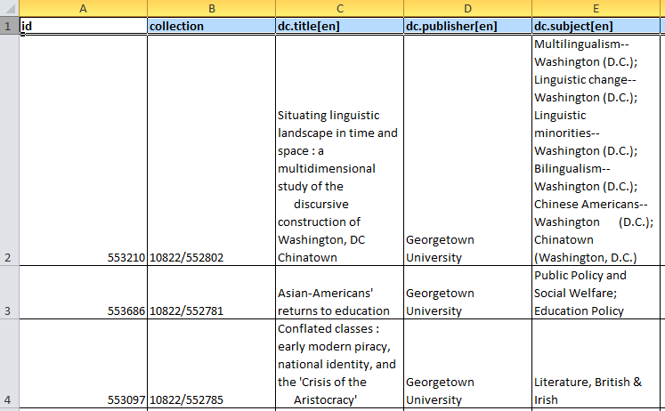
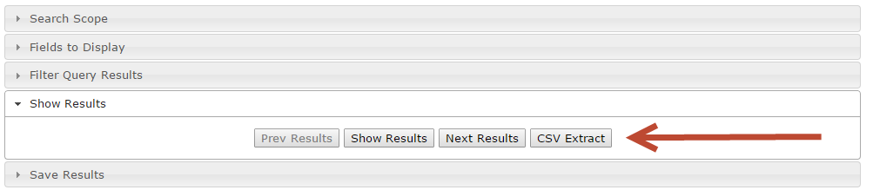
Generate CSV Export
DSpace Bulk Metadata Edit

Slide 34
Our Query Tool: Examples
Kate Dohe, Digital Services Librarian uses these tools to
identify metadata issues that cannot be discovered with the front-end filter tools
precise query
never fail to find an item
bulk metadata enhancement projects
metadata normalization projects

Slide 35
Our Statistics Reporting Tool

Slide 36
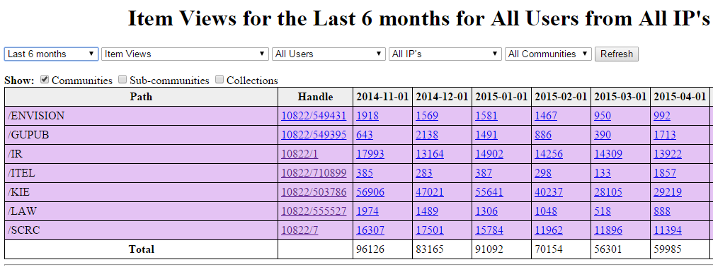
Our Stats Query Tool (PHP)
Filters
Top Level Communities

Slide 37
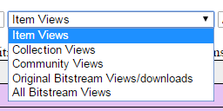
Our Stats Query Tool: Filter By Usage Type

Slide 38
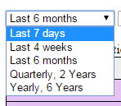
Our Stats Query Tool: Filter By Date Range

Slide 39
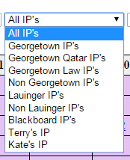
Our Stats Query Tool: Filter By IP
By Campus
Inside/Outside Library
By development team member

Slide 40
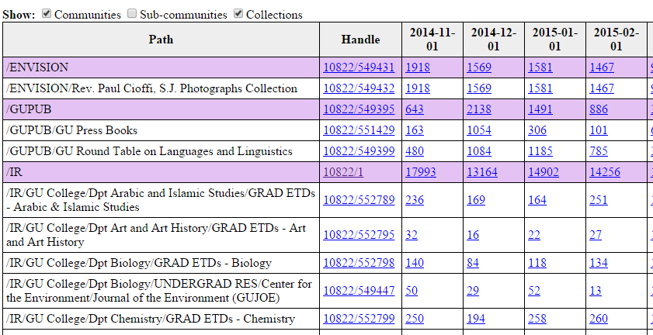
Our Stats Query Tool: Expand Collections
Hierarchy Level
IR Collections

Slide 41
Our Stats Query Tool
Kate Dohe, Digital Services Librarian uses these tools to
Report collection usage
Quarterly and adhoc
View bitstream and item usage at community/collection level
Understand campus vs. non campus traffic
Compare collection usage changes over time

Slide 42
Our PHP Tool: Limitations
Must be maintained locally
PHP Tools have not been successfully shared with other DSpace institutions

Slide 43
Integrating Our Tools into DSpace Core
Prototypes

Slide 44
Integrating Our Tools into DSpace Core
Into the Curation System
Into the REST API

Slide 45
Integration with the Curation System
Prototype

Slide 46
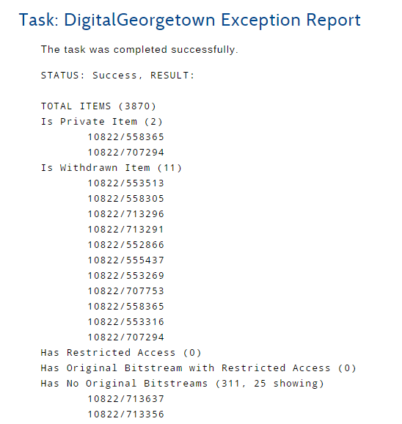
My attempt to write a curation task
List items that may not be visible to a user
withdrawn
private
restricted item
restricted bitstream
no bitstream
Text only output is not persisted
Items are not hyperlinks

Slide 47
Integrate into Curation System
The Curation System would need the following enhancements
Accept input parameters
Present input parameters to the user
Ability to generate HTML, XML, and/or JSON output
Ability to persist output

Slide 48
Integrating Our QC Reports and Query Tool into the DSpace REST API
A Prototype Implementation

Slide 49
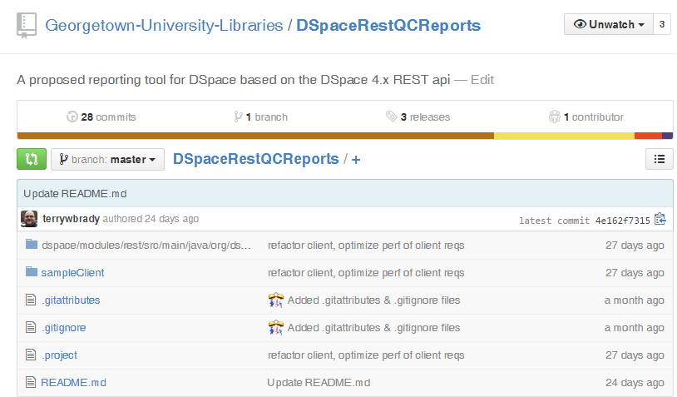
Integrate into the REST API
https://github.com/Georgetown-University-Libraries/DSpaceRestQCReports
https://github.com/DSpace/DSpace/pull/954

Slide 50
Building Tools on the REST API
4 new API Verbs
/filters
/filtered-collection
/metadataregistry
/filtered-items
list filters
get items by filter
list metadata fields
perform item query

Slide 51
QC Report Tool
based on the REST API

Slide 52
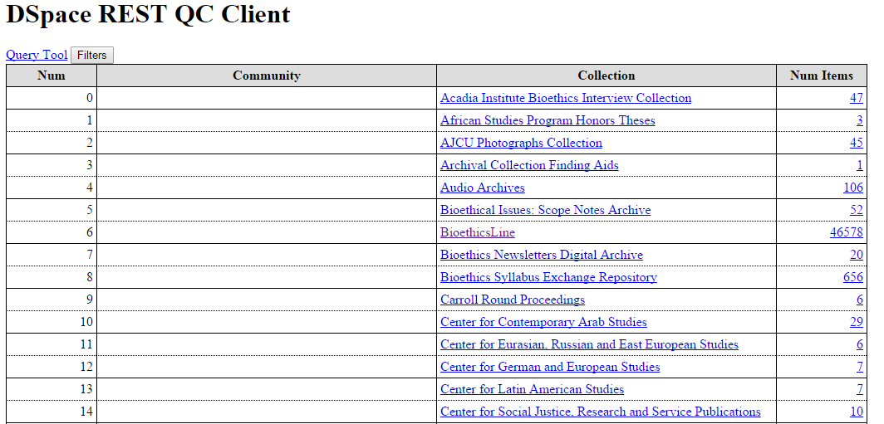
QC Reports (REST): List Collections
/rest/collections
(existing REST verb)

Slide 53
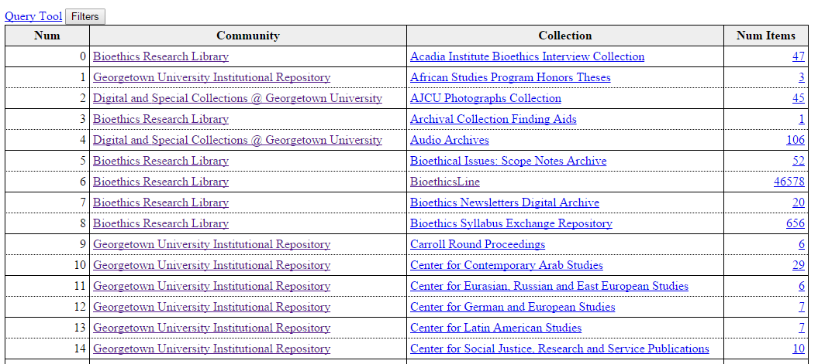
QC Reports (REST): Get Community Name
Run for each collection
/rest/collections/{cid}?expand=parentCommunityList
(existing REST verb)

Slide 54
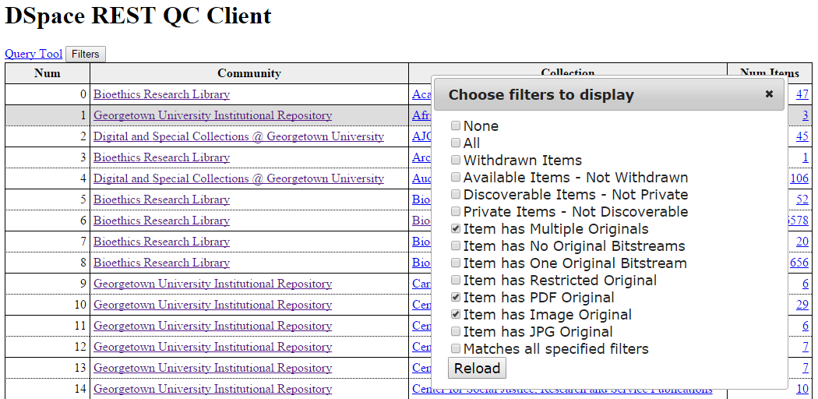
QC Reports (REST): Get Filters
/rest/filters

Slide 55
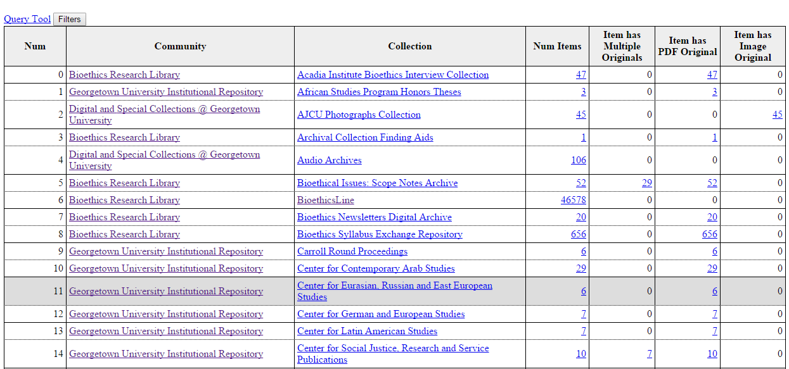
QC Reports (REST): Filter Collections
Run for each collection
/rest/filtered-collections/{cid}?filterString={filter1,...}

Slide 56
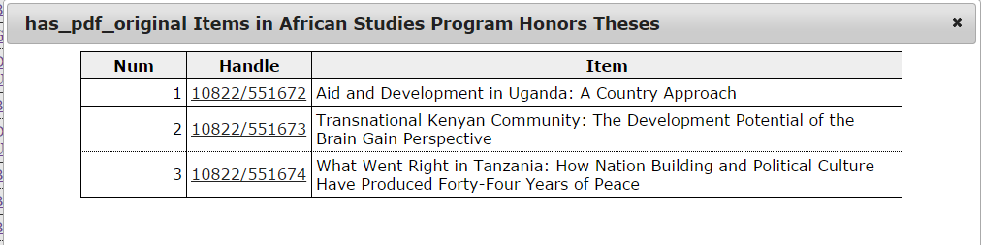
QC Reports (REST): Filter Collection Items
/rest/filtered-collections/{cid}?expand=items&filter={filter}

Slide 57
Metadata Query Tool
based on the REST API

Slide 58
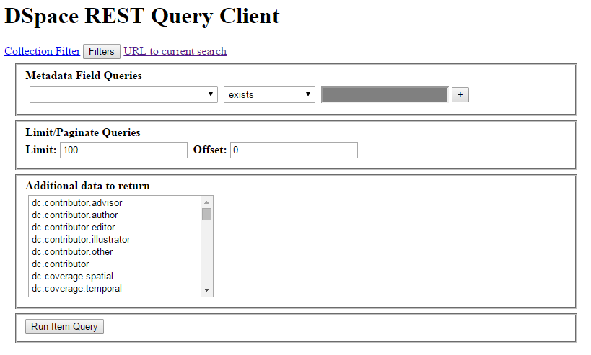
Query Tools (REST): Create Form
/rest/metadataregistry

Slide 59
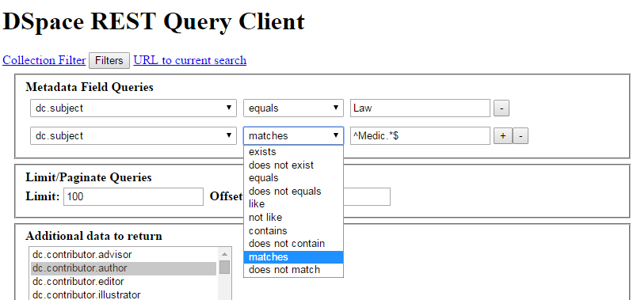
Query Tools (REST): Build Query

Slide 60
Assemble Query Parameters
query_field[]=dc.subject
query_op=equals
query_value=law
query_field[]=dc.subject
query_op=matches
query_value[]=^Medic.*$

Slide 61
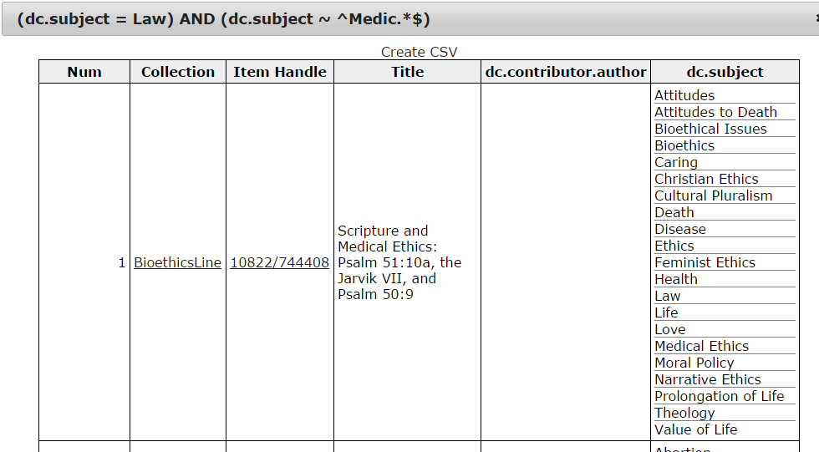
Query Tools (REST): Get Results
/rest/filtered-items?query_field[]=...

Slide 62
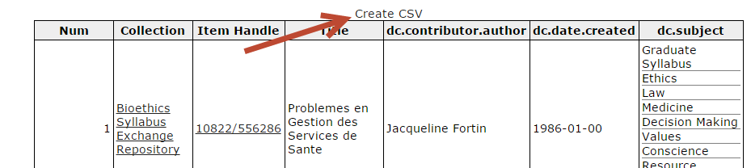
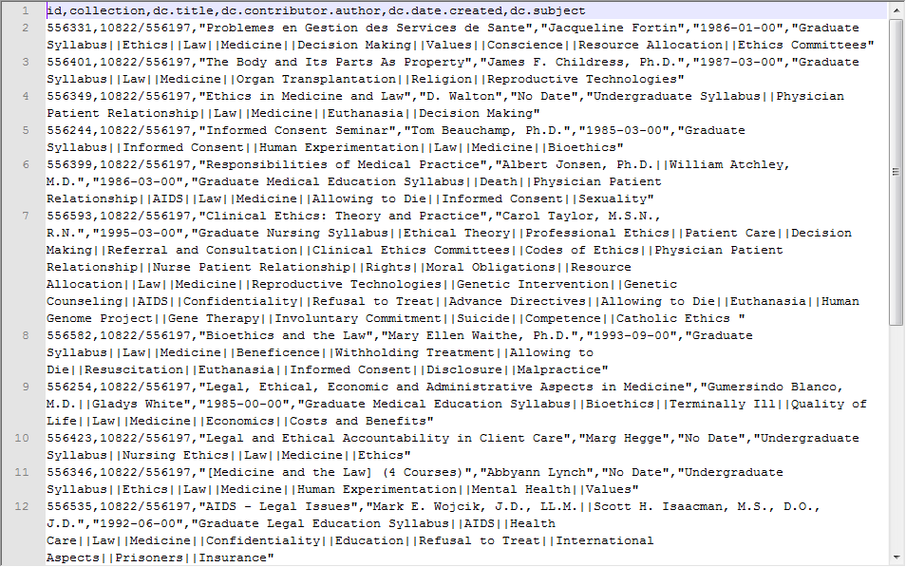
Query Tools (REST): Generate CSV
Input for DSpace Bulk Metadata Edit Process

Slide 63
Statistics Reports
based on the REST API
Not Yet Prototyped

Slide 64
Our Stats Tool in REST API - Not Yet Prototyped
Parameters
Duration:day, month, etc
EndDate
NumDurationToReport
ResourceType: item, collection, etc
IP Include,IP-exclude
Verbs
/community-statistics
/collection-statistics

Slide 65
Deploying Reporting Tools
based on the REST API

Slide 66
Deploying REST Reporting Tools
Add new verbs to REST API
Provide sample client web apps
Reference implementation
HTML and JS
Deployed to the DSpace web server
Determine security for the REST API

Slide 67
Interactive Reporting Tools: Results

Slide 68
Interactive Reporting Tools: Results
Have empowered our collection owners
Driven content enhancements
Uncovered content problems
Saved time
Would be beneficial to other institutions

Slide 69
Interactive Reporting Tools: Evolution
Could be integrated into DSpace
via the curation system
via the REST API (preferred)

Slide 70
Your Thoughts

Slide 71
Your thoughts
Would tools like these be helpful to your institution?
If so, how?
What are your thoughts on
Curation System Integration
REST API Integration
https://github.com/terrywbrady/info

Slide 72
Terry Brady
Georgetown University Library
terry.brady@georgetown.edu
https://github.com/terrywbrady/info

