Slide 1

Integrating the Institutional Repository with the Learning Management System
Terry Brady
terry.brady@georgetown.edu
https://github.com/terrywbrady/info

Slide 2
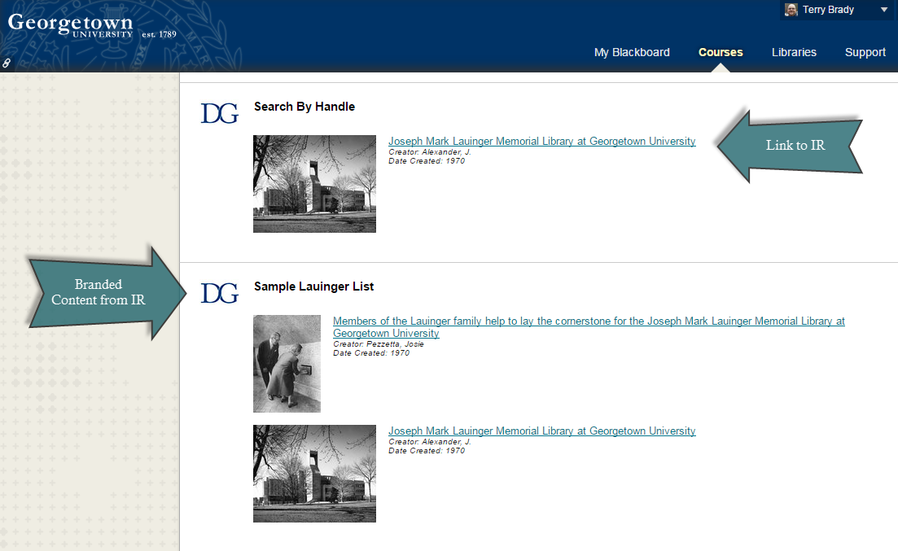

Slide 3
Overview
Legacy system needed retirement
Our repository, DigitalGeorgetown, chosen as target
Challenges introduced by the project
Integration with the Learning Management System
Results

Slide 4
Legacy System for Art Slides
Content
50,000 digitized slides
150,000 item records
Material for instructional use, restricted to university users
250 “Course Sets”
Needed migration
50,000
Images
150,000
Item Records
250 Course Sets

Slide 5
Art Collection impact on the IR
Access control before this project...
No integration with university identity management
No controlled access collections
Scale of Art Collection
300% increase in item count
1000% increase in digital assets

Slide 6

Metadata Mapping
Art Collection data mapped well to IR Item records
Course-specific metadata did not match IR data model
Course-specific access control beyond the scope of the IR
50,000
Images
150,000
Item Records
250 Course Sets
X

Slide 7
Course Set Mapping
Export as static XML/HTML files
Containing exported thumbnails
Linked to IR
250 HTML/XML Files
250 Course Sets

Slide 8
Course Set Data: Use the LMS
Course set data required re-packaging
Faculty and students already use the LMS
LMS is Course Aware
LMS had MashUps for Flickr, YouTube, etc
LMS Course Documents
250 HTML/XML Files

Slide 9
Integrate with University Identity Management
Authenticate using university login
Map Faculty, Students, and Staff to “Georgetown Community” in the IR
Created restricted collections

Slide 10
Challenges
Create trusted connection between LMS and IR
Allow browse, search, retrieval of restricted items and media files
Develop MashUp

Slide 11
Solution
Repository team created an API to query DSpace Database & SOLR
getCollectionHierarchy
getItemsByHandle
search
IP authentication of Blackboard servers in DSpace
University IT team created a MashUp in Blackboard to query the API

Slide 12
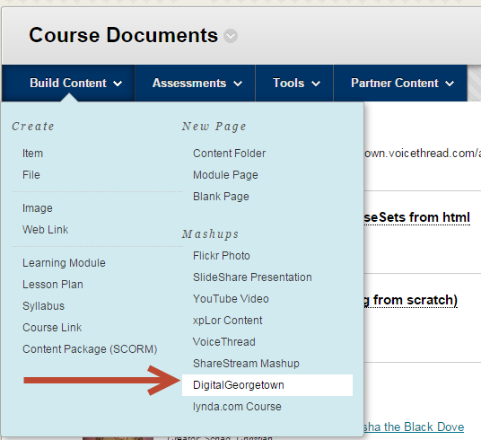
Create MashUp Option

Slide 13
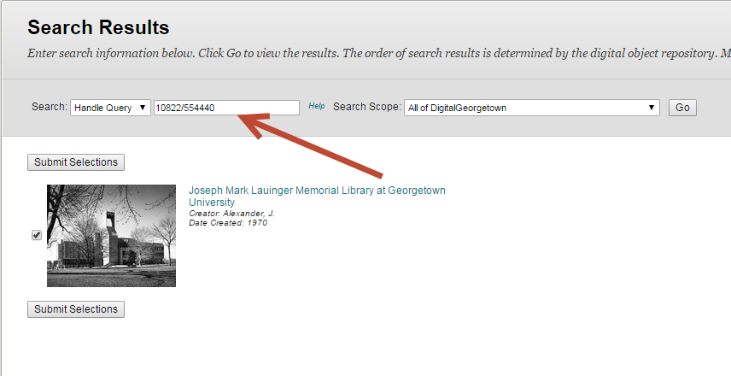
Retrieve Item By Handle

Slide 14
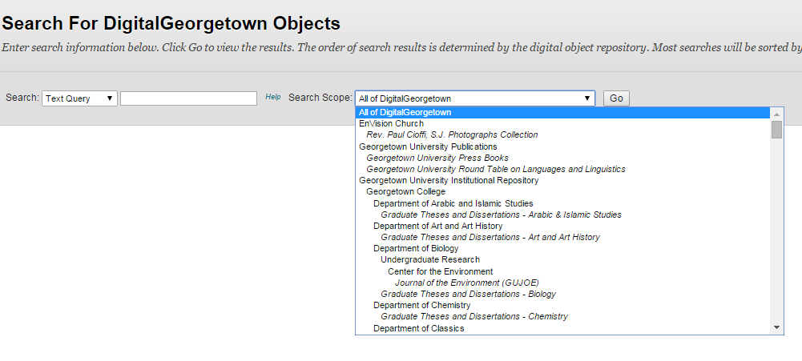
Retrieve the IR Collection Hierarchy

Slide 15
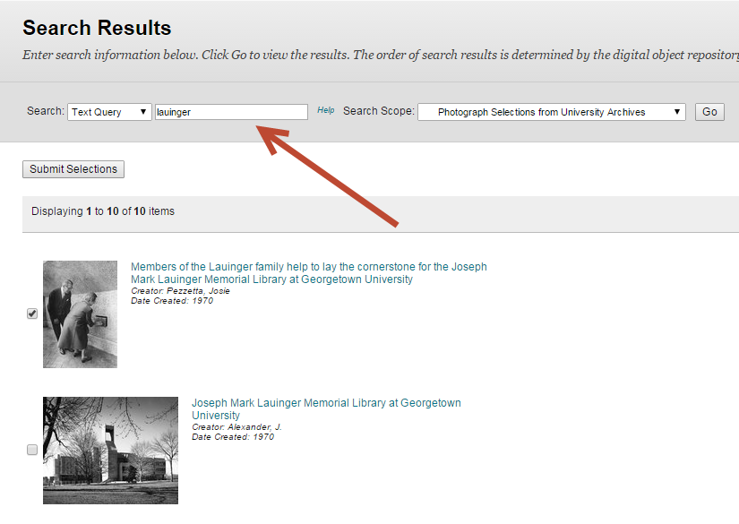
Search for Item

Slide 16
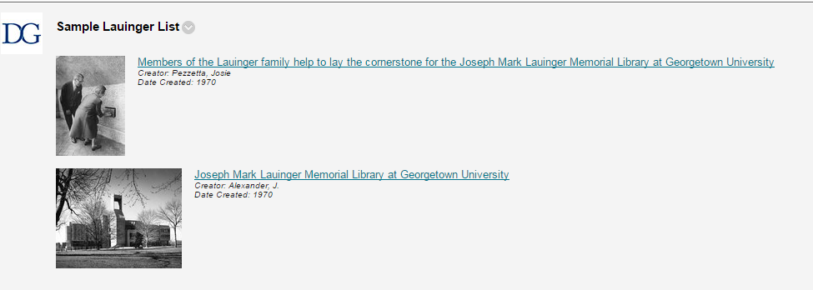
Course Documents View

Slide 17
Modest Usage of LMS Integration
In 18 months since release
9 courses created MashUps
Mostly Art History Courses

Slide 18
Good usage of the Art Collection
Art Collection
10,000 community/collection views
42,000 item views
23,000 full image views
Identity Management Integration
1,100 registered users

Slide 19
Other Benefits
LMS Integration is a talking point with faculty contributors
Link to IR is always present in the LMS
Good precedent for future integrations
Streaming Media Service Integration

Slide 20
Integrating with other University Systems
Simple Access-controlled collections in the IR
Anonymous User
Has University Affiliation (Faculty, Student, Staff)
Defer course enrollment permissions to other systems

Slide 21
Terry Brady
Georgetown University Library
terry.brady@georgetown.edu
https://github.com/terrywbrady/info

