Slide 1

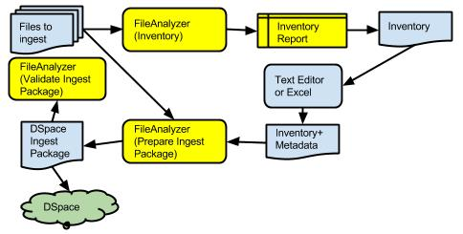
Packaging DSpace Ingest Folders with FileAnalyzer
Automate Bulk Ingest of Large Collections
Generate Metadata Spreadsheet
Build Ingest Folders
Build CONTENTS files
Build dublin_core.xml files
Associate license and thumbnail files
Submit ingest folders to “dspace import -a”
Terry Brady, Georgetown University Library, https://github.com/terrywbrady/info

