Slide 1

Codenvy for DSpace
Terry Brady
Georgetown University Library
https://github.com/terrywbrady/info

Slide 2
What is Codenvy?
https://codenvy.com/
Cloud-based development environment
Uses Eclipse Che
browser-based IDE
IDE runs in a Docker image (eclipse/*)
Provides execution environments running inside of Docker Images
The vision
Provides a full development environment requiring only a browser

Slide 3
Codenvy Service
Free account tier (up to 3GB RAM)
Paid account tier ($10/mo per additional GB)
Paid account for teams

Slide 4
Codenvy Free Tier
Workspaces shut down after 15 min of inactivity
Running applications are internet accessible
Usable as a trial/experiment
Probably not reliable for meaningful development

Slide 5
Codenvy Paid Tier
Workspaces shut down after 4 hours of inactivity
Usable for development
At 6GB, seems to be sufficient for running DSpace in tomcat
Once code has been built with Maven, the IDE consumes a lot of resources
I have had some luck building code outside the project path

Slide 6
Codenvy Dashboard
Stacks
Reference docker images
Contain custom commands
Workspaces
Use one or more stacks
Are linked to projects (code)
Factory
Pre-built, shareable workspace images
Start with one click

Slide 7
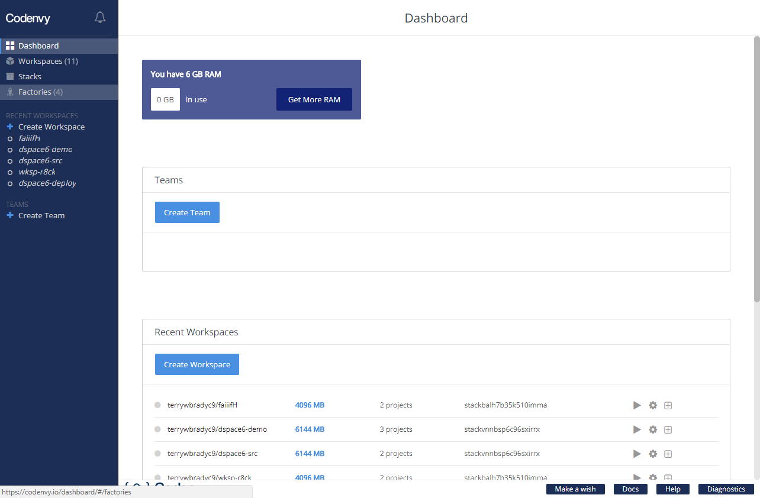

Slide 8
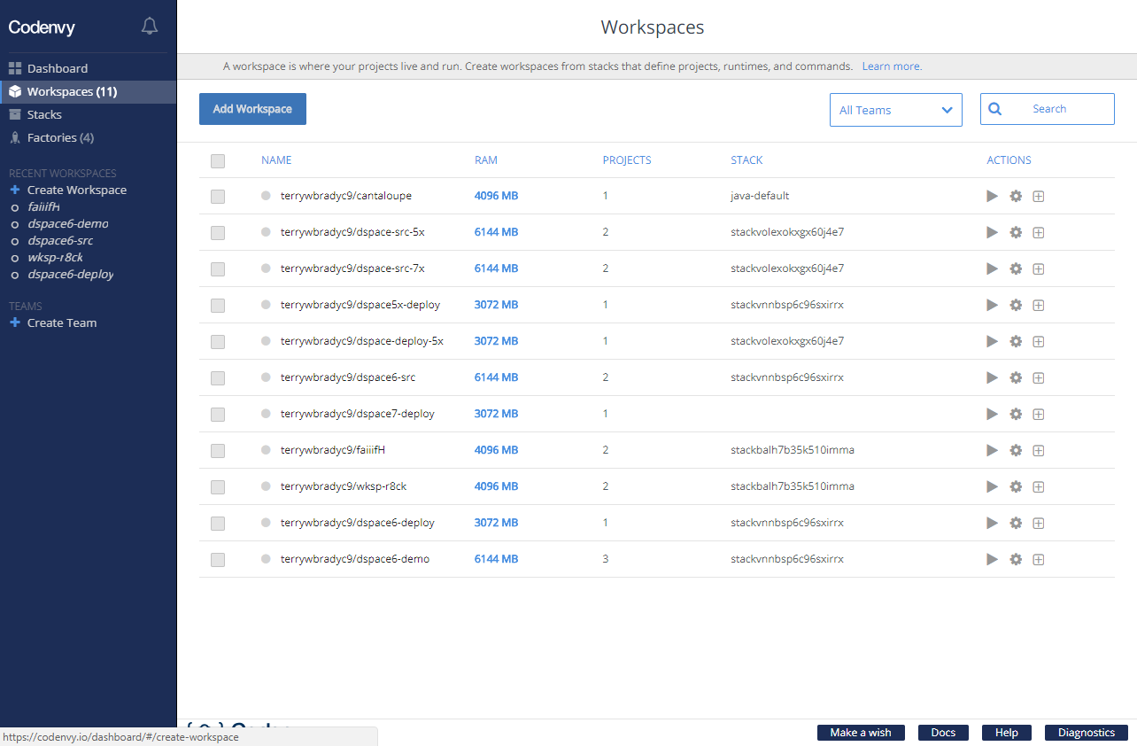

Slide 9
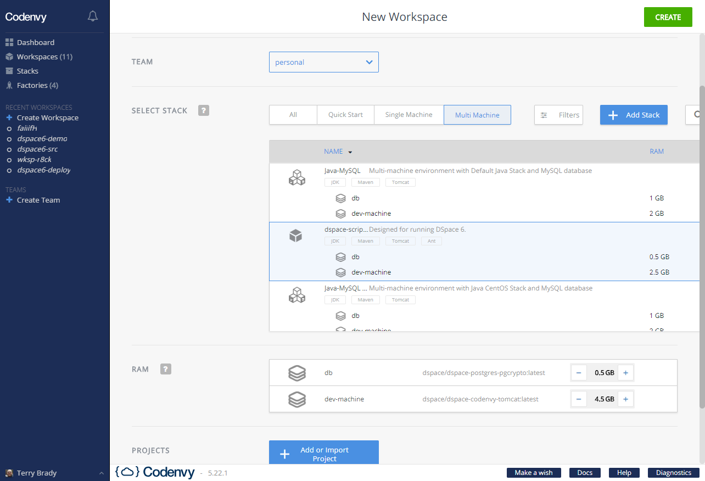

Slide 10
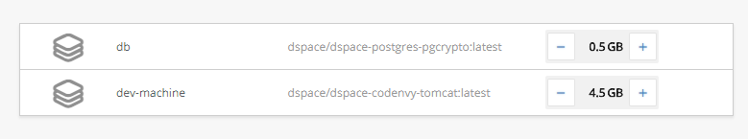
Published Docker Images for DSpace
Database runs in one image
A tomcat image has been customized for Codenvy
https://hub.docker.com/r/dspace/

Slide 11
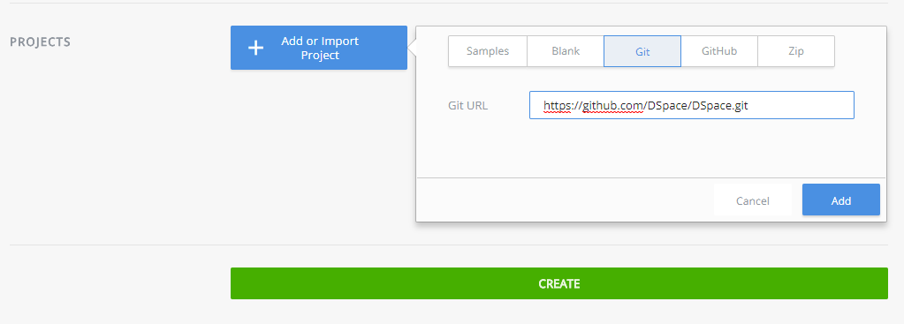
Load DSpace Code

Slide 12
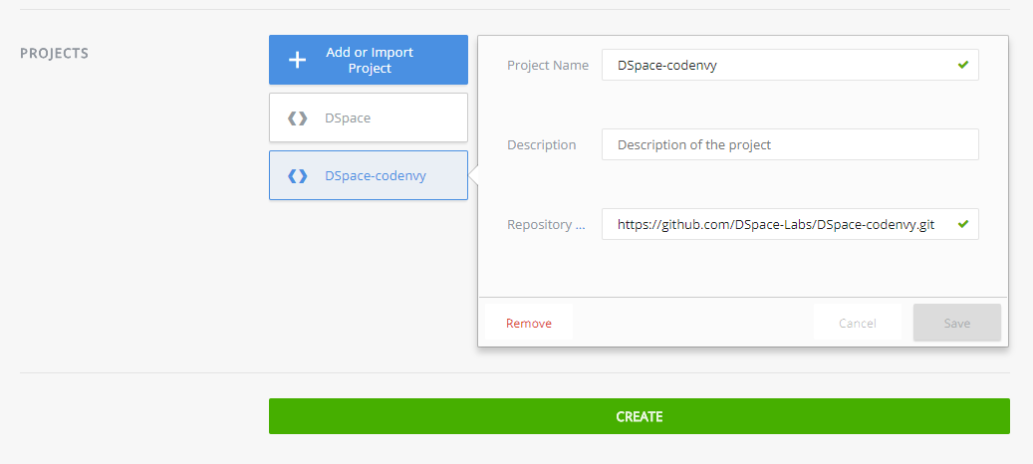
A second project contains scripts and data to populate DSpace

Slide 13
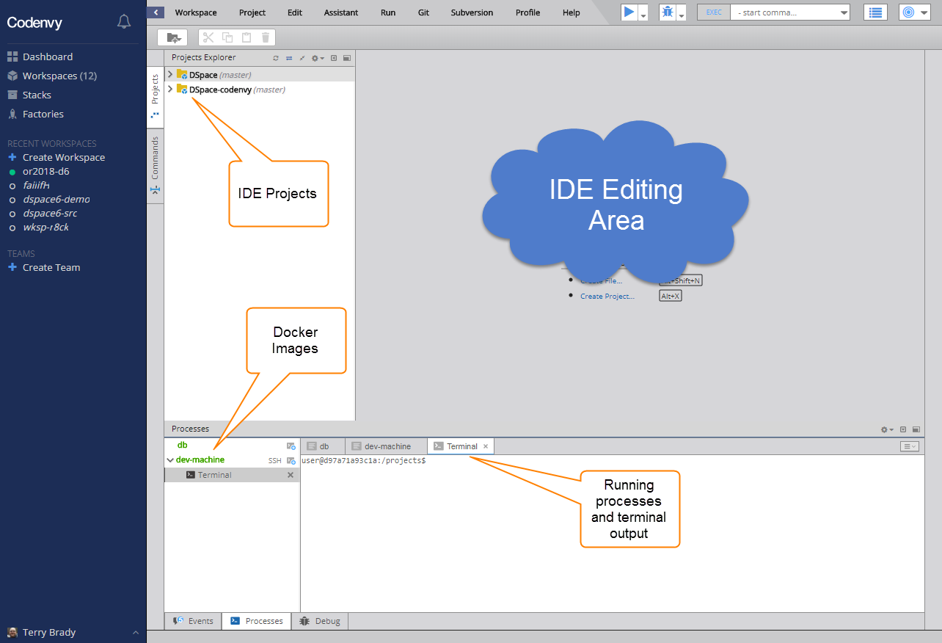

Slide 14
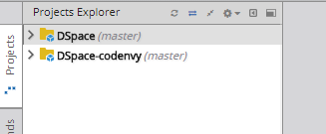
Open projects - note the branch names

Slide 15
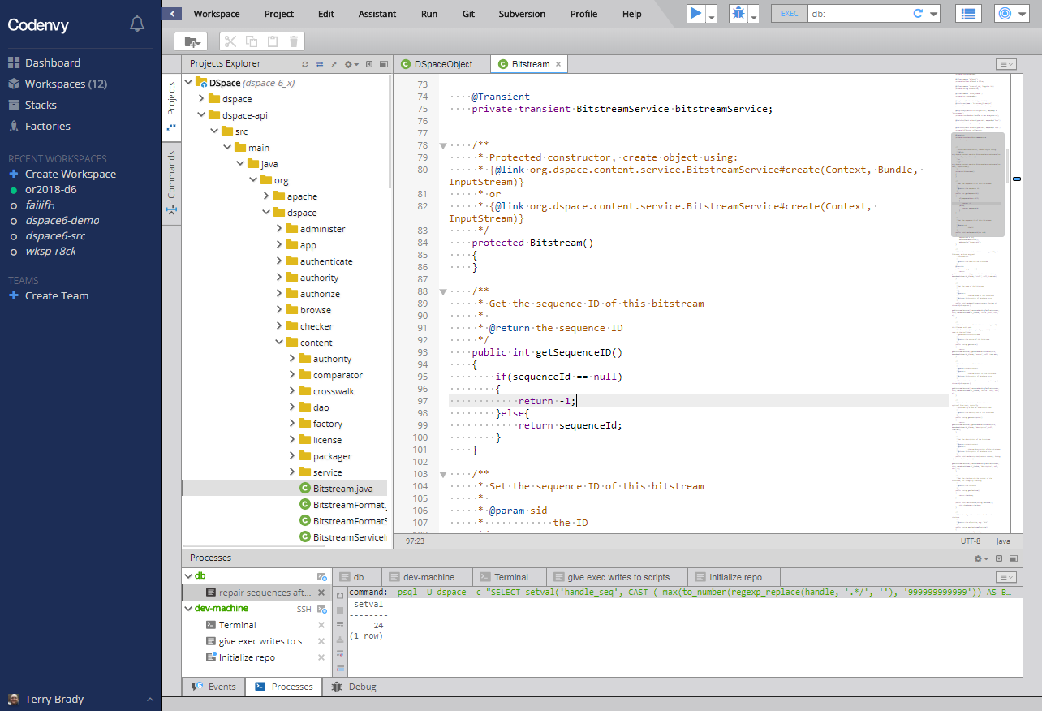

Slide 16
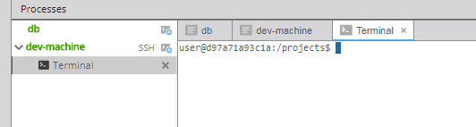
Terminal processes are listed below the image name

Slide 17
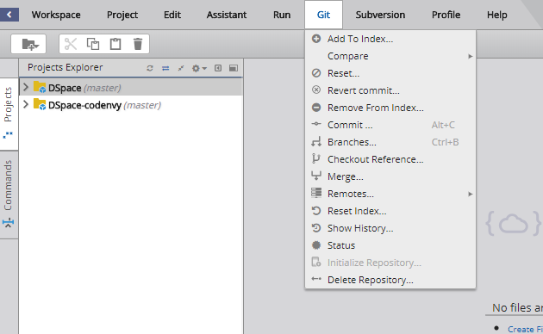
Checkout a code branch

Slide 18
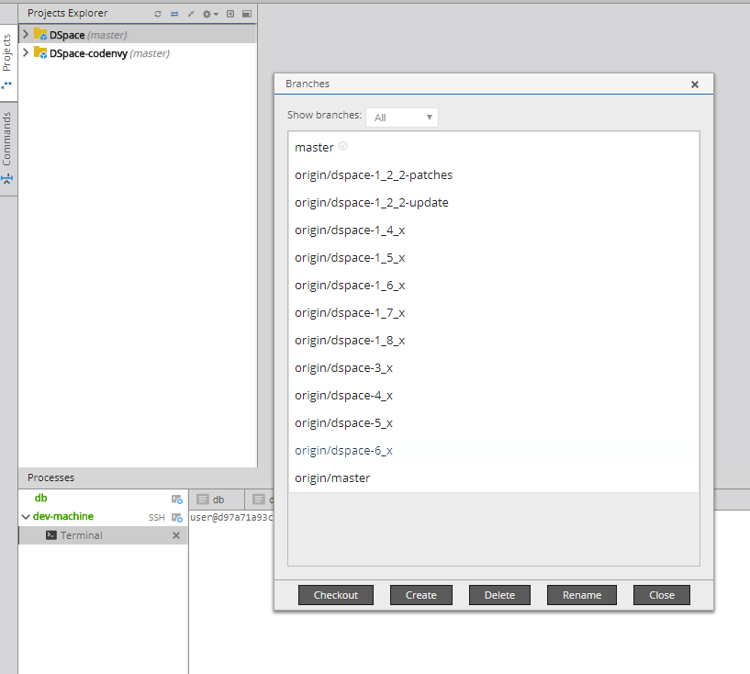
Select branch to checkout

Slide 19
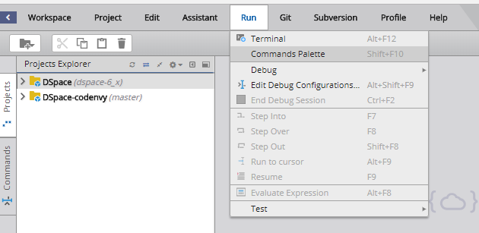
Commands (custom built in the codenvy stack)

Slide 20
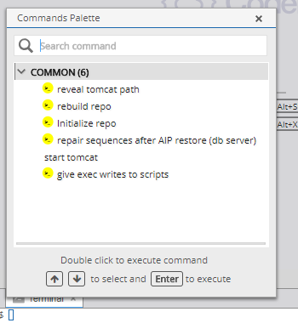
Commands built to ease repository setup

Slide 21
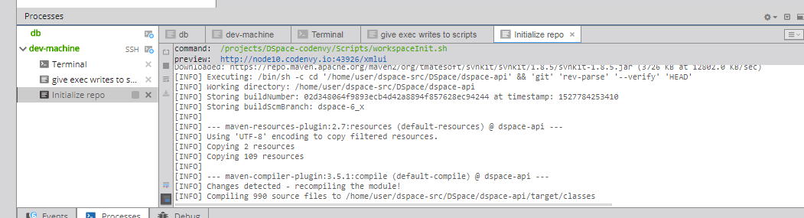
Terminal output from init process

Slide 22
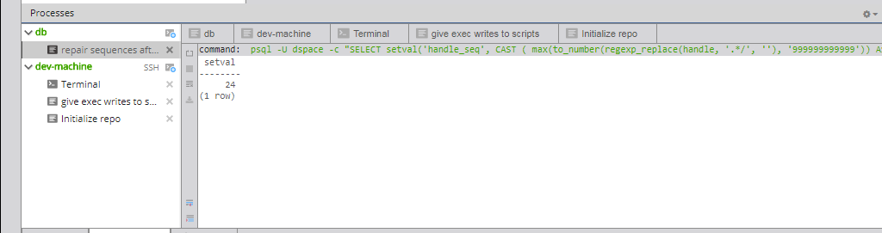
Post-install task run in database image

Slide 23
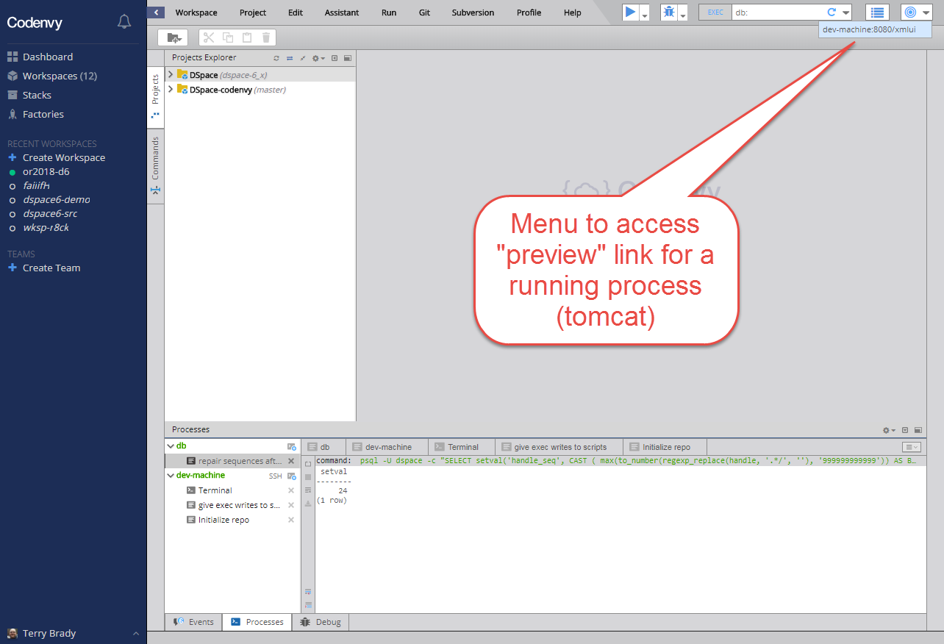

Slide 24
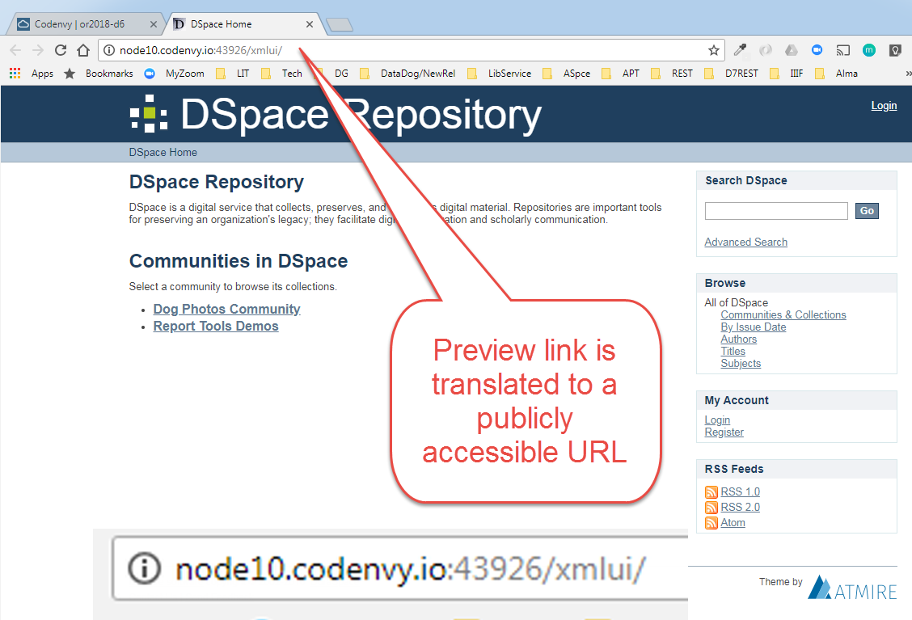

Slide 25
Codenvy and Docker
Codenvy uses an older version of Docker
Volume/Mount management can be confusing
Project areas are refreshed on startup
Persistent data needs to be stored in user’s home directory
Or I have not figured out an alternative

Slide 26
Limitations
Flat cost
Predictable, but impractical if not well-utilized
Docker is there
But you cannot manage volumes
Support is Challenging

Slide 27
Possibilities
Fast onboarding of new contributors
Imagine provisioning a workspace for all participants in a workshop
Sharable test environments
Dev environment requiring only a browser
Auto-build servers with PR code
New contributors could “check-out” a provisioned workspace in order to work on issue

Slide 28
Re-launch the or2018-d6 Repository
(Time permitting)

Slide 29
Thank You
Terry Brady
Georgetown University Library
https://github.com/terrywbrady/info

