Slide 1

Got Git?
Getting More Out of Your GitHub Repositories
Terry Brady, Georgetown University
www.library.georgetown.edu/lit/code

Slide 2
SCCS
Source Code Control System

Slide 3
SCCS: Before Git
Workstation
Enterprise Network
Internet
Work
Folder
SCCS
Checkout
Commit
CVS
SVN
SCCS Client

Slide 4
SCCS: Local Git
Workstation
Enterprise Network
Internet
Work
Folder
Checkout
Commit
Git
Git Shell
Git Client

Slide 5
SCCS: Local Git + Cloud Remote
Workstation
Enterprise Network
Internet
Work
Folder
Enterprise Remote Options are not in the scope of this talk
Web Client
Checkout
Commit
Git
Push
Pull
Git
Remote
Git Shell
Git Client
GitHub
BitBucket

Slide 6
Focus of This Talk
Workstation
Enterprise Network
Internet
Work
Folder
Web Client
Checkout
Commit
Git
Push
Pull
Git
Remote
Git Shell
Git Client
GitHub
BitBucket

Slide 7
Advantages of GitHub Web for Novice Users
Easy to visualize Git concepts
No software to install
No command line
Embedded editor
Meaningful URL’s
Rich online tools
All online resources linked to the code
Web Client
Git
Remote

Slide 8
Georgetown University Libraries
Organization
github.com/Georgetown-University-Libraries
public + private repositories
owners, viewers, contributors

Slide 9
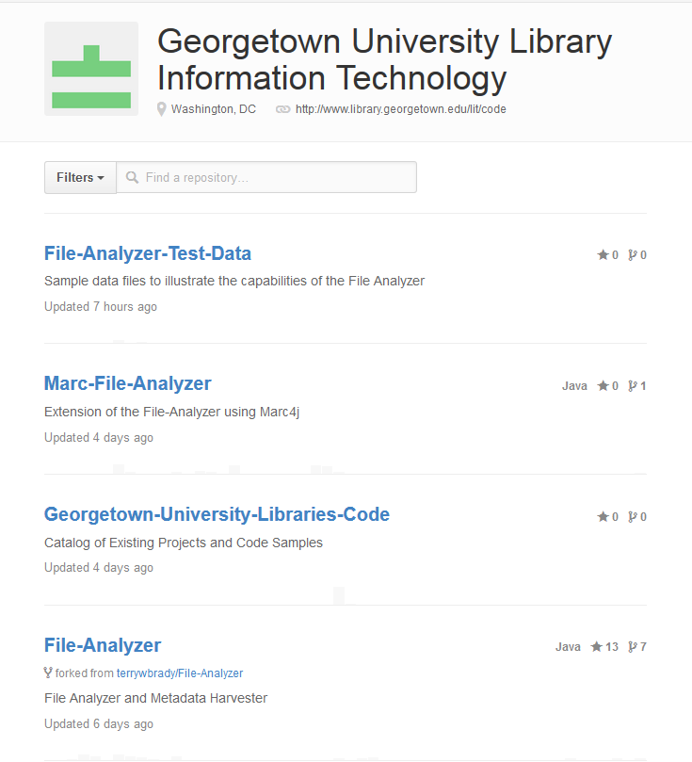
Projects

Slide 10
Project Page
https://github.com/Georgetown-University-Libraries/File-Analyzer

Slide 11
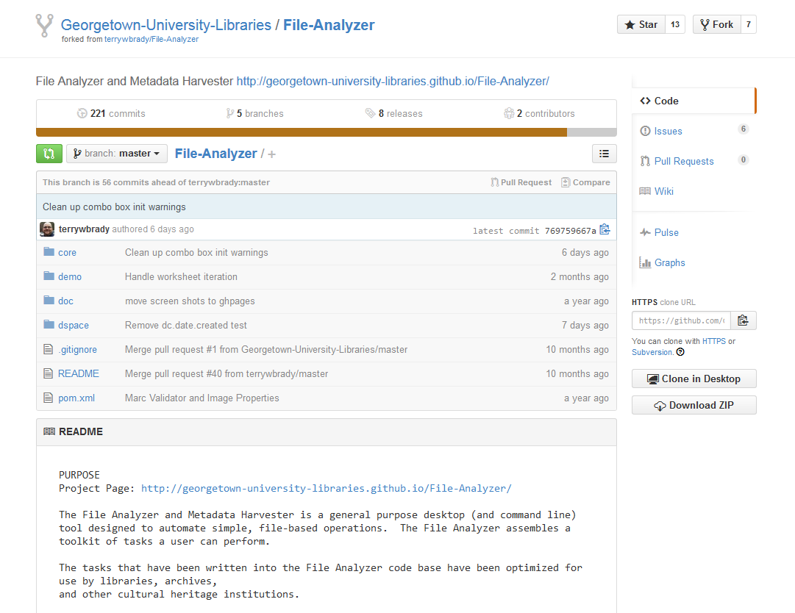

Slide 12
Project Landing Page

Slide 13
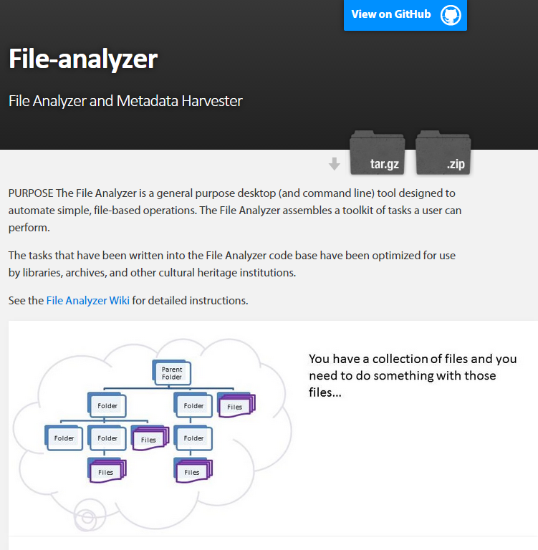

Slide 14
Project Home Page
Visually compelling landing page
Sometimes you only get one click to tell the story
Stored as a project branch: gh-pages
Trackable by Google Analytics

Slide 15
Navigating to Code

Slide 16
Browse Code Directories

Slide 17
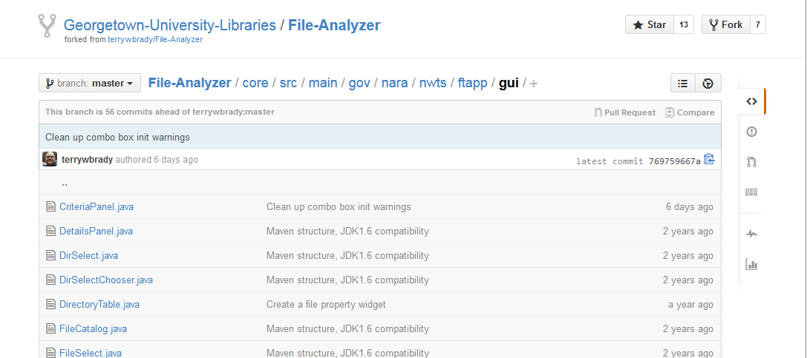

Slide 18
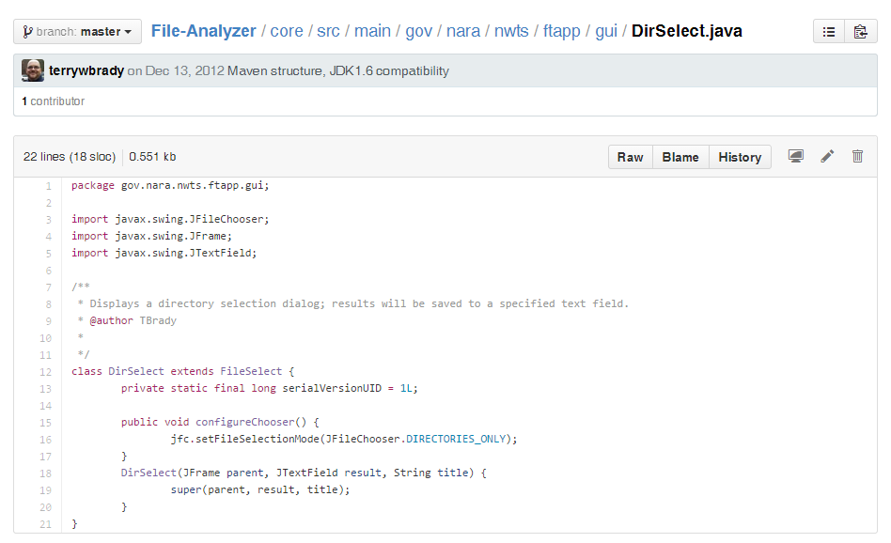
Access Resource by URL
Language Specific Rendering

Slide 19
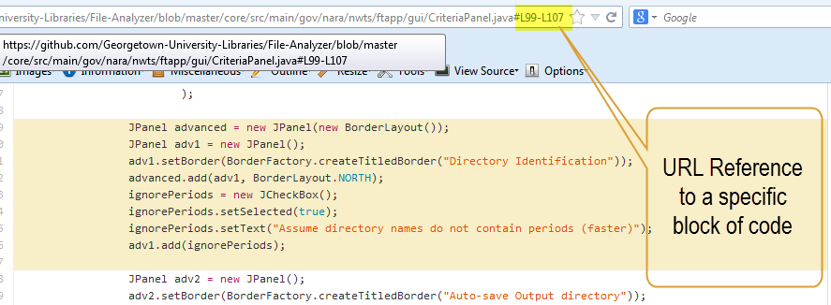

Slide 20
Code Navigation
File-system like navigation within a project
Every node has a meaningful URL
Even to a block of code!
“Raw” Access by URL
Can run a simple html/css/js app from the code repository
Great for test data!
Sample Web App (rawgit)

Slide 21
Code Editing

Slide 22
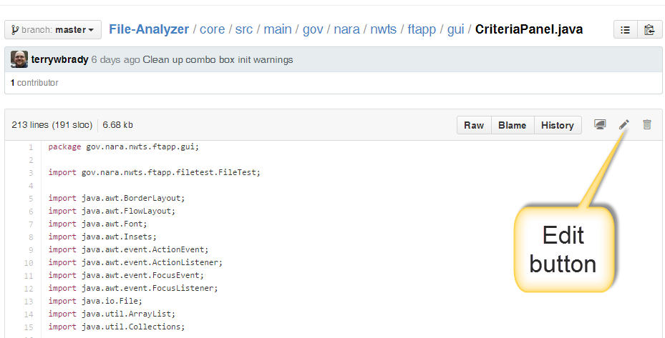

Slide 23
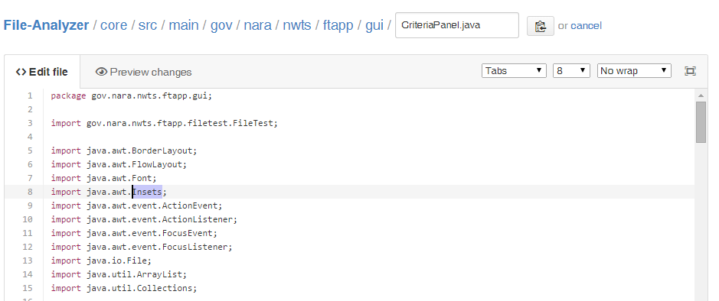
Inline Text Editor
Edit and commit files with no need to install client software.
Example: Your team has a designer who only modifies CSS. A Simple solution!

Slide 24
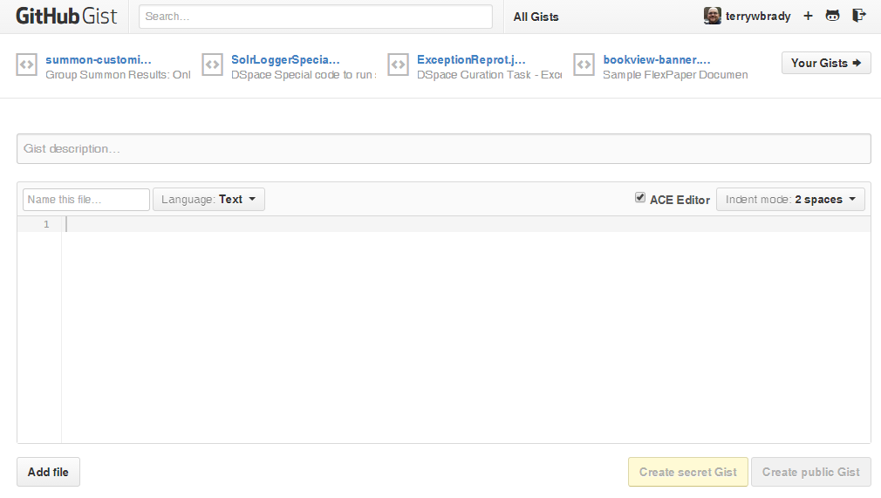
“Gist”
Code Snippet Sharing
Make your Gists Discoverable or “Secret”

Slide 25
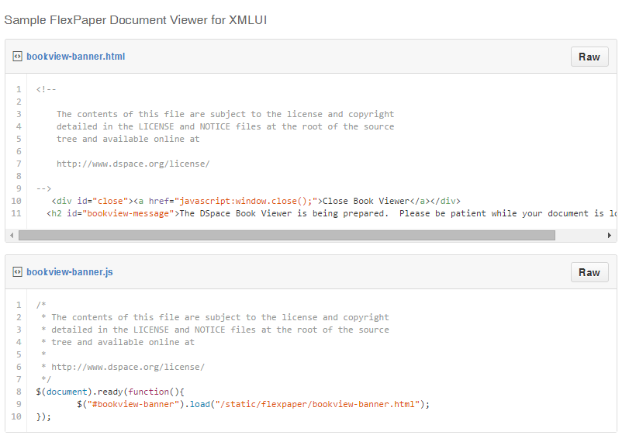
Raw Link
Language Aware Editor

Slide 26
Add new text file
Binary upload not supported

Slide 27
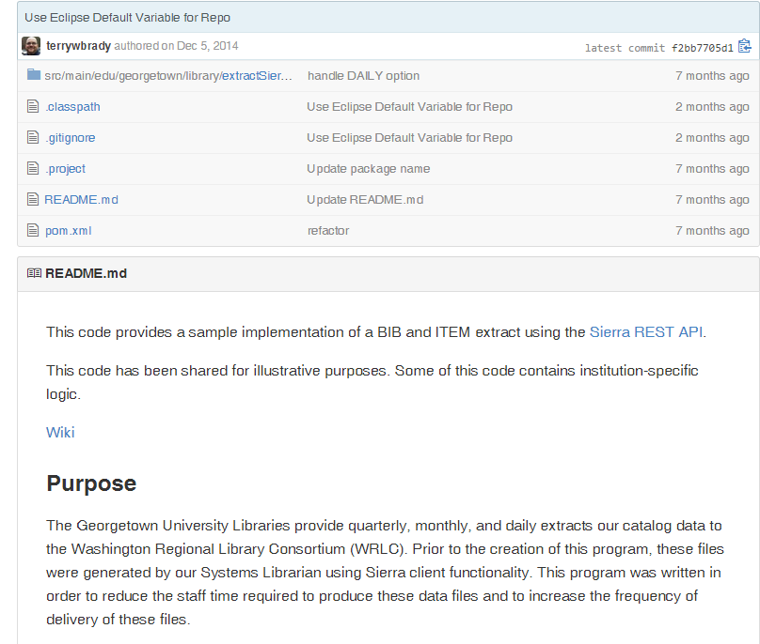
README Content
Markdown format permitted
https://guides.github.com/features/mastering-markdown/

Slide 28
Code Editing with GitHub Web
Language-specific formatting
Quick editing using only the browser
Support non-developer contributors!
2015 Goal: extend code contributors on our projects
Markdown is a powerful wiki syntax for documentation

Slide 29
Change History /
Pull Request

Slide 30
Compare code by branch, by release, or by date
Releases, commits, and branches can be compared against each other or by date

Slide 31
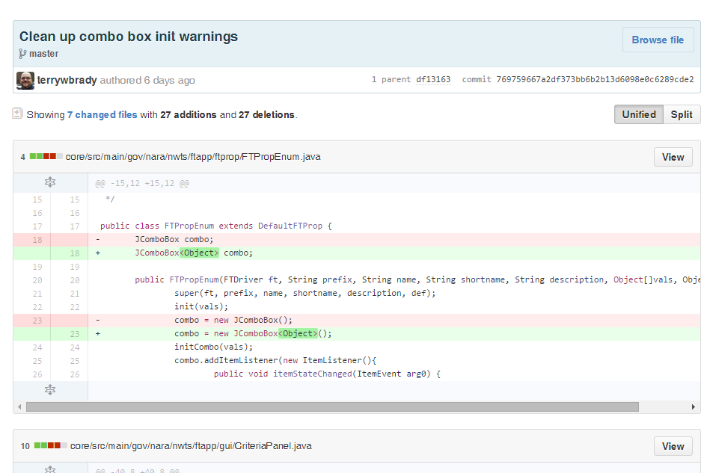
Visualize changes

Slide 32
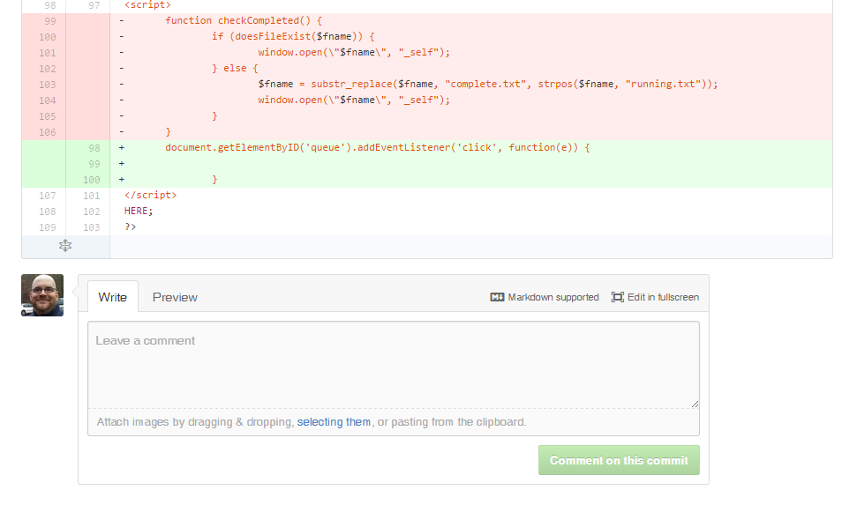
Capture notes about a commit

Slide 33
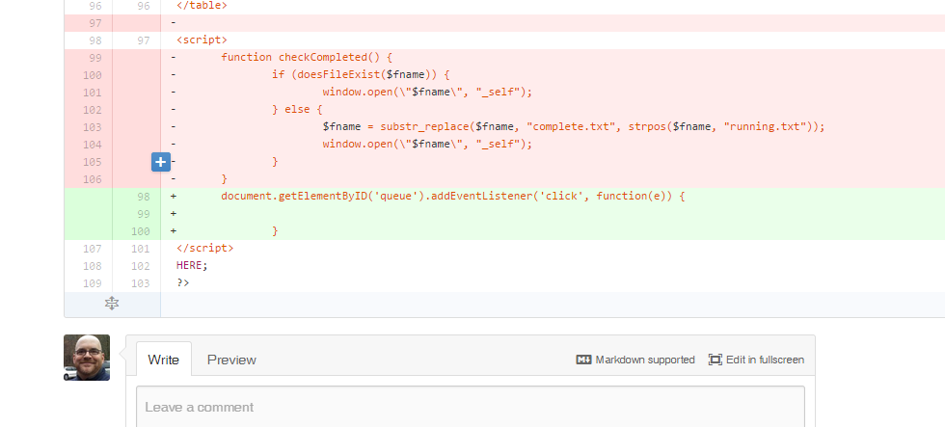
Insert a comment about a specific line (hover to enable)

Slide 34
Create a “pull request” to propose a set of changes
Existing “pull requests”

Slide 35
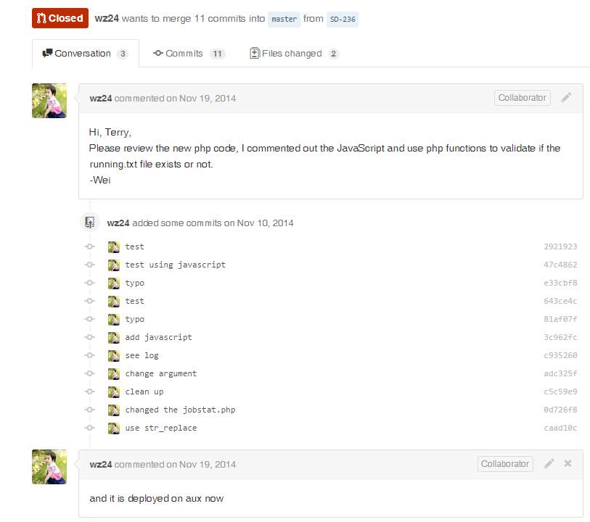
Pull Request Description
Commit History
Pull Request Conversation

Slide 36
Change History / Pull Request
Visualization of changes
Only a browser is needed
Powerful compare options by URL
By Date: .../compare/master@{1month}
By Release: .../compare/v2.0.2...v2.0.5
Conversation around a pull request/commit
Great tool for mentoring staff on changes
Conversation captured right with the code
Rich Markup

Slide 37
Release Tracking

Slide 38
View named releases for a project

Slide 39
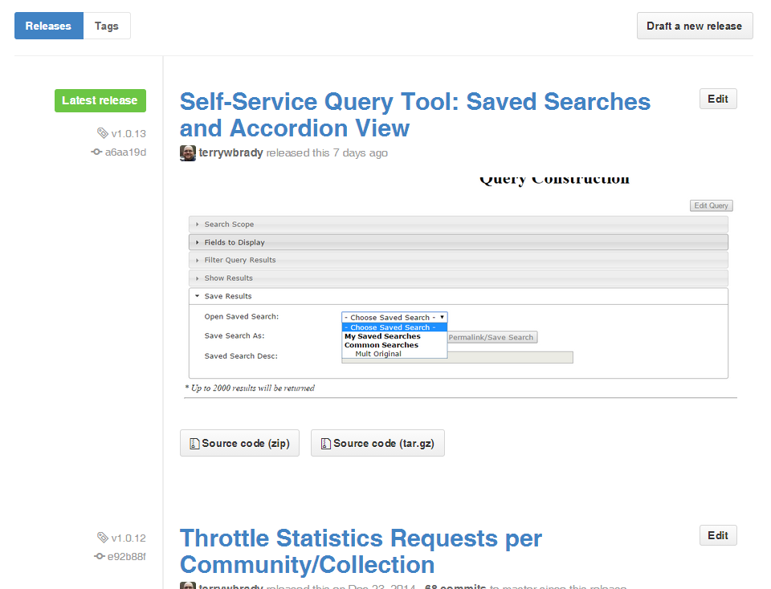
The release history is particularly helpful with embedded screenshots
Release Link

Slide 40
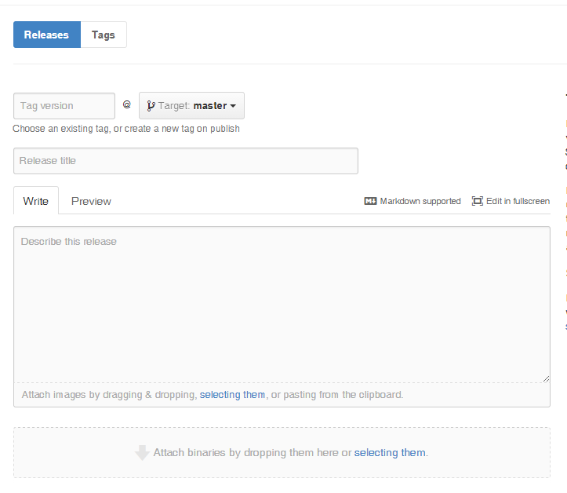
The release editor is easy to use, supports markdown and drag & drop images

Slide 41
Release Tracking
Document every release to production
Rich documentation makes it easy to recall the contents of a release
Very useful for annual review accomplishments
Can function like a blog/project portfolio
GitHub will automatically email release notes to defined team members

Slide 42
Rich Documentation

Slide 43
A simple issue tracking system for the project

Slide 44
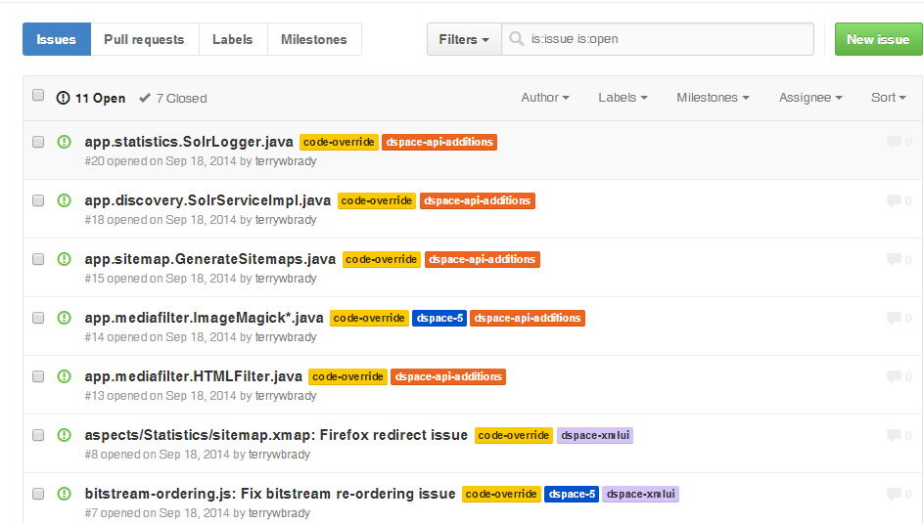
Document local overrides to an open-source package (until the issues are resolved in the source project)

Slide 45
Wiki for project documentation

Slide 46
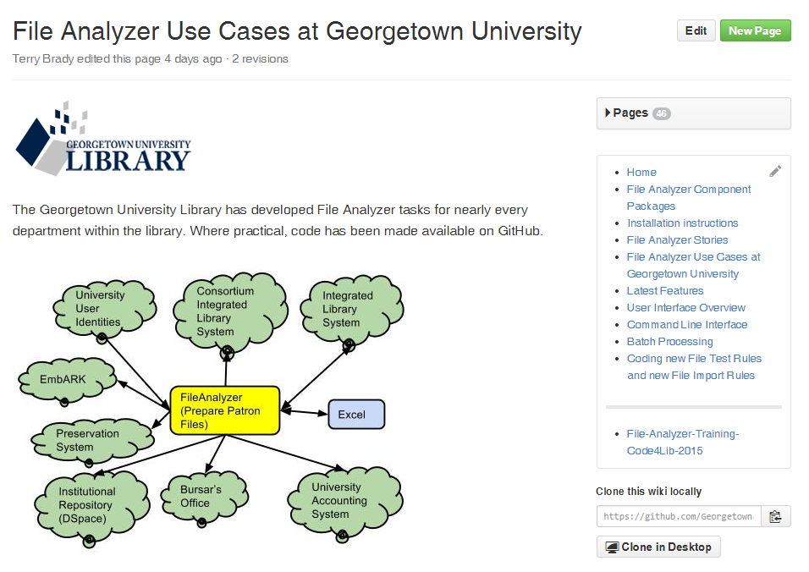
Project Overview
Wiki can also be edited locally
Wiki Link

Slide 47
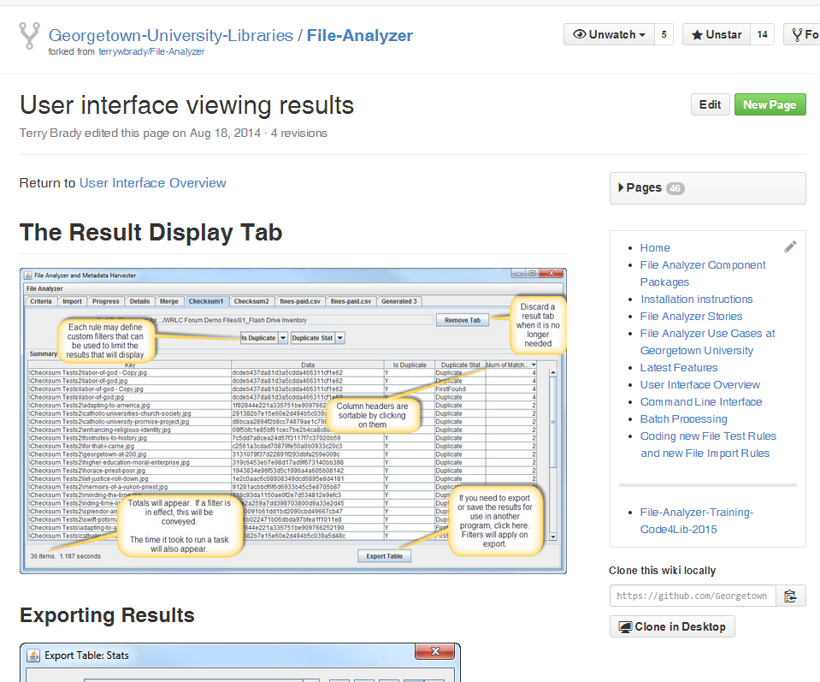
User Documentation

Slide 48
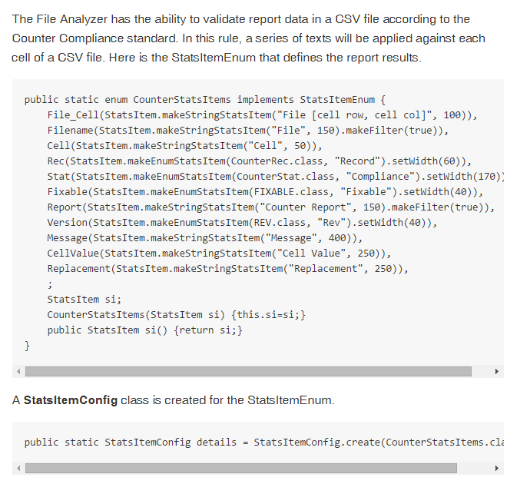
Developer Documentation

Slide 49
Rich Documentation
Issue Tracking
Supplement to your ticketing system, not a replacement
Wiki
Project Marketing Information
End User Documentation
Developer Documentation
Documentation Pages link to your code

Slide 50
Try out these tools
Sample links on the conference wiki
These slides are on the conference wiki

Slide 51
Let’s Talk!
Check out our repository, let me know what you think
Likely open positions
Developer/Systems Admin
Systems Librarian
Others in Seattle?

Slide 52
More Information?
terry.brady@georgetown.edu
https://github.com/terrywbrady
https://github.com/Georgetown-University-Libraries

Slide 53
Other Tools
Time Permitting

Slide 54
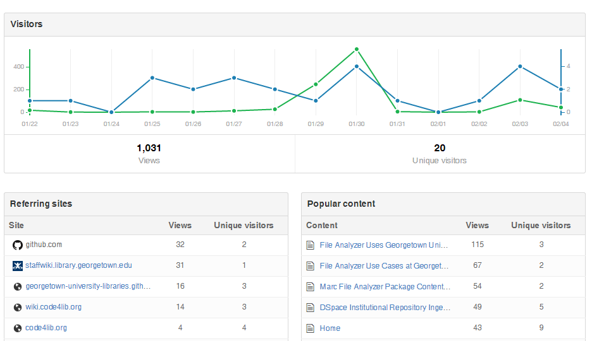
Visitor Tracking

Slide 55
OAuth Tokens
Grant a build process access to private repositories
https://help.github.com/articles/git-automation-with-oauth-tokens/

