Slide 1
AEON Document Log
Operation Manual
Document Reference Number Management System
AEON Delight (Asia) Limited | July 2026
Notes:
Title slide for the AEON Document Log Operation Manual.

Slide 2






Table of Contents
01
Getting Started
Sign in with Microsoft SSO
02
Navigation
Application menu and role-based access
03
Document Reference Log
Create and manage reference numbers
04
Staff Records
Manage staff, import, and search
05
Account Management
Admin user management
06
Configuration
System settings and prefix
Notes:
Table of contents listing all sections of the manual.

Slide 3
01 Getting Started
How to Sign In
User Roles
1
Open the application URL in your browser
Admin (BS Team / IT Team)
https://aeon-document-log.zeabur.app/log-sheet
• View and create document reference logs
2
Click the "Sign In" button on the landing page
• Edit existing log entries
• Manage Staff Records (add, edit, import, deactivate)
3
You will be redirected to Microsoft login
• Account Management and Configuration access
4
Enter your company email and password
User (View Only)
• View document reference logs
5
After authentication, you will be redirected to the Document Reference Log page
• Create new reference numbers
• View Staff Records (read-only)
Notes:
Getting started: sign-in flow and user role descriptions.

Slide 4
02 Navigation
AEON Document Log
Log Sheet
Staff Records
Account Management
Configuration
Sign Out
Log Sheet
All Users
Document Reference Log - create and view reference numbers
Staff Records
All Users (Admin to edit)
View and manage staff members, initials, and contact info
Account Management
Admin Only
Add, edit, or deactivate admin user accounts
Configuration
Admin Only
Manage system settings such as the document prefix
Notes:
Navigation bar overview and access levels for each menu item.

Slide 5
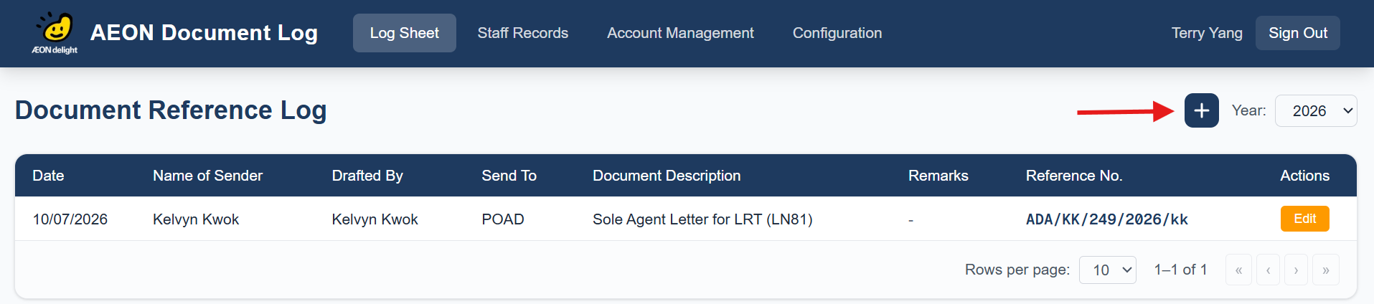
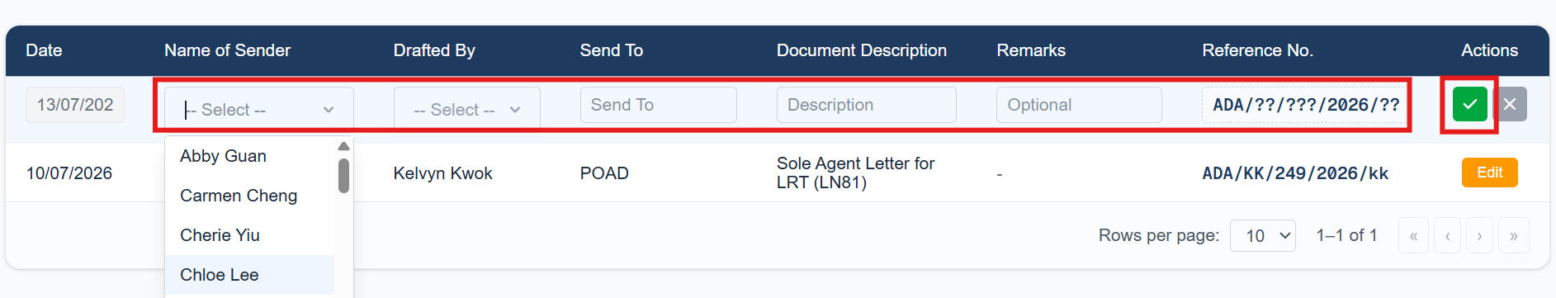
03 Document Reference Log - Creation
Generate New Document Reference No.
1. Click on the “+” button to obtain a new reference no.
2. Input the corresponding values on the dropdown and textbox and then click “✅” button to generate the new reference no.
Notes:
Document Reference Log overview, column descriptions, reference number format, and sequence logic.

Slide 6
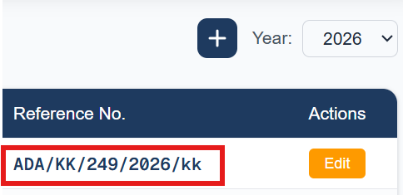
03 Document Reference Log – Assignment Logic
Reference Number Format
ADA / KK / 249 / 2026 / kk
ADA
Prefix (from Configuration)
MB
Sender's Initial (uppercase)
001
Sequence No. (auto-incremented)
2026
Year
pc
Drafter's Initial (lowercase)
Sequence Logic
• Sequence is grouped by Prefix + Year
• Resets to 001 at the start of each new year
• Based on the sequence column in the database, not the reference text
• Year filter dropdown shows all years with existing records
Notes:
Document Reference Log overview, column descriptions, reference number format, and sequence logic.

Slide 7






04 Staff Records
Features
Staff Fields
Quick Search
Name
Required
Full name, must be unique
Filter by Name, Initial, Staff No, or Email instantly as you type
Initial
Required
Short code (e.g. MB, TY)
Status Filter
Staff No
Optional
Employee number
Toggle between Active, Inactive, or All staff records
Email
Required
Company email address
Add / Edit Staff
Admin users can add new staff or edit existing records
Download Template
Duplicate Initial Warning
Download a CSV template for bulk staff import
• A red warning message appears above the table when duplicate initials are found among active staff
Import
• Example: "Duplicate Initial: TL: Tansy Lee, Timothy Lee"
Upload a CSV file to bulk-create staff records with validation
• The Initial cells of affected staff are highlighted with a red background
• Resolve duplicates by editing the Initial field to ensure uniqueness
Notes:
Staff Records features, fields, and duplicate initial warning.

Slide 8


04 Staff Import (Admin Only)
CSV Template Format
How to Import
Click "Download Template" to get a pre-formatted CSV file.
1
Click "Download Template" to get the CSV file
Name,Initial,Staff No,Email
2
Fill in staff data following the template format
John Doe,JD,S001,john.doe@example.com
3
Save the file as CSV (.csv)
Jane Smith,JS,S002,jane.smith@example.com
4
Click "Import" and select your CSV file
Mike Lee,ML,,mike.lee@example.com
5
The system validates and imports valid records
6
Success/error counts are shown via toast notifications
Import Validation Rules
Name, Initial, and Email are required for each row
Duplicate names (vs existing active staff) are rejected
Duplicate names within the same import file are rejected
Partial success is supported - valid records import, invalid rows are skipped with error messages
Notes:
Staff import process, CSV template format, and validation rules.

Slide 9
05 Account Management (Admin Only)
Managing User Accounts
Role Settings
This page controls who has admin access to the application.
Admin Role
Add User
Full access to all features including Staff Records management, Account Management, and Configuration.
Click "+ Add User" and fill in Name, Email, and Role (Admin or User)
Edit User
User Role (View Only)
Click "Edit" to modify a user's details or role
Can view Log Sheet and Staff Records, and create new reference numbers. Cannot edit records or access admin pages.
Deactivate
Click "Deactivate" to disable a user's access (confirmation required)
Reactivate
Important Notes
Inactive users appear in a separate section with a "Reactivate" button
• Users must sign in via Microsoft SSO before they appear in the system
• Email must match the user's Microsoft account email
• Users not in Account Management default to "User" role
Notes:
Account Management page for admin users - adding, editing, deactivating user accounts.

Slide 10
06 Configuration (Admin Only)
System Configuration
Available Actions
The Configuration page manages system-level settings used across the application.
Add Configuration
Click "+ Add Configuration", select Type (PREFIX), enter Value, and save
Current Configuration Types:
Edit
PREFIX
Click "Edit" to modify an existing configuration value
The document reference prefix (e.g. "ADA")
Delete
This prefix is the first part of every reference number generated by the system. It appears as the first segment in the format:
Click "Delete" to remove a configuration entry (confirmation required)
ADA/MB/001/2026/pc
Caution
Changing the PREFIX value will affect all new reference numbers generated after the change. Existing reference numbers will not be updated.
Notes:
Configuration page for managing system-level settings like the document reference prefix.

Slide 11
Thank You
For support or questions, please contact the IT Department
itdept@aeondelightasia.com
AEON Delight (Asia) Limited | July 2026
Notes:
End slide with contact information.

