Slide 1
Ghost Deploy Using Terraform

Slide 2
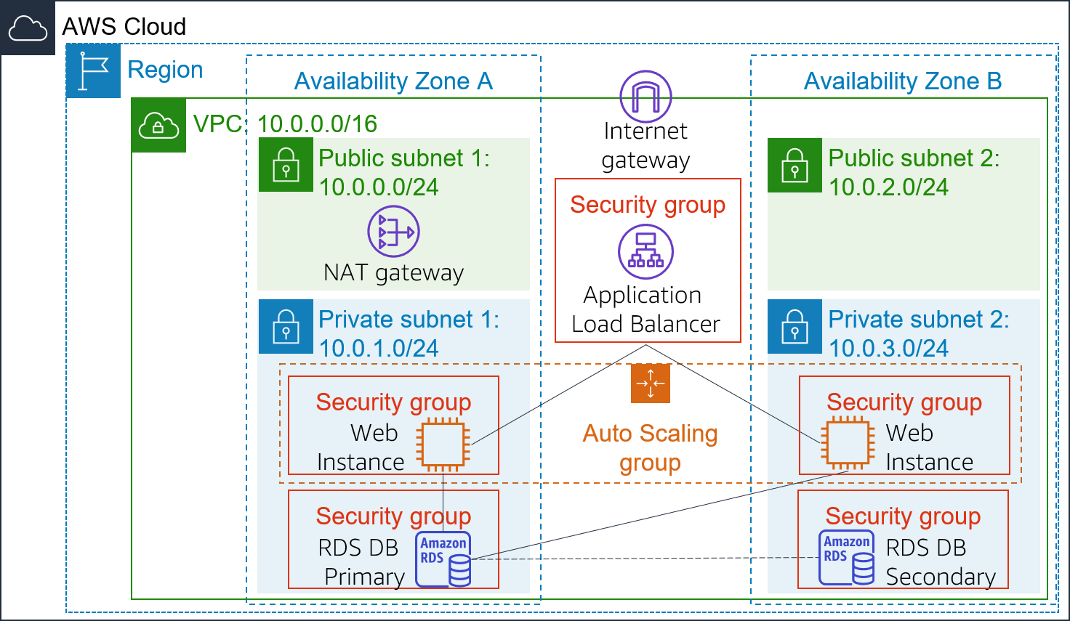
AWS Architecture

Slide 3
Tech stack
Terraform (Assignment 8 is a really good blue print)
Docker & Docker Compose
AWS Resource: ASG, ELB, EC2 , RDB, VPC, IGW

Slide 4
Main Problems:
1. installing Ghost directly on EC2:
Ghost requires Ubuntu 20.04 specifically. Installation failed on Ubuntu 22.04 and 24.04.
Switched to a Docker-based setup instead — much easier to manage.
Note: Docker requires more than 1 GB of RAM.
2. EC2 instance without a public IP (in public subnet):
EC2 instances in a public subnet but without a public IP cannot access the internet.
Solution: Move the instance to a private subnet and set up a NAT Gateway for internet access.
3. SSH access to EC2 in private subnet:
Use a Bastion Host in the public subnet for secure SSH access to the private instance.
This also makes debugging much easier.

Slide 5
Admin url: http://webapp-alb-1157607276.us-east-1.elb.amazonaws.com/ghost/ username: i@terryye.com password: aabbcc1234 blog url : http://webapp-alb-1157607276.us-east-1.elb.amazonaws.com/ Change the domain to ELB’s domain address
Live Demo

