Slide 1
SQL BASICS

Slide 2
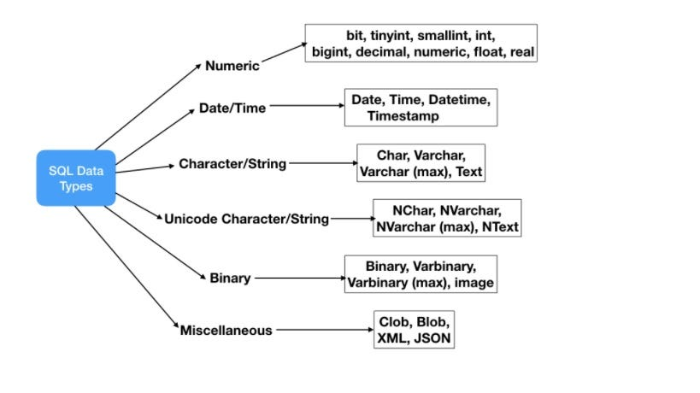
DATA TYPES IN SQL
SQL specifies various types of data that can be stored in a SQL-based database and manipulated by the SQL language.

Slide 3
INT or INTEGER: Used to store whole numbers. For example, you can use INT to represent a person's age.
CHAR(n): Used to store fixed-length character strings with a specified length (n). eg : someones NAME
VARCHAR(n): Used to store variable-length character strings with a maximum length (n). eg: address
Date and Time Data Types:DATE: Used to store date values (year, month, day).
TIMESTAMP or DATETIME: Used to store date and time values, including the year, month, day, hour, minute, and second.
  CREATE TABLE Persons (
  age INT,
  name CHAR(50),
  address VARCHAR(100),
  date_of_birth DATE,
  arrival_time TIMESTAMP
  );

Slide 4
Statements
In SQL (Structured Query Language), statements are a collection of individual commands that are used to interact with a database.
Each statement requests a specific action from the DBMS, such as creating a new table, retrieving data, or inserting new data into the database.
All SQL statements have the same basic form.

Slide 5
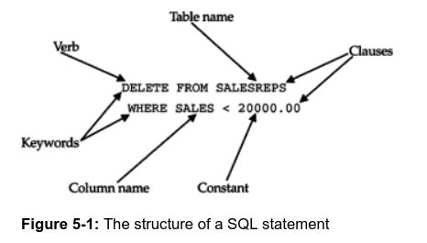
Every SQL statement begins with a verb, a keyword that describes what the statement
Does.
CREATE, INSERT, DELETE, and COMMIT are all examples.
The statement continues with one or more clauses.
Every clause begins with a keyword, such as WHERE, FROM, INTO, and HAVING.
A clause may specify the data to be acted upon by the statement or provide more detail about what the statement is supposed to do.

Slide 6
DDL ,DML, DCL
SQL commands are divided into 3 major categories:
  DDL - Data Definition Language
  DML - Data Manipulation Language
  DCL – Data Control Language
1.DDL - Data Definition Language
DDL ,is a subset of SQL commands that define the structure or schema of the database.
It includes commands such as CREATE, ALTER, and DROP
DDL statements focus on defining the database structure and schema

Slide 7
The list of DDL commands in SQL:
The CREATE command creates database objects, tables, and triggers.
The ALTER command alters the database structure by adding, deleting, and modifying columns of the already existing tables, like renaming and changing the data type and size of the columns.
The DROP command deletes the defined table with all the table data, associated indexes, constraints, triggers, and permission specifications.
The TRUNCATE command deletes all the data and records from an existing table, including the allocated spaces for the records. Unlike the DROP command, it does not delete the table from the database. It works similarly to the DELETE statement without a WHERE clause.
The RENAME command changes the table name when the user or administrator wants to give a more relevant name to it.

Slide 8
2. DML- Data Manipulation Language.
Data Manipulation Language - comprises of commands in SQL language that deal with managing and manipulating data in the database.
It allows you to perform operations such as inserting, updating, and deleting data from database tables.
It enables you to perform operations like storing data in database tables, modifying and deleting existing rows, retrieving data, or updating data.
The most commonly used commands are :
SELECT: fetches records from one or more tables in the database.
INSERT INTO: Inserts new records into a table in the database
UPDATE: Modifies/Updates existing data in a table within the database.
DELETE: Removes/Deletes an existing record from a table in the database.

Slide 9
3. DCL - Data Control Language.
Data Control Language - DCL, is comprised of the commands in SQL that deal with controls, rights, and permission in the database system.
These commands are used to set user permissions, manage user roles, and control data security and integrity within the database.
These commands include :
GRANT: Gives specific permissions to users or user roles.
REVOKE: Revokes previously granted permissions given with the GRANT command.
DENY: Explicitly denies certain permissions.
ALTER USER: Modifies user properties or settings.

Slide 10
DDL -(Data Definition Language) Example:
We can use the CREATE command which is a DDL command to create a new database in SQL.
  CREATE Database Books;
The above SQL query creates a database named Books in our MySQL database.
We can also use the CREATE command to create a new table in SQL.
      CREATE TABLE Student
      (
      Roll_No. INT,
      First_Name VARCHAR(20),
      Last_Name VARCHAR(20),
      Age INT,
      Marks INT,
      ) ;
The query above creates a table in our database named student with the given five columns in the SQL database.

Slide 11
DML(Data Manipulation Language) Example :
Let's take the example of INSERT, which is a DML command. The INSERT command inserts data into the table in the SQL database.
consider a Student table in a SQL database having fields names as : stdnt_id, name , and age.
We can insert a new record into the Student table using the INSERT command.
INSERT INTO Student VALUES(105, 'Nisha', 30);

Slide 12
DCL – Data Control Language Commands Examples:
GRANT SELECT, UPDATE ON Student TO Nisha
In the above SQL Query, we use the GRANT command to give permission.
Using this command, the user gets the SELECT and UPDATE privileges.
The SELECT command gives access to view the record, and UPDATE gives access to modify the record.
The control works on the table Student, which is the object here. Nisha is the username of the person getting permission to view and modify the Student table.

