Slide 1
SCOPE in the C programming language

Slide 2
A scope in any programming language is a region of the program where a defined variable can have its existence .
There are three places where variables can be declared in C programming language −
1.Inside a function or a block which is called local variable.
2.Outside of all functions which is called a global variable.
3.In the definition of function parameters which are called formal parameters.
So the scope of a variable is dependent or determined by where in your program it is declared .

Slide 3
Local Scope
Variables that are declared inside a function or block are called local variables , hence they have local scope.
They can only be used by statements that are inside that function or block of code.
*Note* Local variables are not known to functions outside their own.
#include <stdio.h>
int main( )
{
int a, b, c; // local variable declaration. Here all the variables a, b, and c are local to main() function.
a = 10; // variable initialization
b = 20;
c = a + b;
printf ("value of a = %d, b = %d and c = %d\n", a, b, c);
return 0;
}

Slide 4
Global Scope
Global variables are defined outside a function, usually on top of the program hence they have a global scope.
A global variable holds it value throughout the lifetime of your program. They can be accessed by any function within your program/source code.
#include <stdio.h>
int g; //global variable declaration ( it is declared out side our main( ) function )
int main ()
{
int a, b; //local variable declaration
a = 10;
b = 20; //variable initialization
g = a + b;
printf ("value of a = %d, b = %d and g = %d\n", a, b, g);
return 0;
}

Slide 5
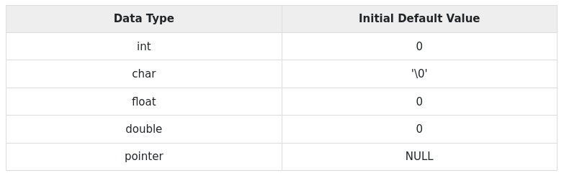
When a local variable is defined, it is not initialized by the system, you must initialize it yourself.
If you do not initialize your Global variables they are initialized automatically by the system as follows :

Slide 6
RECURSION

Slide 7
Recursion is the process of a function calling itself , either directly or indirectly.
When a program allows you to call a function inside the same function, then it is called a recursive call of the function.
void recursion( )
{
recursion( ); //function calls itself
}
int main( )
{
recursion( );
}

Slide 8
When using recursion, programmers need to define an exit condition from the function, otherwise it will go into an infinite loop.

Slide 9
Challenge 1
#include <stdio.h>
int recur(int n)
{
if (n == 0)
{
return 1;
}
else
{
return 7 + recur(n-2);
}
}
int main( )
{
printf("%d", recur(4));
return 0;
}

Slide 10
How to write a recursive function.
The algorithmic steps for implementing recursion in a function are as follows:
Step1 - Define a base case: Identify the simplest case for which the solution is known or trivial. This is the stopping condition for the recursion, as it prevents the function from infinitely calling itself.
Step2 - Define a recursive case: Define the problem in terms of smaller sub problems Break the problem down into smaller versions of itself, and call the function recursively to solve each subproblem.
Step3 - Ensure the recursion terminates: Make sure that the recursive function eventually reaches the base case, and does not enter an infinite loop.
step4 - Combine the solutions: Combine the solutions of the sub problems to solve the original problem.

Slide 11
Challenge 1
Write a program that calculates the factorial of any number using a recursive function

Slide 12
TYPES OF RECURSION
There are for types of recursion :
1. Direct Recursion
2. Indirect Recursion
3. Tail Recursion
4. Non-Tail Recursion

Slide 13
1. Direct Recursion
This is when a function calls the same function within its won code block.
// An example of direct recursion
void directRecFun()
{
// Some code....
directRecFun();
// Some code...
}

Slide 14
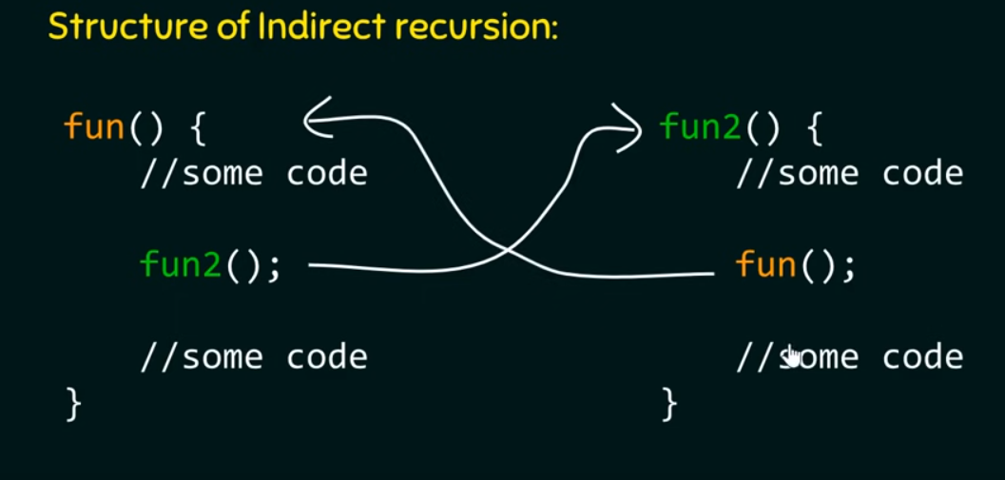
2. Indirect Recursion
This is when a function (func1) calls another function(func2) and then func2 calls func1.

Slide 15
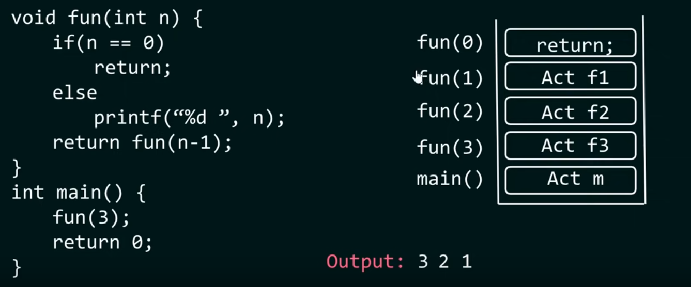
3. Tail Recursion
A recursive function is tail recursive when a recursive call is the last thing executed by the function. So basically nothing is left to execute after the recursion call.

Slide 16
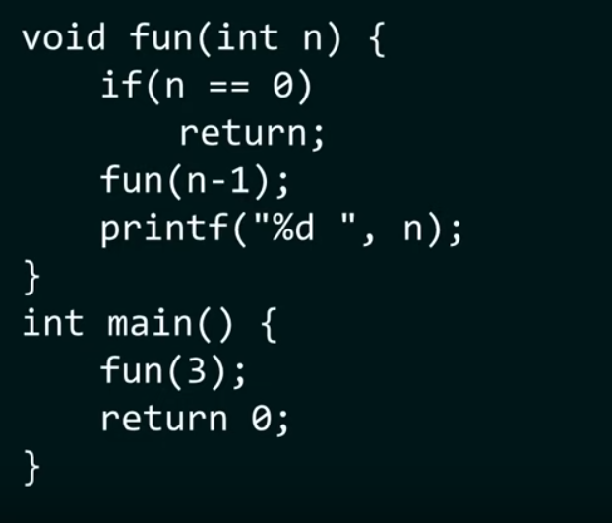
4. Non-Tail Recursion
Non – tail recursion is the opposite of tail recursion.. the recursive call is not the last thing done by the function.
After returning back , there is something left to evaluate.

