Slide 1
STRINGS

Slide 2
Strings are actually one-dimensional array of characters terminated by a null character '\0'.
For example the string Hello is declared and initalised below
char greeting[6] = {'H', 'e', 'l', 'l', 'o', '\0'};
// Declared as an array character by character
You can also declare and intialize it this way:
char greeting[ ] = "Hello";

Slide 3
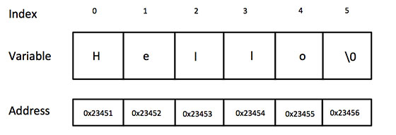

Slide 4
'\0 represents the end of the string. It is also referred as String terminator & Null Character.

Slide 5
