Slide 1
TREE DATA STRUCTURE

Slide 2
A tree is a non-linear hierarchical data structure .
It consists of nodes (where the data is stored) which are connected via links.
Types of Tree data structures
General tree
Binary tree
Binary Search Tree
AVL tree
Red-black tree
Splay tree
Treap
B-tree

Slide 3
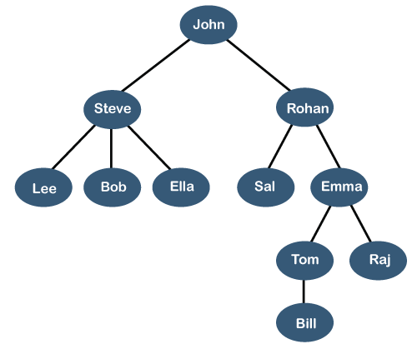

Slide 4
Terminology used in Tree data structure.
A tree is a collection of entities called nodes. Nodes are connected by links called edges.
Each node contains a value or data, and it may or may not have a child node .
The first node of the tree is called the root. If this root node is connected by another node, the root is then a parent node and the connected node is a child.
Leaves are the last nodes on a tree.
The height of a tree is the length of the longest path to a leaf.
The depth of a node is the length of the path to its root.
Level of a node: The level of a node is defined as the number of edges in the unique path between the root and the node

Slide 5
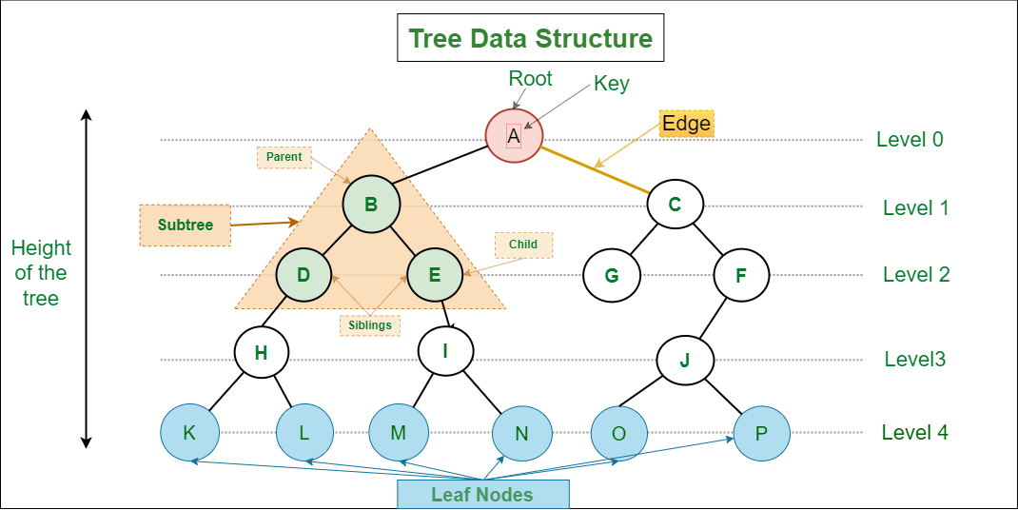

Slide 6
Applications of Tree
File Systems: The file system of a computer is often represented as a tree. Each folder or directory is a node in the tree, and files are the leaves.
XML Parsing: Trees are used to parse and process XML documents. An XML document can be thought of as a tree, with elements as nodes and attributes as properties of the nodes.
Database Indexing: Many databases use trees to index their data. The B-tree and its variations are commonly used for this purpose.
Compiler Design: The syntax of programming languages is often defined using a tree structure called a parse tree. This is used by compilers to understand the structure of the code and generate machine code from it.
Artificial Intelligence: Decision trees are often used in artificial intelligence to make decisions based on a series of criteria.

Slide 7
Advantages of Tree
Efficient searching: Trees are particularly efficient for searching and retrieving data. The time complexity of searching in a tree is typically O(log n), which means that it is very fast even for very large data sets.
Flexible size: Trees can grow or shrink dynamically depending on the number of nodes that are added or removed. This makes them particularly useful for applications where the data size may change over time.
Easy to traverse: Traversing a tree is a simple operation, and it can be done in several different ways depending on the requirements of the application. This makes it easy to retrieve and process data from a tree structure.
Easy to maintain: Trees are easy to maintain because they enforce a strict hierarchy and relationship between nodes. This makes it easy to add, remove, or modify nodes without affecting the rest of the tree structure.
Natural organization: Trees have a natural hierarchical organization that can be used to represent many types of relationships. This makes them particularly useful for representing things like file systems, organizational structures, and taxonomies.
Fast insertion and deletion: Inserting and deleting nodes in a tree can be done in O(log n) time, which means that it is very fast even for very large trees.

Slide 8
Disadvantages of Tree
Memory overhead: Trees can require a significant amount of memory to store, especially if they are very large. This can be a problem for applications that have limited memory resources.
Imbalanced trees: If a tree is not balanced, it can result in uneven search times. This can be a problem in applications where speed is critical.
Complexity: Trees can be complex data structures, and they can be difficult to understand and implement correctly. This can be a problem for developers who are not familiar with them.
Limited flexibility: While trees are flexible in terms of size and structure, they are not as flexible as other data structures like hash tables. This can be a problem in applications where the data size may change frequently.
Inefficient for certain operations: While trees are very efficient for searching and retrieving data, they are not as efficient for other operations like sorting or grouping. For these types of operations, other data structures may be more appropriate.

Slide 9
BINARY TREE

Slide 10
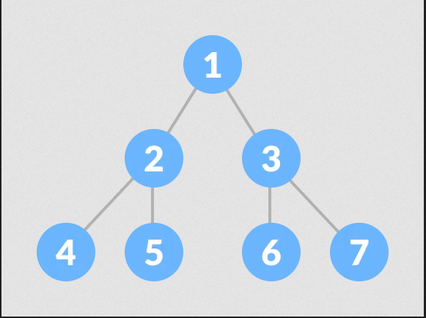
A binary tree is a tree data structure in which each node can have at most two children, which are referred to as the left child and the right child.
In simple terms each parent has a maximum of two children.

Slide 11
Each node of a binary has three attributes:
  Data item (the data stored in the node)
  Address of the left child(pointer to the left child)
  Address of the right child(pointer to the right child)
In C, we can represent a tree node using structures. In other languages, we can use classes as part of their OOP feature.
  // Structure of each node of the tree
  struct node {
  int data;
  struct node* left;
  struct node* right;
  };

Slide 12
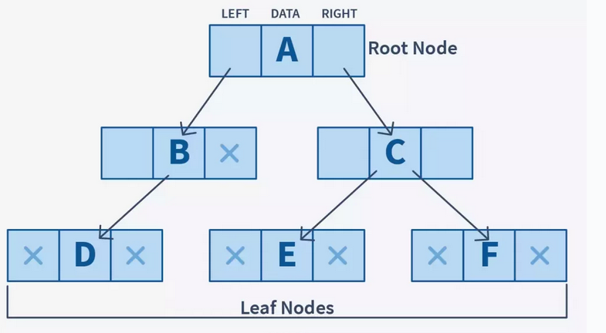

Slide 13
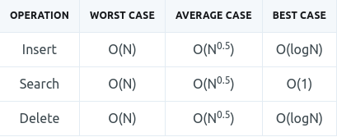
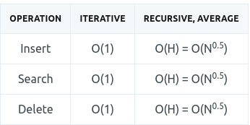
Basic Operations On a Binary Tree
Inserting an element.
Removing an element.
Searching for an element.
Deletion for an element.
Traversal of the binary tree.
Binary tree Time Complexity Binary tree space Complexity

Slide 14
Binary Tree Vs Binary Search Tree(BST)
Binary Search Tree is a node-based binary tree data structure which has the following properties:
The left subtree of a node contains only nodes with keys lesser than the node’s key.
The right subtree of a node contains only nodes with keys greater than the node’s key.
The left and right subtree each must also be a binary search tree.

Slide 15
