Slide 1
TRAVERSAL IN BINARY TREES

Slide 2
Traversing a tree means visiting every node in the tree.
Linear data structures like arrays, stacks, queues, and linked list have only one way to read the data.
But a hierarchical data structure like a tree can be traversed in different ways.
The one we will focus on is Depth First Search or DFS.
The three main types of traversal include:
  In-order traversal
  Pre-order traversal
  Postorder traversal

Slide 3
  1. In-order traversal
The steps taken within the In-order traversal are as follows:
  First, visit(traverse) all the nodes in the left subtree
  Then visit the root node
  Visit(traverse) all the nodes in the right subtree
Point to note : if its a BST :
Remember that the values of the nodes on the left subtree are always smaller than the value of the root node. Also, the values of the nodes on the right subtree are larger than the value of the root node.

Slide 4
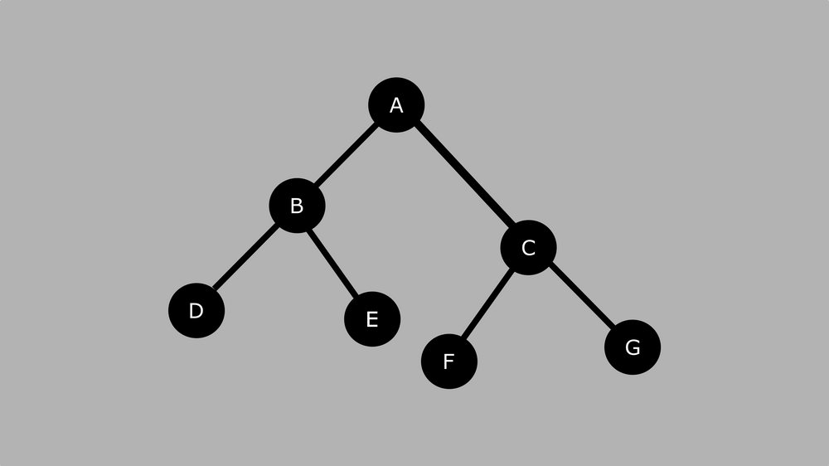
The order for in-order traversal is : Left, Root, Right.
This is the result we get after using in-order traversal:
D, B, E, A, F, C, G

Slide 5
  2. Pre-order traversal
The steps taken within the pre-order traversal are as follows:
  Visit root node
  Visit all the nodes in the left subtree
  Visit all the nodes in the right subtree

Slide 6
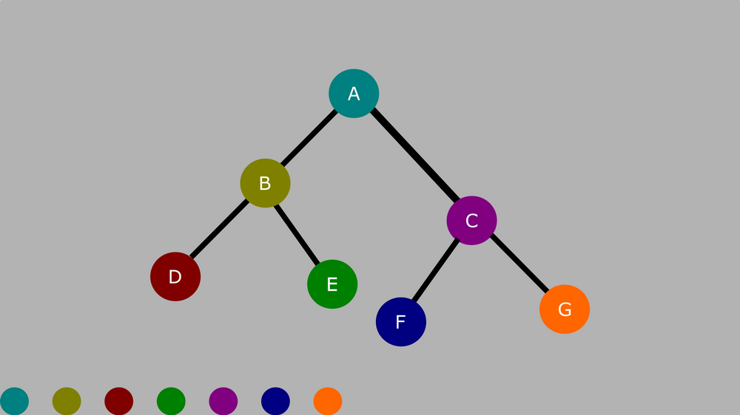
The order for pre-order traversal is: Root, Left, Right.
Using pre-order on the diagram above, the resultant order will be:
A, B, D, E, C, F, G

Slide 7
3. Post-order Traversal
The steps taken within the post-order traversal are as follows:
  Visit all the nodes in the left subtree
  Visit all the nodes in the right subtree
  Visit the root node

Slide 8
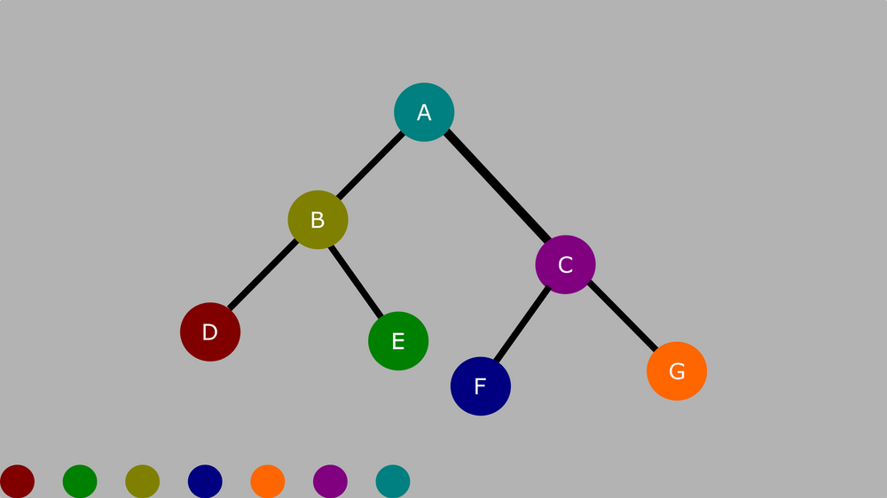
The order for post order traversal is Left, Right, Root.
Using pre-order on the diagram above, the resultant order will be:
D, E, B, F, G, C, A

